Slide 1
Activities
Market segmentation
Socio economic groups

Slide 3
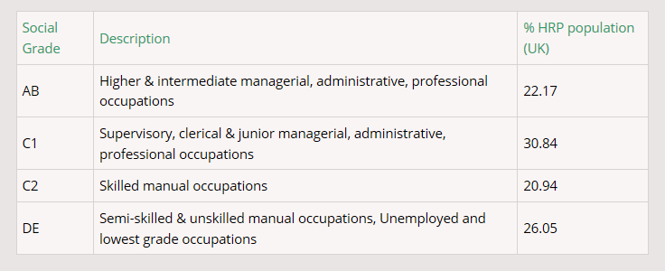
Socio-economic groups

Slide 4
Socio-economic groups activity
In pairs, can you link the newspapers to socio economic groups? Why would a newspaper want to do this?

Slide 5
Summary – 3:2:1
List 3 methods of segmenting a market
List 2 reasons for doing so
List 1 socio-economic group

