Slide 1
BTEC NATIONAL IN BUSINESS Unit 2 Marketing Influences on Marketing Activity (A2)
Lesson 1
Notes:
TEXTBOOK P66-68
Case study Simply Nature - the Brand (page 68)
BENCHMARK Assessment Practice 2.1 page 69

Slide 2
Influences on marketing activity
Internal influences
Cost of the campaign
Availability of finance/financial wellbeing of the business
Expertise/experience of staff
Size and culture of the business
Notes:
TEXTBOOK P66-68
Case study Simply Nature - the Brand (page 68)
BENCHMARK Assessment Practice 2.1 page 69

Slide 3
Influences on marketing activity
External influences
Social
Technological
Economic
Environmental
Political
Legal
Ethical
Notes:
TEXTBOOK P66-68
Case study Simply Nature - the Brand (page 68)
BENCHMARK Assessment Practice 2.1 page 69

Slide 4
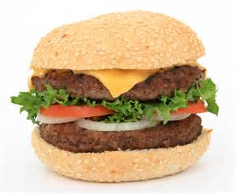
External influences on Brett’s Burgers marketing activity
Activity
Brett is setting up a small independent burger shop in Guildford. As part of his Business Plan he needs to consider external influences and how they will affect his marketing activity
Social
Technological
Economic
Environmental
Political
Legal
Ethical
In pairs/groups – discuss and create a spidergram of your points

Slide 5
External influences on Brett’s Burgers marketing activity?
Activity
ETHICAL
SOCIAL
LEGAL
TECHNOLOGICAL
POLITICAL
ECONOMIC
Notes:
This might be useful to record student Q&A on board

Slide 6
Extension/HW
TEXTBOOK P66-68
Case study Simply Nature - the Brand (page 68)

