Slide 1
BTEC NATIONAL IN BUSINESS Unit 2 Marketing The purpose of researching information to identify the needs and wants of customers (B1)

Slide 2
Purpose of Market Research
To identity target markets
To identify market size, structure and trends in the market
To identify competition
Notes:
May only need 1 week for B1/B2 – if so move on or use time to catch up if behind
TEXTBOOK page 70
WJEC handouts

Slide 3
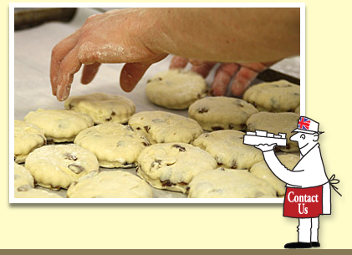
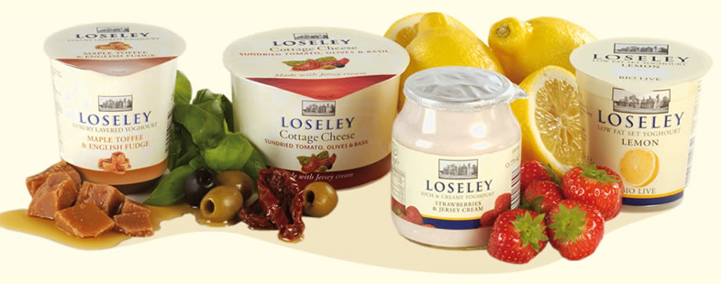
The Loseley Bakery are considering launching a range of jams. In pairs, research and identify:
The target market?
Size/type of market?
Any trends in the market?
Their competitors?
Notes:
May only need 1 week for B1/B2 – if so move on or use time to catch up if behind
TEXTBOOK page 70
WJEC handouts

Slide 4
Activity
Target market?
Notes:
USE THIS TEMPLATE TO BRAINSTORM – POINTS BELOW FOR GUIDANCE
Geographic segmentation – where do customers live, where do they buy?
Demographic segmentation – groups based on age, sex, ethnic background, occupation and income
Behavioural segmentation – looking at usage patterns, levels of brand loyalty, elasticity of demand
Psychographic segmentation – lifestyle groups, personal values and attitudes
age
gender
cultural/ethnic/religious background
socio-economic group
occupation and income
geographical location

Slide 5
Activity
Type of market?
Notes:
Types of market local/global mass/niche trade/consumer product/service seasonal

Slide 6
Activity
Trends in the market?
Notes:
Eg Niche products, buying locally, buying homemade foods again, supporting ethical sources, food as gifts, buying British etc

Slide 7
Competitor Analysis
Country Markets
Notes:
Possible answers on next slide
Other farm produce jams (farmers markets)
Garden centres and gift shops like Secretts
Niche market jams in supermarkets

Slide 8
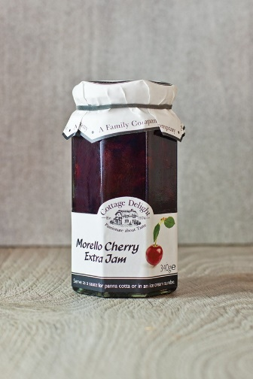
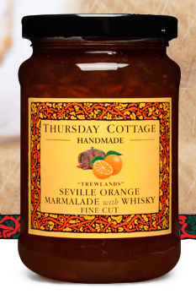
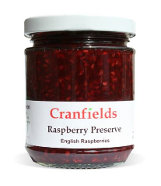
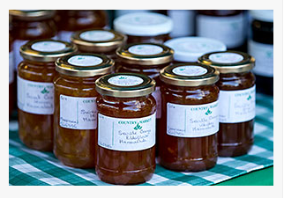
Activity
Competitor Analysis
Country Markets
Notes:
Other farm produce jams (farmers markets)
Garden centres and gift shops like Secretts
Niche market jams in supermarkets

