Slide 1
BTEC NATIONAL IN BUSINESS Unit 2 Marketing Research methods and use (B2)

Slide 2
What is Market Research?
The gathering of information regarding consumers, competitors and distributors within a target market
Notes:
TEXTBOOK page 73-78
Different research methods
Primary & Secondary
Qualitative vs Quantitative
Benefits and drawbacks of each method

Slide 3
Types of Market Research
Primary or secondary (field or desk)
Qualitative or quantitative (opinions or data)
Notes:
TEXTBOOK page 73-78
Different research methods
Primary & Secondary
Qualitative vs Quantitative
Benefits and drawbacks of each method

Slide 4
Primary Research (Field)
Original data, information that has never been collected before.
Survey
Interview
Observation
Trials
Focus groups
Notes:
TEXTBOOK page 73-78
Different research methods
Primary & Secondary
Qualitative vs Quantitative
Benefits and drawbacks of each method

Slide 5
Secondary Research (Desk)
Existing information, information that has already been collected
INTERNAL
Business data on customers
Financial records to include loyalty cards and sale records
EXTERNAL
Commercially published reports
Government statistics
Trade Journals
Media sources (internet)
Notes:
TEXTBOOK page 73-78
Different research methods
Primary & Secondary
Qualitative vs Quantitative
Benefits and drawbacks of each method

Slide 6
What are the advantages and disadvantage of primary and secondary research?
Discussion
Notes:
TEXTBOOK page 73-78
Different research methods
Primary & Secondary
Qualitative vs Quantitative
Benefits and drawbacks of each method

Slide 7
Appropriateness of research
Activity
In pairs, make a list of the advantages and disadvantage of primary and secondary research
What do you notice about your points?
Notes:
The advantages of one is the disadvantage of the other – ie the high cost of primary (disadvantage) is by extension the reverse for secondary (advantage, lower cost than primary research)
Class task – points to consider on next slide
TEXTBOOK page 73-78
Different research methods
Primary & Secondary
Qualitative vs Quantitative
Benefits and drawbacks of each method

Slide 8
Primary Research
ADVANTAGES
Specific information tailored to your needs, so should be more useful
Up to date information
Original, no one else has your data
DISADVANTAGES
Takes time to gather the information
The information is only good if the research is appropriate, valid, reliable etc
More expensive to gather
Skilled researcher required
Notes:
The reverse of the Primary slide
Advantages of secondary
Quick, easy, cheap to obtain
Disadvantages of Secondary
May not be specific
May not be completely relevant or up to date
Data is generic and can be accessed by anybody

Slide 9
What type of information might you need?
Quantitative
closed questions giving statistical information
Qualitative
open questions giving opinions
Questions can be asked in a certain way to generate either quantitative or qualitative data.

Slide 10
Bretts Burgers – what MR should they carry out to decide if their new business is going to be successful?
Activity
In pairs, construct a Market Research plan.
List the Primary and Secondary sources you would use.
What qualitative and quantitative information would be appropriate.
Notes:
Class task – points to consider on next slide
TEXTBOOK page 73-78
Different research methods
Primary & Secondary
Qualitative vs Quantitative
Benefits and drawbacks of each method

Slide 11
Market Research considerations
Research must be appropriate and find out the information that you really need
The methods must be reliable so that you can count on the results (validity)
Costs and benefits need to be considered
What type of information is required, Quantitative or qualitative or both?
Selection and extraction of data should be considered
There must be a sufficient amount of research to justify decision making
Notes:
TEXTBOOK page 73-78
Different research methods
Primary & Secondary
Qualitative vs Quantitative
Benefits and drawbacks of each method

Slide 12
Now consider an different type of business, a Car Wash.
Activity
As before, outline a Market Research plan.
List the Primary and Secondary sources you would use.
What qualitative and quantitative information would be appropriate.
Notes:
Class task – points to consider on next slide
TEXTBOOK page 73-78
Different research methods
Primary & Secondary
Qualitative vs Quantitative
Benefits and drawbacks of each method

Slide 13
Now consider an different type of business, a Car Wash.
Activity
As before, outline a Market Research plan.
List the Primary and Secondary sources you would use.
What qualitative and quantitative information would be appropriate.
Notes:
Class task – points to consider on next slide
TEXTBOOK page 73-78
Different research methods
Primary & Secondary
Qualitative vs Quantitative
Benefits and drawbacks of each method

Slide 14
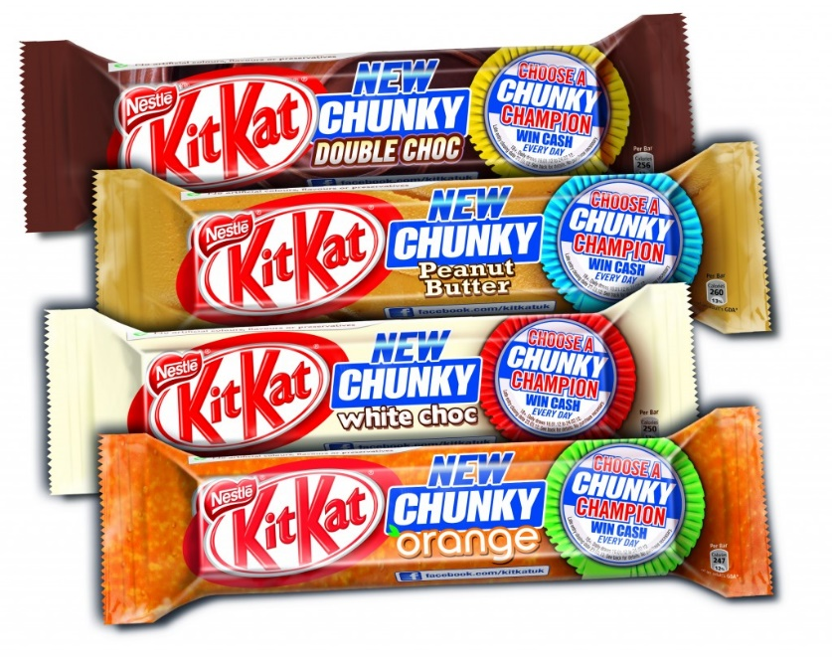
Kellogg’s Case Study
Activity
Godalming Online
Kellogg's case study
Answer all questions

