Slide 1
BTEC NATIONAL IN BUSINESS Unit 2 Marketing Developing the rationale (B3)

Slide 2
Developing the rationale
All research requires a rationale
This sets out the focus, method and means for conducting the research
Also states the outcome being sought
Notes:
TEXTBOOK page 78-79
How can data be analysed?
Use of graphical representations for ease of understanding
Identifying gaps in data

Slide 3
Interpretation, analysis and use of data and other information to make valid marketing decisions
SWOT analysis
PESTLE (external factors)
Setting marketing objectives
Determining the right strategy
Action planning and budget setting
Implementation and monitoring
Notes:
TEXTBOOK page 78-79
How can data be analysed?
Use of graphical representations for ease of understanding
Identifying gaps in data

Slide 4
Identification of any further sources of information that may be required, eg
Government statistics
National economic statistics
Global statistics
Environmental factors
Academic research and articles
Notes:
TEXTBOOK page 78-79
How can data be analysed?
Use of graphical representations for ease of understanding
Identifying gaps in data

Slide 5
How can you EVALUATE the reliability and validity of information obtained?
Question your findings
Assess the positives and negatives – what works well and EBI
Look at what the information does NOT tell you
Notes:
TEXTBOOK page 78-79
How can data be analysed?
Use of graphical representations for ease of understanding
Identifying gaps in data

Slide 6
Evaluation of Market Research
Activity
BTEC textbook page 81
Case study on HMRC
Answer all questions
Notes:
TEXTBOOK page 80
PowerPoint
BTEC textbook Case Study HMRC page 81
WJEC handouts

Slide 7
BTEC NATIONAL IN BUSINESS Unit 2 Marketing The Product Life Cycle (B3)

Slide 8
Product life cycle
development
introduction
growth
maturity
decline
extension
The stages that a product passes through during its lifetime
Notes:
TEXTBOOK page 80
PowerPoint
WJEC handouts

Slide 9
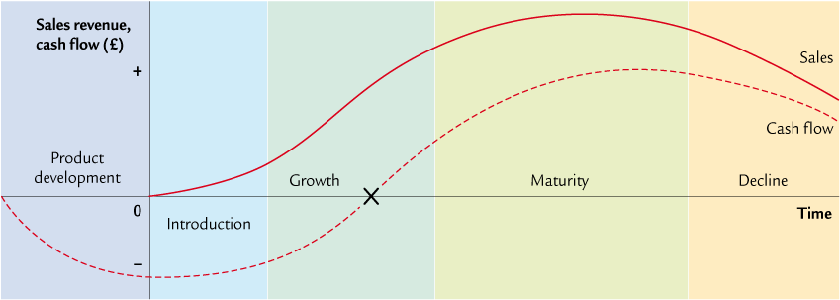
Product life cycle
Notes:
TEXTBOOK page 80
PowerPoint
WJEC handouts
Explain how cash flow follows the product life cycle and how the most expensive times are when products are being developed before they can generate revenue

Slide 10
What are the stages of the product life cycle?
What factors might influence the life of a product?
Discussion
Draw a quick product life cycle and see if you can place an Apple product at each stage of the cycle.
Give reasons why each product is at each stage.
Activity
Notes:
TEXTBOOK page 80
PowerPoint
WJEC handouts
How useful is the product life cycle for making marketing decisions

Slide 11
How useful is the product life cycle for making marketing decisions?
Activity
Quick task – write down all the information that the product life cycle DOES tell you and then write down what it does NOT tell you
Notes:
Tells you about the sales to date and may be useful to make decisions on extension strategies etc
Does not tell you about competition, changes in the external environment (refer back to PESTLE, SWOT etc)
Is not a guarantee of future sales
Needs to be used in conjunction with other forms of analysis

Slide 12
Strategic use of the product life cycle
In theory, a firm should aim to have as many products in ‘maturity’ as possible, as these are the products that should generate most profit.
However, to achieve this in the long run a firm needs to have a policy of new product development, so that it has products in the introduction and growth stages which will eventually enter maturity.

Slide 13
Conclusion
Firms need to have a balance of products under development and in the introductory and growth stages, financed by the profits generated by their mature products.

Slide 14
How can you keep a product at maturity?
Discussion
Do products ever change?
Can you think of any products which have stayed exactly the same?
What has happened to Coca Cola?
Notes:
TEXTBOOK page 80
PowerPoint
WJEC handouts
Case studies from AS eg KitKat
BENCHMARK Assessment practice 2.2 page 82

Slide 15
The main focus of the product life cycle is to keep products at their peak, ie in the maturity stage.
EXTENSION STRATEGIES
Methods used to lengthen the life cycle of a product by preventing or delaying it from reaching the DECLINE stage of the product life cycle.
Notes:
Draw diagram to explain the two choices when a product goes into DECLINE – either kill the product or extend its life

Slide 16
Reasons for extension strategies
To attract new market segments
To increase usage among existing customers
To modify the product
To change the image
To target new markets

Slide 17
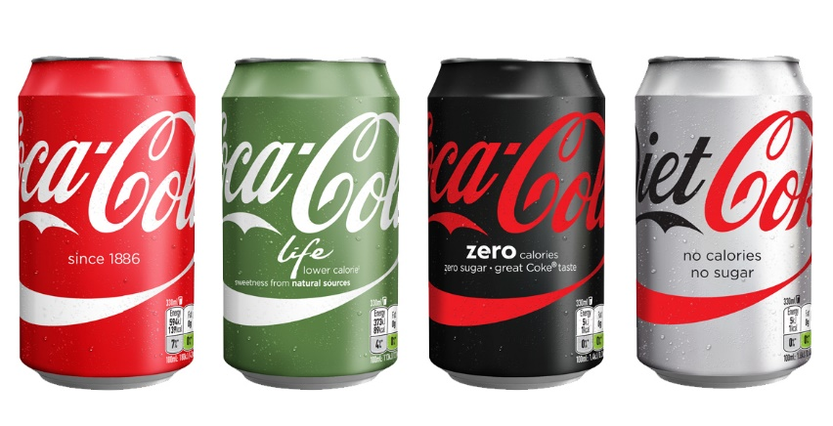
Extension strategies
Activity
Think about these products – Apple i-pod, Walkers Crisps, Kellogg's Corn Flakes, Coca Cola
How have extension strategies been used to keep these products in the maturity stage of the product life cycle?
Notes:
Kit Kat – different sizes (2 bar, 4 bar, chunky, bitesize) and flavours (orange, mint, dark, milk etc)
Over 200 flavours of Kit Kat in Japan

Slide 18
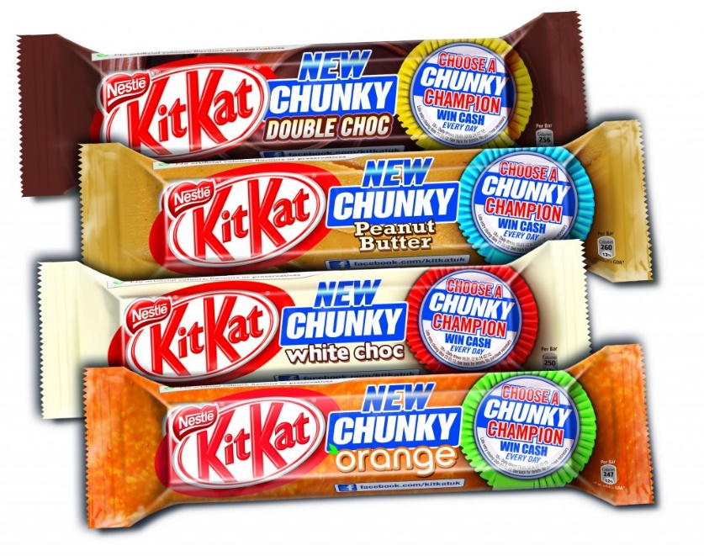
Kit Kat Case Study
Activity
Godalming Online
Kit Kat case study
Answer all questions
Notes:
Kit Kat – different sizes (2 bar, 4 bar, chunky, bitesize) and flavours (orange, mint, dark, milk etc)
Over 200 flavours of Kit Kat in Japan

