Slide 1
BTEC NATIONAL IN BUSINESS Unit 2 Marketing The Marketing Mix (C2) PRODUCT

Slide 2
What is a product?
Physical goods – items you can touch
Services – hairdressing, dentistry, accountancy, law
Experiences – balloon ride, test drive
Events – festivals, concerts, balloon flight
Persons – celebrities, performers
Places, properties – National Trust,
Organisations – memberships, clubs
Information and ideas – paid web info resources
Notes:
TEXTBOOK P89

Slide 3
Product
Businesses must make sure that their products are meeting the needs of their customers.
This means paying close attention to a number of features such as
How it will be used
Its appearance
How much it will cost to make and what price you will sell it at
Its USP
Its position in the market

Slide 4
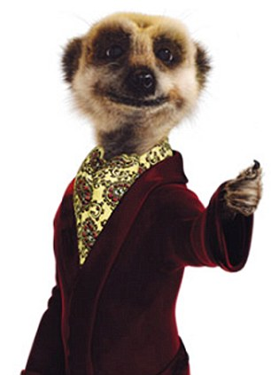
Product development - what to consider?
Type of product
Brand identity (logo, jingle, slogan, image, USP)
Packaging (basic/distinctive, useful, original/unique)
Form and function of the product (in good design, form follows function. Does the product really work and does it look good?)
Stage in the product life cycle.
Notes:
TEXTBOOK P89 -90
Animals in advertising – Meerkats in Go Compare, annoying jingles etc to make the product distinct

Slide 5
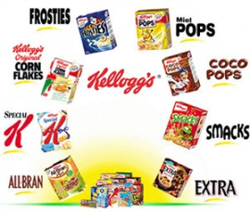
Activity
Kellogg's have asked you to invent a new product, a breakfast cereal. In pairs, decide
What is the product?
What makes it special?
Does it have an identity?
Who is the target market?
Does it have a specific function?
Notes:
TEXTBOOK P89 -90
Animals in advertising – Meerkats in Go Compare, annoying jingles etc to make the product distinct

