Slide 1
BTEC NATIONAL IN BUSINESS Unit 2 Marketing The Marketing Mix (C2) PLACE

Slide 2
Place
This refers to how the product is distributed to the consumer.
It can include how the product is sold - such as direct to end users? Through retailers or wholesalers? (B2B or B2C)
It is where the product is bought - physical location or Online

Slide 3
Direct to end users (mail, online, auction)
Apple sells directly through their website and in Apple Stores
Purchases of Apple products can also be made indirectly on Amazon or through other stores
Screwfix, Littlewoods, Wickes and Boden sell through catalogues
eBay sells through online auction
Notes:
TEXTBOOK P89

Slide 4
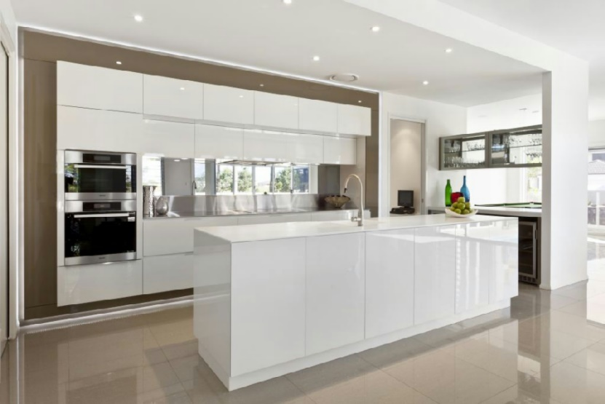
Activity
Place how the product gets to the customer
John is starting up a new kitchen company
He is considering where and how to sell his kitchens
What are his options?

Slide 5
What are the advantages and disadvantages of these 3 options?
Activity
Online?
Directly from his own shop?
Through retail stores like B&Q?
Through housebuilding companies (displayed in their show house)?

Slide 6
Directly from his own shop?
High level of cost for display and promotion of the kitchens
He would be responsible for delivery and customer service
He may find only be able to provide a service within a local area
However, he would have control over the service and reputation of his business/product

Slide 7
Through retail stores like B&Q
They carry the cost for displaying and promoting to the customer
They have lots of showrooms/stores across the UK
They have a national delivery network – the ordering and delivery are taken care of by them
John would not be able to control the quality of customer service, installation or delivery – poor service could damage his reputation
Through retail stores like B&Q

Slide 8
Through housebuilders like Barratt Homes
They carry the cost for displaying and promoting to the customer
They have lots of showrooms/stores across the UK
They have a national housebuilding network – the ordering and delivery are taken care of by them
John would not be able to control the quality of customer service, installation or delivery – poor service could damage his reputation.

