Slide 1
BTEC NATIONAL IN BUSINESS Unit 2 Marketing The Marketing Mix (C2) PROMOTION

Slide 2
What is promotion?
The process of communicating the products/services of the business to raise awareness and generate sales

Slide 3
Why communicate?
To provide customers with information
To increase sales or market share
To give products an image
To establish a corporate image

Slide 4
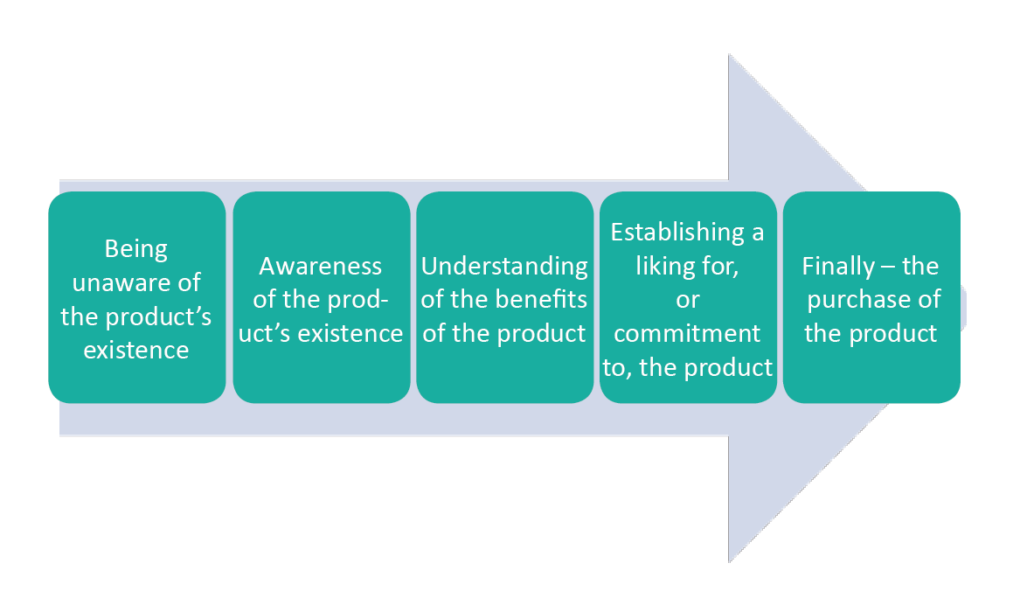
Stages of promotion

Slide 5
Aims of promotion - AIDA
Attention
Interest
Desire
Action

Slide 6
Choice of media? Depends upon…
Target market
Cost
The reach of the media
The type of product
The amount of information to be conveyed

Slide 7
Promotion – often a combination of
Above the line
Usually advertising eg TV, radio, cinema, newspapers, internet, digital/e-media,
Below the line
Tends to support the main forms of advertising eg Public Relations (PR), merchandising, sponsorship, direct marketing, personal selling, competitions

Slide 8
Other forms of promotion (BTEC spec)
Public Relations (PR) – business communications and relationship with the public
Formal (eg a professional P.R. campaign)
Informal (eg promoting the business by word of mouth)
Notes:
AIDA page 93
TEXTBOOK P93-95

Slide 9
Other forms of promotion (BTEC spec)
Sponsorship
Paying to have your corporate identity promoted on merchandise or at an event
RBS at the 6 Nations Rugby
Adidas & DHL sponsor Manchester United FC
Sainsbury’s sponsor Channel 4 dramas
Notes:
AIDA page 93
TEXTBOOK P93-95

Slide 10
Other forms of promotion (BTEC spec)
Social and other media
Google
You Tube
Facebook
Twitter
Notes:
AIDA page 93
TEXTBOOK P93-95

Slide 11
Other forms of promotion (BTEC spec)
Guerrilla marketing
Creative and unconventional methods to attract attention
Flash mobs
Graffiti
Events/stunts
Maximum impact if it can go viral on social media
Examples? Click here
Notes:
AIDA page 93
TEXTBOOK P93-95

Slide 12
Other forms of promotion (BTEC spec)
Personal Selling
A seller presents the product direct to the customer
Face to face
Telesales
An expensive method requiring a skilled sales team
Notes:
AIDA page 93
TEXTBOOK P93-95

Slide 13
Other forms of promotion (BTEC spec)
Product Placement
When TV programmes and films display recognisable brands
Apple Computers – Mission Impossible, Independence Day
Mercedes Benz – The Lost World: Jurassic Park
Aston Martin – James Bond films
Pepsi – Back to the Future
Nationwide Cash Machine – Coronation Street
Notes:
AIDA page 93
TEXTBOOK P93-95

Slide 14
Other forms of promotion (BTEC spec)
Digital marketing
Promotion of products or services using digital media
Websites
Social media (FB, LinkedIn)
Text messaging
Emails
Notes:
Impact of the internet
Pricing
Access to customers
Niche products
Internet promotion (eg junk email, pop ups, click throughs, meta tags, search engine listings and search engine advertising)
TEXTBOOK P93-95

Slide 15
Other forms of promotion (BTEC spec)
Corporate image
What sort of image does the company want to project?
Google, Microsoft – almost a family image, friendly
Apple – successful, thinking out of the box
British Airways – patriotic, popular, the favourite
Notes:
AIDA page 93
TEXTBOOK P93-95

Slide 16
Conclusion: influences on the choice of promotion
Objectives of the campaign
Costs and budgets
The target market
The balance of promotions in a campaign
Legal factors
External factors

Slide 17
Discussion – promoting the coffee shop
Jane needs to promote her new coffee shop in Godalming High Street.
How should she go about this,
what methods would you suggest
and why?

