Slide 1
The Other 3 Ps
Physical Environment
People
Processes

Slide 2
Services
These 3 Ps allow businesses to make intangible products more tangible.
Therefore, they are used for SERVICES.
Remember, services include retail and customer service, so please ensure you include these in your proposal.

Slide 3
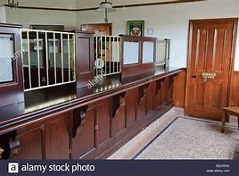
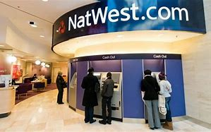
Physical Environment
From this
Décor
Plants
Colour schemes
Merchandising
Layout
Feng shui
Ambience
To this

Slide 4
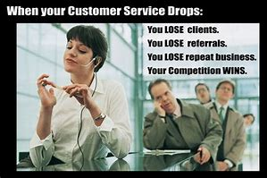
People
Customer service
Training
Services are provided by PEOPLE so the people are key
Uniforms?
Hair & Make-up?

Slide 5
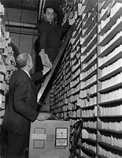
Processes
Systems
How things are done
Sequencing
Order
Level of bureaucracy
Speed of information and service

Slide 6
Tasks
Task 1
Think of a business that focuses on these 3 Ps.
Explain how it has used Physical Environment, People and Processes to good effect, in order to beat the competition.
Task 2
Next, imagine you are going to start up a shop on Godalming High Street. It can be any kind of shop: Grocery, or a hairdressers, or a chemist, or a clothes shop… the choice is yours.
Explain how you intend to manage the 3 service Ps to make your business successful.

