Slide 1
Unit 3: Topic B4
Information, guidance and advice
Personal finance is a complicated matter and important to all individuals.
In today’s lesson we are going to learn about the government funded and independent organisations which offer guidance and advice to individuals

Slide 2
Information, guidance and advice Copy and complete the table to form part of your notes
Provider | Explanation | Advantages | Disadvantages
Citizens Advice | i.e. government-funded or independent? How do they offer advice (face to face, email, web chat, telephone etc), What sort of financial advice do they offer? (e.g. debt, benefits, banking, pensions, insurance etc)
Independent financial advisor (IFA)
Price comparison wesbites
Money advice service

Slide 3
Information, guidance and advice Copy and complete the table to form part of your notes
Provider | Explanation | Advantages | Disadvantages
Debt Counsellors
Individual Voluntary Arrangements (IVAs) bankruptcy
Go to the next slide for the end of Topic B assessment questions.

Slide 4
Assessment practice 3.2
It is important when you are answering assessment questions that you pay attention to the stem word in the question (e.g. identify, describe, discuss etc.) to ensure your answers include sufficient detail and depth.
Your teacher will give you more guidance on how to answer different types of questions. Also see the next slide for help understanding the assessment outcomes (AOs)
Describe the role of the Financial Conduct Authority [2 marks]
Identify two disadvantages of online banking [2 marks]
Explain two advantages of building societies. [4 marks]
Bethany is still not sure what to do with her inheritance money. She has tried researching online but is overwhelmed by the amount of information available. Discuss the different sources of financial information and guidance Bethany could use. [12 marks]

Slide 5
Assessment outcomes
AO1 | Demonstrate knowledge of terms, concepts, theories, methods and models to show an understanding of how individual and organisation are affected by and response to business issues. This type of question requires short, concise answers and recall of material that you have memorised.
AO2 | Apply knowledge and understanding to various business contexts to show how individuals and organisations are affected by and respond to issues. You must make sure that you relate your answer to the case study and provide reasoning or some reference to theory.
AO3 | Analyse issues within business, showing an understanding of the impact on individuals and organisations of external and internal influences. You will need to demonstrate that you can break down information and understand the implications of what you have been presented with. You will need to identify causes and effects and interrelationships. You may be required to analyse data, use ratio analysis or use appropriate theories to investigate the question.
AO4 | Evaluate quantitative and qualitative information to make informed judgements and propose evidence-based solutions to business issues. These types of questions will normally require you to provide full and detailed arguments ‘for’ and ‘against’ to show your depth of understanding. You will be required to show judgement in weighing up the relative importance of different points or sides of an argument, in order to reach a conclusion.

Slide 6
Key terms used in assessment

Slide 7
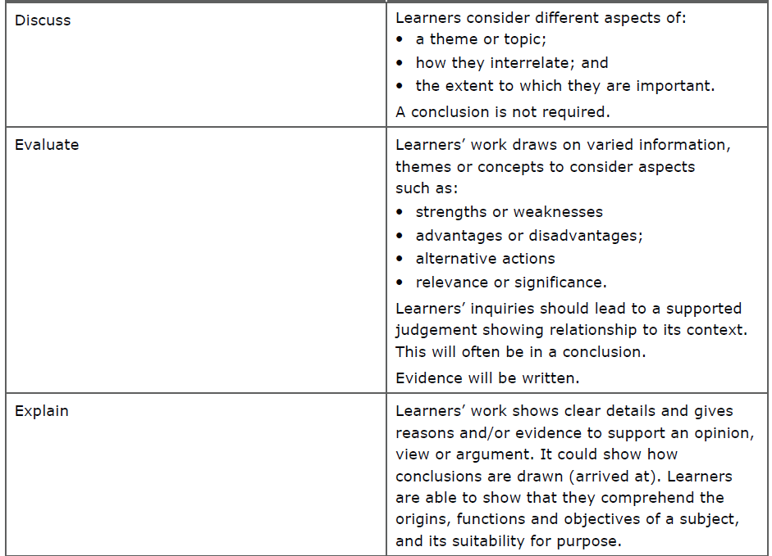
Key terms used in assessment

Slide 8
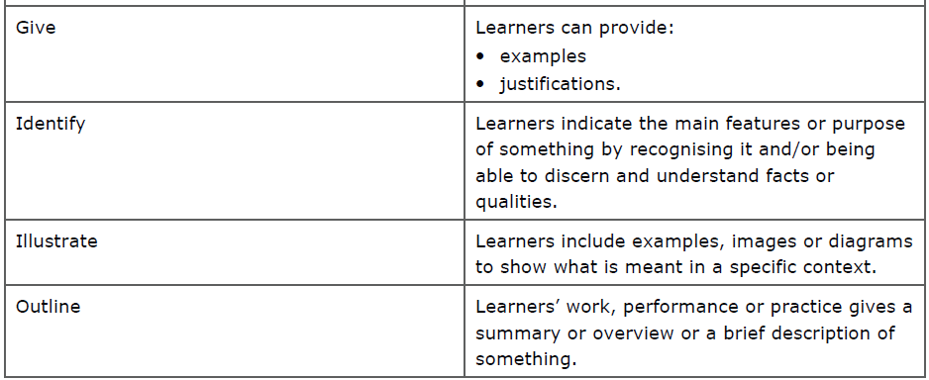
Key terms used in assessment

