Slide 1
Unit 3: Business finance TOPIC E1: Cash flow forecasts
Lesson 1
Learning aim E relates to understanding the use of cash flow forecasts for planning monitoring, controlling and target setting.
Today’s lesson will introduce you to cash flow forecasting.

Slide 2
Starter activity
Make a list of all the possible inflows (receipts) and outflows (payments) a business may have

Slide 3
Learning Objectives
Explain what is meant by cash flow
Explain what is meant by a cash flow forecast
Construct, calculate and interpret cash flow forecasts

Slide 4
Key Terms
Cash flow: the continuous movement of cash in and out of the business
Cash flow forecast: showing the expected flows of cash in and out of a business
Cash flow statement: shows an historic view, showing the actual flows of cash in and out of the business
Credit period: the length of time given to customers to pay for goods or services received
Liquidity: measures a firm’s ability to meet short-term cash payments
Insolvent: when a firm is unable to meet

Slide 5
Purpose of cash flow forecasting
Cash flows into and out of a business on a regular basis. A cash flow forecast tries:
To predict in advance what and when these cash flows will be.
To anticipate potential shortages of cash
To examine and possibly adjust the timings of receipts and payments in order to avoid problems
To arrange financial support
A healthy cash flow means that a business will have enough cash at any one point in time to meet demand for short term outflows.

Slide 6
Cash inflows and outflows
Inflows | Outflows
Cash sales | Cash purchases
Credit sales: the customer pays in a pre-agreed period after the sale e.g. 30 days | Credit purchases
Loans | Purchase of assets
Capital introduced: money invested from shareholders or entrepreneurs | VAT
Sale of assets | Bank interest (e.g paid on loans)
Bank interest received | Rent
 | Salaries
 | Wages
 | Utilities

Slide 7
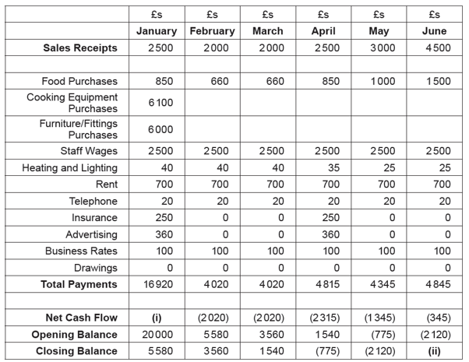
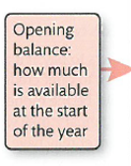
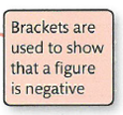
Cash Flow Forecast Structure
Opening balance = the amount of cash available in a business at the start of a set time period, for example a month
Closing balance = amount of cash available in a business at the end of a set time period for example a month.
Formula =
Opening balance + cash inflows – cash outflows
(14,420)
(2,465)
January’s closing balance becomes February’s opening balance

Slide 8
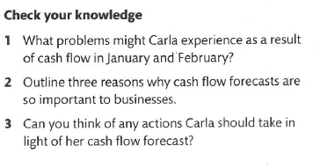
Cash Flow Forecast Structure
Check you knowledge
What problems does this business face as a result of their negative net cash flows from Jan to March
Outline three reasons why cash flow forecasts are so important to businesses
Can you think of any actins this business should take in light of their cash flow forecast?
(14,420)
(2,465)

Slide 9
Credit periods and negative closing balances
Credit period:
Must consider how long to give customers to pay. The longer the credit period, the slower will be the money coming in.
Credit periods affect the ability of the business to gain credit from its suppliers. If a business can secure supplies on credit, this will then slow down the flow of cash out of the business.
Negative closing balance:
Business is often said to have liquidity issues and is in danger of becoming insolvent

Slide 10
Activity
Open the Nut and Spanner template
Carefully use the information alongside the template to complete the cash flow forecast for both businesses (Nut on one tab, Spanner on another)

