Slide 1
Unit 3: Business finance TOPIC E2: Break Even
Lesson 1
Learning aim E also requires you to understand Costs and how to classify them, Sales and how much you are making by selling goods and services and be able to use Break Even and Margin of Safety

Slide 2
Starter activity
Make a list of as many running costs as you can. Running costs are also known as ‘Revenue Expenditure’.

Slide 3
Learning Objectives
To be able to classify costs correctly
To be able to calculate costs and sales
To be able to calculate Contribution and the Break-Even Point of output and know what it signifies
To be able to calculate the Margin of Safety and know what it signifies

Slide 4
Key Terms: costs
Costs:
Variable Costs: vary with the level of output, e.g. raw materials
Fixed Costs: do not vary with output, e.g. rent
Semi-Variable Costs: part of the cost stays the same and part varies in relation to the degree of business activity, e.g. phone bill: the line rental element is FIXED but the call charges are VARIABLE
Total Costs = Fixed Costs + Variable Costs

Slide 5
Activity
Which of the following costs are variable, which are fixed, and which are semi-variable?
Rent
Wages
Salaries
Raw materials
Administration
Power
Stationery
Telephone

Slide 6
Costs and Break Even analysis
To calculate Break Even, we have to classify costs into just FIXED and VARIABLE. If a cost is SEMI-VARIABLE, it will be divided up into FIXED and VARIABLE elements.
Example: If employees are paid a flat salary each month but also incur overtime pay, the salary will be considered to be FIXED and the overtime payment VARIABLE. This is just when calculating BREAK EVEN and semi-variable costs aren’t a part of the break even formula.

Slide 7
Key Terms: sales
Sales:
Total Revenue: the total amount of money coming in from sales. Total Revenue = Quantity Sold x Selling Price per unit.
Total Sales: the amount of sales made in a set time period e.g. 1 year. This can be expressed in £ or units. If expressed in £ it has the same meaning as Total Revenue.
Sales in Value: Means the same as Total Revenue
Sales in Volume: Sales expressed as a quantity, for example tons or units.
Selling Price Per Unit: the amount the customer pays for each unit sold.

Slide 8
activity

Slide 9
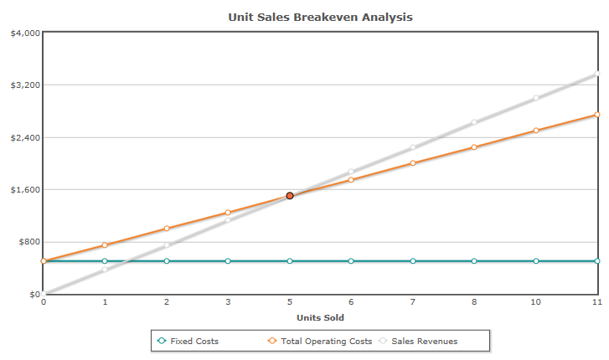
Break even graphs … an introduction
Once a table has been completed showing costs, revenues and profits, each column can be plotted on a graph to show a BREAK EVEN CHART. We will be looking at how to do this next lesson. (Assume £ rather than $!)

Slide 10
Break Even calculations
If an exam questions asks you to CALCULATE the break even level of output, use the formula. Do not construct a chart.
To do this use the break even formula:
See next slide for all the BREAK EVEN formulae.

Slide 11
Key Terms: Break even point
Break Even
This is the point where TOTAL REVENUE (TR) = TOTAL COSTS (TC) The formula used is FIXED COSTS
CONTRIBUTION PER UNIT The answer is expressed in UNITS
Contribution per Unit = Selling Price per Unit – Variable Costs per unit.
Total Contribution = Sales Revenue – Total Variable Costs
or Contribution per unit x number of units sold
Total Variable Costs = Variable costs per unit x quantity sold

Slide 12
Contribution
Contribution per unit = Selling Price per unit – Variable Costs per unit.
Imagine you run a coffee shop.
The selling price is how much a business sells each cup of coffee for. You sell a cup of coffee for £2
The variable costs per unit are £0.50. What are the variable costs of a cup of coffee?
So every time we sell a cup of coffee, we make a CONTRIBUTION of £1.50
Why can’t we call this PROFIT?

Slide 13
Break Even
If the FIXED COSTS of our coffee shop = £150 000 per year, how many cups of coffee do we need to sell to break even?
£150 000/£1.50 = 100 000 cups of coffee.
If we sell any more than this we make of profit on each cup of coffee we sell.
If we sell less than 100 000 cups we make a loss, because we haven’t yet covered our FIXED COSTS.

Slide 14
activity
Using the data from our earlier example, when we completed the table, work out the Break Even level of output needed to cover all the costs and break even.
Remember: Fixed costs = £500
Variable Costs per unit = £200
Selling Price per Unit = £300

Slide 15
Another worked example

Slide 16
Key Terms: MARGIN of safety
A good way of looking at Margin of Safety is to think of being ‘How far in the clear is the firm, with its actual level of output? How far away are they from the Break Even level of output?
After all, a business wouldn’t want to produce at the Break Even level of output really. They’d want to produce far more than that in case there has been an error in calculating or the figures are inaccurate. They are only estimates, remember.
Margin of Safety: the actual number of units sold over and above the break even point. Margin of Safety = Actual Sales in Units – Break-Even Level of Output

Slide 17
Worked example
Back to Fay from our earlier example.
Assume Fay sold 1500 cakes.
Margin of Safety = actual sales in units – break-even level of output
Margin of safety = 1500 cakes – 1250 cakes = 250 cakes.
ALWAYS MAKE SURE YOU EXPRESS YOUR ANSWER IN THE CORRECT WAY - £s or UNITS

