Slide 1
Changes in variables
Break-even charts can be used to demonstrate the effect of changes in fixed costs, variable costs and price.
Changes in price: affect total revenue line (steepness)
Changes in fixed costs: shift the fixed costs line up or down. Will also affect the TC line.
Changes in variable costs: will affect the gradient of the TC line.
Notes:
Break even charts provide a visual means of analysing changes in output on total cost, total revenue, profits and the margin of safety

Slide 2
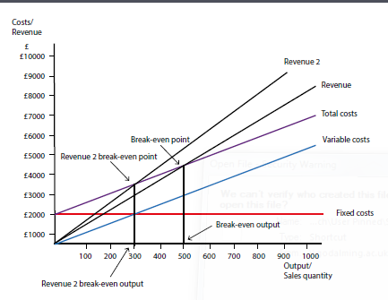
Example of an increase in price
An increase in the price of the boxes from £9 to £11 will change the total revenue line (Revenue 2), it becomes steeper
TR will cut the total cost line sooner, resulting in break-even at a lower level of output.
If the price was reduced then the opposite would happen and the break-even point would be at a higher level of output.

Slide 3
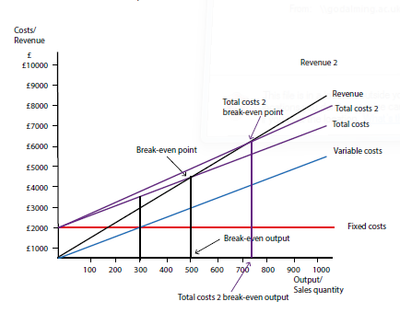
Example of an increase in variable costs
An increase in the variable cost will change the total cost line (Total costs 2).
It becomes slightly steeper and will cut the revenue line at a higher output level, resulting in break-even at a higher level of output.
If the costs were reduced then the opposite would happen.
If variable costs remained the same but fixed costs changed then this would result in a parallel shift in the total cost line.

