Slide 1
Unit 3: Business finance TOPIC f1: statement of comprehensive income
Lesson 1
You have learnt how to monitor whether or not a business have enough cash to survive on a day-to-day basis and whether it can achieve break even. Beyond survival a business will likely have the objective of profit.
In learning aim F you will look at the financial documents a business produces at the end of a financial year.

Slide 2
Starter activity
Is there only one type of profit?
How do you calculate profit?

Slide 3
Learning Objectives
Explain the purpose and use of income statements
Be able to complete, calculate and amend statements to include gross profit and the calculation of profit or loss for the year

Slide 4
Key Terms:
Statement of comprehensive income (also called income statement): Calculates whether the firm has made a profit or a loss by deducting all expenses from sales revenue.
Costs of goods sold: the actual value of inventory used to generate sales.
Opening inventory: the value of inventory in a business at the start of the financial year
Closing inventory: the value of inventory at the end of the financial year.

Slide 5
Purpose and use of statement of comprehensive income
A statement of comprehensive income, if produces correctly, will give an accurate calculation showing how much profit or loss the business has made.
It records sales, costs and profit over a period of time (normally a year).

Slide 6
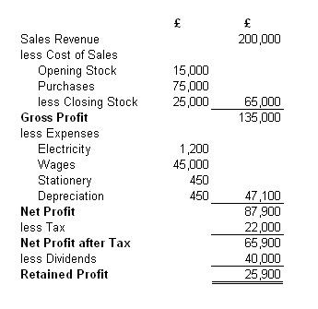
Structure
Trading Account: tells us what the sales of the company have been and the direct costs of making those sales
Opening stock: The stock the business had at the start of the year.
Profit and Loss Account: Once gross profit is calculated, a business can then calculate how much profit or loss it has made by adding extra income or subtracting its expenses.
Purchases made throughout the year.
Closing stock is stock left over at the end of the year. We always take away closing stock as it has not yet been sold or used so it is not part of costs of sales
Profit and Loss Appropriation Account: This shows how the company’s profit or loss is distributed

Slide 7
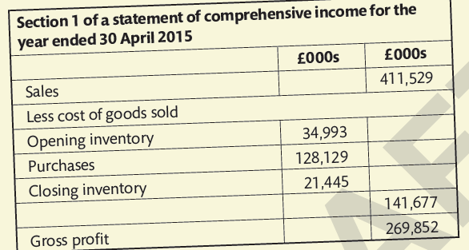
Calculation of gross profit
The first part of the statement of the comprehensive income (the trading account) is made up of three components:
Sales revenue: is the money coming into the business from providing a trade – for example selling goods, manufacturing goods or providing a service.
Sales revenue calculation = quantity sold x selling price
Cost of goods sold: the costs directly linked to providing that trade (e.g. raw materials)
Cost of goods sold calculation = opening inventories + purchases – closing inventories
Gross Profit: is the amount of money left of the surplus after the costs of goods sold has been deducted from the sales turnover, this his not however the businesses final profit as there are other expenses to deduct in the next part of the account
Gross Profit calculation = sales revenue – cost of goods sold

Slide 8
Calculation of profit or loss for the year
Profit is the money after all other expenses have been deducted from gross profit and any other revenue income has been added
Revenue income is non-capital income that is received by the business from other sources other than sales, for example, discounts received and interest on positive bank balances
Depreciation is shown as an expense as this is a way that accountant can spread the cost of a fixed asset over its lifetime (you will learn more about this in later lessons)
The calculation for profit or loss for the year (also called operating profit and net profit) is:
Gross profit – expenses + other revenue income

Slide 9
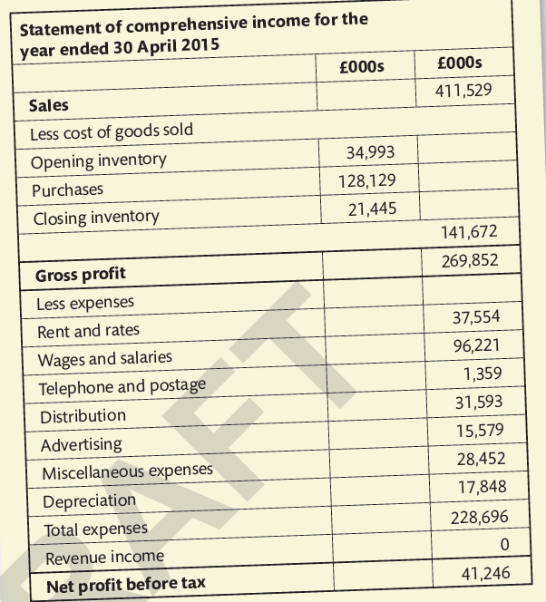
Transfer of profit to a statement of comprehensive income
Tax is to be deducted from profit: this is a percentage of the profit that is to be paid to HMRC. This then gives a profit after tax figure.
The business then has to decide how to use this profit. If is a company, a proportion of it may be issued to shareholders as dividends. For a sole trader or partnership, it could be take n out of the business ad drawings or be invested back into the business. This is called retained profit
Retained profits are transferred from the statement of comprehensive income to the statement of financial position (balance sheet)

Slide 10
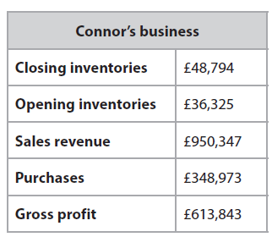
activity
Connor has given you his gross profit figure of £613,843 but having carried out a stock take you notice his closing inventories figure has changed from £48,794 to £49,102.
Calculate Connor's new gross profit figure

Slide 11
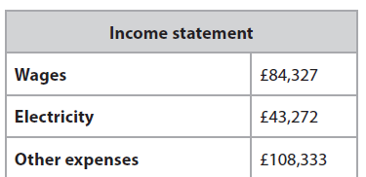
activity
Connor has given you the rest of the figures for the statement of comprehensive income
Using your gross profit figure calculate Connor’s profit or loss for the year

Slide 12
Activity
Work your way through the L1 Statement of Comprehensive Income Worksheet

