Slide 1
Unit 3: Business finance TOPIC f1: statement of comprehensive income
Depreciation
In this lesson you will learn how to make adjustments for depreciation (straight line and reducing balance)

Slide 2
Starter activity
What is an asset?
Come up with as many examples as you can think of.

Slide 3
Learning Objectives
Be able to explain depreciation
Be able to calculate straight-line and reducing balance depreciation.

Slide 4
Key terms
Historic cost: the cost of an asset when it was first purchased
Expected life: how long an asset is expected to be used in a business
Residual value: the value of an asset when it is disposed of by the business, for example, resale value

Slide 5
What is depreciation
Depreciation is the decrease in value of an asset due to wear and tear, decay, decline in price, etc.
Most FIXED ASSETS do not retain their value over time. This is depreciation.
In accounting, depreciation is a concept used to spread the cost of an asset over its useful life.
Assets are depreciated on an annual basis and the annual amount by which the asset is depreciated is shown as an expense in the statement of comprehensive income.
The current value for the asset is called the net book value. This represents what the asset is thought to be worth at that moment in time.

Slide 6
Calculating depreciation
There are two ways in which depreciation can be calculated:
Straight line depreciation: an asset is depreciated by a set amount each year
Reducing balance depreciation: an asset is depreciated by a set percentage of its remaining value each year

Slide 7
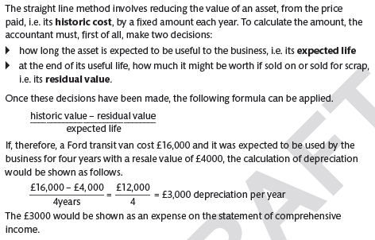
STRAIGHT LINE METHOD

Slide 8
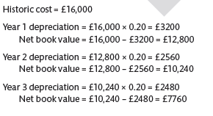
Reducing Balance method

Slide 9
activity
Complete the ‘What is depreciation’ worksheet

