Slide 1
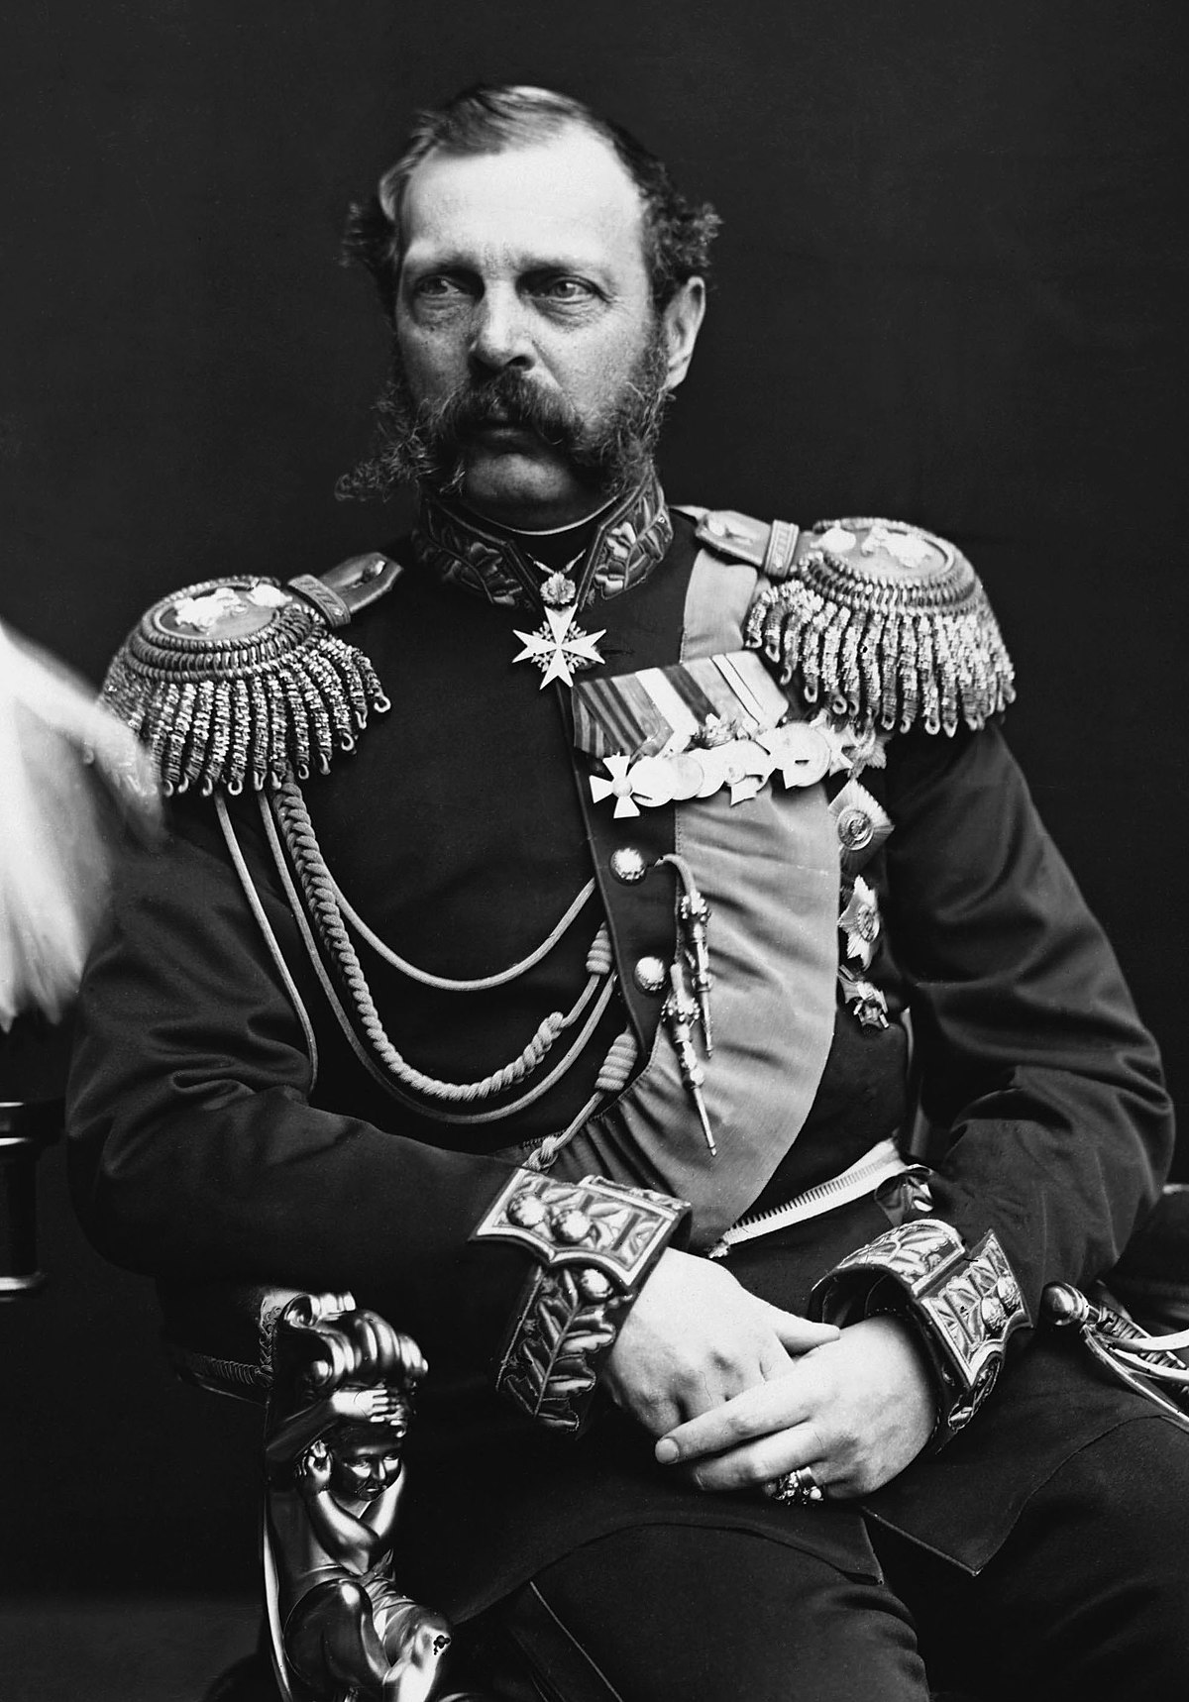
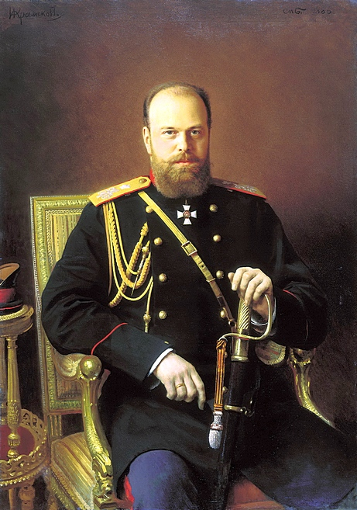
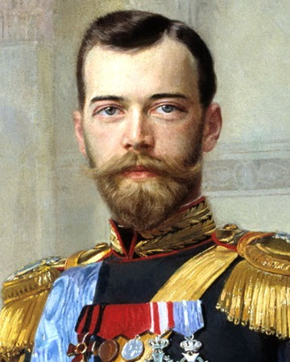
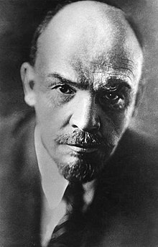
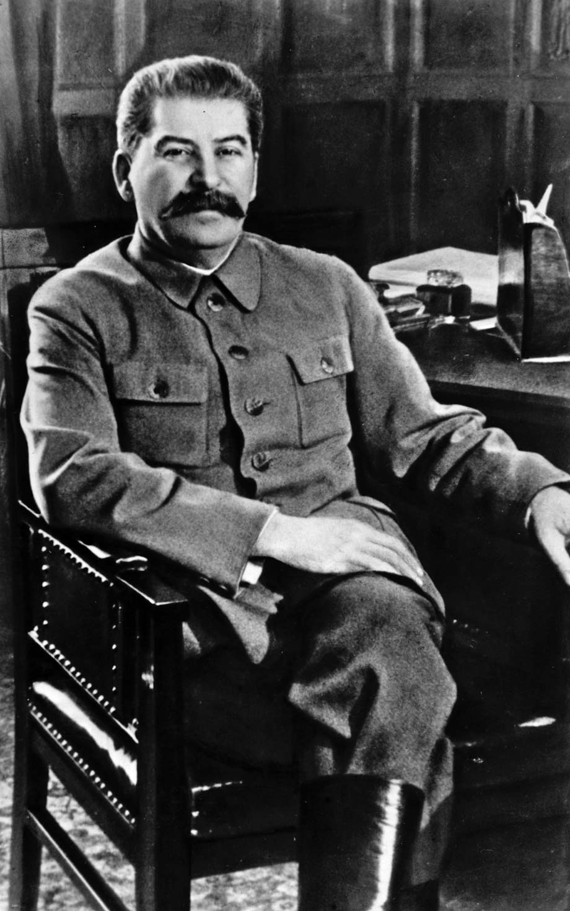
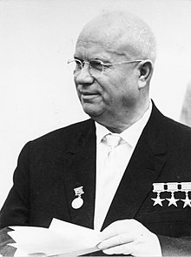
Unit 3; Russia and its Rulers, 1855-1964
Introduction to the Course

Slide 2
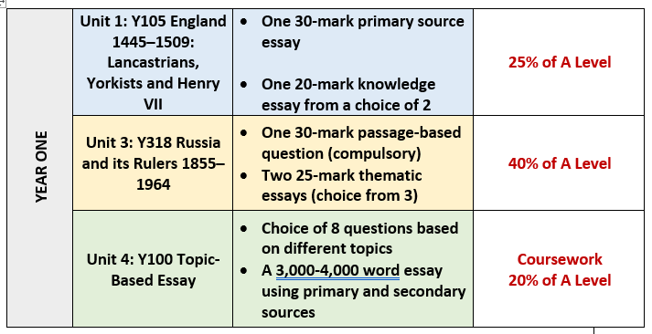
Structure of the Course

Slide 3
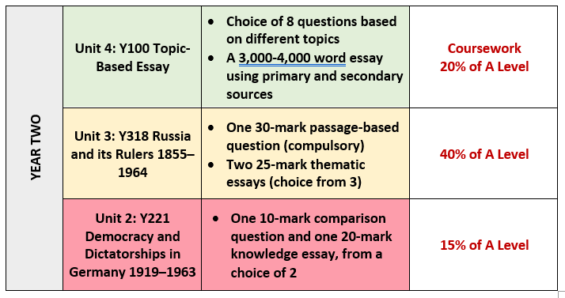
Structure of the Course

Slide 4
Unit 3; Russia and its Rulers, 1855-1964
Key Details:
The Unit 3 course is worth 40% of your overall A-Level and is the biggest component of your History A-Level
The final exam is in May of your second year
The exam is worth 80 marks and lasts 2 hours 30 minutes
You will answer one interpretation question based on two extracts from historians, along with two essay questions from a choice of three
You will be taught Unit 3 across both years of your History A-Level

Slide 5
Unit 3; Russia and its Rulers, 1855-1964
Content – Themes
The course examines Russian history in this period based around 4 themes:
The Nature of Government
The Impact of War and Revolution
The Economy and Society
Nationalities of the Russian Empire/USSR
Content – Depth Studies
Unit 3 course also contains three depth studies. These are time periods which you will study in detail and in particular you will examine the historical debates that surround them.
Alexander II and his reforms
The Provisional Government
Khrushchev in Power

Slide 6
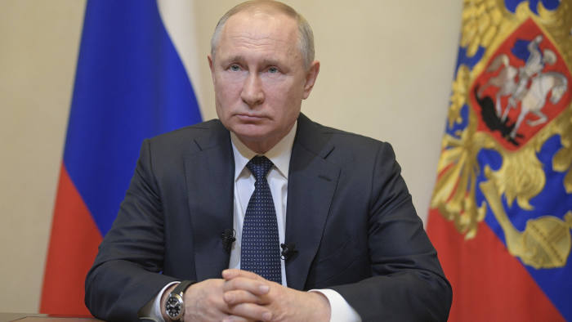
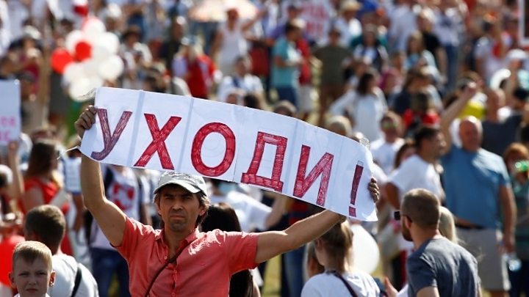
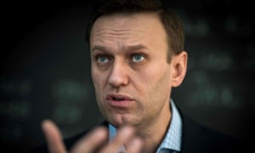
Putin and modern Russia – induction work
What do you know about Putin and modern Russia?
What recent news stories have featured Putin?

Slide 7
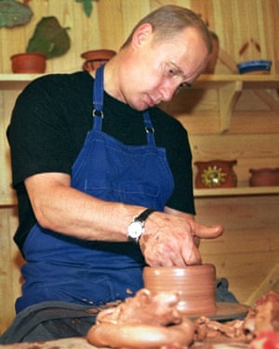
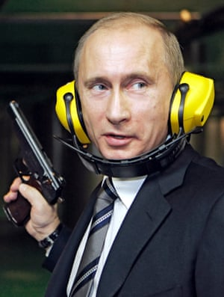
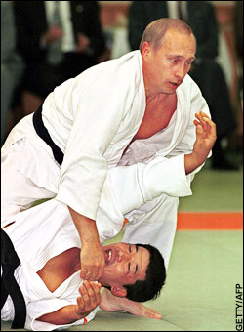
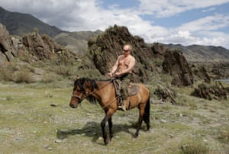
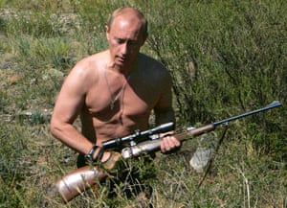
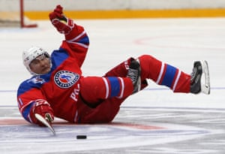
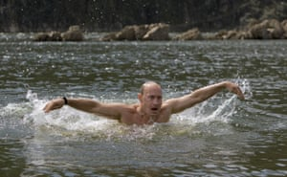
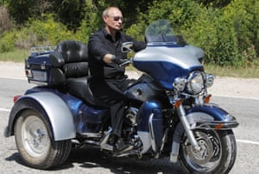
What image of Putin is being projected through photographs such as these? What might this tell you about Russian politics?

Slide 8
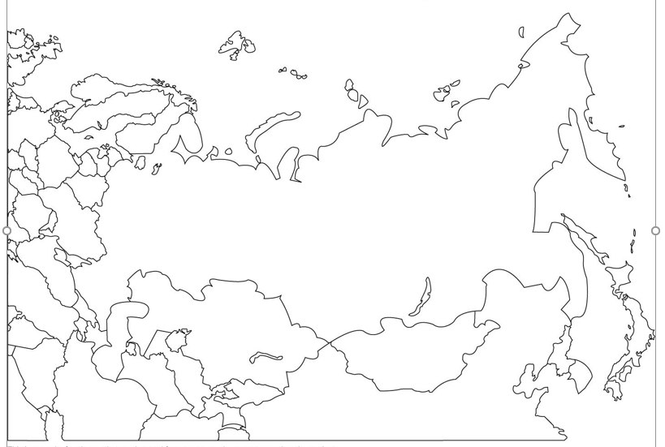
Russian geography – p.8-9
Try labelling the blank map of Russia on p.8 with the key cities/areas/ geographical features listed on p.9
It doesn’t have to be perfect! – it’s just to give you an idea of Russia’s geography
Then answer the question that follows

Slide 9
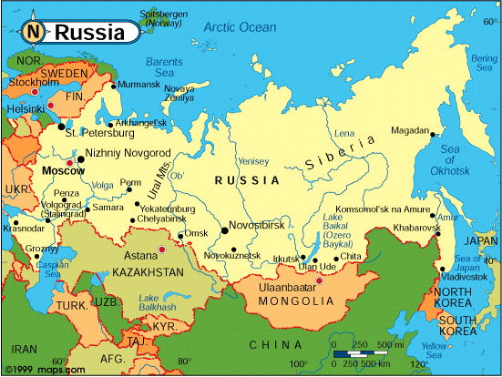
What would be the challenges of governing an area such as this?
Vast distances – travel, communication challenging
Clash of European & Asian cultures & heritage
Huge regional variations e.g. climate, timezones, soil
Governing people of different cultures, religions, languages
Defending extensive borders

Slide 10
Russian history 1855-1964
During the period we are going to be studying, Russia underwent enormous change.
The country moved from an authoritarian state based on the divine right of the tsars to govern, to a one-party Communist dictatorship that claimed its legitimacy from the people.
At the start of the period Russia suffered a catastrophic defeat in the Crimean War due to her backwardness, and at the end of the period she was one of two global superpowers locked in an economically crippling arms & space race.
To begin understanding the chronology of the period, look up the events listed at the top of p.10 and add them to the timeline.
Extension: add some very brief notes to the timeline to explain what happened for the key events.

Slide 11
Russian history 1855-1964
On the U3 course we will be studying four themes. They are:
The nature of government
The economy and society
The impact of war and revolution
The experience of Russia’s minorities
Colour-code the events on the timeline according to the four themes above.
Can you identify any turning points in Russia’s history in this period? Consider what is meant by turning point.

Slide 12
Homework
Finish the timeline on p.10-12.

Slide 13
The Tsarist and Communist leaders 1855-1964
In pairs or small groups, you are going to research one of the 6 leaders we will be studying over the course.
Produce a Powerpoint presentation no more than 4 slides long which briefly covers:
their background and suitability to govern
the dates of the period they ruled
the key events of their rule & challenges faced during their time in power
some of their key domestic policies whilst in office
how they fell from power. P.5-9 of the Holland textbook would be a good starting point for your research.

Slide 14
The Tsarist and Communist leaders 1855-1964
Which one of the rulers between 1855 and 1964 was best prepared, both by their experiences before taking power and by their abilities, to rule Russia?
What qualities/experience would have been important?

Slide 15
The Tsarist and Communist leaders 1855-1964
Which one of the rulers between 1855 and 1964 was best prepared, both by their experiences before taking power and by their abilities, to rule Russia?
Use the Wells & Fellows extract to help/further your understanding.
Award each of the rulers a mark between one and five for each factor.
Make a judgement i.e. decide who would gain the highest marks overall.
Explain briefly why the ruler of your choice could be seen as the best qualified /strongest of the rulers between 1855 and 1964 on the basis of the criteria chosen.

