Slide 1
Godalming College History Department A Level History
Welcome to Godalming College and to the History Department
R & R (Revolution & Rebellions)

Slide 2
Introduction to the Course
In your first year at college you will study two units, one British and one non-British
In your second year you will study one examined unit and one coursework unit
First Year |  | Second Year
Unit 1: GB 1930-97 (25%) | Unit 3 Civil Rights in the USA 1865-1992 (40%) | Unit 2: French Revolution and Napoleon (15%) | Unit 4; Coursework 3,000-4,000 words + Civil Rights (20% Coursework)

Slide 3
Introduction to the Course
In your first year your time will be divided equally between the Unit 1 and Unit 2 courses – you will have three 45 minute lessons on each side of the course per week
This means a total of 4 hours 30 minutes of History each week
You will be taught each unit by a different teacher
At the end of the first year you will have a formal mock exam in both your British and French papers. The final exams in these units will be at the end of the second year
A level History is a ‘linear’ subject

Slide 4
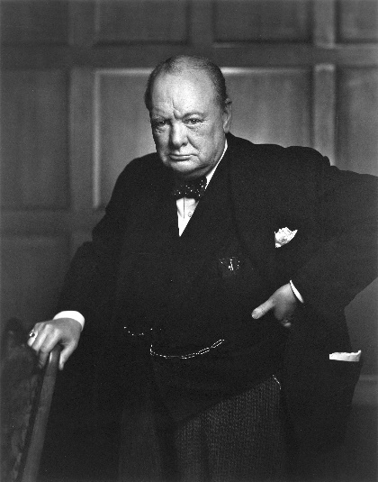
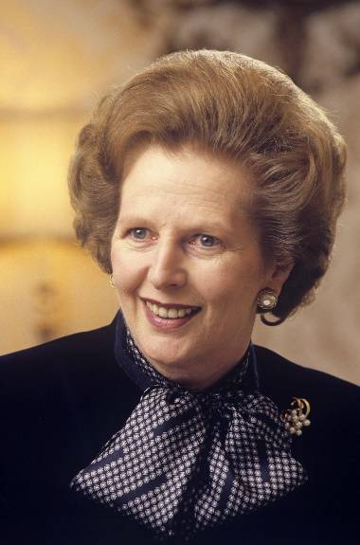
Introduction to the Course
GB 1930-97
The Unit 1 topic examines the career of Winston Churchill’s career 1930-51 & then British politics & foreign policy 1951-97
It combines detailed own knowledge of the period with the ability to analyse and use primary sources
In the Unit 1 exam you will answer questions from two sections
SECTION A: a 30 mark question in which you will use four primary sources to assess a view/argument on the period 1930 - 1951 (known as the ‘Enquiry Topic’)
SECTION B: one 20 mark own knowledge essay from a choice of two
Unit 1= 50 marks, 1 hour 30 minutes exam
Henry VIII
150-1547

Slide 5
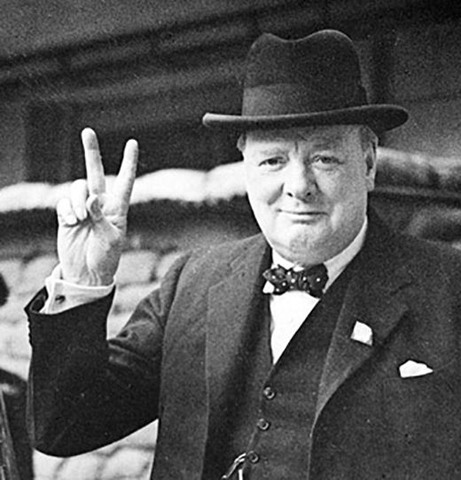
Introduction to the Course
Unit 1: GB 1930-97
Churchill’s “Wilderness Years” 1930-40
His role as Prime Minister during WW2 1940-5
His role in international relations 1940-51
The above three points make up what is called the ‘Enquiry Topic’. It is from this period that you will be given sources in the exam

Slide 6
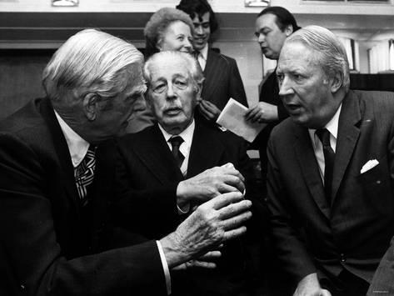
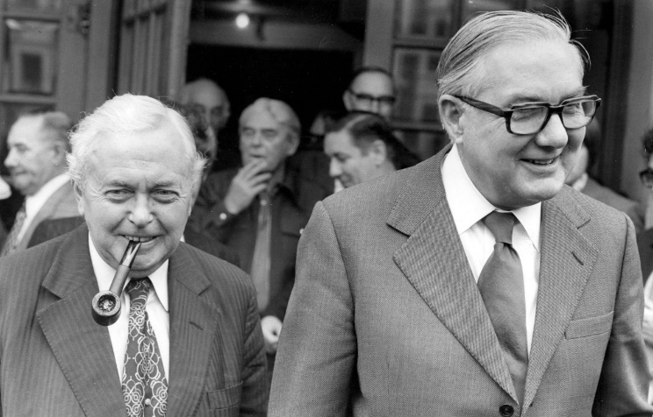
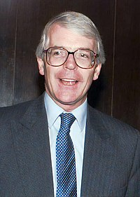
Introduction to the Course
Unit 1: GB 1930-97
The Era of Consensus: British Domestic Politics 1951-79
Conservative Dominance 1979-97
British Foreign Policy 1951-97
In the exam you will choose one out of 2 source less essays on these topics

Slide 7
Reminders for next lesson
Organisation – make sure you have a folder ready to keep your notes as ordered as possible
Homework – If you are going to use a diary you will need one for the start of next week
On line resources – if you haven’t already, make sure you have logged on to Godalming Online and have located the correct History page – ‘History, Year , R & R U1’ – Resources will be uploaded throughout the term and you will need to stay up-to-date. Also make sure you can locate estream.
Emails – get in the habit of checking your college email account regularly. It will be the main way that teachers contact you

Slide 8
How will split learning work?
Expectations:
Just because you are at home does not mean you are not involved.
You will be registered the same as those in the classroom attendance is compulsory.
You will expected to participate and contribute over the mic and in chat on teams.
Your work will be checked in the following week when you are in class
If you are ever feeling behind we are always here to help. Please don’t hesitate to contact us either via teams or email or see us in college.

Slide 9
Resources and work
All resources (powerpoints and class sheets) will be available on teams and Godalming online
Weekly instructions will also be on teams.
If you are in the home working group please upload your completed work on GOL before your first lesson of the following week.

Slide 10
Induction work
Glossary
Churchill strengths and posts

Slide 11
Churchill has been excluded from power after the 1931 election and is forced to watch from the side lines. However a figure like Churchill will still be listened to by many in the political establishment.

Slide 12
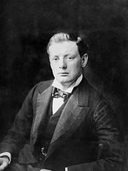
You are Winston Churchill
In pairs you get to make some of the key decisions which faced Churchill over the period of the first topic. Your job is to try to maintain political influence you start with five influence points but unfortunately correct decisions do not add to your total, you just don’t lose any. See how many you have left at the end. If you remain in positive figures you stay politically relevant.

Slide 13
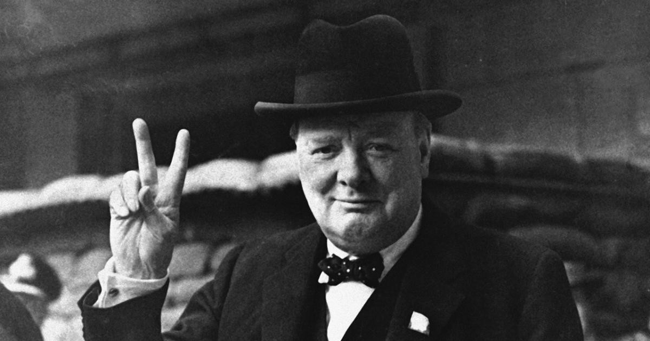
Now let’s see how you have done
If you lose 5 points are consigned to the political wilderness
Can you survive as Churchill?

Slide 14
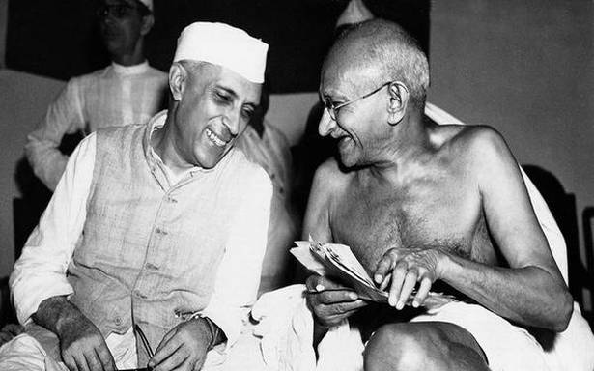
India
This would have been the best option it would have appeased the Indian nationalists and might for the first time have helped the British retain the most important part of their empire in the long run
This was what Churchill did but was ignoring the fact that the Indian nationalists were increasingly popular and in, Gandhi, Nehru and Jinnah had a strong leadership (-1)
This would be giving up the main source of Britain's power and wealth. (-2)

Slide 15
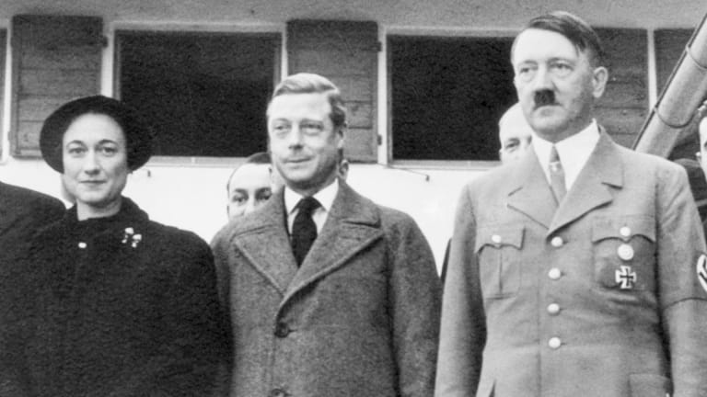
Edward VIII
Bad idea it goes against the popular position and you will be seen to be backing a fascist and his dodgy mates (-2)
Better but still backing a man who would be a disaster as a monarch (this was Churchill's position) -1
Good idea if you want power back

Slide 16
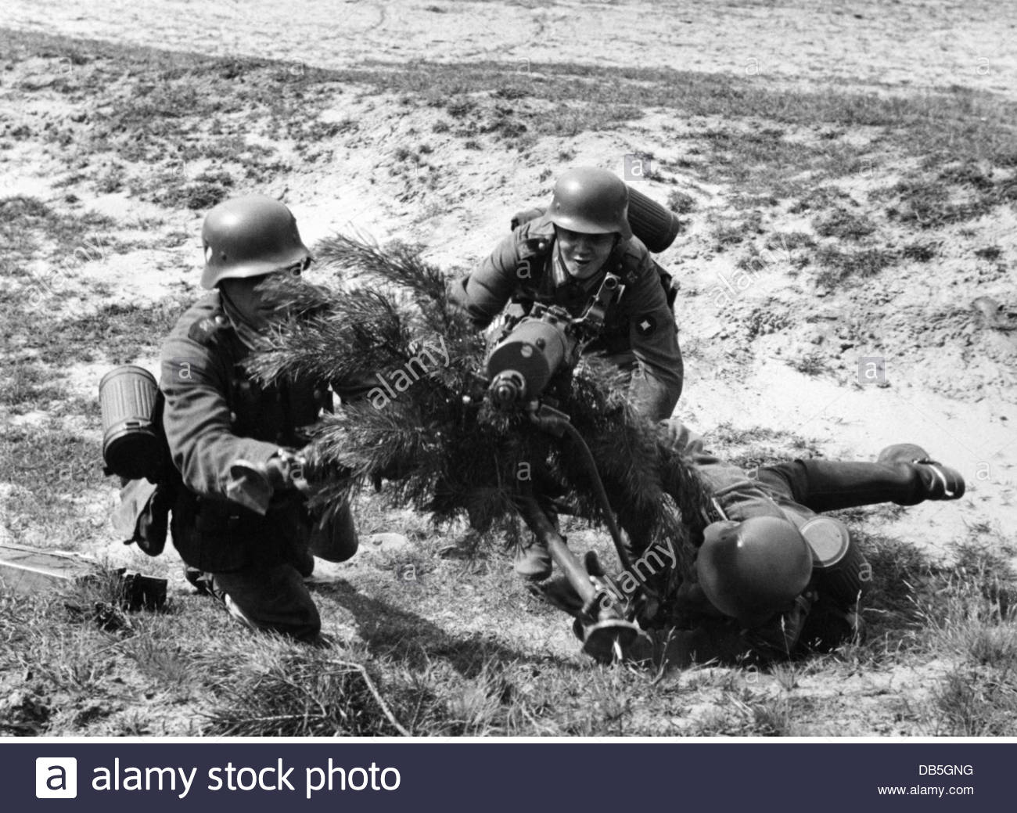
German Rearmament
Best option Britain needs to be ready and it gives you a political position to build on ( Churchill did this)
Not too bad but full rearmament would have turned out better in 1939
A bit early for that (-1) would leave Britain isolated and looking like a warmonger

Slide 17
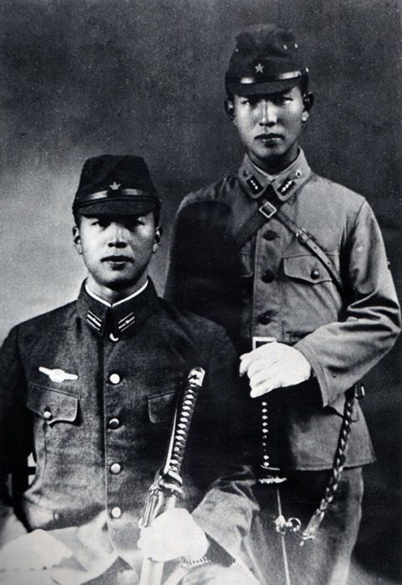
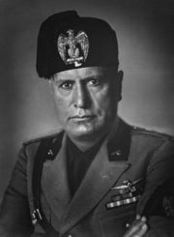
Japan and Italy
A) How many wars can Britain fight on its own? Plus Japan had been an ally in WW1 (-1)
Even on its own Japan would be a serious threat to the empire in the East and India (-1)
Before Britain is ready and with public opinion this is really the only option

Slide 18
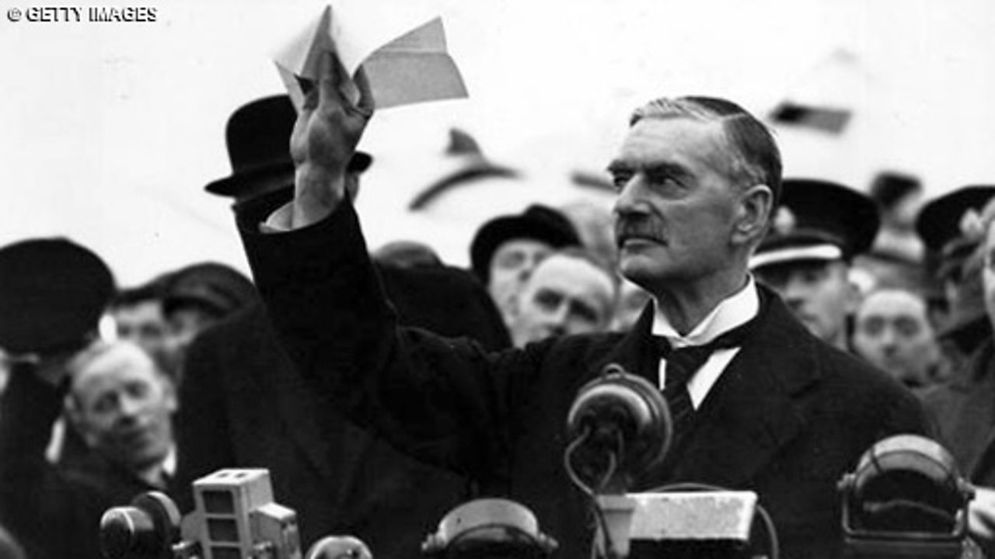
The Munich Agreement
A) This is starting to look very weak plus it gives Germany access to resources (-1)
B) Good idea it would have headed off the Nazi Soviet pact which started WW2
C Dangerous and unrealistic without allies (-1)

Slide 19
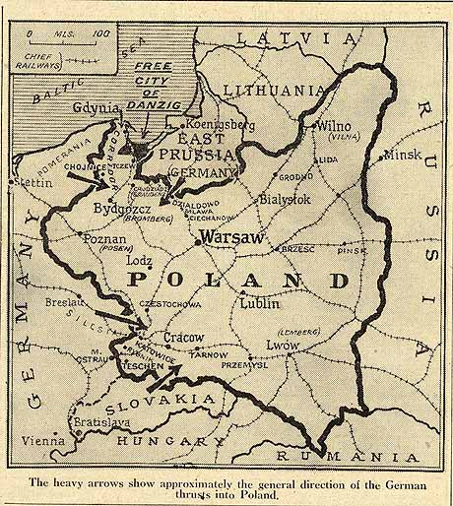
Guaranteeing Poland
What's next Belgium, France… Kent!! (-2)
Would be the practical option although it is Stalin you are doing a deal with !
Better than nothing but leaves Britain and France making a guarantee they will struggle to support.

Slide 20
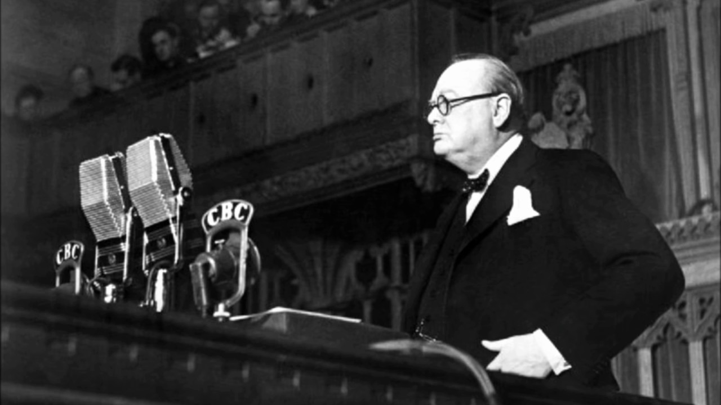
Becoming Prime Minister
No-one ever got ahead in politics by telling the truth. This would be the end of the road (-3)
Probably the most sensible option
Makes you look disloyal at a time the nation needs strong leaders (-1)

Slide 21
Conclusions
How well did you do? However well or badly you did as Churchill the real purpose of this game was to introduce you to some of the key issues and events of the first topic and the problems he had to deal with.
Can you answer these questions (in the gap at the bottom:
1: What were the main concerns of Churchill as a politician in the 1930s?
2: What have you learned about Churchill himself?
3: Why do you think he got back into power?

