Slide 1

Resilience and Resourcefulness
BTEC Induction 2016
It’s great not to know…!

Slide 2
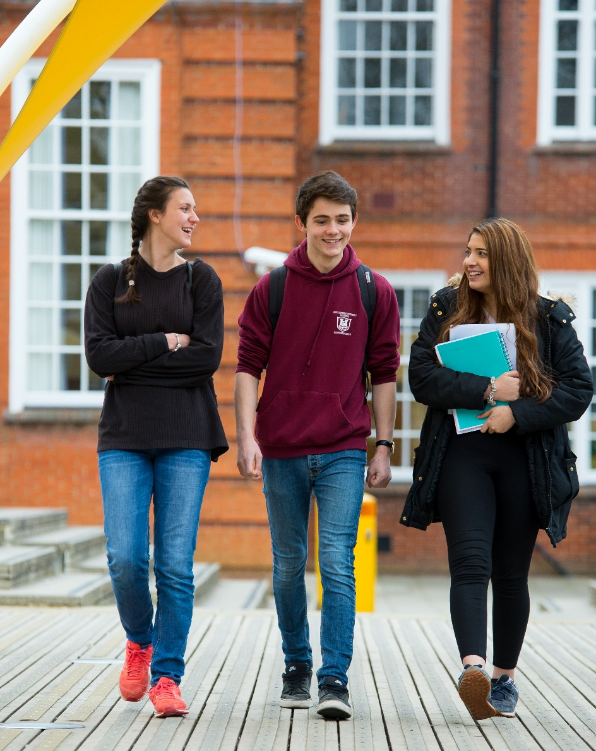
Why are we here?
To have a good time?
To make friends?
To pass exams?
To learn?
To prepare you for life after college? Work? University?.....

Slide 3
What is Learning?
Understanding things that you did not know before?
Learning from your mistakes?
Coming out of a lesson more informed than when you went in?

Slide 4

Is it ever right to do
something wrong?

Slide 5

We can learn from our mistakes….
YES!

Slide 6
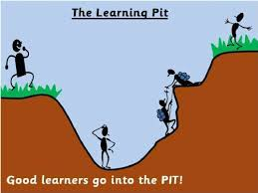

Slide 7
If you know the answer straight away, how much learning has taken place?

Slide 8
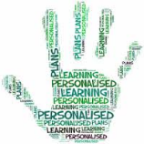
It’s great not to know….
This is how we develop LEARNING STRATEGIES

Slide 9
So how do we get out of the pit?
What do I do when I don’t know what to do?....
Brain book buddy boss

Slide 10

It’s THE how rather than THE what
Learn to do your own research

Slide 11
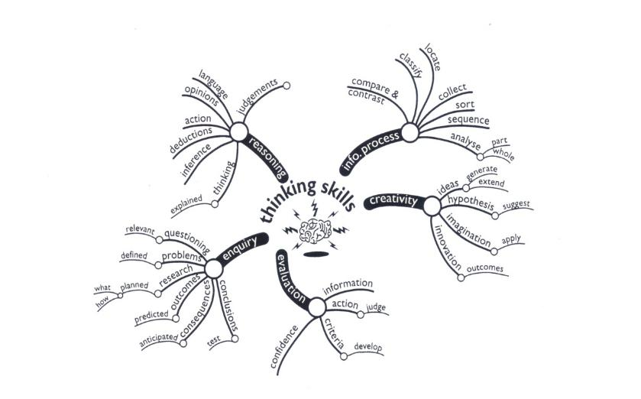
Use your Brain!

Slide 12
Decide where the best source of information might be and use it.
Use textbooks, lesson support materials on Godalming Online, the LRC, the internet (NOT just Google or Wikipedia)
Organise the information that you have found
Use our guidance to plan and structure your answers
You are on the way to becoming an independent learner!

Slide 13


Learning is a challenge
A challenge is set so that we can achieve something, it’s a target
It requires effort
The challenge may be tough but how do we feel when we get to the end?
It’s great not to know….

Slide 14
Skills are needed to master a challenge
Resilience and Resourcefulness

Slide 15
Resilience
If we accept that there are things that we don’t know (and therefore things that we need to learn) and we have the skills to find and use information to solve problems then we are developing resilience.

Slide 16
Resilience
A challenge is not set to crush you, it is set to get you to do better.
How will you know that you have been successful?
How can you measure your success?

Slide 17
Setting targets - SMART
Specific, measureable, achievable, realistic and time linked targets can help us to be successful.
BTEC assignments are time linked with realistic and achievable tasks for you to attempt
Good organisational skills will help you meet your targets

Slide 18
It’s great not to know…!
Its ok to be criticised if you don’t meet the target
If you’ve not met the target you need to know so that you can improve your work
Without this understanding there is no progress
To accept this and see it as a challenge not a poor result
is to develop RESILIENCE

Slide 19
Rise to the challenge!
Set targets
Try to meet them
Review your progress regularly and reset those targets to keep your progress steady

Slide 20
How? - RESOURCEFULNESS
SMART targets
Use teacher feedback
Independent research skills
ESSENTIAL - A POSITIVE ATTITUDE AND A DESIRE TO IMPROVE

Slide 21
Recommended sources of information
Godalming Online
Recommended internet sites
Course textbooks
Broadsheet newspapers
Online, TV & Radio news
ILC
Brain book buddy boss

Slide 22
Lets relate this approach to your studies
Task sheet issued (the challenge)
Write it up (and be prepared to change it)
Review the finished piece
Plan your response
GREAT! Get researching, discussing, finding answers)
WWW? EBI?
Brain book buddy boss

Slide 23
The BTEC levels of achievement
Understanding shown and related to the business - PASS
The situation analysed, advantages and disadvantages considered - MERIT
Your analysis points weighed up and a judgement made – DISTINCTION!

Slide 24
Your journey - from here to the next stage
We are the guides. We signpost the way.
YOU DO THE TRAVELLING
You are here to learn, to develop new skills, to gain qualifications that show what you have achieved.
YOU set your targets. YOU learn to meet them.

Slide 25
Your journey - how far can you go?.....
September 2017
July 2019
robotic
resourceful
rule bound
creative
passive
curious
fragmented
reflective
dependent
collaborative
fragile
resilient
Success!
Dependence to independence
Notes:
25

Slide 26
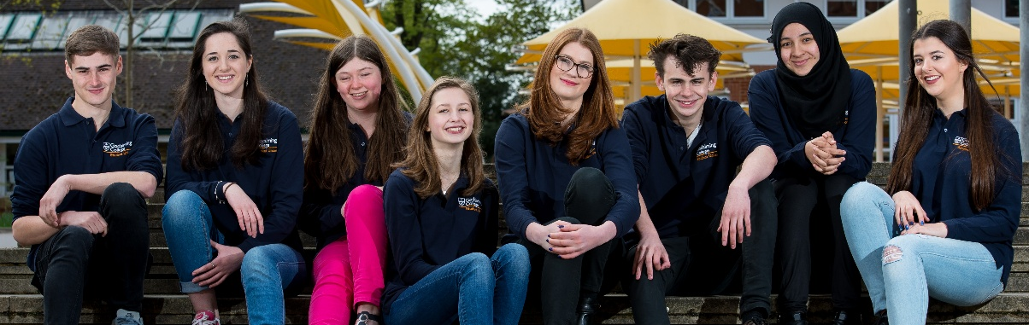
Positive attitude to learning
Resourcefulness and resilience
Skills for life, not just for college

