Slide 1
Techniques to meet skills requirements
Week 2
(14th – 18th September)
Past Paper Practice:
January 2018 NBCC - Activity 2 (Training & Development)
Unit 6 Lesson 1
Learning Aim D2

Slide 2
D2 Techniques to meet skills requirements
Recruitment
Upskilling/reskilling/ training
Outsourcing
Changing job roles
Restructuring

Slide 3
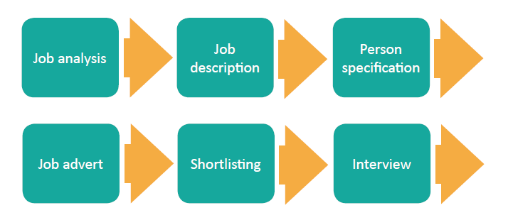
recruitment

Slide 4
outsourcing
Sometimes an organization cannot handle all aspects of a business process internally.
Additionally some processes are temporary and the organization does not want to employ new people to perform the tasks.
Outsourcing is contracting another company to take the responsibility of carrying out the required tasks or functions
Many councils outsource the street cleaning and rubbish collection
Notes:
https://www.cipd.co.uk/knowledge/fundamentals/people/hr/outsourcing-facsheet#7815
Outsourcing can offer benefits, such as increased efficiency and access to expertise; however, it can also present challenges, such as loss of local knowledge and processes, and fragmentation of the service provided.
Advantages
Swiftness and Expertise: Most of the times tasks are outsourced to vendors who specialize in their field. The outsourced vendors also have specific equipment and technical expertise, most of the times better than the ones at the outsourcing organization. Effectively the tasks can be completed faster and with better quality output
Concentrating on core process rather than the supporting ones: Outsourcing the supporting processes gives the organization more time to strengthen their core business process
Risk-sharing: one of the most crucial factors determining the outcome of a campaign is risk-analysis. Outsourcing certain components of your business process helps the organization to shift certain responsibilities to the outsourced vendor. Since the outsourced vendor is a specialist, they plan your risk-mitigating factors better
Reduced Operational and Recruitment costs: Outsourcing eludes the need to hire individuals in-house; hence recruitment and operational costs can be minimized to a great extent. This is one of the prime advantages of offshore outsourcing
Disadvantages
Risk of exposing confidential data: When an organization outsources HR, Payroll and Recruitment services, it involves a risk if exposing confidential company information to a third-party
Synchronizing the deliverables: In case you do not choose a right partner for outsourcing, some of the common problem areas include stretched delivery time frames, sub-standard quality output and inappropriate categorization of responsibilities. At times it is easier to regulate these factors inside an organization rather than with an outsourced partner
Hidden costs: Although outsourcing most of the times is cost-effective at times the hidden costs involved in signing a contract while signing a contract across international boundaries may pose a serious threat
Lack of customer focus: An outsourced vendor may be catering to the expertise-needs of multiple organizations at a time. In such situations vendors may lack complete focus on your organization’s tasks

Slide 5
restructuring
Restructuring is the corporate management term for the act of reorganising the structure of a company for the purpose of making it more profitable, or better organized for its present needs
It may involve upskilling/reskilling/ training or making people redundant
Notes:
http://www.investopedia.com/terms/r/restructuring.asp
Organizational Restructuring
When a company restructures internally, the operations, processes, departments or ownership may change, enabling the business to become more integrated and profitable. Financial and legal advisors are often hired for negotiating restructuring plans. Parts of the company may be sold to investors, and a new chief executive officer (CEO) may be hired to help implement the changes. The results may include alterations in procedures, computer systems, networks, locations and legal issues. Because positions may overlap, jobs may be eliminated and employees laid off.
Restructuring should result in smoother, more economically sound business operations. After employees adjust to the new environment, the company should be better equipped for achieving its goals through greater efficiency in production.
http://www.acas.org.uk/index.aspx?articleid=3619

Slide 6
Upskilling/re-skilling/re-training
The process of improving skills or teaching workers new skills
Re-skilling is needed to adapt to rapid economic and technological change
Traditional jobs may be less secure, upskilling to avoid redundancy
Increased retirement age means people are working for longer and need to continue to participate in the labour market
Older workers may need to retrain and develop skills to move back into employment in their current sector or a new one
Social mobility is essential to building sustainable growth for the economy
Notes:
The process of learning new skills or teaching workers new skills
Retraining and developing new skills
Reskilling is needed to
Adapt to rapid economic and technological change
Traditional jobs may be less secure, upskilling to avoid redundancy
Increased retirement age means people are working for longer and need to continue to participate in the labour market
Older workers may need to retrain and develop skills to move back into employment in their current sector or a new one
Social mobility is essential to building sustainable growth for the economy

Slide 7
conclusion
Organisations change
Skills requirements change
People are in work for a long time
People often return to work or change direction
People may need to retrain to stay in work, to change direction or to re-join the workforce

Slide 8
D3 Training and development
Week 2
(14th – 18th September)
Past Paper Practice:
January 2018 NBCC - Activity 2 (Training & Development)
Unit 6 Lesson 1
Learning Aim D3

Slide 9
Why do people need training?
the development and introduction of new products
restructuring of the firm
the development and introduction of new technology
changes to procedure, including improvements to customer service
high labour turnover
low morale
changes in legislation

Slide 10
Types of Training
internal/ external
on-the-job/off-the job
induction
mentoring
coaching
Notes:
www.businesscasestudies.co.uk (A series of real-life business cases studies covering a variety of management-related issues.)
www.businessballs.com (Tuckman’s team formation model.)
www.tutor2u.net (Search for ‘organisational structures worksheet’; see also the slide presentation by Jim Riley on organisational structures, and the article ‘How Businesses organise

Slide 11
Internal or external training?
Internal: take place at work, appropriate if training needs are specific to the organisation
External: provided by an outside agency, costs more but can be motivating and the trainee will meet people from other organisations to exchange ideas

Slide 12
On or off the job training?
on-the-job training: where an employee learns a job by seeing how it is carried out by an experienced employee.
off-the-job training: all forms of employee education apart from that at the immediate workplace.

Slide 13
Induction training
Education for new employees, which usually involves learning about the way the business works rather than about the particular job that the individual will do.
An effective induction programme is likely to:
reduce labour turnover
improve employees’ understanding of both the corporate culture and the situation in which the organisation is placed
mean that employees contribute to the organisation more quickly
increase motivation

Slide 14
mentoring
"A mentor is a more experienced individual willing to share knowledge with someone less experienced in a relationship of mutual trust"
Mentoring involves the use of the same models and skills of questioning, listening, clarifying and reframing associated with coaching.
Traditionally, however, mentoring in the workplace has tended to describe a relationship in which a more experienced colleague uses his or her greater knowledge and understanding of the work or workplace to support the development of a more junior or inexperienced member of staff

Slide 15
coaching
Coaching targets high performance and improvement at work and usually focuses on specific skills and goals, although it may also have an impact on an individual’s personal attributes such as social interaction or confidence.
The process typically lasts for a relatively short defined period of time, or forms the basis of an on-going management style

Slide 16
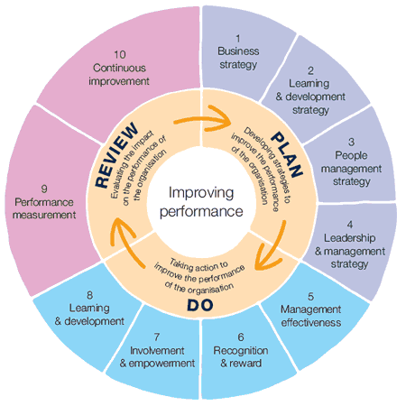
effectiveness of Training
Training costs money – so a business will want to know if the training was effective, was it money well spent?
4 aspects to measure
Reaction
Learning
Behaviour
Results
Notes:
The Four Levels
Donald Kirkpatrick, Professor Emeritus at the University of Wisconsin and past president of the American Society for Training and Development (ASTD), first published his Four-Level Training Evaluation Model in 1959, in the US Training and Development Journal.
The model was then updated in 1975, and again in 1994, when he published his best-known work, "Evaluating Training Programs."
The four levels are:
Reaction.
Learning.
Behavior.
Results.
Let's look at each level in greater detail.
Level 1: Reaction
This level measures how your trainees (the people being trained), reacted to the training. Obviously, you want them to feel that the training was a valuable experience, and you want them to feel good about the instructor, the topic, the material, its presentation, and the venue.
It's important to measure reaction, because it helps you understand how well the training was received by your audience. It also helps you improve the training for future trainees, including identifying important areas or topics that are missing from the training.
Level 2: Learning
At level 2, you measure what your trainees have learned. How much has their knowledge increased as a result of the training?
When you planned the training session, you hopefully started with a list of specific learning objectives: these should be the starting point for your measurement. Keep in mind that you can measure learning in different ways depending on these objectives, and depending on whether you're interested in changes to knowledge, skills, or attitude.
It's important to measure this, because knowing what your trainees are learning and what they aren't will help you improve future training.
Level 3: Behavior
Donald Kirkpatrick (1959 and then revisited in 1994)
https://www.mindtools.com/pages/article/kirkpatrick.htm
At this level, you evaluate how far your trainees have changed their behavior, based on the training they received. Specifically, this looks at how trainees apply the information.
It's important to realize that behavior can only change if conditions are favorable. For instance, imagine you've skipped measurement at the first two Kirkpatrick levels and, when looking at your group's behavior, you determine that no behavior change has taken place. Therefore, you assume that your trainees haven't learned anything and that the training was ineffective.
However, just because behavior hasn't changed, it doesn't mean that trainees haven't learned anything. Perhaps their boss won't let them apply new knowledge. Or, maybe they've learned everything you taught, but they have no desire to apply the knowledge themselves.
Level 4: Results
At this level, you analyze the final results of your training. This includes outcomes that you or your organization have determined to be good for business, good for the employees, or good for the bottom line

Slide 17
Training and market failure
Some companies have a great training scheme
This makes their staff very desirable to other companies
Other companies poach their ready trained staff rather than training their own staff
The companies with the great training schemes are spending too much on training staff who then leave
They decide to stop the training schemes

Slide 18
conclusion
Training is designed to improve performance and productivity
Training costs money
The benefits of training need to be measurable and measured to ensure value for money (cost/benefit analysis)

Slide 19
Activity to run for the week NBCC Case Study Jan 18 Activity 2 (up to 6 slide ppt)
With reference to the case study, you are to prepare a presentation for the Managing Director of NBCC Ltd
1
Explain the training and development approaches that NBCC could use
2
Recommend methods that NBCC could use to measure the effectiveness of training and development initiatives
3
Notes:
What does HR Planning involve?
Why is HR Planning important to NBCC?
What actions could be taken to improve competitiveness?

Slide 20
Activity 2 PLAN
Marks Scheme – use throughout:
Data Analysis (12 marks)
Use figures, statistics, ratios
Key principles of management (12 marks)
Theories, types, skills
Suggest ALTERNATIVE approaches (12 marks)
For every decision you make, what alternatives did you discount and why?
Structure and Presentation (8 marks)
Logical structure, business terminology, relevant principles and concepts
Up to 6 slides with speaker notes
Explain the training and development approaches that NBCC could use
Recommend methods that NBCC could use to measure the effectiveness of training and development initiatives

