Slide 1
D4 Performance appraisal
Week 3
(21st – 25th September)
Past Paper Practice:
June 2019 Cookson’s Chemists - Activity 2 (Performance Appraisals)
Unit 6
Learning Aim D4

Slide 2
What is performance appraisal?
An attempt by the business to find out the qualities, usefulness and or worth of employees
Usually takes the form of regular meetings in which the staff members performance is analysed
Notes:
www.cipd.co.uk (Chartered Institute of Personnel Development – factsheet on performance appraisal.)

Slide 3
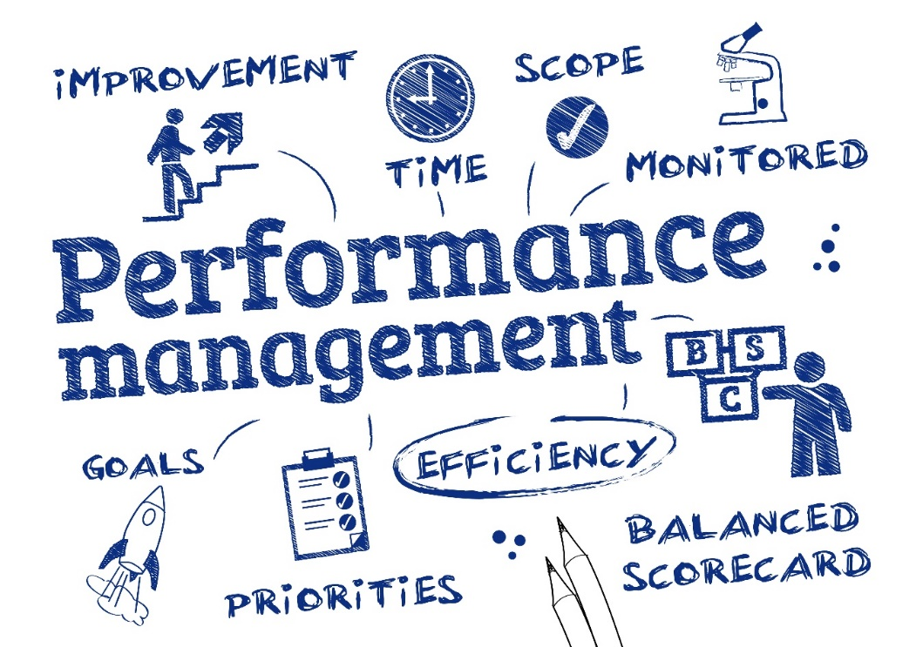
Purpose of performance appraisal:
to set individual and group targets
to assess individual and group performance
to provide employee feedback
to identify training needs
Notes:
www.cipd.co.uk (Chartered Institute of Personnel Development – factsheet on performance appraisal.)

Slide 4
Types of appraisal
self-assessment
management by objectives
ratings scales
360° appraisal
https://www.youtube.com/watch?v=IkYUDQCYGHA
Notes:
You tube clip – skip the bit with the girls talking
www.cipd.co.uk (Chartered Institute of Personnel Development – factsheet on performance appraisal.)
An employee may be judged on a range of tasks completed, such as:
Number of complaints
Performance of subordinates
Management of budget
Customer service

Slide 5
Self assessment
The process of having the employee:
Reflect on their own performance
Record their progress
Suggest targets for future
Perhaps the most important benefit is self-reflection:
‘How can I improve?’
Notes:
www.cipd.co.uk (Chartered Institute of Personnel Development – factsheet on performance appraisal.)

Slide 6
MBO (superior’s assessment)
Most appraisals are carried out this way
Benefit: the supervisor usually has an intimate knowledge of the tasks that a worker has performed and how well they’ve done them
Drawback: difficult for the supervisor to remain impartial
Notes:
www.cipd.co.uk (Chartered Institute of Personnel Development – factsheet on performance appraisal.)

Slide 7
Ratings scales (peer assessment)
The process of having employees of similar levels of responsibility critically comment upon performance of a co-worker and perhaps suggest methods of improvement
Peer assessment involves employees taking responsibility for assessing the work of their peers against set assessment criteria.
They can therefore be engaged in providing feedback to their peers (sometimes referred to as peer review), summative grades (moderated by you or your colleagues), or a combination of the two.
Notes:
www.cipd.co.uk (C
Peer assessment involves students taking responsibility for assessing the work of their peers against set assessment criteria. They can therefore be engaged in providing feedback to their peers (sometimes referred to as peer review), summative grades (moderated by you or your colleagues), or a combination of the two.hartered
Institute of Personnel Development – factsheet on performance appraisal.)

Slide 8
360° appraisal
The appraised staff member receives feedback from people whose views are considered helpful and relevant
e.g. fellow workers, line managers, junior staff, team members, customers and suppliers
It also includes self-assessment to give a complete appraisal of the individual (360°)
Notes:
This method should provide a full picture of performance and it may help a business when making decisions when related to the performance of the individual
www.cipd.co.uk (Chartered Institute of Personnel Development – factsheet on performance appraisal.)

Slide 9
Impact of performance appraisal
on the individuals/on the business.
Motivates staff
Improves performance
Allows the setting of achievable targets
Identifies training needs
Identifies potential
Enables achievable bonuses to be earned
Causes tension in the workplace
Puts workers under pressure to improve
Places too much power in the hands of line managers
Notes:
www.cipd.co.uk (Chartered Institute of Personnel Development – factsheet on performance appraisal.)

Slide 10
Activity to run for the week Cookson’s Chemists (CCL) past paper June 2019 Activity 2
With reference to the case study, you are to prepare a presentation for the Managing Director of Cookson’s Chemists Ltd
1
Your report should show understanding of the purpose, types and impact of performance appraisals that CCL could use
2
Recommend improvements that CCL could make in its performance appraisal processes
3

