Slide 1
E1 Managing change
Week 6
(5th – 9th October)
Past Paper Practice:
June 2019 Cookson’s Chemists - Activity 1 (Change Management)
Unit 6
Learning Aim D3
Notes:
https://www.tutor2u.net/business/reference/stakeholders-introduction

Slide 2
Managing change
Change is a common thread that runs through all businesses regardless of size, industry and age.
The world is changing fast and organizations must change quickly, too.
Organizations that handle change well thrive, whilst those that do not may struggle to survive
3 factors to consider – internal, external and stakeholders
Notes:
www.change-management-coach.com (See Lewin’s change management model.)
www.stakeholdermap.com (includes a short video presentation on Stakeholder Theory)
www.businesscasestudies.co.uk (A series of real-life business cases studies covering a number of management–related scenarios.)
www.bized.co.uk (See the section on business stakeholders and resolving conflicts between stakeholders, including task sheets.)
www.tutor2u.net (See section on ‘Business Stakeholders’ including case studies and ‘Stakeholder Statements’ from major companies.)

Slide 3
Internal factors that influence change
The internal environment: the company's mission statement, organizational culture and style of leadership
This will influence organizational activities, decisions, and employee behaviour and attitudes.
Changes in the leadership style, the organization's mission, or culture can have a considerable impact on the organization.
Notes:
www.change-management-coach.com (See Lewin’s change management model.)
www.stakeholdermap.com (includes a short video presentation on Stakeholder Theory)
www.businesscasestudies.co.uk (A series of real-life business cases studies covering a number of management–related scenarios.)
www.bized.co.uk (See the section on business stakeholders and resolving conflicts between stakeholders, including task sheets.)
www.tutor2u.net (See section on ‘Business Stakeholders’ including case studies and ‘Stakeholder Statements’ from major companies.)

Slide 4
external factors that influence change
Customers, competition, the economy, technology, political and social conditions (PEST) are common external factors that influence change in an organisation.
Managers must monitor and adapt to the external environment, working to make proactive changes earlier on rather than having to take a reactive approach, which can lead to a vastly different outcome
Notes:
www.change-management-coach.com (See Lewin’s change management model.)
www.stakeholdermap.com (includes a short video presentation on Stakeholder Theory)
www.businesscasestudies.co.uk (A series of real-life business cases studies covering a number of management–related scenarios.)
www.bized.co.uk (See the section on business stakeholders and resolving conflicts between stakeholders, including task sheets.)
www.tutor2u.net (See section on ‘Business Stakeholders’ including case studies and ‘Stakeholder Statements’ from major companies.)

Slide 5
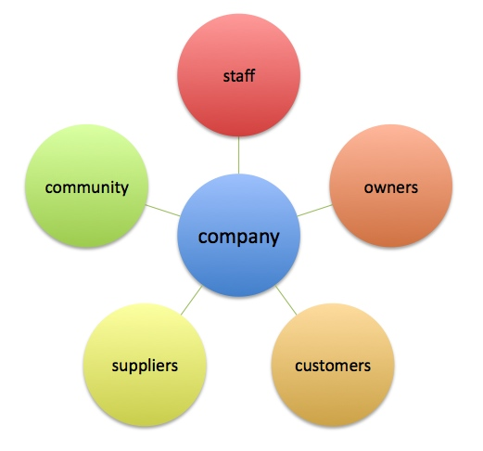
What are stakeholders?
Stakeholders are groups or individuals that are affected by and/or have an interest in the operations and objectives of the business
Stakeholder groups vary both in terms of their interest in the business activities and also their power to influence business decisions
Notes:
https://www.tutor2u.net/business/reference/stakeholders-introduction
www.change-management-coach.com (See Lewin’s change management model.)
www.stakeholdermap.com (includes a short video presentation on Stakeholder Theory)
www.businesscasestudies.co.uk (A series of real-life business cases studies covering a number of management–related scenarios.)
www.bized.co.uk (See the section on business stakeholders and resolving conflicts between stakeholders, including task sheets.)
www.tutor2u.net (See section on ‘Business Stakeholders’ including case studies and ‘Stakeholder Statements’ from major companies.)

Slide 6
Stakeholders who influence change
Owners Looking for profit, security, continuity
Managers Looking for salary, security,
Customers Want the business to produce quality products/service at reasonable prices
Regulators Looking to see that the business is operating fairly and legally
Financial institutions want to be repaid on time and in full
Government Want people employed, able to pay tax and spend money
Employees Want to be paid, have security and/or prospects
Notes:
www.change-management-coach.com (See Lewin’s change management model.)
www.stakeholdermap.com (includes a short video presentation on Stakeholder Theory)
www.businesscasestudies.co.uk (A series of real-life business cases studies covering a number of management–related scenarios.)
www.bized.co.uk (See the section on business stakeholders and resolving conflicts between stakeholders, including task sheets.)
www.tutor2u.net (See section on ‘Business Stakeholders’ including case studies and ‘Stakeholder Statements’ from major companies.)

Slide 7
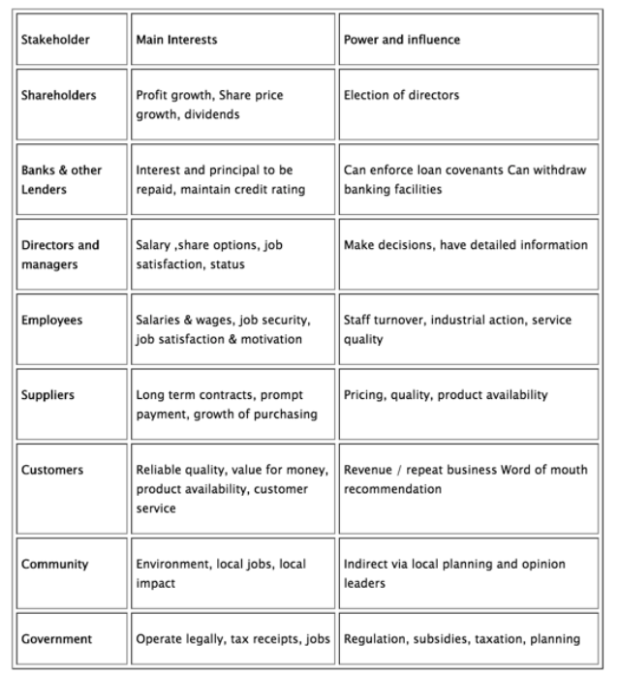
Level of influence
Stakeholder groups vary both in terms of their interest in the business activities and also their power to influence business decisions

Slide 8
The importance of understanding Stakeholders in change management
Businesses and competitive environments change over time
Businesses must respond to these changes to remain competitive
Stakeholders may have conflicting interests and levels of influence
All these interests have to be managed if change is to be successful
Notes:
www.change-management-coach.com (See Lewin’s change management model.)
www.stakeholdermap.com (includes a short video presentation on Stakeholder Theory)
www.businesscasestudies.co.uk (A series of real-life business cases studies covering a number of management–related scenarios.)
www.bized.co.uk (See the section on business stakeholders and resolving conflicts between stakeholders, including task sheets.)
www.tutor2u.net (See section on ‘Business Stakeholders’ including case studies and ‘Stakeholder Statements’ from major companies.)

Slide 9
Common change management principles for business survival and success
At all times involve and agree support from people within the system
Communicate and involve as early and openly and as fully as possible.
Understand where the organisation is at the moment
Understand where you want to be, when, why and how to get there
Plan your change in appropriate achievable measurable stages
Notes:
www.change-management-coach.com (See Lewin’s change management model.)
www.stakeholdermap.com (includes a short video presentation on Stakeholder Theory)
www.businesscasestudies.co.uk (A series of real-life business cases studies covering a number of management–related scenarios.)
www.bized.co.uk (See the section on business stakeholders and resolving conflicts between stakeholders, including task sheets.)
www.tutor2u.net (See section on ‘Business Stakeholders’ including case studies and ‘Stakeholder Statements’ from major companies.)

Slide 10
Lewin’s change management model
Change management is a collective term for all approaches to preparing and supporting individuals, teams, and organizations in making organizational change.
Unit 6
Learning Aim D3
Notes:
https://www.tutor2u.net/business/reference/stakeholders-introduction

Slide 11
Unfreeze, change, refreeze
If you have a large cube of ice but realize that what you want is a cone of ice, what do you do?
First you must melt the ice to make it amenable to change (unfreeze).
Then you must mold the iced water into the shape you want (change).
Finally, you must solidify the new shape (refreeze).
https://www.mindtools.com/pages/article/newppm_94.htm
Notes:
Understanding Lewin's Change Management Model
If you have a large cube of ice but realize that what you want is a cone of ice, what do you do? First you must melt the ice to make it amenable to change (unfreeze). Then you must mold the iced water into the shape you want (change). Finally, you must solidify the new shape (refreeze).
By looking at change as a process with distinct stages, you can prepare yourself for what is coming and make a plan to manage the transition – looking before you leap, so to speak. All too often, people go into change blindly, causing much unnecessary turmoil and chaos.
To begin any successful change process, you must first start by understanding why the change must take place. As Lewin put it, "Motivation for change must be generated before change can occur. One must be helped to re-examine many cherished assumptions about oneself and one's relations to others." This is the unfreezing stage from which change begins.
Unfreeze
This first stage of change involves preparing the organization to accept that change is necessary, which involves breaking down the existing status quo before you can build up a new way of operating.
Key to this is developing a compelling message showing why the existing way of doing things cannot continue. This is easiest to frame when you can point to declining sales figures, poor financial results, worrying customer satisfaction surveys, or suchlike. These show that things have to change in a way that everyone can understand.
To prepare the organization successfully, you need to start at its core – you need to challenge the beliefs, values, attitudes, and behaviors that currently define it. Using the analogy of a building, you must examine and be prepared to change the existing foundations as they might not support add-on storeys. Unless this is done, the whole building may risk collapse.
This first part of the change process is usually the most difficult and stressful. When you start cutting down the "way things are done," you put everyone and everything off balance. You may evoke strong reactions in people, and that's exactly what needs to be done.
By forcing the organization to re-examine its core, you effectively create a (controlled) crisis, which in turn can build a strong motivation to seek out a new equilibrium. Without this motivation, you won't get the buy-in and participation necessary to effect any meaningful change.
Change
After the uncertainty created in the unfreeze stage, the change stage is where people begin to resolve their uncertainty and look for new ways to do things. People start to believe and act in ways that support the new direction.
The transition from unfreeze to change does not happen overnight: people take time to embrace the new direction and participate proactively in the change. In order to accept the change and contribute to making it successful, people need to understand how it will benefit them. Not everyone will fall in line just because the change is necessary and will benefit the company. This is a common assumption and a pitfall that should be avoided.

Slide 12
Kotter’s 8 steps
Kotter suggests that for change to be successful, 75 percent of a company's management needs to "buy into" the change
https://www.mindtools.com/pages/videos/kotter-change-transcript.htm
Unit 6
Learning Aim D3
Notes:
https://www.tutor2u.net/business/reference/stakeholders-introduction

Slide 13
Kotter’s model for Managing change
Increase urgency - inspire people to move, make objectives real and relevant.
Build the guiding team - get the right people in place with the right mix of skills and levels.
Get the vision right - get the team to establish a simple vision and strategy
Communicate for buy-in - Involve as many people as possible, communicate the essentials simply
Empower action - Remove obstacles, enable constructive feedback and lots of support from leaders - reward and recognise progress and achievements.
Create short-term wins - Set aims that are easy to achieve - in bite-size chunks. Manageable numbers of initiatives. Finish current stages before starting new ones.
Don't let up - Foster and encourage determination and persistence - ongoing change - encourage ongoing progress reporting - highlight achieved and future milestones.
Make change stick - Reinforce the value of successful change via recruitment, promotion, new change leaders. Weave change into culture.
https://www.mindtools.com/pages/videos/kotter-change-transcript.htm
Notes:
John Kotter's "8-Step Change Model" is a useful approach to follow, and this video shows you how.
Kotter's first step is to create a sense of urgency around the need for change. This helps spark the motivation in your team to get things moving. Discuss the threats of not changing, and the opportunities that successful change will offer. Give people the chance to ask questions and get involved.
Next, get together a powerful coalition of people who are willing to show their support for your idea. A mix of respected leaders, experts and stakeholders, from across your organization, can make highly effective champions.
Then, create a vision for change. Explain the values that are central to the process, and share an inspiring picture of the future that people will want to be part of.
The fourth step is to keep communicating your vision, frequently and powerfully, and to embed it in everything you do. Talk about it at every chance you get, and "walk the talk" to demonstrate the kind of behavior you're looking for from others.
One of the most helpful things you can do for your team members is to remove any obstacles in their path. Are there any processes or structures that are holding up change? Is there anyone who still needs convincing? If so, focus your energies there. Then, recognize and reward people for making change happen.
There are three more steps to follow in Kotter's Change Model: Creating Short-Term Wins, Building on the Change, and Anchoring the Change.

Slide 14
Task for this week 12th – 16th Oct Cookson’s Chemists (CCL) Past Paper Jan 18 Activity 1
With reference to the case study, you are to write a report for the your manager to give to the owners of Cookson’s Chemists Ltd
1
Your report should show understanding of the need to manage the proposed change at CCL successfully including the factors and stakeholders that will influence this change
2
Make recommendations about the actions CCL needs to take to manage the proposed change
3

Slide 15
Plan your answer (1)
Your report should show understanding of the need to manage the proposed change at CCL successfully including the factors and stakeholders that will influence this change
the need to manage the proposed change The first third should explain that there are HR issues already because the company has undergone change (more shops and changing job roles) and this has not always been well received by the staff. Show that you understand there there are a range of stakeholders affected by this change (staff, managers, owners/shareholders), customers). The change has not been smooth so far and so a clear change management policy is required.
The remaining 2/3 of the report should be a detailed explanation of the Change Management policy that you would implement - ie how would you communicate the changes and make sure that the changes ran smoothly without staff rebelling? Change management is largely about communication and persuasion, keeping all stakeholders involved and on your side at all times.

Slide 16
Plan your answer (2)
Make recommendations about the actions CCL needs to take to manage the proposed change
The remaining 2/3 of the report should be a detailed explanation of the Change Management policy that you would implement - ie how would you communicate the changes and make sure that the changes ran smoothly without staff rebelling? Change management is largely about communication and persuasion, keeping all stakeholders involved and on your side at all times.
Use Kotter’s 8 steps as a guide to your proposal. You can also refer to Lewin’s idea about Freeze/unfreeze/refreeze and apply that to their situation. Your proposal of how to manage the changes taking place does not have to be restricted to one theory – there might be a number of business theories and/or concepts that are relevant. Make sure that you consider Leadership style and skills as well. Motivation might also be relevant.

