Slide 1
Enterprise
Needs, wants and identifying opportunities

Slide 2
Enterprise: Needs, wants, identifying opportunities
STARTER:
What is your understanding of the terms ‘NEED’ and ‘WANT’? Can you define them?
Write a few points on the following:
Explain how the needs of customers in 21st Century UK differ from needs of customers in 1940s UK.
Explain how the wants of customers in 21st Century UK differ from wants of customers in 1940s UK.

Slide 3
Learning Objectives
Be able to identify the features of a successful business
Be able to explain the meaning of enterprise and SMEs
Be able to discuss how satisfying needs and wants can give opportunities to entrepreneurs
Notes:
1 min

Slide 4
Satisfying Needs and Wants = Opportunity
Needs = limited
Wants = unlimited
Opportunities occur when a market need exists
Create a product or service that isn’t already available, or find one that be improved.
Notes:
10 minutes
Reflect on enrolment task: Discuss the needs and wants investigated.
Explain how these needs and wants are satisfied by different businesses / organisations and how they could provide business opportunities for entrepreneurs.

Slide 5
Key terms
Enterprise: an organisation whose purpose is to produce goods and service
SME: Small and medium enterprises
Entrepreneur: someone who takes a risk to create or start a new business enterprise or project
Open the L1 Enterprise: Needs, Wants, Opportunities workbook from Godalming Online and complete the first page
Notes:
2 mins

Slide 6
Notes:
5 mins

Slide 7
Features of a successful business
Think of a successful SME in your local area....
What makes it successful?
Notes:
Necessity (satisfy a need / want)
Growth - Survival
Break even
Good understanding of their customer base
Meet objectives
Entrepreneur driving business forward (link to new learning)

Slide 8
Identifying a business opportunity
Notes:
30 sec

Slide 9
What business to start in 2020
Startups.co.uk reveals growth trends and the hot new business opportunities you could seize in 2020/21…
Can you guess what they are?
Can you think of any trends?
Jot down you ideas and be prepared to share with the class
5 minutes
Notes:
10 minutes
What does “justify” mean

Slide 10
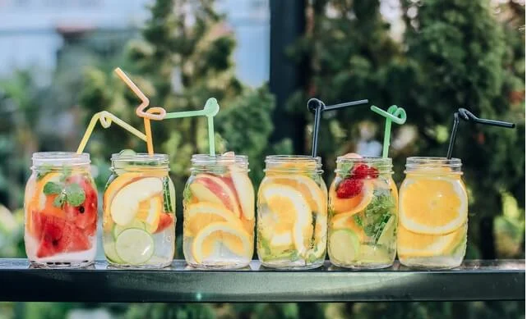
Non alcoholic fun!
Going alcohol-free for dedicated months are well-established campaigns in the UK, but the decision to ditch drinking on a longer term basis is growing.
This means there’s a potential business opportunity to cater to this market, offering sober alternatives to traditional pub culture and other (often heavily drinking-oriented) leisure activities.
While there have always been people who don’t drink, and the concept itself isn’t new (we identified starting a low or no alcohol beer brand as an emerging business idea back in 2017), the idea to focus on non-alcoholic fun more widely offers a fresh perspective on this trend.
https://startups.co.uk/business-ideas/non-alcoholic-fun/
Notes:
There are a number of factors that can mean people don’t drink alcohol – whether it’s a decision to lead a teetotal lifestyle, religious, ethical, or medical reasons, or as part of the ‘sober curious’ movement who abstain from alcohol for a period of time. And, in turn, this abstinence calls for ways to have fun without alcohol.

Slide 11
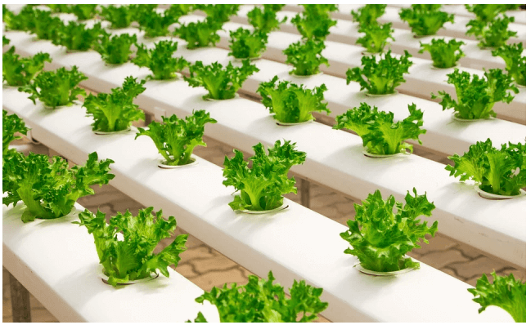
Urban Farming
Urban farming, put simply, is the cultivation and distribution of food in urban or densely populated areas. More specifically, this can mean the DIY growing of food (or even keeping of bees or farming of bugs!) in your own home, or the high-tech setups such as vertical farming and Controlled Environment Production (CEP).
Vertical farming is the indoor cultivation of plants in a stacked formation, allowing for several rows of crops to be grown in vertically arranged layers. The produce is grown in a controlled environment (light and temperature) and, in some cases, even without any soil (thanks to techniques such as hydroponics). The urban spaces used for this farming can be anything from abandoned warehouses to shipping containers.
Finally, as people become more concerned about exactly where their food is coming from, and with ‘field-to-fork’ on the rise, it’s unsurprising that there’s been a surge in restaurants, companies and individuals wanting to grow food themselves in the city.
One reason urban farming is likely to prove a lucrative business opportunity in 2020 (and far beyond) is due to its necessity in an increasingly urbanised world with a crippling demand for more food. In addition, the growth of the industry will continue to be driven by a growing demand for produce that is high-quality and grown without the use of pesticides, in a way that does not negatively impact the environment and climate.
Notes:
https://startups.co.uk/business-ideas/urban-farming/

Slide 12
Tailored pet nutrition and premium pet food
Similarly, an increasing number of owners seem to understand that, like humans, each animal is unique and would benefit from a diet that is nutritionally varied and tailored to their specific needs.
This means that more animal owners are now reluctant to pick up standard one-size-fits-all cans of processed animal food from the supermarket shelf. Instead, they want to invest in healthier, premium pet food which boasts natural, balanced, ‘human-grade’ ingredients and alleviates specific health problems – anything from skin issues and obesity to diabetes.
The pet industry has long been a lucrative option for entrepreneurs thanks to its consistent year-on-year growth; the UK pet care market grew steadily from $3.4m in 2010 to $4.8m in 2019, and it's expected to reach $5m in 2020.
Despite the recent influx of businesses focused on premium and wholesome (non-processed) pet food, there are still plenty of chances for breaking into this market.
Notes:
https://startups.co.uk/business-ideas/tailored-premium-pet-food/

Slide 13
From the Topic notes
According to the Department of BIS [Business, Innovation and Skills] data, 99.2% of all UK businesses are defined as ‘small’ (i.e. they have between 0 and 49 employees).
SMEs make up 67% of UK private sector jobs.
Interestingly, this 99.2% of businesses is responsible for 47% of all private sector employment in the UK, and around one third of all turnover created by private enterprise.
Think & Share
Is this good / bad for the economy? Why / why not?
How do entrepreneurs contribute to the economy?
Notes:
5 minute discussion

Slide 14
Why are SMEs/entrepreneurs important for the economy?
Create businesses that hire people
Add to national income
Crate demand for products which in turn create jobs for other businesses
Introduce new technologies to the market
Community development

Slide 15
Activities – Read page 2 of the workbook and complete the activities on page 3
Identify 3 features of a successful start up.
In a short paragraph, explain how SMEs contribute to the economy.
Using the computers:
Carry out research to identify and investigate a successful SME in your local area.
Choose a business that you are interested in!
Find out:
What makes the business successful?
What inputs (factors of production) are required to meet the needs and wants of customers.
How could the business be improved?

Slide 16
Plenary
“Big businesses make the headlines, so why bother about the growth of small businesses?”
Do you think this statement undervalues the importance of SMEs to the UK economy?
(justify your response)
5
minutes
Notes:
5 minutes writing / 5 minutes chat
Write down response first. Then choose students (ideally with differing responses) to share with group.
Whilst students are writing response, circulate room checking knowledge and understanding via points being made.

