Slide 1
Introduction to Geography
A Level

Slide 2
WELCOME TO GEOGRAPHY
Expectations of the department
You must be organised. Get a ring binder and make sure you keep all of your booklets and notes in it.
Bring stationary to class e.g. pens, highlighters, paper.
Bring current booklet to classes.
Complete and submit homework on time – your teachers will advise you of submission arrangements e.g. via Teams.

Slide 3
Classrooms arrangements due to COVID 19
Classrooms have been set up by the Estates team to maintain distance between the students, and 2m from the teacher.
Students will then sanitise their hands as they enter the room.
Students will take wipes on entry to the classroom and are to wipe down ‘touch surfaces’ including their desk and chair at the beginning of the lesson.
The used wipes will be kept on the floor under the students’ desk and taken to the bin at the end of the lesson as the students leave the room.
Students will then sanitise their hands as they leave the room.
Booklets/hand-outs - Students will collect their own copy as they arrive having just sanitised their hands.
Students will remain seated and at their desks wherever possible during the lesson.
Students will use the same seats for all lessons in a specific classroom to reduce movement.

Slide 4
Lessons – Blended Teaching
We will be giving out booklets in lessons. You need to ensure you bring these to lessons or have them available if teaching via Teams.
Classes will be split in half with half the class in the room and half accessing the lesson via Teams at home for at least the first 4 weeks of teaching. We expect students to have their camera ON when in lessons.
You will need some form of technology in lessons. This will be for research and submission of work. Ideally a laptop or tablet is needed – ensure it is charged and you bring a charge pack with you. You won’t be able to charge these in lessons due to the risk of trailing wires.
Make sure you have Word and Teams. If you go to office.com you will be able to download all Office products for free using your college log in.

Slide 5
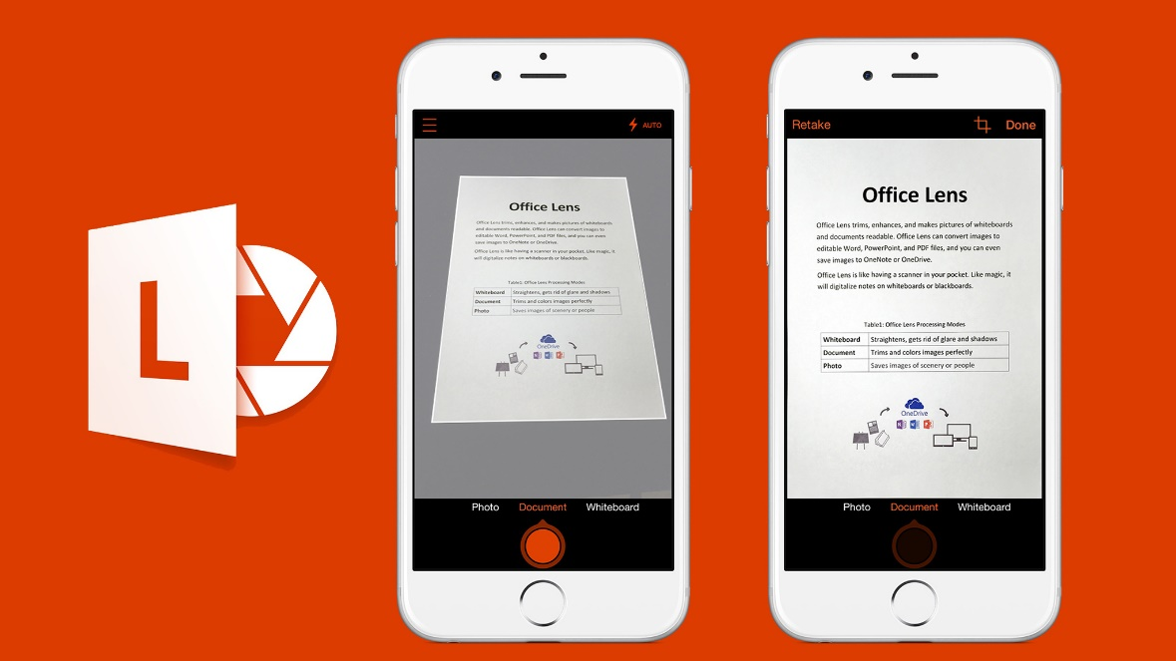
Online Work Submission – Microsoft Teams
NOTE: Please only upload work for submission as one document rather than individual pages.
If you do not have a scanner at home this app can be used.
Office Lens
This can be searched and downloaded for free on your phone.
You then use it as a 'scanner' taking pictures of each page of a document.
It will collate the pages as one document.
You can then be email the document to your inbox to upload or directly upload to Microsoft Teams.

Slide 6
Topics covered:
PAPER 1 - PHYSICAL | PAPER 2 - HUMAN | NEA: GEOGRAPHY FIELDWORK INVESTIGATION
YEAR 1 Coastal systems and landscapes Hazards | YEAR 1 Changing Places Contemporary urban environments | Students complete an individual investigation which must include data collected in the field. The individual investigation must be based on a question or issue defined and developed by the student relating to part of the specification content.
YEAR 2 Hazards Water and the carbon cycle | YEAR 2 Global systems and global governance

Slide 7
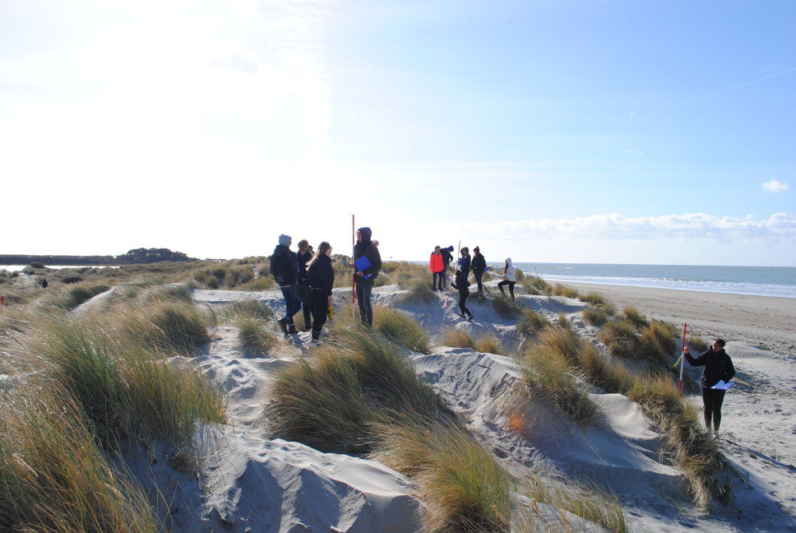
Fieldwork
Fieldwork is an essential component of studying Geography and each year the department runs compulsory fieldtrips, designed to provide excellent preparation for students to complete their independent investigation.
Students are required to complete the fieldtrip visits as part of their final assessment and will cover fieldwork tasks for both physical and human geography.
Provisional Date(s) and destinations:
West Wittering: Friday 6th and Monday 9th November 2020 (one day only)
Godalming: Provisional w/b 23rd November and w/b 30th November 2020 (one day only)
Guildford: w/b 22nd March and w/b 29th March 2021 (one day only)

Slide 8
ASSESSMENT PLAN
BENCHMARK 1: October half term Coasts Changing Places Comprised of shorter exam questions.
BENCHMARK 2: 2nd half of Autumn term Coasts Changing Places Comprised of shorter and longer exam questions.
BENCHMARK 3: 2nd half of Spring Term Coasts Contemporary Urban Environments Comprised of shorter and longer exam questions.
BENCHMARK 4: around May half term Coasts Changing Places and Contemporary Urban Environments Comprised of shorter and longer exam questions. This results will lead up to the formation of your Annual Review Grade. This grade will be predominately based on the result of this benchmark and consider other benchmark and work across the year. This grade forms the basis of your predicted grade for university/apprenticeships.

Slide 9
The exam papers for the A-Level
Paper 1: | Paper 2: | NEA - Coursework
Physical Geography | Human Geography | Independent Investigation
40% of A Level grade | 40% of A Level grade | 20% of A Level grade
2 hour 30 minutes exam | 2 hour 30 minutes exam | 3000 – 4000 words
120 marks | 120 marks | 60 marks
Questions on Water and Carbon worth 36 marks | Questions on Global Systems and Global Governance worth 36 marks
Questions on Coasts worth 36 marks | Questions on Changing Places worth 36 marks
Questions on Hazards worth 48 marks | Questions on Contemporary Urban Environments worth 48 marks

Slide 10

Recommended Text Book
Hodder AQA A Level Geography
ISBN 978-1-4718-5869-7
This is available with other resources in the ILC and also as an eBook on Browns VLE.

Slide 11

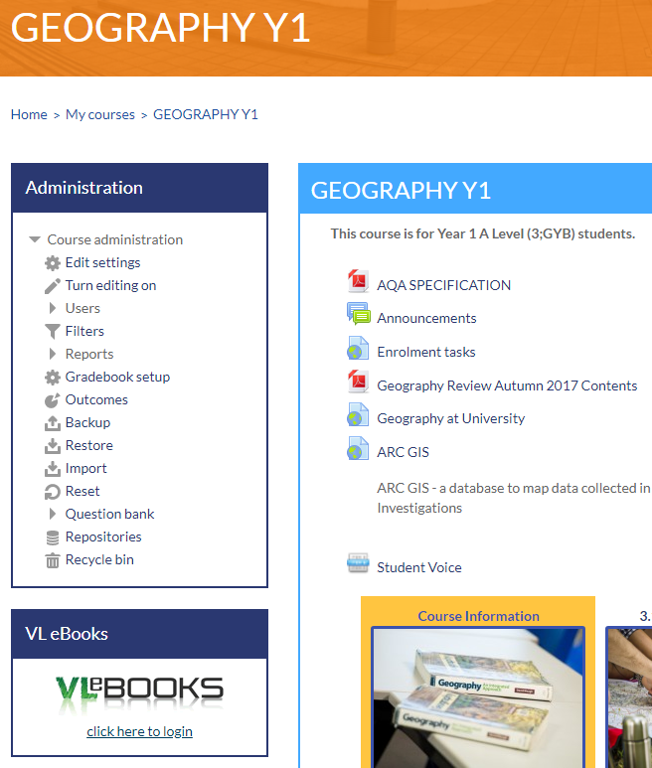
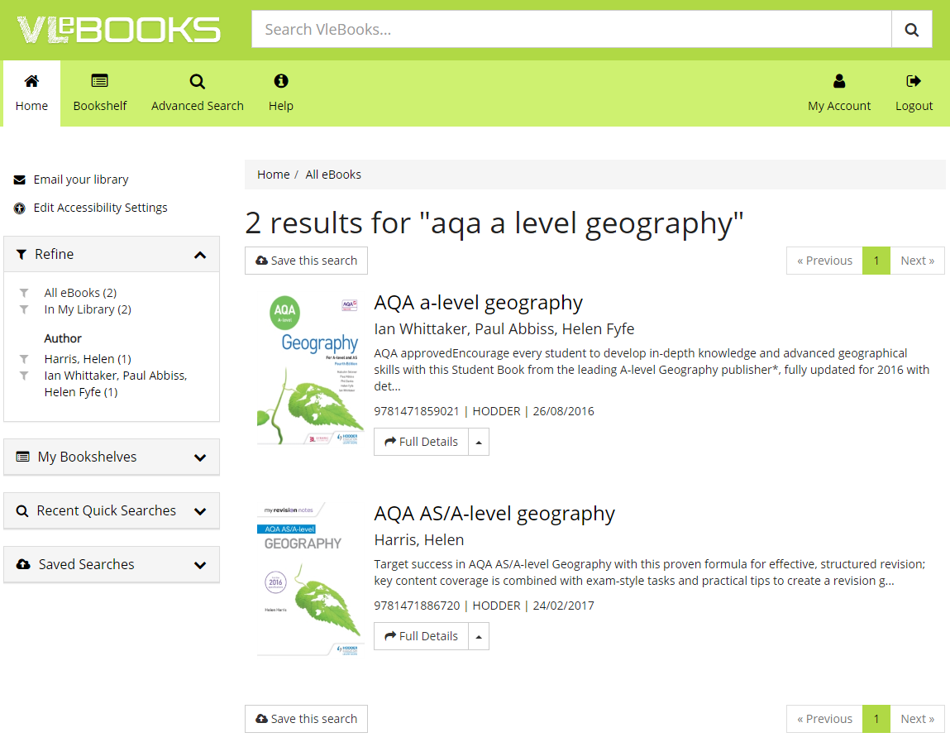
Finding an eBook on Browns VLE using Godalming Online.
Step 3: Type aqa a level geography into the search bar.
Step 1: Go to Godalming Online, Geography Y1.
Step 4: Click on the book you want to open where you will have options to read online, download and add to your bookshelf.
Step 2: Go to VLeBOOKS and click on ‘click here to login’
Text book
Revision Guide

Slide 12
Other considerations:
Please check your college email regularly and empty your deleted files regularly to ensure you get all of your mail.
Phones must be put in bags unless we explicitly ask you to use them in class. Visible phones will be taken off you.
Lanyards must be worn in all lessons.
The college’s minimum attendance is 90%. Any absence must be authorised by a parent/guardian by either ringing into college or emailing attendance@godalming.ac.uk It is your responsibility to contact a teacher to catch up on any work missed.

Slide 13
50:50
Homework does not necessarily need to be completed at home! You can use free periods during the day to complete these tasks outside of lessons.
To keep a good work/life balance, you might like to treat College as a 0900 to 1600 day and use your free periods in the library completing tasks.
Along with work set by teachers, on the handout are suggestions of additional work to do each week.
50/50 is a good way of thinking about this: 50% of the time spent on the subject will be spent in lesson but to be successful over the two years you should be matching this with the same amount of time in your own independent study of the subject.

Slide 14
Remember:
We are here to help and support you.
If you are not sure about any of the content being covered please get in touch, sooner rather than later.
It is not good enough to turn up to a lesson without homework claiming that you didn’t understand – check early and ask your teacher.
Use Godalming online and Microsoft Teams – lots of supporting material can be found on there.
Prepare thoroughly for benchmark assessments.
Come to a Department Workshop lunchtimes for some help. These will be advertised within the department.
The A Level Geography Handbook containing information about the course, assessment policy etc. can be found on GOL under Course Information.

