Slide 1
Introduction to Geography
A Level Year 2

Slide 2
WELCOME BACK TO GEOGRAPHY
A reminder of expectations of the department
You must be organised. Get a ring binder and make sure you keep all of your booklets and notes in it.
Bring stationary to class e.g. pens, highlighters, paper – due to COVID-19 we are unable to lend any resources to students.
Bring current booklet(s) to classes/online teaching.
Complete and submit homework on time – your teachers will advise you of submission arrangements e.g. via Teams.

Slide 3
Classrooms arrangements due to COVID 19
Classrooms have been set up by the Estates team to maintain distance between the students, and 2m from the teacher.
Students will then sanitise their hands as they enter the room.
Students will take wipes on entry to the classroom and are to wipe down ‘touch surfaces’ including their desk and chair at the beginning of the lesson.
The used wipes will be kept on the floor under the students’ desk and taken to the bin at the end of the lesson as the students leave the room.
Students will then sanitise their hands as they leave the room.
Booklets/hand-outs - Students will collect their own copy as they arrive having just sanitised their hands.
Students will remain seated and at their desks wherever possible during the lesson.
Students will use the same seats for all lessons in a specific classroom to reduce movement.

Slide 4
Lessons – Blended Teaching
We will be giving out booklets in lessons. You need to ensure you bring these to lessons or have them available if teaching via Teams.
Classes will be split in half with half the class in the room and half accessing the lesson via Teams at home for at least the first 4 weeks of teaching. We expect students to have their camera ON when in lessons from now on.
You will need some form of technology in lessons. This will be for research and submission of work. Ideally a laptop or tablet is needed – ensure it is charged and you bring a charge pack with you. You won’t be able to charge these in lessons due to the risk of trailing wires.
Make sure you have Word and Teams. If you go to office.com you will be able to download all Office products for free using your college log in.

Slide 5
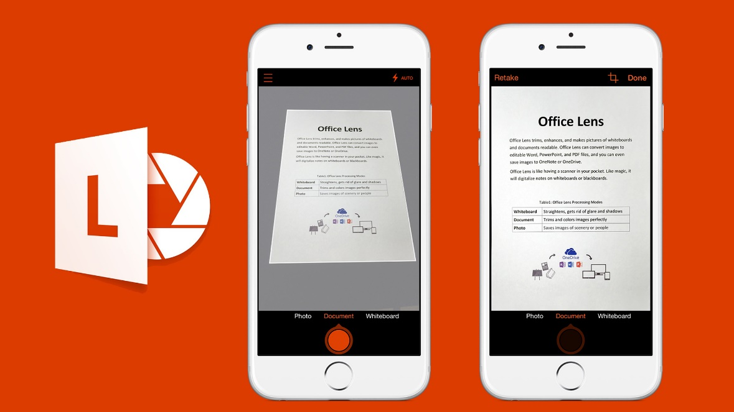
Online Work Submission – Microsoft Teams
NOTE: Please only upload work for submission as one document rather than individual pages.
If you do not have a scanner at home this app can be used.
Office Lens
This can be searched and downloaded for free on your phone.
You then use it as a 'scanner' taking pictures of each page of a document.
It will collate the pages as one document.
You can then be email the document to your inbox to upload or directly upload to Microsoft Teams.

Slide 6
Topics covered:
PAPER 1 – PHYSICAL (40%) | PAPER 2 – HUMAN (40%) | NEA: GEOGRAPHY FIELDWORK INVESTIGATION (20%)
YEAR 1 Coastal systems and landscapes Water and the carbon cycle | YEAR 1 Changing Places Contemporary urban environments | Students complete an individual investigation which must include data collected in the field. The individual investigation must be based on a question or issue defined and developed by the student relating to part of the specification content.
YEAR 2 Hazards | YEAR 2 Global systems and global governance

Slide 7
Pre-work
At enrolment you were set pre-work on the Hazards and Global Systems and Global Governance topics.
  Hazards - research and create a fact file on 2 Hazard events. (Resource on GOL)
  Global Systems and Global Governance – complete pre-work booklet.
  NEA - locate and look through your pre-work and follow-up work for the Witterings and Godalming fieldtrips, and the pre-work for the Guildford fieldtrip. Refer to the NEA Skills Preparation Folder in the Independent Investigation Folder if unable to locate your own resources. Bring your NEA folder complete with workbook and folder to all Physical lessons in the coming weeks.
Global Governance and NEA booklets issued at U6 enrolment must be brought to your lessons.

Slide 8

Recommended Text Book
Hodder AQA A Level Geography
ISBN 978-1-4718-5869-7
This is available with other resources in the ILC and also as an eBook on Browns VLE.

Slide 9

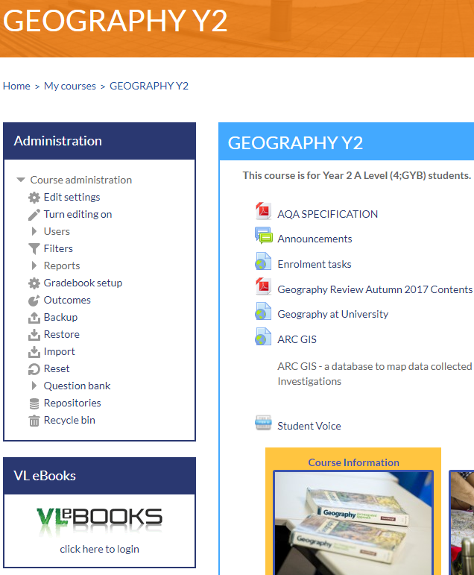
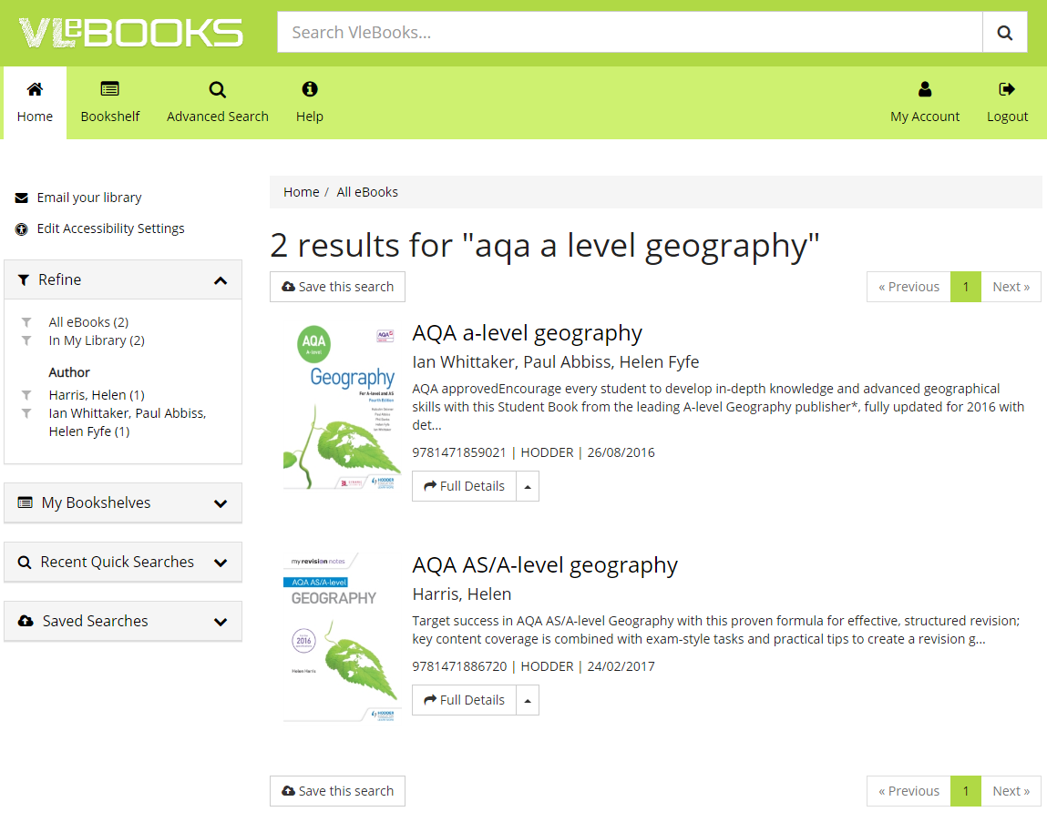
Finding an eBook on Browns VLE using Godalming Online.
Step 3: Type aqa a level geography into the search bar.
Step 1: Go to Godalming Online, Geography Y2.
Step 4: Click on the book you want to open where you will have options to read online, download and add to your bookshelf.
Step 2: Go to VLeBOOKS and click on ‘click here to login’
Text book
Revision Guide

Slide 10
PROVISIONAL ASSESSMENT PLAN
BENCHMARK 5: September 2020 Water & Carbon Cycles and Coasts Changing Places and Contemporary Urban Environment Comprised of short and longer exam questions.
BENCHMARK 6: November 2020 Water & Carbon Cycles, Hazards Global Systems & Global Governance and Contemporary Urban Environments Comprised of short and longer exam questions.
BENCHMARK 7 (MOCK): After February half term Water & Carbon, Coasts and Hazards Global Systems and Global Governance, Changing Places and Contemporary Urban Environments Comprised of short and longer exam questions.

Slide 11
Plan for lessons over the coming weeks
Week Beginning 7th September:
Exam Technique & Independent Investigation – 1 or 2 lessons (depending on timetable)
Global Systems and Global Governance – 1 lesson (depending on timetable)
Week beginning 14th September:
Exam Technique & Independent Investigation – 2 lessons
Global Systems and Global Governance – 1 lesson
Week beginning 21st September:
Benchmark Assessments
  Human and Physical benchmark in 1st lesson of the week.
Independent Investigation – 1 lesson
Global Systems and Global Governance – 1 lesson
Week beginning 28th September onwards:
Topic teaching:
  Physical Geography – 2 lessons per week Hazards
  Human Geography – 1 lesson per week Global Systems and Global Governance
NOTE: Please ensure you bring the correct folders and work to the required lessons

Slide 12
NEA/Independent Investigation
Due to the COVID-19 outbreak and the entering of lockdown it was not possible for us to start the NEA (Independent Investigation) last term.
Instead, the topic of Water and Carbon was taught and so we are on schedule to fully complete the course as planned.
The start of this term will be devoted to supporting you through the NEA and this will be delivered during your Physical Geography lessons.
You were asked to locate and look through your pre-work and follow-up work for the Witterings and Godalming fieldtrips, and the pre-work for the Guildford fieldtrip by the start of term.
All your work should have been kept, together with the NEA workbook, in a cardboard folder that was issued in class. You were asked to refer to the NEA Skills Preparation Folder in the Independent Investigation Folder if unable to locate your own resources.
Bring your NEA folder complete with workbook and folder to all Physical lessons in the coming weeks.

Slide 13
NEA/Independent Investigation – Key Dates
By Friday 18th September you must submit your completed proposal form to Microsoft Teams. An assignment will be set up for this.
By Friday 25th September proposal forms should be approved ready for you to collect your primary data.
Progress check to see you are on target for the final deadline week beginning 2nd November.
All work will need to be run through Turnitin plagiarism, checked and any amendments made prior to the final submission.
Provisional Final Deadline for coursework is Thursday 10th December.
Full details of Turnitin and submissions to follow.

Slide 14
Benchmark 5 week beginning Monday 21st September
Physical |  | Human
Topic | Tariff | Topic | Tariff
Coastal Landscapes | 4 x 1 | Changing Places | 4 x 1
Water Cycle | 1 x 1 | Contemporary Urban Environments | 3 x 1
 | 3 |  | 1 x 9
Carbon Cycle | 2 x 1
 | 6
NOTE: Resources are available on Godalming Online in the
Revision and Exam Practice folder to support your revision
and exam practice preparation for the benchmarks along
with the Exam Technique Booklet.

Slide 15
Resources on GOL to support your benchmark preparation
There are resources available on Godalming Online in the Revision and Exam Practice and Topic Folders to support your revision and preparation for the benchmarks along with the exam technique booklets issued in class last year.
Exam Technique Booklet
Issued in class last year and a copy can be found in the Revision and Exam Practice folder.
Review notes
Review notes sheets have been produced and set as work to complete by your teachers. These can be found under each topic area on GOL.
Hodder Workbook practice questions and answers
Practice questions and answers for all topics covered. These can be found in the Revision and Exam Practice folder.
AQA Exam Questions and Mark Schemes
All AQA published papers and marks schemes. These can be found in the Revision and Exam Practice folder.

Slide 16
The exam papers for the A-Level
Paper 1: | Paper 2: | NEA - Coursework
Physical Geography | Human Geography | Independent Investigation
40% of A Level grade | 40% of A Level grade | 20% of A Level grade
2 hour 30 minutes exam | 2 hour 30 minutes exam | 3000 – 4000 words
120 marks | 120 marks | 60 marks
Questions on Water and Carbon worth 36 marks | Questions on Global Systems and Global Governance worth 36 marks
Question on Coasts worth 36 marks | Questions on Changing Places worth 36 marks
One Question on Hazards worth 48 marks | Questions on Contemporary Urban Environments worth 48 marks

Slide 17
Geography A Level Exam Paper Structure
Paper 1 – Physical Geography (120 MARKS)
TOPIC | Section | Question and marks | Total
Water and carbon cycles | A (Question 1) | 4 (AO1)
 |  | 6 (AO3)
 |  | 6 (AO1 2 marks, AO2 4 marks)
 |  | 20 (AO1 10 marks, AO2 10 marks) | 36
Coastal systems and landscapes | B (Question 3) | 4 (AO1)
 |  | 6 (AO3)
 |  | 6 (AO1 2 marks, AO2 4 marks)
 |  | 20 (AO1 10 marks, AO2 10 marks) | 36
Hazards | C (Question 5) | 4 (AO1)
 |  | 6 (AO3)
 |  | 9 (AO1 4 marks, AO2 5 marks)
 |  | 9 (AO1 4 marks, AO2 5 marks)
 |  | 20 (AO1 10 marks, AO2 10 marks) | 48

Slide 18
Paper 2 – Human Geography (120 MARKS)
TOPIC | Section | Question and marks | Total
Global systems and global governance | A (Question 1) | 4 (AO1)
 |  | 6 (AO3)
 |  | 6 (AO1 2 marks, AO2 4 marks)
 |  | 20 (AO1 10 marks, AO2 10 marks) | 36
Changing places | B (Question 2) | 4 (AO1)
 |  | 6 (AO3)
 |  | 6 (AO1 2 marks, AO2 4 marks)
 |  | 20 (AO1 10 marks, AO2 10 marks) | 36
Contemporary urban environments | C (Question 3) | 4 (AO1)
 |  | 6 (AO3)
 |  | 9 (AO1 4 marks, AO2 5 marks)
 |  | 9 (AO1 4 marks, AO2 5 marks)
 |  | 20 (AO1 10 marks, AO2 10 marks) | 48
Timing = 120 marks in 2 hours 30 minutes

Slide 19
Other considerations:
Please check your college email regularly and empty your deleted files regularly to ensure you get all of your mail.
Phones must be put in bags unless we explicitly ask you to use them in class.
Lanyards must be work in lessons.
The college’s minimum attendance is now 90%. Any absence must be authorised by a parent/guardian by either ringing into college or emailing attendance@godalming.ac.uk It is your responsibility to contact a teacher to catch up on any work missed.

Slide 20
50:50
Homework does not necessarily need to be completed at home! You can use free periods during the day to complete these tasks outside of lessons.
To keep a good work/life balance, you might like to treat College as a 0845 to 1615 day and use your free periods in the library completing tasks.
Along with work set by teachers, on the handout are suggestions of additional work to do each week.
50/50 is a good way of thinking about this: 50% of the time spent on the subject will be spent in lesson but to be successful over the two years you should be matching this with the same amount of time in your own independent study of the subject.

Slide 21
Remember:
We are here to help and support you.
If you are not sure about any of the content being covered please get in touch, sooner rather than later.
It is not good enough to turn up to a lesson without homework claiming that you didn’t understand – check early and ask your teacher.
Use Godalming online – lots of supporting material can be found on there.
Prepare thoroughly for benchmark assessments – these are very important as seen this year.
Come to a Department Workshop lunchtimes for some help. These will be advertised within the department.
The A Level Geography Handbook containing information about the course, assessment policy etc. can be found on GOL under Course Information.

