Slide 1
Starter
Identify 4 features of a successful start up.
Briefly describe the three sectors of business activity
Give 2 examples of how SMEs contribute to the economy?
State and explain 1 of the four factors of production
Notes:
Necessity (satisfy a need / want)
Growth - Survival
Break even
Good understanding of their customer base
Meet objectives
Entrepreneur driving business forward (link to new learning)

Slide 2
Feature of a successful business
Necessity (satisfy a need / want)
Growth - Survival
Break even
Good understanding of their customer base
Meet objectives
Entrepreneur driving business forward (link to new learning)

Slide 3
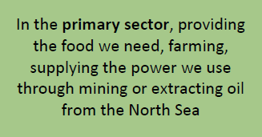
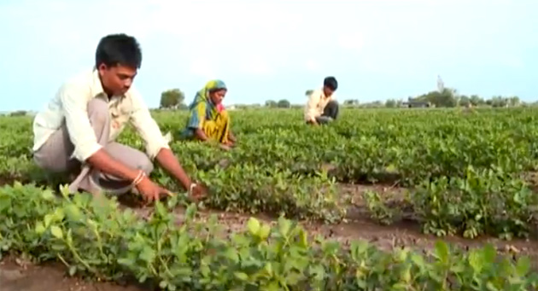
Primary Sector
Extractive – produces raw materials e.g. iron ore (goes into making steel) and oil (that makes petrol, plastics etc.)
Producing final products e.g. fish, oranges.

Slide 4
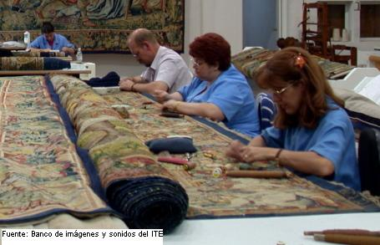
Secondary Sector
Manufacturing and construction industries make, build and assemble products

Slide 5
Tertiary Sector
Includes the provision of services.
Services give value to people but are not physical goods.
Direct services (to people e.g. police, hairdressing)
Commercial services (to business e.g. business insurance, financial services etc.)

Slide 6
Why are SMEs/entrepreneurs important for the economy?
Create businesses that hire people
Add to national income
Crate demand for products which in turn create jobs for other businesses
Introduce new technologies to the market
Community development

Slide 7
Factors of Production
Land – natural resources (e.g. coal, diamonds, forests, rivers), owners of land may receive rent from those that use it
Labour – workforce (manual, skilled and management)
Capital – money owners use to set up the business. Also capital machinery or tools.
Enterprise – the entrepreneur is crucial in business success, they will have the idea and then organise the other factors of production to carry out the activities of the business

Slide 8
Enterprise
Characteristics and motives of entrepreneurs

Slide 9
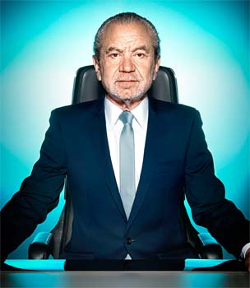
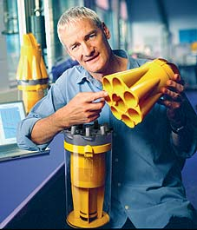
Think & Share Consider the successes of the following entrepreneurs... What characteristics/skills do they have?
Notes:
5 mins
Sir Alan Sugar, Dame Mary Perkins, James Dyson, Sophie Cornish and Holly Tucker, Sir Richard Branson
Use to instigate discussion. What are the similarities / differences between their skills / characteristics?

Slide 10
Learning Objectives
Explain the role of the entrepreneur in creating, setting up, running and developing a business
Explain the financial and non-financial motives of entrepreneurs
Explain the characteristics and skills of entrepreneurs

Slide 11
It takes risk and initiative!

Slide 12
Task – Characteristics of entrepreneurs
In the L2 workbook, rank these skills/characteristics in order of importance.
Write a brief justification of your top 3 choices.

Slide 13
The role of the entrepreneur
Owns (start up capital)
Organises (hiring / buying / decision making )
Take risks (loss of money / security)
Notes:
Choose students to share their responses before displaying on board
Discuss

Slide 14
The role of the entrepreneur in creating, setting up, running and developing a business
Organising – planning, instructing, prioritising, setting up systems, meeting deadlines, problem solving
Financial management – managing cash flow, budgets, accurate financial records, chasing debt, arranging loans/overdrafts
Communication – interacting with a wide range of stakeholders verbally and in writing
Managing people – important to recruit the right people, need to show leaderships skills
Decision making – being able to make decisions quickly and with consideration. This involves the ability to process, analyse and evaluate information
Negotiating – reaching agreements on prices with customers and/or suppliers. Being calm, assertive, reasonable and able to compromise
IT skills – useful to have but entrepreneur may employ people with specialist IT skills

Slide 15
Risk, reward and opportunity cost
Being an entrepreneur is risky. If the business fails:
May leave debts
May have left well paid employment
May find it difficult to return to working for someone else
Success and failure have an opportunity cost.
Opportunity cost = the benefits lost from the next best alternative
Notes:
Opportunity cost for a successful entrepreneur is likely to be lower than the benefits of owning a business.
If unsuccessful, the opportunity cost is likely to be higher. Unsuccessful entrepreneurs are likely to close the business.

Slide 16
Motivations of entrepreneurs
What would motivate you to start your own business?
Notes:
Build on work from the enrolment task
2 minutes for first part

Slide 17
Financial and non-financial motives
Financial | Non financial
To gain a profit (survival) | To be their own boss
To use redundancy money | Personal satisfaction
Grow personal wealth | To turn a hobby/passion into a business
 | Change in personal circumstances

Slide 18
Activities
Complete the rest of the L2 workbook (Characteristics and Motives of Entrepreneurs)
Use what we have discussed in the class, the lesson slides and the reading (Role of an Entrepreneur) to help you answer the questions.

Slide 19
Plenary
To what extent do you agree with the statement “All successful entrepreneurs are risk takers”
Do you agree / disagree?
Why / why not?
Justify your response.
Notes:
Do they agree / disagree? Why / why not?
Justify
Discuss other skills / attributes required to be a success...

Slide 20
Prep work for Monday’s lesson
1. Read the “Stakeholder Notes” at the top of the Enterprise page on Godalming Online.
Create a or mind map or a table which includes a definition of “stakeholder” and then outlines each of the stakeholder groups and their
2. Read through the “Assessment Objective Guidance” document on our main Business Team page. You should start learning the command words as part of your 50/50

