Slide 1
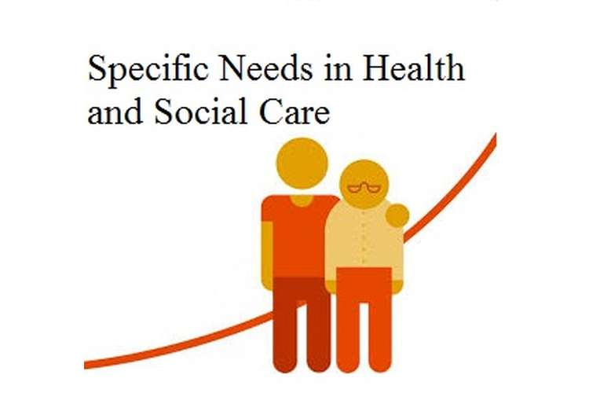
Unit 2 – Part 1
C1: People with specific needs

Slide 2
Learning Objectives:
By the end of this teaching block you will be able to:
Understand the role and responsibilities of a Nurse
Identify all 5 groups of people with specific needs.
Describe the specific needs of service users
Complete case studies to understand the holistic approach and implications in providing care for service users
Assessment practice – exam tips and complete an exam question

Slide 3
C1 People with specific needs
Read C1 from the Unit 2 Specification
Summarise C1 in your own words on the next slide
Discuss what you think this section of learning is about

Slide 4
what do you think C1 is about?
C1 People with specific needs
Ill health, both physical and mental
Learning disabilities
Physical and sensory disabilities
Age categories, which will include early years and later adulthood

Slide 5
Part 1 teaching and learning C1 People with specific needs
For C1 you are a Trainee Nurse doing your placement in a hospital setting for two weeks, working with a range of service users.

Slide 6
Objectives:
Over the next two weeks you will learn about the role of a nurse.
The C1 Workbook is about your first placement as a Trainee Nurse in a community hospital.
You will learn about some of the specific needs people may have and how standards are set and monitored for those working in this sector.

Slide 7
List as many jobs (on the next slide) as you can think of in the health and social care sector.
clues: NHS categories of careers, home care roles, residential roles, hospital and trusts
Remember: All of these roles are very important in the health and social care sector and there is a multi-agency approach applied to meet the different and specific needs that people may have.

Slide 8
List the roles here:
Doctors – GPs
Consultants
Registrars
Specialist Doctors
Care Assistant and Care Manager
Specialist Nurses including: Paediatric, Geriatric, Oncology, Mental Health
Healthcare Assistants
Nursery Nurses
Social Workers
Occupational Therapists
Physiotherapists
Support Worker

Slide 9
nursES
Nurses are the largest group of professionals working in the Health Services
Some choose to specialise in a certain area. You may even see a Nurse practitioner now in your GP surgery rather than a GP.
Adult Nurses
Mental Health Nurses
Children's Nurse (Paediatric)
Learning Disability nurses
District Nurses
Neonatal nurses
Health Visitor
Practice nurse
School nurse

Slide 10
Careers in nursing VIDEOS:
Watch these videos, then discuss why it is important that we have nurses?
https://mental health Nurse
https://www.youtube.com/watch?v=yk-nS_sys8I&feature=share
https://www.youtube.com/watch?v=UviWEJvz_V0&feature=share
https://www.youtube.com/watch?v=nTO8YtSA2jM&feature=share

Slide 11
THE ROLE OF THE NURSE:
Nurses have many different roles within health and social care:
Caregiver and comforter
Ethical decision maker
Protector
Advocate
Case manager
Communicator
Teacher
Leader

Slide 12
Skills and qualities
All health, social care and early years professionals need particular skills and qualities to assist them to do their jobs. Without these skills and qualities individuals may not receive the care and attention that they require.
Identify the skills and qualities needed by nurses to carry out their day-to-day work
Think about PIES skills…
What would you want a nurse to be like?

Slide 13
How do you become a nurse?
Explain what qualifications you need to become a nurse
What is the basic salary?

Slide 14
Question: If you were thinking about becoming a nurse, what specialism would you choose and why?

Slide 15
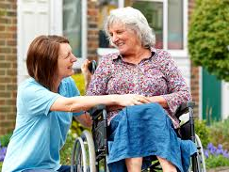
Service Users:
The people you will be working with are referred to as service users and they will have a variety of specific needs.
Question: Identify what some of their specific needs might be, so that you can begin to determine how you can best support them?
There are a range of service user groups that professionals in health and social care work with.

Slide 16
Service Users:
There are a range of service user groups that professionals in health and social care work with.
Team Task:
In your role as nurse identify 2 needs for each of these three individuals and how you could support them:
A child of 5 with a hearing impairment and diabetes
A 35 year old man who had a car accident and has suffered paralysis as a result of a brain injury
An elderly lady aged 79 years old with early signs of dementia

Slide 17
5 Groups of people with specific needs are:
Can you name the 5 main ‘groups’ of people with specific needs that you will meet whilst you are at your placement?
1.
2.
3.
4.
5.

Slide 18
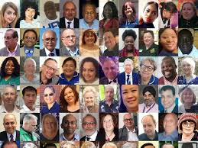
The 5 main ‘groups’ of people with specific needs are:
1. Physical and Mental Ill Health
2. Learning Disability
3. Physical and sensory disabilities
4. Early Years
5. Later adulthood

Slide 19
1. Physical and mental ill health:
When supporting people with physical and mental ill health, using a multi-disciplinary approach is usual practice.
Care professionals aim to take a holistic approach to meet the needs of the whole person.
People with mental health problems often have associated physical ill health.
Watch this video called: We're being forced to fix our own mental health and it's not working
http://www.theguardian.com/commentisfree/video/2016/mar/30/were-being-forced-to-fix-our-own-mental-health-its-not-working-video

Slide 20
THE Caption below the video link:
We are a nation of people waiting for mental health treatment, says journalist Deborah Coughlin.
She spent years battling an agoraphobic panic disorder, while being repeatedly fobbed off and put on waiting lists by the NHS. With people self medicating, taking inappropriate antidepressants and attempting suicide, she argues, the health service needs the ability to help people properly
Induction Booklet Task:
Consider the above and then answer question 1 in your workbook

Slide 21
2. Learning Disability:
Research by The Foundation for People with Learning Difficulties has found that between 25-40% of people with learning difficulties also suffer from mental health problems.
‘a reduced intellectual ability and difficulty with everyday activities… which affects someone for their whole life
Induction Booklet Task:
Consider the above and then answer question 2 in your workbook
Watch this video: http://www.youtube.com/watch?v=xFB0tczJW_8
Title of video: Working with people with learning disabilities- Camden Learning Disabilities Service

Slide 22
3. Physical and Sensory Disabilities:
Watch these videos and then do the Induction Booklet Task: Question 3
Disabling Environment- video 1
https://www.youtube.com/watch?v=vSG6LGutkHo&fs=1&hl=en%5FGB
Physical disability Talk to me - video 2
https://sites.google.com/site/wattshealthandsocial/new-btec-level-3/unit-2/learning-aim-c---working-with-peopel-with-specific-needs-in-health-and-social-care/people-with-specific-needs

Slide 23
4. Specific age groups - Early Years:
One age group that you will need to know about is the early years, and this includes babies and children.
Quick quiz about early years:
5 questions:
Which age group is early years?
Name 5 different childcare and education settings?
Identify three medical conditions that can impact on a child’s learning?
What is emotional wellbeing and how is this promoted in children?
Identify support a Trainee Nurse could provide for a child age 5 who has come into hospital with a broken leg? The child is on the Autistic Spectrum with social communication challenges

Slide 24
Specific age groups - Early Years:
Induction Booklet Task: Answer question 4 in your workbook
Question: Children develop holistically. What does this mean?
Question: When working with this age group in a registered setting you need to follow a specific curriculum. What is this curriculum called?
When planning the learning, care and education for babies and children, the curriculum covers 7 areas that need to be met to support holistic development.
Task: List the 7 areas of learning and development from the EYFS in your Induction Booklet

Slide 25
5. Later Adulthood:
The effects of ageing for most people are most acute in later adulthood.
List some of the effects of ageing in your workbook
Induction Booklet Task: Answer question 5 in your workbook including the ‘think higher’ question.
For the final part of the booklet:
CASE STUDIES: Read and complete the questions for each of the 5 case studies

Slide 26
EXAM TIPS for Unit 2
Practice exam type questions in class on a weekly basis to gain confidence
The aim is for you to read and answer a question in good detail and gain maximum marks
Read the question at least twice; Do you understand what knowledge and understanding is required to be demonstrated?
Highlight key words (i.e. identify, discuss, needs, explain etc…)
Highlight words you are not sure of and check their meaning
Research the topic and do a mind map of key phrases and words
Draft your answer - are you making your points clearly?
Use sentences and paragraphs with higher mark questions (6 or 8 marks)

Slide 27
EXAM PRACTICE TIME
Question:

Slide 28
EXAM PRACTICE question from blue practice assessment book
Answer here …

Slide 29
Glossary of key words to learn
Describe:
Discuss
Explain:
Identify:
Service User:
Early Years:
Later Adulthood:
Physical Health:
Mental Health:

