Slide 1
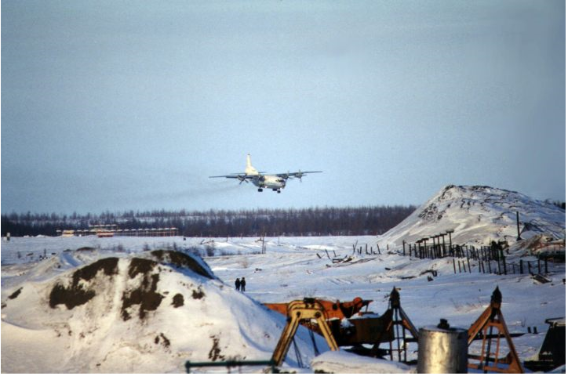
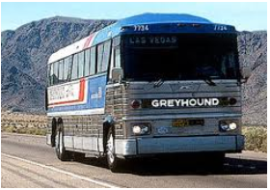
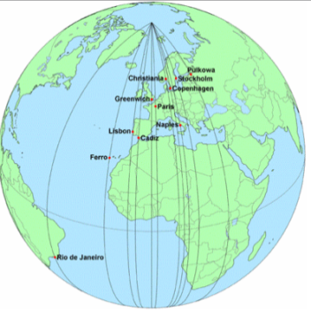
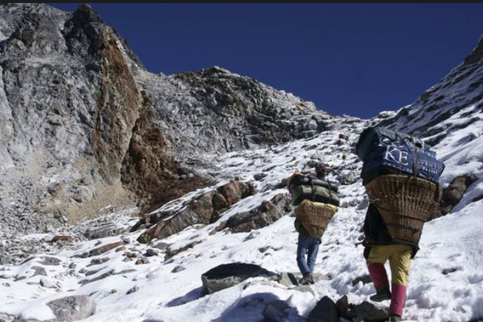
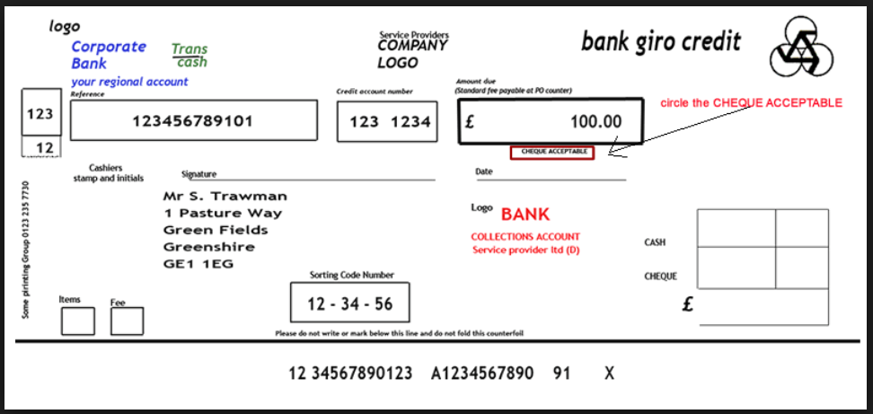
‘The Furthest Distances I’ve Travelled’
Unpack these images, their connotations and the order in which they appear on the page.
Come up with three or four themes that the poem could be highlighting, and comment on their structure (order).
Notes:
The poem moves from the expansive and exciting images relating to global travel, through the more mundane images of daily life back home, to images that are more tender – ‘souvenirs’ of relationships rather than places. Arguably that doesn’t necessarily resolve the poem’s meaning though.
Students could be asked to physically write out the appropriate image as it appears in the poem and look at its positioning in the text (juxtaposed with other images or building upon them in a list form). They could then analyse it in context as well as within the overall patterns that surround it.

Slide 2
Match these images to the verbal images in the poem and explore their significance,
thinking about the meaning of the poem along with its shape and structure

Slide 3
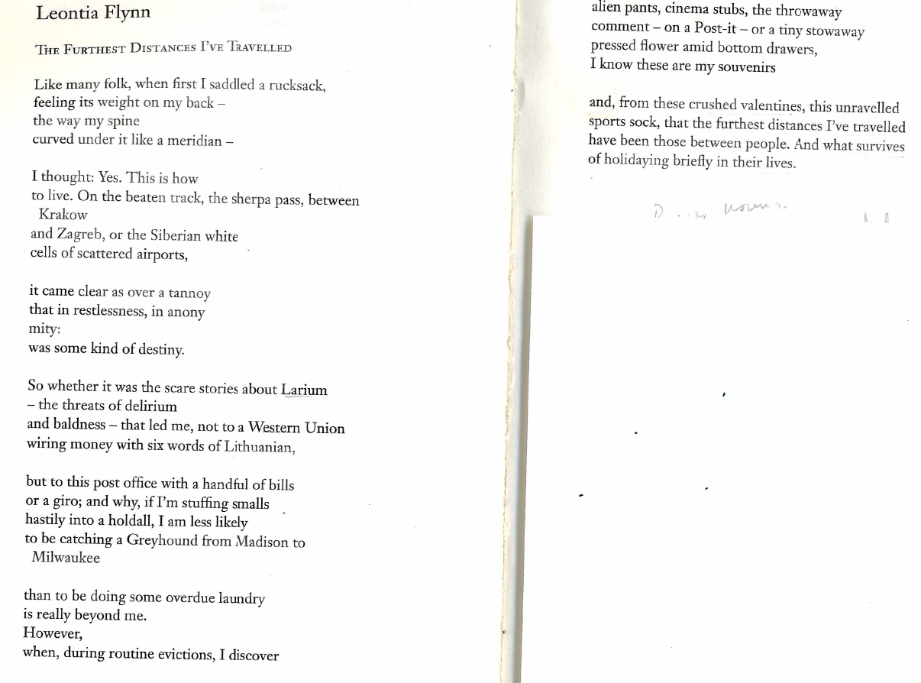

Slide 4
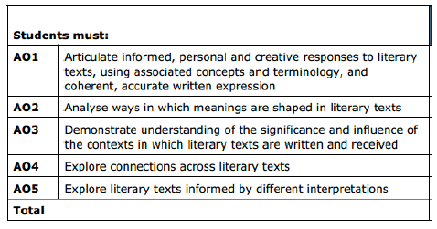

Slide 5
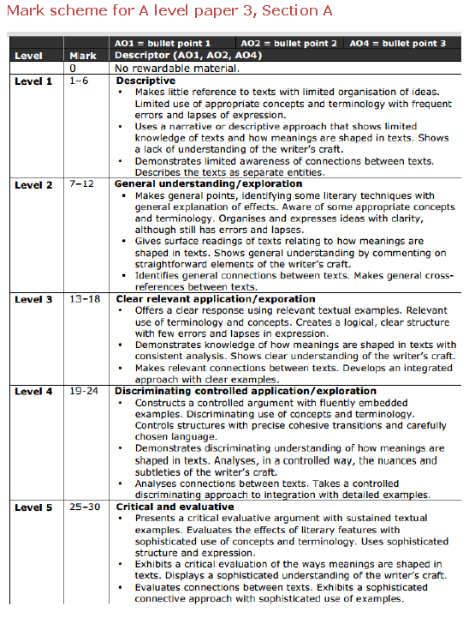
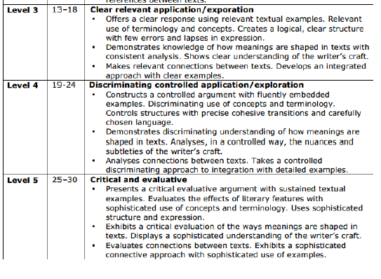

Slide 6
In pairs, compare these two poems according to the ways in which the two poets present the process of maturing into adulthood. How do the two poets do it?
Poems | ‘To My Nine Year Old Self’ | 'The Furthest Distances'/'An Easy Passage'
The premise of the two poems: comparing your reading of the two poems in relation to the theme with overview
Speaker/voice (1st or 3rd person, warm, chatty, intimate, formal, distant, demotic vs ‘poetic’)
Form and structure (changes and shifts; distinctive choices; free verse, rhyme, rhythm etc; shape on the page)
Key lines and patterns relating to theme (supported by comment on… imagery and figurative language, repetition (including semantic or lexical fields), diction, connotation, sounds, grammar)

