Slide 1
Week 2 - stylistics
Theory and practice
Notes:
Introduction. Aims and objectives: to revise some terms introduced in last week’s lesson; to explore the theory of stylistics; to apply dramatic and stylistic analysis to the text; to begin to think about the themes within the text. 5 mins

Slide 2
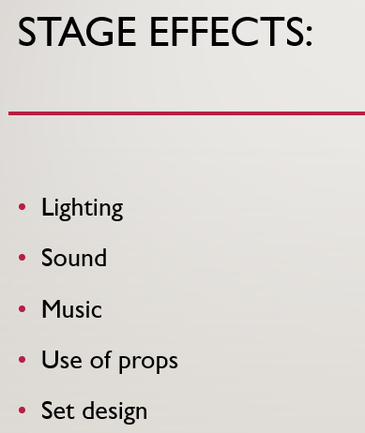
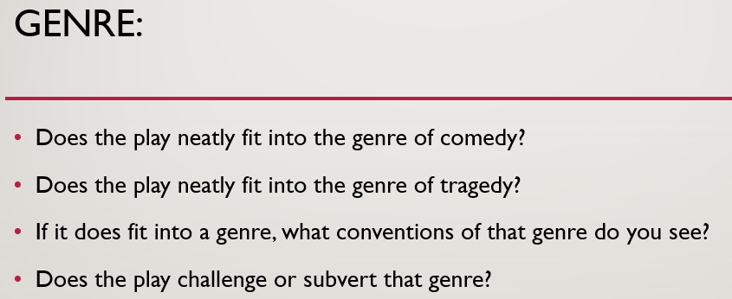
Dramatic features: what do you remember?
Notes:
Revision – question 5 mins

Slide 3
Your transformed lines
Look at the original and at the transformed text.
Decide what has been lost and what gained in the transformation.
You may choose to look at:
use of adverbs
use of tense
use of narrative perspective
use of analeptic references
Notes:
In order to remind the students of the role and techniques used by drama…. 5

Slide 4
Look at the original and at the transformed text, and decide what has been lost and what gained in the transformation. You may choose to look at: use of adverbs, the tenses used, the narrative perspective, use of analeptic references
JOHNNY. And he deserved it. Lippy bastard…
GINGER. Moonrakers, you broke the security camera then a week after they let you back, you pick a fight with a squaddie.
JOHNNY. I never started that. Bloody Rambo…
GINGER. First night back you set fire to the Christmas tree. Royal Oak, you were doing whizz off the bar during the meat raffle. Then on Kiddies' Fun Day you slaughtered a live pig in the car park.
JOHNNY. It was a rural display.
GINGER. With a flare gun.
JOHNNY. That was a bloody big weekend.
GINGER. Congratulations. You got the grand slam. To think they say it would never happen.
Beat.
“And he deserved it,” said Johnny “lippy bastard.” “Moonrakers, you broke the security camera then a week after they let you back, you pick a fight with a squaddie.” accused Ginger Johnny started indignantly, “I never started that. Bloody Rambo…” Ginger snorted. “First you set fire to the Christmas tree. Royal Oak, you were doing whizz off the bar during the meat raffle. Then, on Kiddies’ Fun Day you slaughtered a live pig in the car park.” Ginger whirled his arms around enigmatically. “It was a rural display.” Johnny slipped his hands into his pockets and looked down sheepishly. “With a flare gun!” Ginger was frothing at the mouth now. “That was a bloody big weekend…” A wince. More stares at the floor. “Congratulation, you got the grand slam. To think they said it would never happen.” With this final jab, Ginger flounced down onto a soaked and sagging couch. It sighed, spraying ancient debris across the ground.
Notes:
Read the two – respond 10 mins

Slide 5
Look at the original and at the transformed text, and decide what has been lost and what gained in the transformation. You may choose to look at: use of adverbs, the tense used, the narrative perspective, use of analeptic references
Enter GINGER from behind the trailer, singing:
GINGER. Unite and unite…In the merry morning of May!
Morning, Rooster!
JOHNNY. Morning Ginger.
GINGER starts robotics…
Ginger strolls from behind the trailer, singing joyfully whilst admiring the much-anticipated return of summer. "Unite and Unite, For Summer is a-come unto day, And wither we are going we all unite, In the merry morning of May". His exultation is fuelled by the arrival of summer, " Morning Rooster!" he shrills, "Morning, Ginger." he replied bluntly, clearly not sharing Ginger's excitement. Shrugging off Johnny's bland mood, Ginger bursts into dance as he begins to start 'robotics, moonwalking and doing ' the crouch' all at the same time'.
Notes:
repeat 10 mins

Slide 6
Or this one…
Visible speech tags – informing the reader how to understand the text
Increased detail and description – increased use of adjectives
Adverbs of time – not relevant in a script that unfolds as it is performed.
Interpretative verbs – leading the reader to an understanding
Physical description – not necessary in a visual medium.
GINGER. Here we go.
JOHNNY. Be nice.
GINGER. Here we fucking go.
JOHNNY. Oi. Play nicely. Ginger -
GINGER. I'm not saying anything.
Enter the PROFESSOR, smartly dressed, with wellies, through the wood.
PROFESSOR. Good morning, Mr Byron.
“Here we go”, commented Ginger, rolling his eyes.
Amused, Johnny replied, “Be nice”, with a slight edge to his voice.
“Here we fucking go”, barked back Ginger.
Now annoyed, Johnny said, “Oi. Play nicely. Ginger – ”
“I’m not saying anything,” interrupted Ginger, putting his hands up in a mock surrender, trying to hide the grin on his face.
The Professor sauntered out of the woods in an odd combination of a tuxedo with bright pink wellies. An expression of complete seriousness printed on his wrinkled face.
“Good morning, Mr Byron”, he drawled with a far away look in his glassy eyes.

Slide 7
Commentary
The use of adverbs increase the sense of the descriptive nature of the prose version
The inclusion of analeptic references (back stories)
The explicit recognition of the power balance between the two characters
The use of the third person narrative, with one character as the focaliser of the action
The distance from the characters in the prose version
The work that the writer does in the prose version, compared to that of the actor/director etc
Notes:
10 mins

Slide 8
One term you have learned?
Notes:
5 mins

Slide 9
A couple of terms
technique in drama where sequences of single or half or two-line speeches are spoken by alternating characters. It typically features repetition and antithesis. Derivation: Greek stikhos ("row, line of verse") + muthos ("speech, talk").
Notes:
As a class: to identify this term. 2 mins

Slide 10
stichomythia

Slide 11
The analysis of the physical space between characters on the stage: how close they stand to one another, the contact between them etc.
Notes:
Repeat with first hand up – no conferring. 2 mins

Slide 12
proxemics
Notes:
Remind them about the meaning of “soliloquy” – ask for meaning and spelling…. 2 mins

Slide 13
Read from the beginning…
PROLOGUE
A curtain with the faded Cross of St George. A proscenium adorned with cherubs and woodland scenes. Dragons. Maidens. Devils. Half-and-half creatures. Across the beam:
-THE ENGLISH STAGE COMPANY –
A drum starts to beat. Accordians strike up. The lights come down. A fifteen-year-old girl PHAEDRA, dressed as a fairy, appears on the apron. She curtsies to the boxes ad sings, unaccompanied.
PHAEDRA.
And did those feet in ancient time,
Walk upon England's mountains green.
And was the holy lamb of God,
On England's pleasant pastures seen.
She beams, pulls a string and the wings flap.
And did the Countenance Divine, Shine forth upon those clouded hills,
And was Jerusalem builded here,
Among those dark satanic –
Thumping music. She flees. The curtain rises upon…
From the start, we are made aware of the mythical elements of this play (Dragons. Devils etc)
There is the sense of metatheatricality in the way that it draws attention to the fact that it is a play (THE ENGLISH STAGE COMPANY)
The drums start to beat from the start – it is the first and last sound we will hear
Phaedra is a liminal character, existing outside the play itself, and aware of the audience (she curtsies to the boxes). She fulfils the function of the Greek chorus, introducing the play.
The song sets the mood for the play: the threat of industrialisation to rural England.
The contrast between her unaccompanied song, and the modern music (Thumping music) highlights these two worlds: ancient and modern.
Notes:
10 mins

Slide 14
Reading from the beginning….
Notes:
15 mins

Slide 15
Notes:
15 mins

Slide 17
stylistics
On the following slide are two explanations of "stylistics"
Your task is to paraphrase it so that a 10 year old could understand it.
You may use up to five sentences to do so.
Notes:
Hand out sheets of paper – each group can have either one or two. They need to read and agree on a definition that they feed back to the board. 20 mins

Slide 18
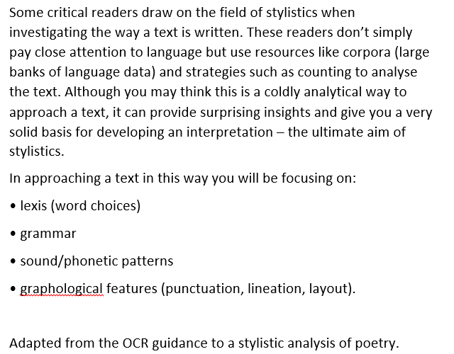
Choose either explanation… remember, you are re-writing it for a 10 year old….

Slide 19
Stylistics – a simplified version in three sentences.
An method used to help understand literature, where you identify the patterns made and the patterns broken. You look for patterns of words (lexis), or patterns of sentences (“parallelism”), or patterns of sound (“phonetic parallelism”). You can look for unusual use of words (“lexical deviation”) or grammar (“syntactical deviation”), or even unusual ways of presenting the words (“graphological deviation”).
Notes:
Compare to this version: what has been lost and what gained? 5 mins

Slide 20
Lexical repetition of noun “beard” (x2), foregrounding the focus of the text
There was an old man with a beard
Who said, “It is just as I feared
Two owls and a wren
Two larks and a hen
Have all made their nests in my beard.”
syntactical repetition of “Two… and a”: building the sense of the number of resident birds
Lexical deviation in the shift from indefinite article in line 1 to the first person possessive in the final line, to emphasise the focalisation on the old man here, in the use of direct speech
Notes:
Tongue in cheek illustration of stylistics in its diluted form 5 mins

Slide 21
So what does the question look like?
Explore some of the ways in which Butterworth presents power in this extract from Jerusalem.
You should consider the use of dramatic and stylistic techniques in the extract, its significance within the play and any relevant dramatic or other contexts.

Slide 22
Analysing the text
Your task is to annotate the text (pp 6-8).
With the focus on:
Dramatic (more “literary”) and
Stylistic (more “linguistic”) features.
Notes:
The students should prepare to present on pp 6-8 with the focus on either dramatic or stylistic features. 20 mins

