Slide 1
Scale of visitor attractions & ownership structures
A2

Slide 2
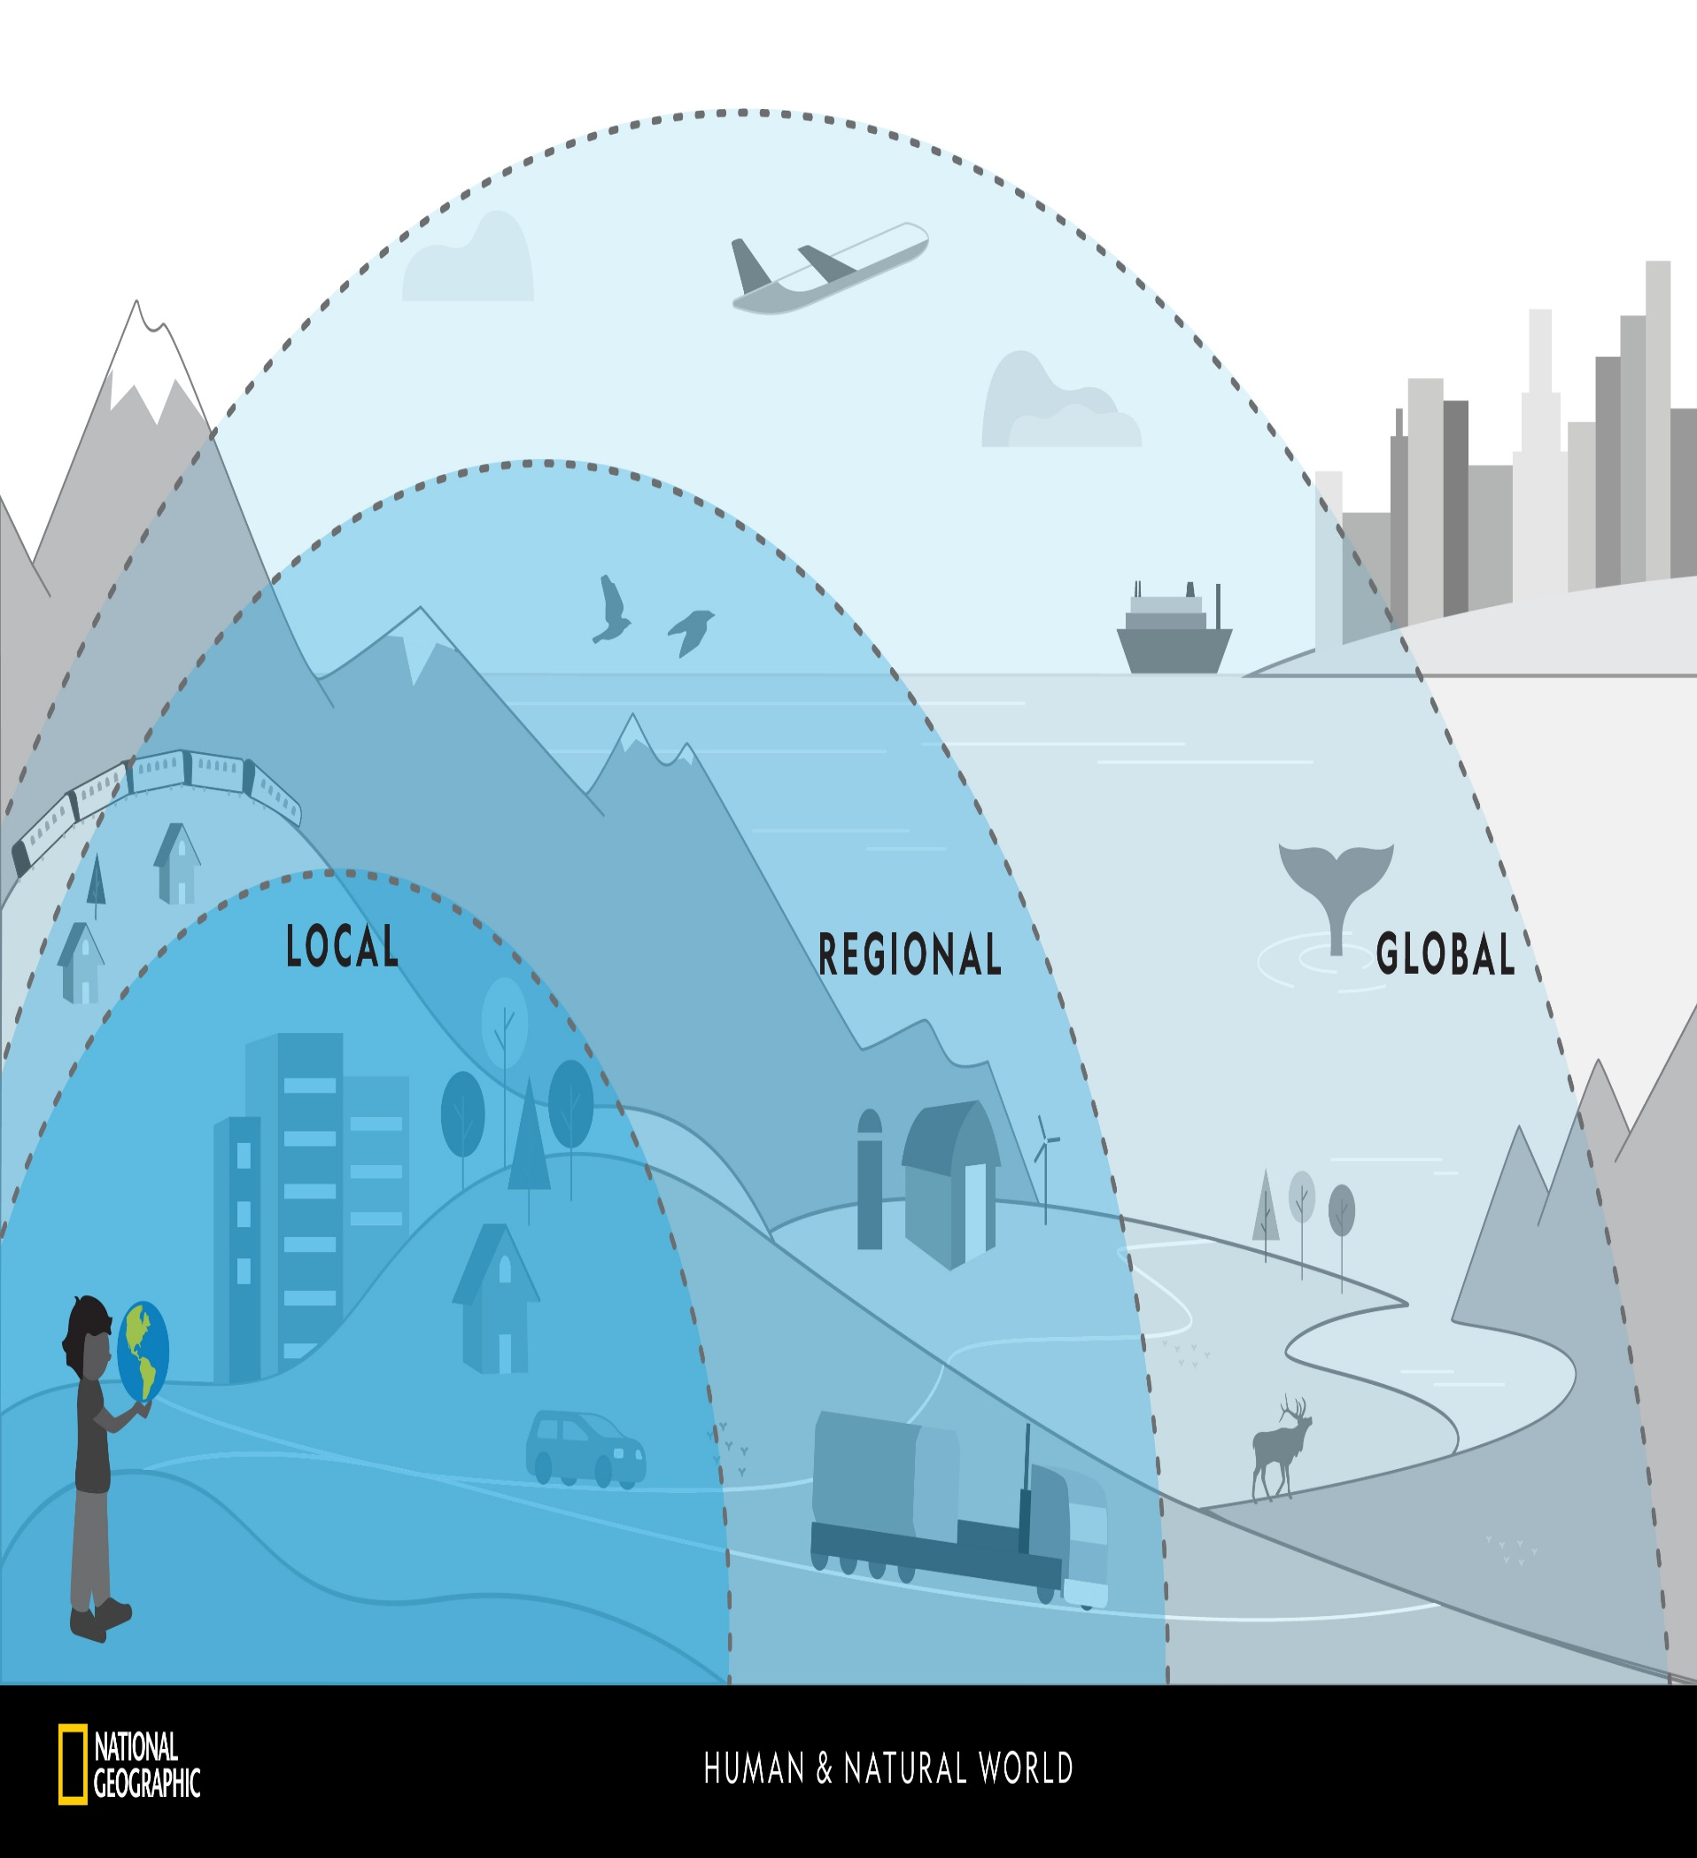
Scale
Scale relates to the size of an attraction and its potential customer reach (where customers come from to go the attraction)
International = Disney World / stonehenge
National = Eden project
Regional = Whipsnade Zoo
Local = Godalming museum

Slide 3
Scale of different attraction
Using our list of attractions from the previous lesson, make four columns and decide if the attraction is:
International
National
regional
Local
Now look at the attractions again and decide if they have an international, National, regional or local customer reach.

Slide 4
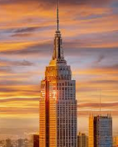
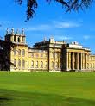
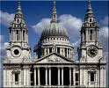
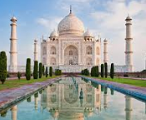
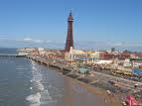
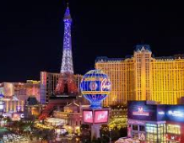
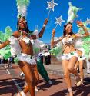
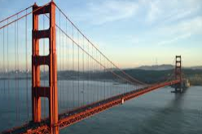

Slide 5
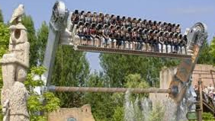
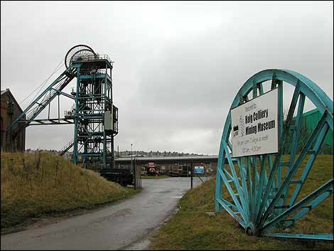
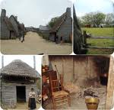
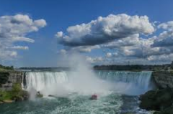
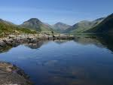
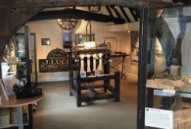

Slide 6
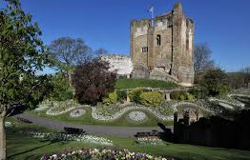
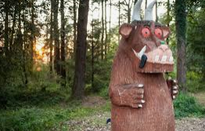
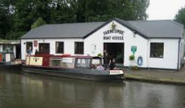
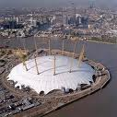
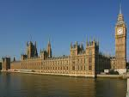

Slide 7
Ownership of attractions The 3 Tourism Sectors
Organisations in travel and tourism are often put into one of
three categories
Private Sector – These organisations are owned and operated by private individuals or partnerships. Profits made are for the people who own or have shares in the organisation
Public Sector – These organisations are owned and operated by local or central government
Voluntary Sector – These organisations are supported by voluntary contributions and grants. Many of, but not all of the employees will be on very low salaries or they may be working voluntary.

Slide 8
Objectives of Private Sector/Commercial Businesses
Satisfying
Customers
Profit
Environment
Survival
Image and
Reputation
Share Price
Objectives
Social Issues
Quality and
Innovation
Market Power
Efficiency
Sales and Sales
Revenue

Slide 9
Private / Commercial Organisations
private organisations can be categorised further by their size!
Large global companies e.g. Virgin Atlantic, Tui, Intercontinental Hotel Group. Expected to make a profit for the shareholders who have invested in the company.
Small to medium sized enterprises (SME’s), e.g. small independent hotels, attractions and travel agents. Aim again is to make a profit to keep their businesses running!

Slide 10
Non Commercial Organisations
How would you define the term non commercial organisation in your own words?
Non commercial organisations are generally regarded as voluntary or public organisations, and are funded by the government or through voluntary contributions. Their main aim is not to make a profit!

Slide 11
Aims and objectives of public sector services
To provide a service to the local residents
available to all regardless of location or income
services offered at prices that are cheaper than private sector or free at the point of use
available to anyone whatever their background, status, income, class, race, religion, etc.
Job Creation
Economic Growth
Enforce planning restrictions
Protect and conserve our countryside (National Park Authority)
Promote an area
Create regional/national identity
Enhance their image

Slide 12
Voluntary Sector Organisations
Types of organisations include:
Charities - WWF
Trusts – National Trust
Non Government Organisations – English Heritage
Pressure Groups – Tourism Concern
Community Groups – Gatwick Area Conservation Campaign (GACC)
Conservation Organisations – Tribal Voice

Slide 13
Aims and Objectives of voluntary organisations
Educate
Preserve
Inform
Conserve
Notes:
Laminated activity placing correct sentence with the heading.

Slide 14
Ownership Structure task
Take your list of attractions from earlier and lets see if you can identify their ownership structure….????
Also state if Would you regard the attraction to be simple or complex, be ready to justify your reasons?

Slide 18
Key economic terms
PRIMARY SECTOR - The primary or production sector are all jobs from which raw materials from plants and animals are obtained. In this group, we can find agriculture, farming, forestry, fishing and mining.
Secondary sector - Secondary Industries involves the transformation of the raw material into the finished or manufactured goods.
Tertiary sector - The Tertiary Sector is actually the service sector, which involves the giving away direct services to its consumers. It supplies services to the immediate consumers and the business houses and it includes services related to retail, transportation, hotels, sales and much more
Quaternary sector - is an improved form of tertiary sector as it involves the services related to the knowledge sector, which includes the demand for the information- based services like taking the consultancy from tax managers, statisticians and software developers

Slide 19
How do visitor attractions contribute to the local/national economy?
Visitor attractions can be incredibly important to both the local and national economy.
The bigger an attraction becomes, the more staff it will employ – this is positive for the local economy as employment opportunities can be sparse (think Alton Towers location). Additional employment means that more tax is also being paid.
Attractions can also be the beginning of the positive multiplier effect – leading to the regeneration and development of areas. The London Docklands has benefitted hugely from the opening of the O2 Arena (Millennium Dome), the Emirates Airline and other attractions such as The London Dockland Museum.
Tourists staying near attractions will also bring money into the economy as they will spend money in local businesses – further benefitting the local economy.

Slide 20
How do visitor attractions benefit the local and national economies
National
Local

Slide 21
What is the Multiplier effect?
Tourism not only creates jobs in the tertiary sector, it also encourages growth in the primary and secondary sectors of industry. This is known as the multiplier effect which in its simplest form is how many times money spent by a tourist circulates through a country's economy.
Money spent in a hotel helps to create jobs directly in the hotel, but it also creates jobs indirectly elsewhere in the economy. The hotel, for example, has to buy food from local farmers, who may spend some of this money on fertiliser or clothes. The demand for local products increases as tourists often buy souvenirs, which increases secondary employment.
The multiplier effect continues until the money eventually 'leaks' from the economy through imports - the purchase of goods from other countries.

Slide 23
Understanding Company Accounts
We will now look at the company accounts of Natural history museum
Take note of what information to look out for in these documents
When researching your visitor attractions, ask google to look for ‘company accounts for ???. This should then take you to ‘companies house’ website, go to ‘filing history’ tab and search for the latest account information pdf (this will usually be a long document at the top)
You can then download the document and search for the relevant information (income/profit/loss) and company statements into the financial trading year.

Slide 24
Scale of attractions
From what we have studied so far you should now start to see a correlation between the scale of an attraction, the way it is funded (links with their aims and objectives) and how they can benefit both local and national economies…..

