Slide 1
Travel and Tourism
Coursework Guidelines

Slide 2
Assignment Work
At the beginning of every new coursework learning aim, you will receive theoretical input and guidance and be expected to research around the subject area, preparing you for the assignment brief
Once the assignment brief is set you will have a period of approximately two weeks of controlled class assessment (and homework time) to complete the your first official assignment draft.
You must then by the set deadline date, upload the completed work to Godalming Online, YR 1 Travel and Tourism page.

Slide 3
Late Submissions
If you are late in uploading your work (the system tells me), then you are in breach of BTEC rules and will forgo the right to receive any formal feedback from your teacher.
Officially you get one resubmission attempt which will take place later in the term once the unit is complete or at a time

Slide 4
Unit 9 – Visitor Attractions
There will be three assignments within this unit of work, with the aim to be complete by the end of January.
Grades which you can attain are:
Pass - Explain
Merit - Analyse
Distinction – Evaluate/Justify
Your assignment will include all three grades therefore the more you are able to justify and evaluate the higher the grade you will get.

Slide 5
Unit 9 Grade Boundaries - A
Unit 9/A.P1 | Examine the appeal of two different visitor attractions and how they are funded
Unit 9/A.P2 | Explain the scale and scope of two different visitor attractions and their contribution to the local and national economy
Unit 9/A.M1 | Analyse the appeal of two different visitor attractions, how they are funded and the importance the visitor attractions have for the local and national economy
Unit 9/A.D1 | Evaluate the appeal of two different visitor attractions, the way they are funded and their contribution to the local and national economy

Slide 6
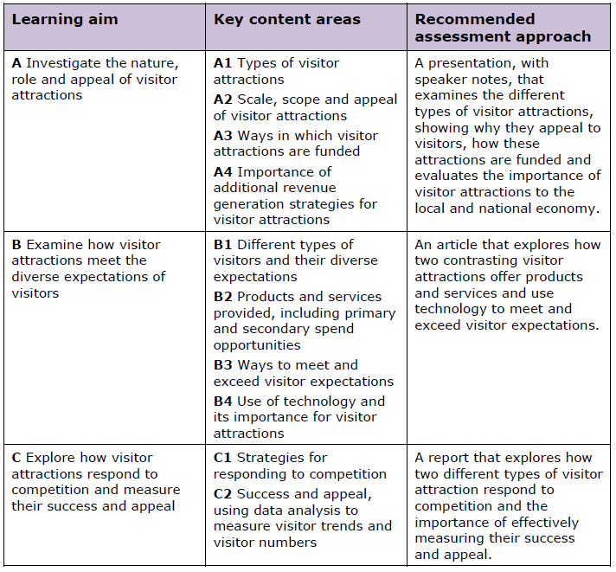

Slide 7
Organising Work
IT IS VITAL THAT YOU DO NOT LOSE YOUR COURSEWORK: Back up your work (College User Area? Cloud? Office 365? Home PC? USB Stick?)
Set up a Travel and Tourism Folder in your College user area.
Then set up a folder for each Unit.
Save each task into its relevant unit folder, with an appropriate file name (e.g. Learning Aim A).

Slide 8
Your Attraction Choices

