Slide 1
Setting up EduBlogs

Slide 2
SUBMITTING YOUR WORK
All your BTEC work for 2 years is submitted online, in a website you create and manage.
Create an account at https://edublogs.org/
In order to organise your website and your work to make it accessible to markers and moderators you’ll need to create a menu.
There is a help file we’ll follow together on GOL

Slide 3
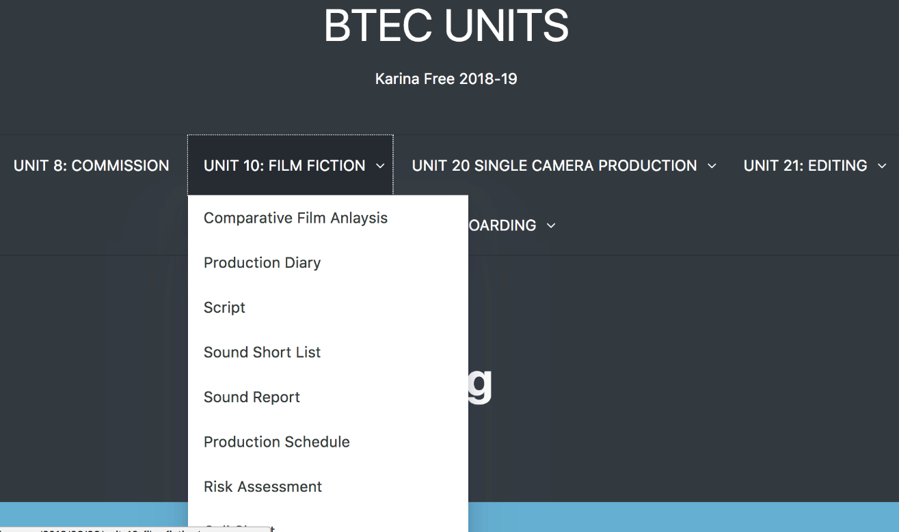
Your website
Eventually your menu will look like this
A student last year created this
Create your menu and add your Edward Scissorhands Task to it

Slide 4
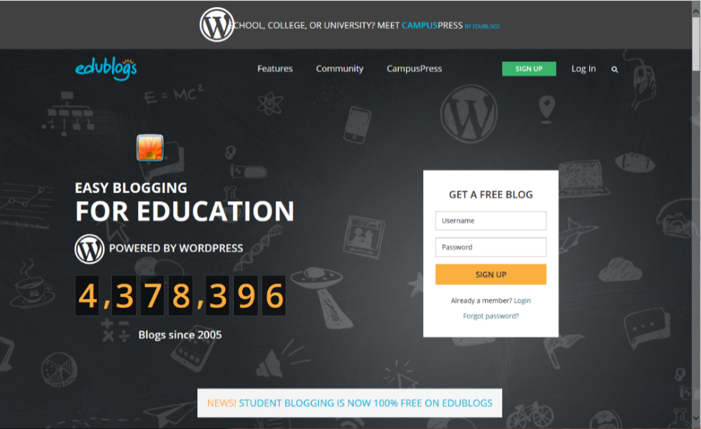
Step 1
1. Go to Edublogs.org homepage.
2. Enter your username, password and click Sign up.
Your username must be your initials followed by your student number
E.g. mat178989
Record your username and password in a safe location.

Slide 5
3. ON THE NEXT PAGE SELECT WHICH BEST DESCRIBES YOU.
4. ADD YOUR EMAIL ADDRESS (college account).
228989@godalming.ac.uk

Slide 6
5. ADD YOUR BLOG TITLE AND BLOG URL. (Same as username)
6. SELECT THE TYPE OF BLOG YOU WANT TO CREATE.
Matt Toogood’s Blog
mat228945

Slide 7
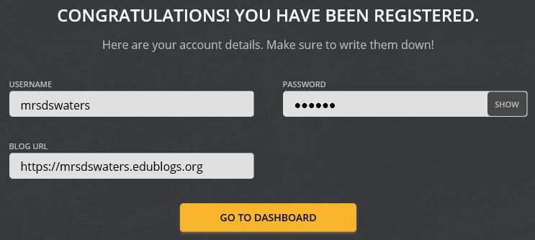
9. Click “Go to Dashboard” to access the dashboard of your blog.
Record your username, password and blog URL in a safe location.

Slide 8
7. SELECT ‘I AGREE TO TERMS OF SERVICE’ AND ‘I’M NOT A ROBOT’.
8. CLICK ‘CREATE A BLOG‘

Slide 11
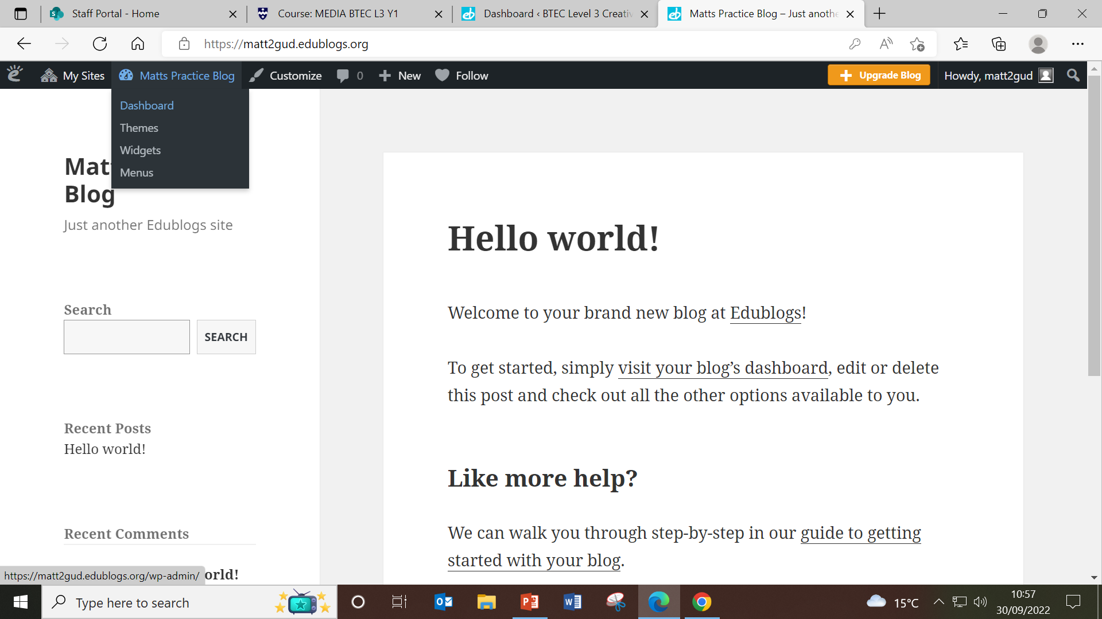

Slide 12
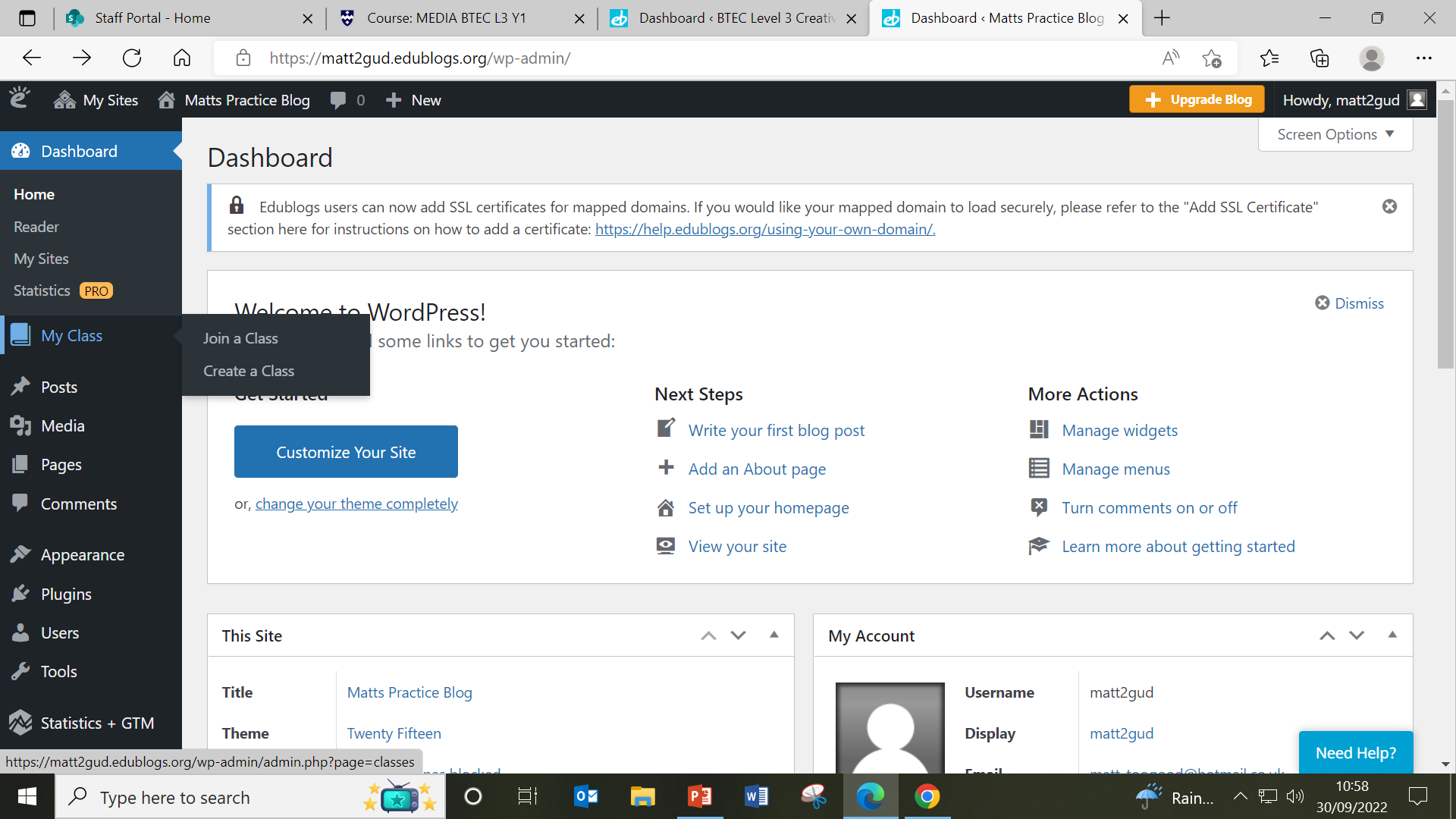

Slide 14
Search for your class blog by entering just the first part of your class blog’s URL. mvp1970

Slide 17
Personalise and Experiment

