Slide 1
Learning Aim A: Understand the values and skills required to work effectively in Health and Social Care

Slide 2
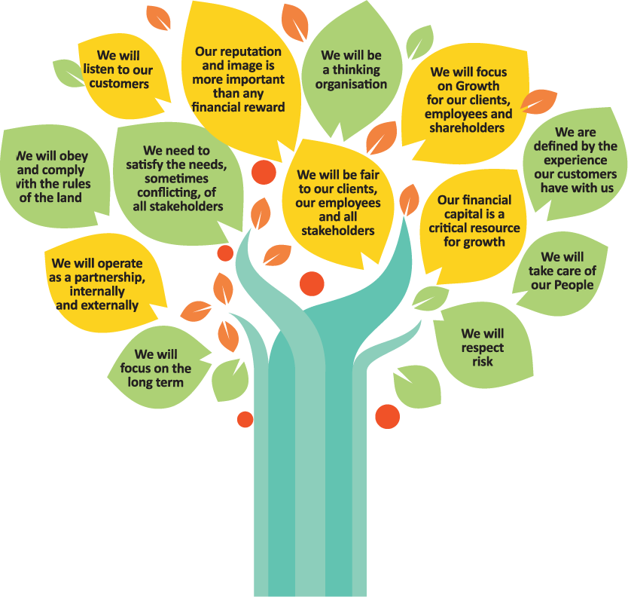
Understand the term ‘Values’
Values are beliefs and views that people hold about what is right or wrong.
Values are what is important to us in our life?
WHAT DO YOU VALUE IN YOUR LIFE?
Watch this:
https://www.youtube.com/watch?v=kOJu1vj_BVk

Slide 3
What are some of the values you might need to work in health and social care?
Dignity and respect for others
Learning and reflection (thinking about what you do and why you do things in a certain way)
Working together
Commitment to quality care and support

Slide 4
Demonstrate your values, behaviours and attitudes
Activity: You may not have experience of working in a health and social care role however you can still demonstrate that you have the right values.
Draw on your experiences from a hobby, work experience, home life, a previous job, volunteering or everyday living.
Complete the table of the values and behaviours employers would like to see, writing down examples of where you have used these in your life.

Slide 5
Values to work in health and social care | Your experiences
Spending time to listen to people and get to know them
Respecting people’s rights to make their own choices and decisions
Identifying when you need help if you are feeling a bit stressed
Working as part of a team and supporting others
Recognising and respecting that other people have different needs and priorities in their life
Being flexible and adapting to changes in your day calmly and with understanding

Slide 6
What is a skill?
A skills is the ability to do something well or to practise and become better at it such as listening well, drawing a picture, taking a photograph, writing a report etc…
Identify 3 skills that you have ….
The way that professionals work in health and social care is underpinned by a set of values that will influence positive working practices and enable positive relationships to be developed with service users and other professionals.
For example the 6Cs

Slide 7
Communication skills
Communication skills help us to develop positive relationships with individuals and help us to get on with people
4 main types of communication where we provide and receive information are:
written, verbal, visual or non-verbal
Good communication is recognising to listen actively, have positive body language, use appropriate language, observe and monitor behaviours and changes in others, identify barriers to communication and support individuals to overcome challenges, use a good tone of voice and facial expressions and body language that reassure individuals that you want to help and support them.

Slide 8
People skills
People skills help us to get on with others and build trusting relationships with them
Some essential people skills applicable particularly in health and social care that you can draw on in your report are:
Empathy – to share and understand the emotions of others, putting yourself in their ‘shoes’.
Patience - to listen, understand, remain non-judgmental and to accept or tolerate an issue without becoming annoyed or anxious
Sense of humour – to maintain a positive outlook and see the funny side of things
Problem-solve – looking for a solution, having the ability to ask the right questions and find answers, using initiative and team working effectively
Negotiate – listen, understand and attempt to reach an agreement about the care and support that will be most appropriate for an individual
Trust – develop trust with other professionals and the individuals so that they respect and trust you

Slide 9
Explain on the next slide how you can underpin each of these care values to your two case studies

Slide 10
6Cs | Case Study 1 | Case Study 2
Care
Compassion
Competence
Communication
Courage
Commitment

