Slide 1
Jerusalem - week three
Themes, Discourse and Power
Notes:
Introduction. Aims and objectives. 5 mins To introduce the idea of analysing the text through the lense of discourse. Revision of themes – links to quotes, analysed through dramatic features and stylistic features. Revision of power in conversation – application to the text.

Slide 2
Analysing the text
Your task is to annotate the text (pp 6-8).
With the focus on:
Dramatic (more “literary”) and
Stylistic (more “linguistic”) features.
What did you notice?
Notes:
The students should prepare to present on pp 6-8 with the focus on either dramatic or stylistic features. 20 mins

Slide 3
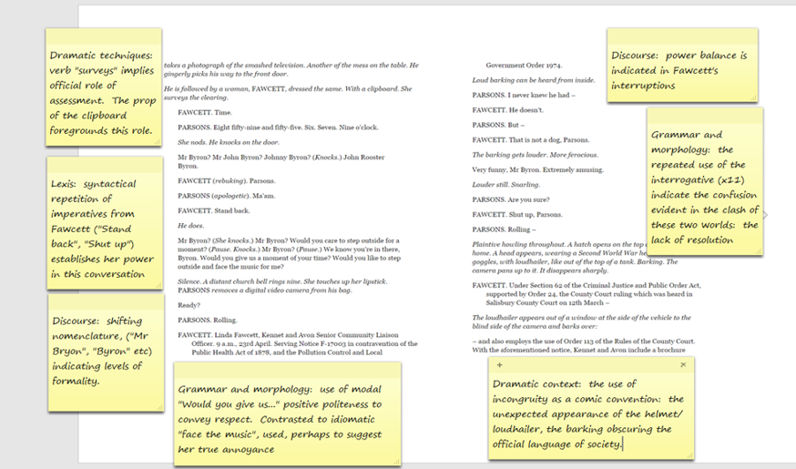

Slide 5
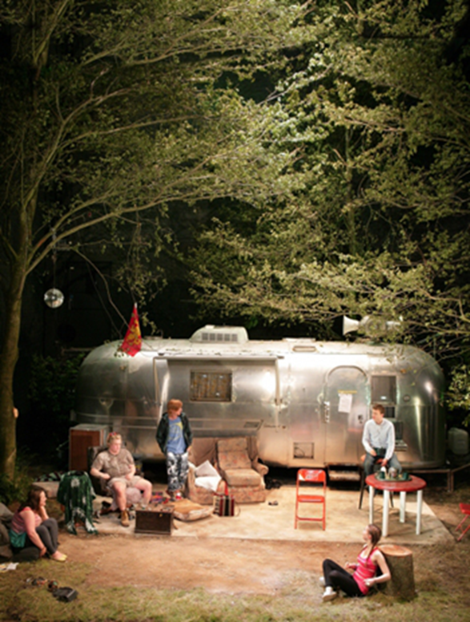
The themes…
Looking at this image of the set of
the original production of the play,
what do you see as the possible
themes of Jerusalem (i.e. what do
you think it might be about)?
Notes:
Snowballing discussion, prompted by images. Asked to find links between the images in terms of theme - ideas being written up at the front of the class. 10 mins

Slide 6
Natural (moon, trees, clearing)
V manmade (mobile home, chairs and tables etc)
Ancient (the wood, the wyvern flag)
v modern (the plastic furniture, the sofa etc)
community/unity (characters in a circle, listening to a speaker)

Slide 7
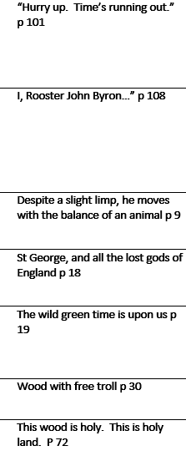
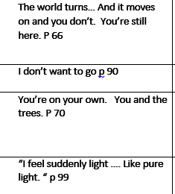
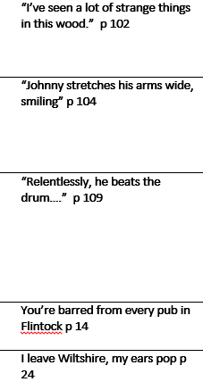
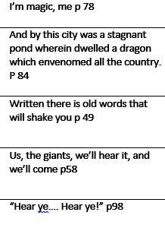
Link these quotes together – identifying as many themes as you can

Slide 8
The themes…
Any more that have emerged?
Notes:
Snowballing discussion, prompted by images. Asked to find links between the images in terms of theme - ideas being written up at the front of the class. 10 mins

Slide 9
To start you off…
“Englishness”
Role of myth in contemporary England
Anarchic v civilised world
Creation of stories
Truth/reality
Official and the anarchic
Society v the outsider
Urban v rural
Ancient v the modern
Love
Friendship
Loyalty etc etc

Slide 10
Annotating the text
Select one pair of quotes.
On a piece of A4, annotate the quote in terms of the use of lexis and syntax – linking them to the theme you had initially identified.
To be displayed.
Notes:
Create a wall display of axiomatic quotes, annotated and linked to theme. 20 mins

Slide 11
Discourse: what is it?
it describes the structure of any whole or partial text (spoken or written) that is longer than a single sentence.
One aspect is spoken discourse, where you could look at:
Adjacency pairs.
Agenda setting.
Terms of address.
Interruptions.
Turn taking etc.
Types of utterances: private conversation v public speech, quoted lines.
Notes:
Students to respond in a discussion. Compare to slide 5 mins Hand out pack of cards. The power/status game. Those who have picture cards are very powerful in a meeting. Etc. Discussion about what happens to those who have power. Add in status dimension. What happens to those who have high power but low status cards etc. 10 mins

Slide 12
Read on to P 18
p 14 Repetition of stage direction "beat" (repeated twice on p 14) – meaning pause – characteristic of this play, and echoing the beat of the drum
p 14 elliptical and simple, declarative sentences of Johnny ("Last night, you say" etc), foregrounding the sense of certainty about what happened.
p14 "Barred from every pub…" Johnny is now isolated in Rooster's Wood – his kingdom is shrinking
p 14 stichomythic exchange: "It was a rural display… with a flare gun", where Johnny defends his actions, and Ginger counters them.

Slide 13
p 15
p 15 Johnny anticipating Ginger's attitude – indicating the closeness of the two, and also the respect that Johnny has for the Professor
p 15 Contrasting costume of the Professor, foregrounding his difference from Ginger and Johnny, for example ("Smartly dressed"). The incongruity of the wellies and "smartly dressed" could be seen to signal his confusion.
p 15 term of address "Mr Byron" characteristically formal and archaic language of the Professor
p 15 Note the lack of taboo language from Johnny ("Morning, Professor etc") – he upwardly converges when he communicates with him.
p 15 Archaic language of the Professor's verse ("warlock", "roundelay", "all this upon" etc)
p 15 repeated interrogatives of the Professor (x3) indicating uncertainty

Slide 14
p 16
p 16 refusal of Ginger to upwardly converge – addressing the Professor as "mate" (x 3 on this page)
p16 declarative of "I'm a DJ" repeated twice, countered by Johnny's declarative ("He's an unemployed plasterer"): power matching between the two.
p 16 "Just a tick mate" – it is clear that Ginger has more power in this conversation than the Professor – able to control the turn allocation, and to not respond to his question "pure or applied?" Although "sorry" does indicate some degree of recognition that he has not be obeying the rules of conversation.
p 16 Ginger adopts the discourse ("sick beats" "ruckus) – sense of parodying the idiolect
p 16 Repeated interrogatives of the Professor (x4), as he requires clarification
p 16 Graphological deviation in the use of the italics (Doctor Maureen…) to emphasise the pre-modifier and to establish status
Important page to establish the contrasting worlds of Ginger and the Professor, to establish the archaic, confused character of the Professor and the unrealistic aspirations of Ginger.

Slide 15
p 17
p 17 parody of formal language ("meet our quotas") for humorous effect
p17 in turn, Johnny parodies Ginger's language ("Bring the ruckus")
p17 Here we see the feature of mistaken identity, so common in Shakespearean comedies, where the Professor thinks Ginger is Maureen, and Ginger reinforces his mistake ("that's right (x 2)
p 17 the conflict between the two worlds is evident in the contrasting vocabulary (Professor's archaic vocabulary and Ginger's adoption of subject specific lexis)

Slide 16
Conversational Power – instrumental and influential
If you have power through your status (instrumental power):
Interruptions
turn taking more often and talking for longer
Use of rhetorical devices
speaking more slowly and calmly
not responding to adjacency pairs
agenda setting
use of discourse markers to hold the floor
allocating the next speaker
If you want to gain power (influential power):
speaking more quickly
more loudly
Gesticulating
Agitated
little figurative language
Notes:
Compare to slide. Use this slide as a reference for the analysis of p 17 of Jerusalem. 10 mins. Discussion: decision about where the power lies, how we can tell, whether it is instrumental or influential power. 10 mins

Slide 17
Echoing of words, graphological deviation (italicisation) marking correction – assertion of power
Use of future tense: sense of certainty
Johnny: I’ll tell you what, Maureen.
Ginger: It’s Doctor Maureen.
Johnny: I’ll tell you what, Doctor. You pop in there, make us two bacon rolls. I’ll roll a spliff, we’ll spruce up. Get down in time for the floats.
Ginger: Only if you tell me I’m a DJ.
Johnny: You’re not a DJ.
Ginger: Just say it. Say, “Ginger is a DJ.”
Johnny: I’ll never say it.
Ginger: Say it.
Johnny: Never.
Ginger: Ginger is a DJ.
Johnny: Fuck off.
Ginger: Say it.
Johnny: No
Ginger: Say it.
Johnny: No.
Implied imperative: indication of instrumental power. “pop” – idiomatic and high frequency, to reduce sense of face-threatening . Nomenclature, (“Doctor”) used to parody, and undermine Ginger
Johnny’s responses become increasingly brief: from declarative to minor sentences
Johnny’s use of taboo language to counter Ginger’s ineffectual imperatives
Lexical repetition of “never”(x2) and “no” (x2) countering Ginger’s lexical repetition of say (x5) – indicating the ineffectual nature of Ginger’s imperatives

Slide 18
Re-Write this extract to re-dress the power balance.
Johnny: I’ll tell you what, Maureen.
Ginger: It’s Doctor Maureen.
Johnny: I’ll tell you what, Doctor. You pop in there, make us two bacon rolls. I’ll roll a spliff, we’ll spruce up. Get down in time for the floats.
Ginger: Only if you tell me I’m a DJ.
Johnny: You’re not a DJ.
Ginger: Just say it. Say, “Ginger is a DJ.”
Johnny: I’ll never say it.
Ginger: Say it.
Johnny: Never.
Ginger: Ginger is a DJ.
Johnny: Fuck off.
Ginger: Say it.
Johnny: No
Ginger: Say it.
Johnny: No.

Slide 19
Your essay – due in 29 September 2020.
How does Butterworth explore power from "Now we can see…" on p 6 to "PARSONS. Rolling" on p 8
You should consider the use of dramatic and stylistic techniques in the extracts, its significance within the play and any relevant or other contexts.
Notes:
Hand out annotated text. The students should use it to start an essay on the idea of power and how it is manifested in the text

Slide 20
Your favourite quote or term so far….
I’ve never seen the point of other counties. I leave Wiltshire, my ears pop. p24
Notes:
If time: pool ideas about favourite quotes or terms…

