Slide 1
How to save a PowerPoint to a pdf and keep the notes pages visible
This method should work for a standard PC – if you have a Mac, go to the print option and then select ‘with notes’ from the options on slide publishing format and finally print as a pdf

Slide 2

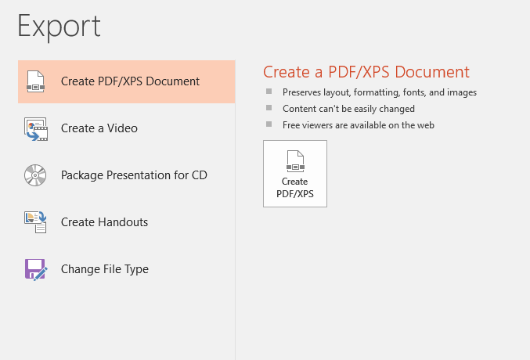
Go to your ppt
Select ‘Export’ from the orange menu on the left
Then create the pdf document as shown here

Slide 3
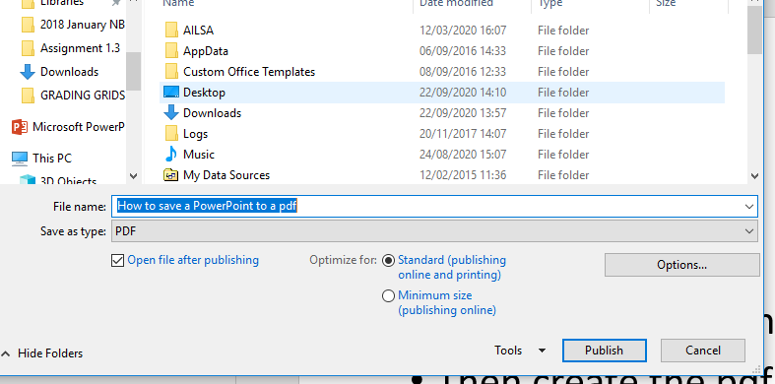
Then create the pdf document as shown here

Slide 4
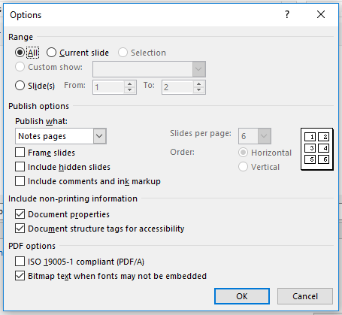
You should now be able to save it to your desktop ready to upload
Then select Notes pages from the Options and click OK

