Slide 1
AQA
    AS Level
      Computer Science
      Paper 2
Bits, bytes and binary
Data representation

Slide 2
Objectives
Understand how data is stored and processed in a computer system
Define bits and bytes, and use names, symbols and corresponding powers of 2 for binary prefixes (Ki, Mi)
Differentiate between the character code of a decimal digit and its pure binary representation
Describe ASCII and Unicode coding systems and explain why Unicode was introduced
Describe methods used for error-checking and correction

Slide 3
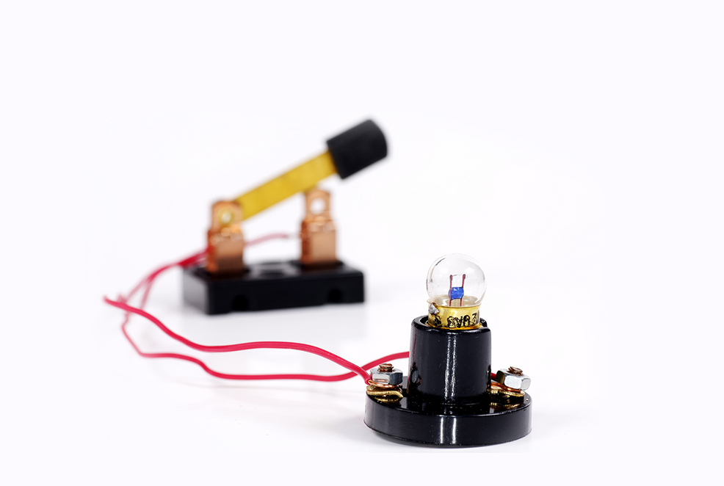
Creating a circuit
Computers comprise billions of switches to turn voltage on and off

Slide 4
Circuits
Use the keywords below to explain how this electrical circuit works:
+
_
Battery Switch Lamp

Slide 5

Electricity
A computer is an electrical device that works in the same way as a light bulb connected to a battery
  Data is stored and processed using combinations of ON and OFF voltages, equivalent to a lamp turning on and off where ON = 1 and OFF = 0
  These voltages are ‘transferred’ around the parts of the computer using wires

Slide 6
Representing values
Consider the value 21₁₀
  In binary we would represent this value as 10101₂
  As an electrical circuit this could be represented as:
1
0
1
0
1

Slide 7
Binary digits
Each individual digit in a binary value is referred to as a bit, (from the term binary digit)
In a computer we can represent binary values by using ON and OFF voltage signals for each individual bit
  For n bits a computer can produce 2^{n} different combinations of values
  How many combinations are there using 3 bits and what are they?

Slide 8
Bytes
As a binary value gets larger it will need more bits to store the number
A computer has fixed wiring that cannot be adjusted to accommodate more bits; instead it works with bits grouped together into units called bytes
A byte is a collection of 8 bits
Two or more bytes can be grouped together to hold larger values

Slide 9
Fixed bits
Consider the previous circuit model for 21₁₀
  By padding the data with three leading 0s, its definition can be extended to describe a complete byte of data (0001 0101):
0
0
0
1
0
1
0
1

Slide 10
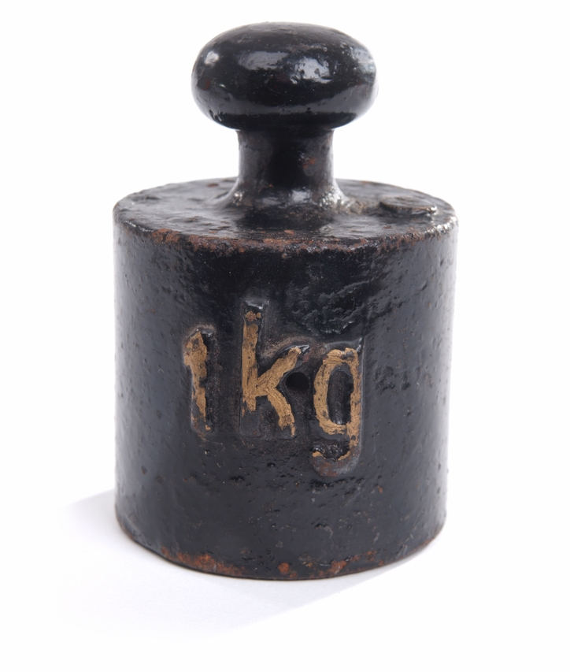
Large values
Computers process and store large amounts of bytes, often in the order millions or billions
  When dealing with large quantities
  it is more convenient to summarise
  this using number prefixes
  A common example of this is
  the kilogram k which is equivalent
  to 1000 grams:

Slide 11
Prefixes for bytes
The same number prefixes for decimal values can be used to summarise large quantities of bytes
Common prefixes include:
Prefix | Symbol applied to Bytes | Multiple
kilo | kB | 10³ = 1,000
mega | MB | 10⁶ = 1,000,000
giga | GB | 10⁹ = 1,000,000,000
tera | TB | 10¹² = 1,000,000,000,000

Slide 12
Incorrect prefixes
Traditionally computer scientists used these same number prefixes to refer to groups of bytes
These are not the same as their decimal equivalents
  Base 2 was used as the multiplier instead of base 10
  For example, a kilobyte was used as a representation of 2¹⁰ bytes, megabyte 2²⁰ and so on
  So, 1 kB was equivalent to 1024 Bytes and 1MB to 1,048,576 Bytes or 1024 kB

Slide 13
New prefixes
To eliminate this confusion, in 1998 the International Electrotechnical Commission (IEC) established different prefixes to represent multiples of base-2:
Prefix | Symbol applied to Bytes | Multiple
kibi | KiB | 2¹⁰ = 1,024
mebi | MiB | 2²⁰ = 1,048,576
gibi | GiB | 2³⁰ = 1,073,741,824
tebi | TiB | 2⁴⁰ = 1,099,511,627,776

Slide 14
Activity
Complete Worksheet 2, Task 1

Slide 15
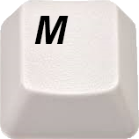
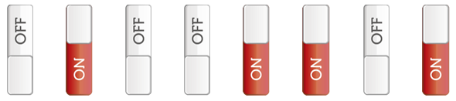
Representing text characters
If a computer understands only 1s and 0s, what happens when the ‘M’ key is pressed on the keyboard?
0 1 0 0 1 1 0 1

Slide 16
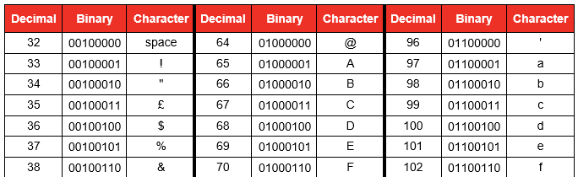
ASCII Code
In 1963 the American Standard Code for Information Interchange, (ASCII,) was established to encode symbols found in the English alphabet
  It was composed of a 7 bit character set giving 2⁷ (128) possible binary codes
What are the limitations of using a 7 bit character set?

Slide 17
Representing characters
Every character on the keyboard is represented by a binary value
Uppercase letters (capitals) have different values from lowercase characters
Punctuation symbols have their own characters
How many characters are there on a standard keyboard? How many bits would be required to represent this many combinations?
What character is represented by 0100000 (32)?

Slide 18
ASCII Table
Why does a Space need a character? (Code 32)
What happens if you press ALT+65 on a keyboard?
The first 32 codes are control characters, for example:
  Backspace (Code 8)
  Carriage Return or Enter (Code 13)
  Escape (Code 27)
An eighth bit was later introduced for extra characters such as ©, ® etc.

Slide 19
Character form of decimal digits
Numeric characters are also encoded
  The code 0111001 represents the character ‘9’ in ASCII
  The binary byte representing ‘9’ would be 00001001₂
Why is there a difference and what are the implications of this difference?
  What will this code output?
print ('9 + 3 =',9 + 3)
print ('"9" + "3" = ',"9" + "3")
print ('ord("9") + ord("3") = ',ord("9") + ord("3"))

Slide 20
Unicode
The Unicode system was introduced to standardise the encoding of characters from all languages
  Unicode can apply a variable length encoding of either 16 bits or 32 bits
  In order to improve adoption of this new standard the first 128 Unicode characters were set to be the same as the ASCII character set
What is the disadvantage of using up to 4 bytes per character?

Slide 21
Worksheet 2
Complete Task 2

Slide 22
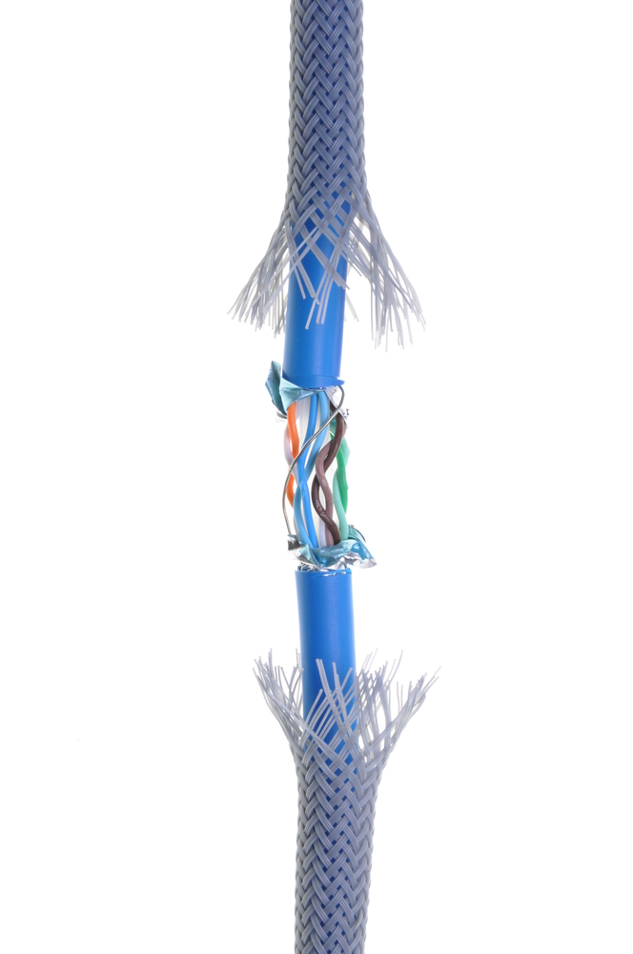
Transmission errors
When data is transmitted, it doesn’t
always arrive in the same format that
it was sent
  Electrical interference
  Power surges
  Synchronisation issues
  Wear and tear on the cable or connectors
These errors can cause bits to flip
from 1s to 0s and 0s to 1s

Slide 23
Error detection
The following are techniques that can be used to check for errors in transmission:
  Parity bits
  Majority voting
  Check digits
  Checksums
When an error is detected:
  The data cannot be corrected
  A request to resend the data is invoked

Slide 24
Parity bits
Computers use either odd or even parity
When sending a byte of data, one bit is used as a parity bit
This bit is set to a 1 or 0 to make the total number of 1s or 0s in the byte (including the parity bit) odd or even depending on the machine
0 | 1 | 0 | 0 | 1 | 1 | 0 | 1
Parity bit

Slide 25
Odd or even parity
What would be the value of the parity bit for the following, using even parity?
Give the parity bit value here using odd parity
 | 1 | 0 | 0 | 1 | 0 | 1 | 0
Parity bit
 | 0 | 1 | 0 | 1 | 1 | 0 | 1
Parity bit

Slide 26
Using parity for error detection
When data is transmitted, the parity bit is set at the transmitting end and parity is checked at the receiving end
If the wrong number of bits are ‘on’, an error has occurred
The receiving computer notifies the transmitting end and the data is resent
  How could an erroneous byte escape detection in spite of a parity check bit being used?

Slide 27
Majority voting
Each bit of a message is sent three times
If a bit value is flipped erroneously the recipient computer uses the majority rule and assumes that the two bits that have not changed were therefore correct
  What drawbacks does this system have?
0 |  |  | 0 |  |  | 1 |  |  | 0 |  |  | 0 |  |  | 1 |  |  | 1 |  |  | 0
0 | 0 | 1 | 0 | 0 | 0 | 1 | 1 | 0 | 0 | 0 | 0 | 1 | 0 | 0 | 1 | 1 | 1 | 1 | 0 | 1 | 0 | 0 | 0

Slide 28
Check digits
A check digit is an additional digit at the end of a string of other numbers designed to check for mistakes in input or transmission
Printed books and other products have a unique barcode with a ISBN (International Standard Book Number) or EAN (European Article Number)
The first 12 digits of the barcode are the unique item number, the 13th is the check digit calculated by an algorithm based on the other 12 digits
This can be calculated using the Modulo 10 system

Slide 29
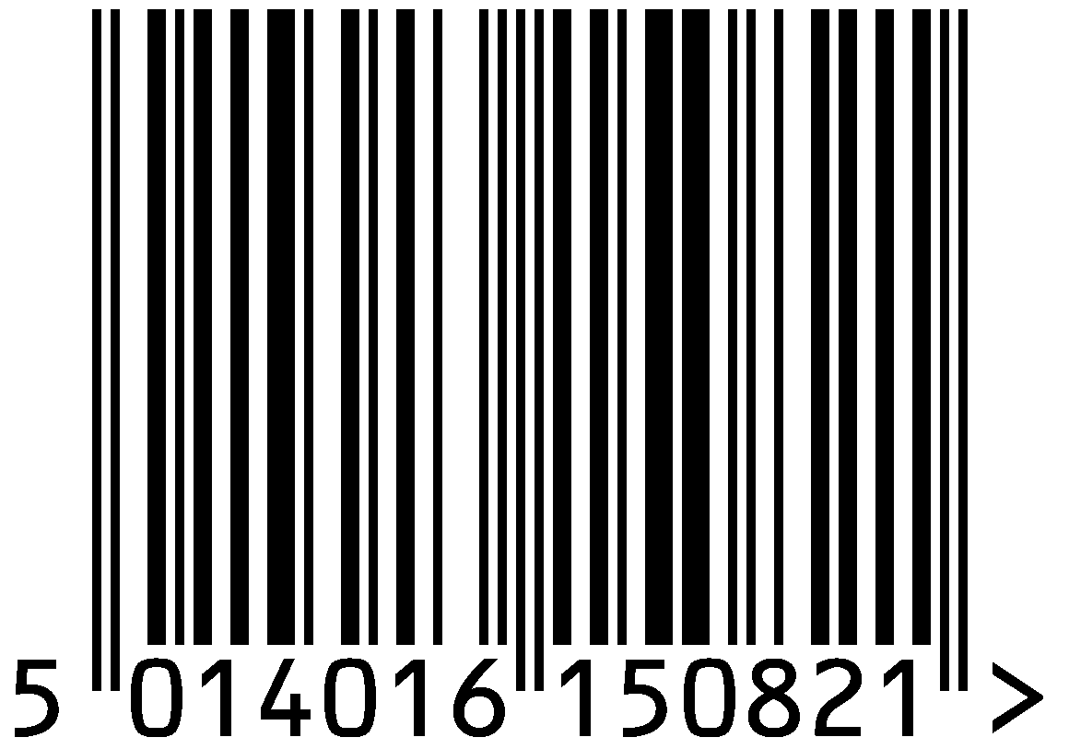
Calculating the check digit
ISBN | 5 | 0 | 1 | 4 | 0 | 1 | 6 | 1 | 5 | 0 | 8 | 2 | 1
Weight | 1 | 3 | 1 | 3 | 1 | 3 | 1 | 3 | 1 | 3 | 1 | 3
Multiplication | 5 | 0 | 1 | 12 | 0 | 3 | 6 | 3 | 5 | 0 | 8 | 6
Addition | Add all the numbers |  |  |  |  |  |  |  |  |  |  |  | 49
Remainder | Find the remainder when divided by 10 |  |  |  |  |  |  |  |  |  |  |  | 9
Subtraction | Subtract the result from 10 |  |  |  |  |  |  |  |  |  |  |  | 1

Slide 30
Checksums
A checksum works in a similar way to a check digit
  A total sum of all bytes in a transmission of data is calculated using an algorithm
  The sum is often sent with the data
  The receiving computer recalculates the checksum based on the data it received and compares it with the checksum received or a known, expected value
  If it does not match, the data may have been altered or corrupted during transmission and the data is resent
Checksums are used with credit card numbers

Slide 31
Simple checksum example
The number of bytes in the transmission is counted and found to be 4
The checksum is given the value 4 in binary and sent with the real data
What flaws or weaknesses are there in the method used in this example?
00000100 |  | 01101011 |  | 11011011 |  | 01101010 |  | 10010110
Check sum

Slide 32
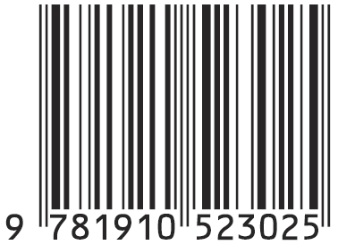
Worksheet 2
Complete Task 3 on Worksheet 2 to calculate the check digit on the back of a book, or the one below:

Slide 33
Plenary
Electrical signals operated by switches ‘create’ a binary pattern
New prefixes e.g. Kibi and Mebi describe 2^{n} bytes
ASCII and Unicode are used to represent characters
An ASCII digit is not the same as its direct binary translation
Transmission errors can be detected using a range of methods

