Slide 1
AQA
    AS Level
      Computer Science
      Paper 2
Representing images
  Data representation

Slide 2
Objectives
Understand how bitmapped images are represented in terms of size in pixels, resolution and colour depth
Be able to calculate the storage requirements for a bitmap image
Be aware that images contain metadata and be able to describe typical metadata
Explain how vector graphics represents images using lists of objects (A Level only)
Compare the vector graphics approach with the bitmap graphics approach (A Level only)

Slide 3
Binary recap
For n number of bits there 2^{n} possible combinations
How many combinations can be represented by:
  8 bits
  16 bits
  24 bits

Slide 4
Computer data
A computer often has to store and process real-world data
A computer needs data in a format it can understand: patterns of 1s and 0s
This type of data is referred to as digital data
It is different from analogue data which can in theory be measured to any degree of accuracy

Slide 5
‘Seeing’ images
Humans see ‘images’ by detecting the light reflected by objects they are looking at
Light is transmitted as waves and changing wave lengths produce different colours
  Even though a human cannot detect them all, there is an infinite number of possible colours
  When a photo is taken using a digital camera, the embedded computer needs to capture and approximate these colours

Slide 6
Capturing an image
When a digital camera captures the image it breaks up what it sees through its lens into a grid of pixels
  A light sensor measures the intensity of colour in each pixel
  Each measurement is converted into a binary code using an electronic component called an analogue-to-digital convertor
  The number of pixels recorded in the grid affects the number of bits used and, therefore, the size of the file created

Slide 7
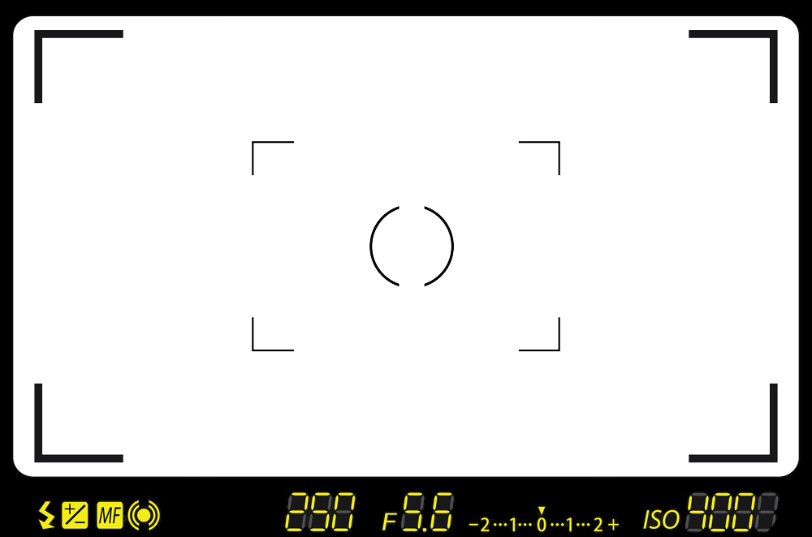
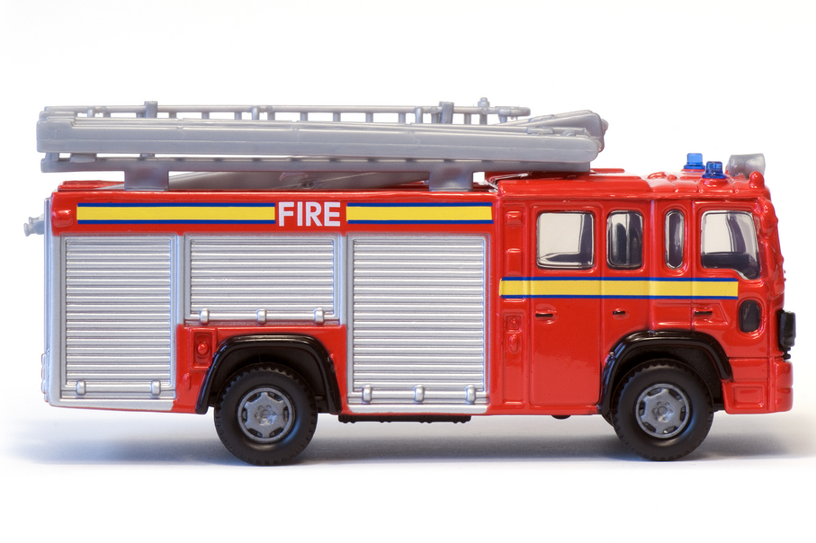

What a camera sensor sees

Slide 8
Approximating an image

Slide 9
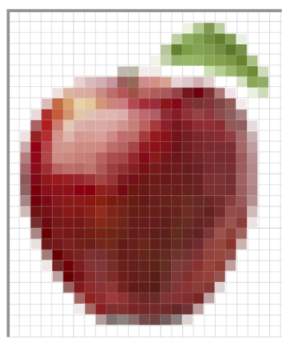
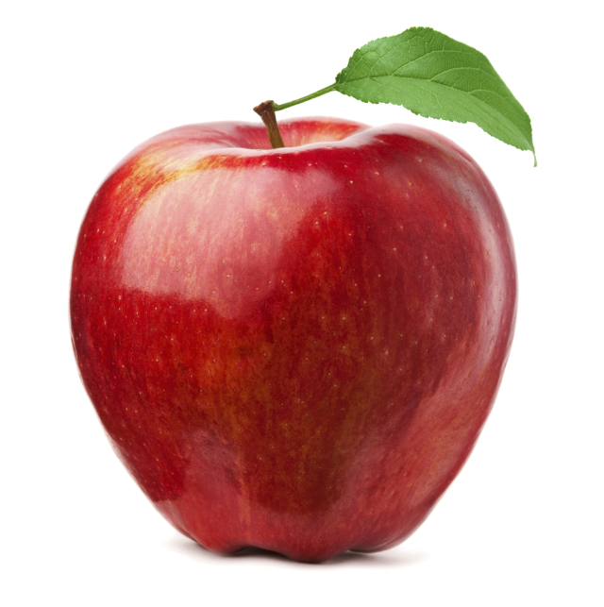
Bitmapped (Raster) graphics
x
Bitmapped graphics are created using a grid of pixels
Each pixel is given a colour value
y
X | Y | Colour value
21 | 3 | 75a248
X | Y | Colour value
6 | 11 | f0c297
X | Y | Colour value
15 | 24 | 751b13

Slide 10
Types of bitmap files
An image that is comprised of pixels is a bitmap file
Common bitmap file types are:
  BMP
  JPG
  GIF
  PNG
  TIF

Slide 11

Bitmap resolution
The number of pixels used to make up a bitmap image is defined by the resolution
The area is defined by the image width and height in pixels e.g. 1080x768
  72dpi = screen resolution
  300 dpi = print quality resolution
1x1 2x2 5x5 10x10 25x25 50x50 72x72 300x300

Slide 12
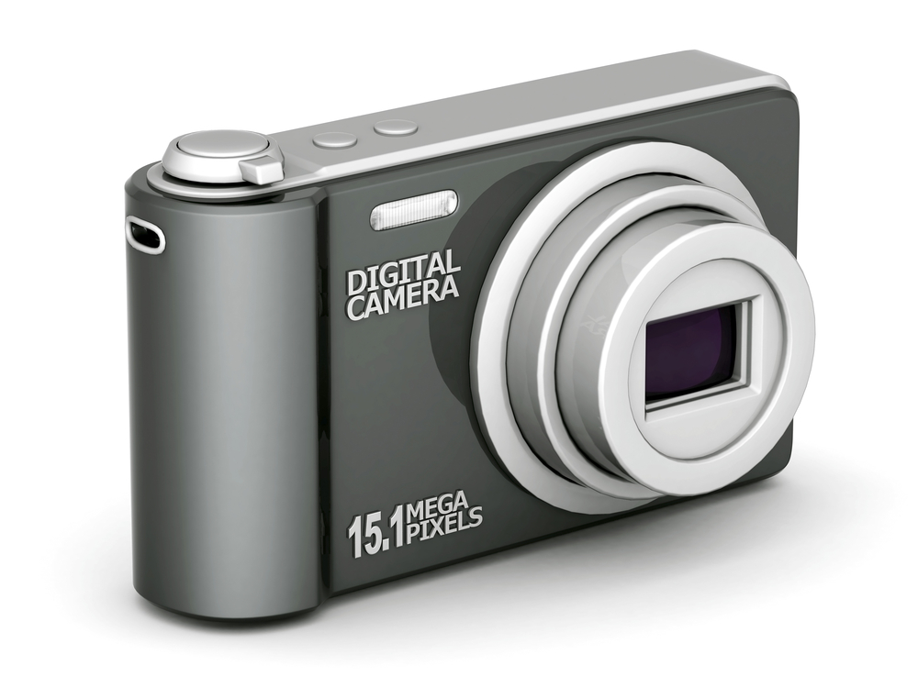
Number of pixels
Resolution is defined as width x height
  A typical bitmap might be 1000 x 1000
  This would mean a total of 1,000,000 pixels would be used
  Typically this would be referred to as a 1 megapixel image

Slide 13

Image size
Resolution doesn’t define the actual physical size of an image
  If an image is made bigger (or smaller), the size of each pixel grows or shrinks to maintain the required resolution
  This is why there is a deterioration in
  quality when a bitmap is resized
x0.5 x1 x2 x4 x16

Slide 14
Creating an Image
Each Pixel is given a binary value
Each value represents a different colour
Using one bit per pixel allows only 2 values, 0 and 1
1 = White, 0 = Black
0 | 0 | 0 | 0 | 0 | 0 | 0 | 0 | 0 | 0
0 | 0 | 1 | 0 | 0 | 0 | 0 | 0 | 0 | 0
0 | 1 | 1 | 1 | 0 | 0 | 0 | 0 | 0 | 0
0 | 1 | 0 | 1 | 0 | 0 | 1 | 0 | 0 | 0
0 | 1 | 0 | 1 | 0 | 1 | 1 | 1 | 0 | 0
0 | 1 | 1 | 1 | 1 | 1 | 1 | 1 | 1 | 0
0 | 1 | 1 | 1 | 1 | 0 | 1 | 0 | 1 | 0
0 | 1 | 0 | 1 | 1 | 0 | 1 | 0 | 1 | 0
0 | 1 | 0 | 1 | 1 | 1 | 1 | 1 | 1 | 0
0 | 0 | 0 | 0 | 0 | 0 | 0 | 0 | 0 | 0

Slide 15
Increasing the number of colours
More bits per pixel = more colour combinations
  1 bit = 2 Colours
  2 bits = 4 Colours
  3 bits = 8 Colours
  4 bits = 16 Colours
How many bits per pixel required for 256 colours?
11 | 11 | 11 | 11 | 11 | 11 | 11 | 11 | 11 | 11
11 | 11 | 11 | 11 | 11 | 01 | 01 | 01 | 01 | 11
11 | 11 | 11 | 00 | 11 | 01 | 11 | 11 | 01 | 11
11 | 11 | 11 | 00 | 11 | 01 | 11 | 10 | 01 | 11
11 | 11 | 11 | 00 | 11 | 01 | 10 | 10 | 01 | 01
11 | 01 | 10 | 10 | 10 | 01 | 00 | 00 | 00 | 01
11 | 00 | 00 | 01 | 01 | 00 | 00 | 00 | 00 | 00
00 | 10 | 10 | 00 | 01 | 00 | 00 | 10 | 00 | 00
00 | 10 | 10 | 00 | 01 | 00 | 00 | 00 | 00 | 00
11 | 00 | 00 | 11 | 11 | 11 | 00 | 00 | 00 | 11
01 =
10 =
00 =
11 =

Slide 16
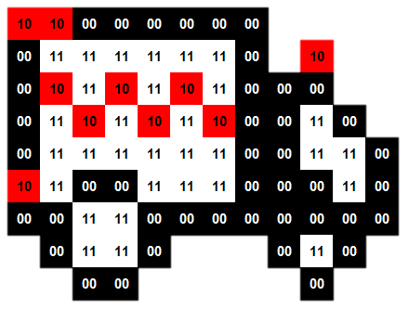
Creating images
Use Bit depth.xls to create an image of either 1 or 2 bits colour depth
  How does the colour depth affect the number of colours that can be represented?
  How does bit depth
  affect file size?

Slide 17
Colour or bit depth
Each pixel can represent a finite number of colours
  A pixel is attributed a number of n bits
  The number of combinations (2^{n}) dictates the bit depth and therefore the number of colours that can be represented
  A higher bit depth gives a greater range of colour and a better quality of image
8 bits per pixel = 2⁸ = 256 colours
16 bits per pixel = 2¹⁶ = 65,536 colours
24 bits per pixel = 2²⁴ = 16,777,216 colours

Slide 18




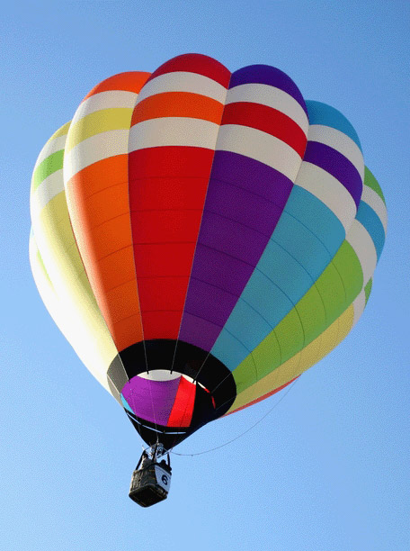
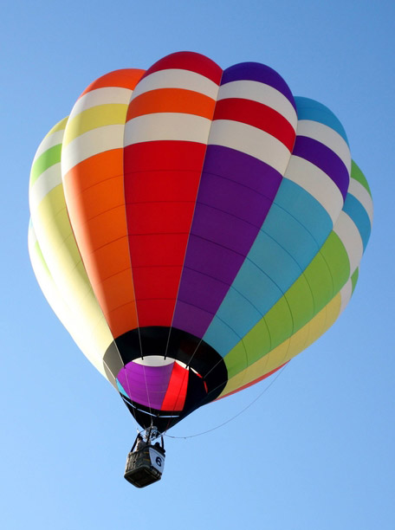
Variation in quality
Changing the colour depth of an image will affect the number of colours it can display, as shown below:
2 Colours 4 Colours 8 Colours 16 Colours 256 Colours 16.7m Colours

Slide 19
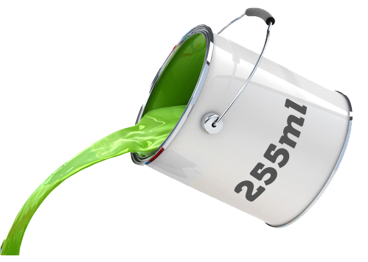
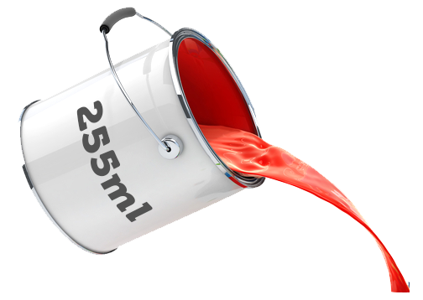
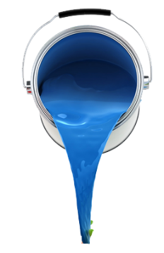
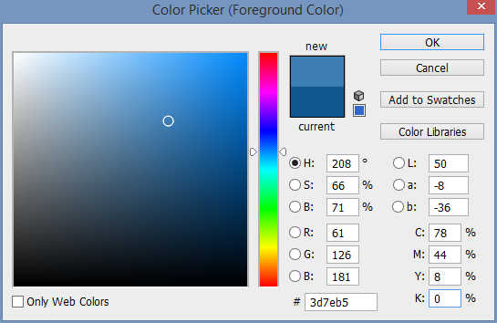
Colour values
126ml
61ml
181ml

Slide 20
Looking at colour codes
Colour values of individual pixels are expressed as denary RGB values and in hexadecimal. Why not in binary in this instance?
RGB (Red, Green and Blue) values range between 0-255. How many bits are required for 256 variations of each?
How many bits altogether?
In 32-bit colour what are the last 8 bits for?

Slide 21
Calculating file size
Image file size is determined by the number of pixels used and the number of colour combinations available
For example:
  An image is captured on a 2 megapixel camera
  Image captured with a 24 bit colour depth
  2,000,000 x 24 = 48,000,000 bits / 8 = 6,000,000 bytes
  or 6 MB
Quality is traded off against file size – you can’t have high quality and a low file size

Slide 22
Bitmap images
Complete Task 1 on Worksheet 4

Slide 23
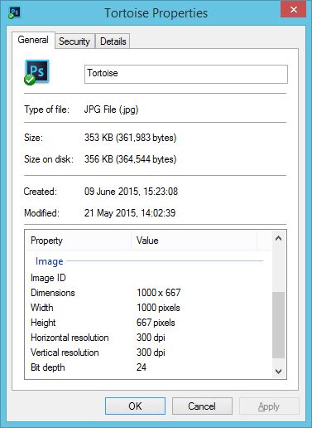
Metadata
Metadata is data about data and is stored in the same file as the image data
This includes:
  the date it was created
  the width and height in pixels of the image
  the colour depth and
  the GPS coordinates of where a photo was taken

Slide 24
Metadata
Complete Task 2 on Worksheet 4

Slide 25
Vector graphics
Vector images are made up of geometric shapes or objects rather than by manipulating individual pixels
The properties of each shape are stored and retrieved in order to mathematically redraw the shape on the screen to display it
  What properties would you need to store in order to draw this rectangle in the right place on the screen?
x
y

Slide 26
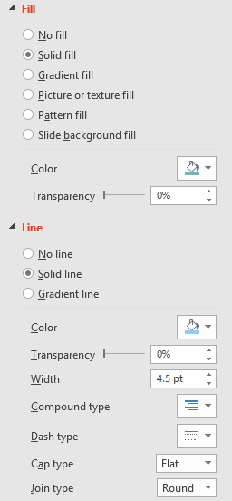
Vector properties
The properties of shapes are stored in a vector drawing list to define them. These include:
  Shape type and position on the screen
  Fill colour
  Line colour and weight
  Length and width or radius
Common software functions
can be used to set or adjust
these properties

Slide 27

Resizing images
Whilst bitmap graphics will often pixelate as you enlarge them, vectors are mathematically redrawn at whatever size they are set to
  This perfectly maintains their crispness – which is which?
A Level only

Slide 28
Comparing bitmaps and vectors
Complete Task 3 of the worksheet
 | Bitmap graphics | Vector graphics
Made up of
File size
Resizing
File formats
A Level only

Slide 29
Comparing bitmaps and vectors
Complete Task 3 of the worksheet
 | Bitmap graphics | Vector graphics
Made up of | Pixels | Shapes
File size | Typically smaller | Typically larger
Resizing | Causes pixellation | No loss of quality
File formats | png, bmp, jpg | swf, eps, svg
A Level only

Slide 30
Plenary
Resolution is the density of pixels over an area, it is not the physical size of the image
Colour or bit depth determines the number of colours that an image can display
Image quality comes at the expense of file size
Metadata is stored with images and specifies the width, height and colour depth amongst other details

