Slide 1
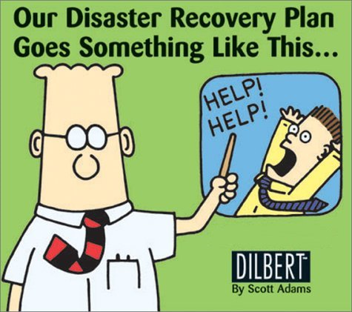
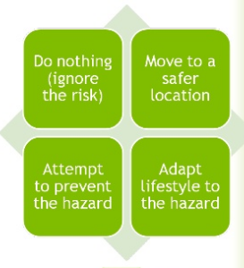
Hazards 2: How do people respond to hazards?

Slide 2
Which other topics and examples have involved responses like these?

Slide 3
3.1.5.1 The concept of hazard in a geographical context
This is what the exam board says you should know:
Characteristic human responses – fatalism, prediction, adjustment/adaptation, mitigation, management, risk sharing;
Their relationship to hazard incidence, intensity, and level of development.
The Park model of human response to hazards. The Hazard Management Cycle.
Hazard perception and its economic and cultural determinants.
Key terms:
Fatalism adaptation primary effects secondary effects mitigation

Slide 4
Primary vs secondary impacts
Primary =
the effects of a hazard event resulting directly from that event, e.g. ground shaking.
Secondary =
the effects that result from the primary impact of the hazard event, e.g. building collapse.

Slide 5
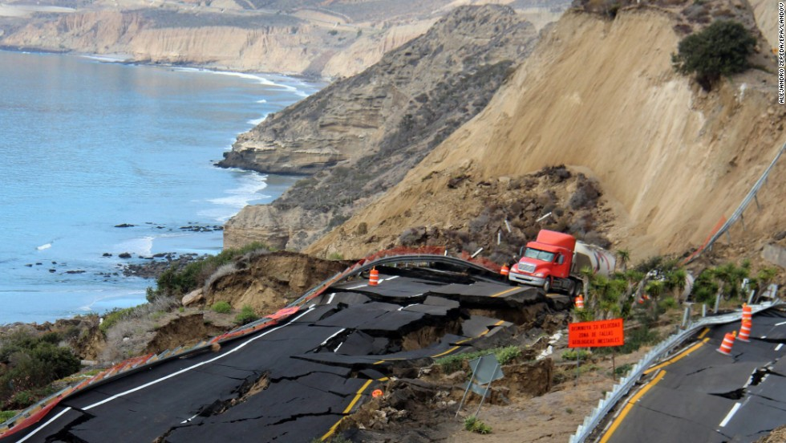
Primary or secondary?

Slide 6
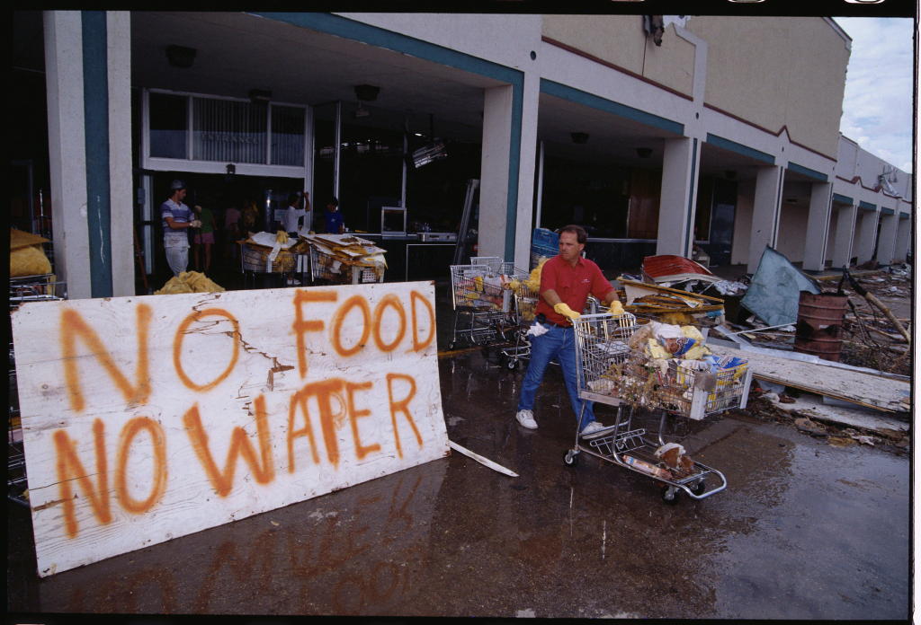

Slide 7
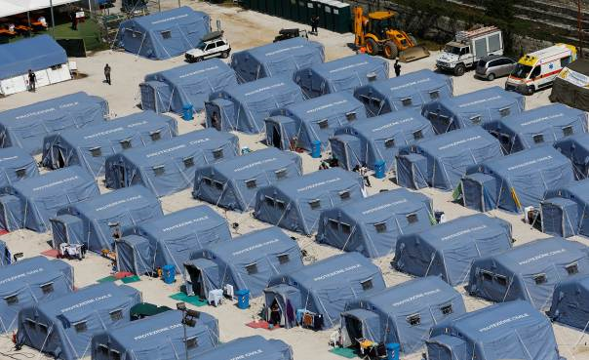

Slide 8
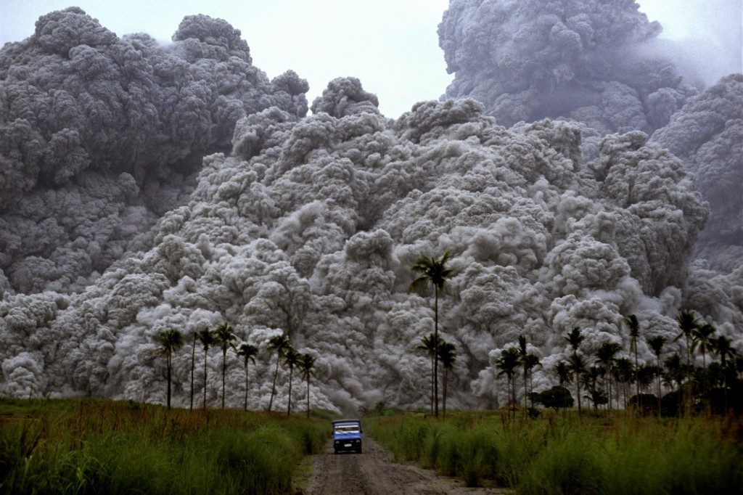

Slide 9
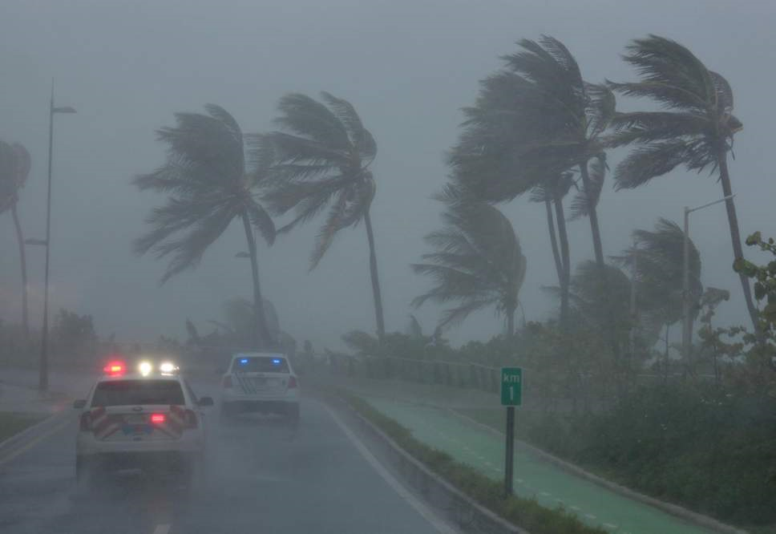

Slide 10
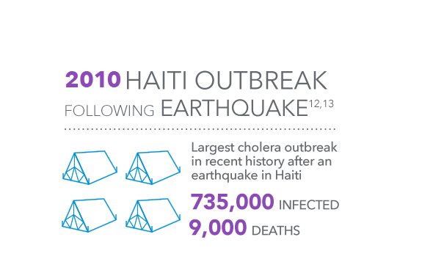

Slide 11
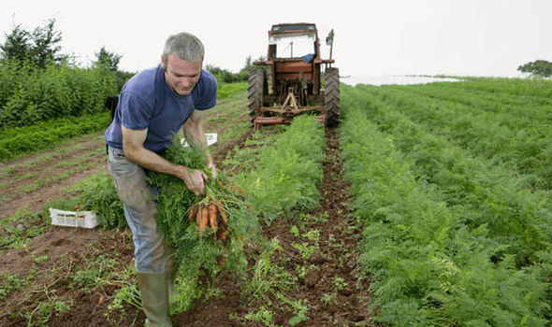
Heatwave pushes up UK fruit and vegetable prices as yields fall
Farmers are struggling to raise crops, which stop growing in temperatures above 25C

Slide 12
 | Short-term | Long-term
Primary
Secondary
Some may fit in more than one category!
TSUNAMI LAVA FLOW COLLAPSED HOMES
FOOD SHORTAGES CRACKS IN GROUND DISRUPTED WATER SUPPLY
PEOPLE HOMELESS SHAKING BUILDINGS BREAKDOWN IN LAW AND ORDER

Slide 13
How do people respond to natural hazards?
There are three key responses to natural hazards:
Fatalism: Acceptance that hazard events are natural and there is little or nothing we can do to prevent them. Few, if any, preventative measures are put in place. Some may believe that taking action could harm existing ecosystems.
Fear: The perception of the hazard is such that people feel so vulnerable that they are no longer able to face living in the area and move away to regions perceived as safer.
Adaptation: People see it is possible to prepare for, and therefore survive, the event by prediction, prevention, and/or protection, depending upon the economic and technological circumstances of the area.

Slide 14
The park model of human responses
When a hazard event occurs, it disrupts economic and social life often immediately and totally. The Park model describes a sequence of phases following such an event.
It refers to the strategies and approaches taken to get ‘back to normal’ after a disaster. These methods span from immediate ‘relief’ to providing temporary housing to reconstructing after the damage.

Slide 15
Park’s model of hazard response
Will the shape of the curve be the same for different events?
The shape of the curve depends on the nature of the event. The scale, severity and length of warning will all affect the curve.
Improvement
Quality of Life. Level of Economic Activity. Social Stability Communications / service level
Normality
Hazard event
Deterioration
Disruption
Recovery
Search Rescue Care
Temporary housing services
Rebuild
Pre-Disaster
Relief
Rehabilitation
Reconstruction
Hours - days
Weeks-Months
Weeks - Years
Relief and rehabilitation often with the help of outside agencies
Notes:
1. Explain the y axis (criteria are shown) 2. Explain the X axis. (stage of the hazard)

Slide 16
Park’s model of hazard
response
Stage 1: Normality, attempts made to modify the event before it happens.
Stage 2: The event
Stage 3: Emergency search and rescue
Stage 4: Relief and Rehabilitation including national and international help.
Stage 5: Nature of recovery related to the need to reduce vulnerability and the need to restore normality ASAP.
Is there improvement or just a return to normality?

Slide 17
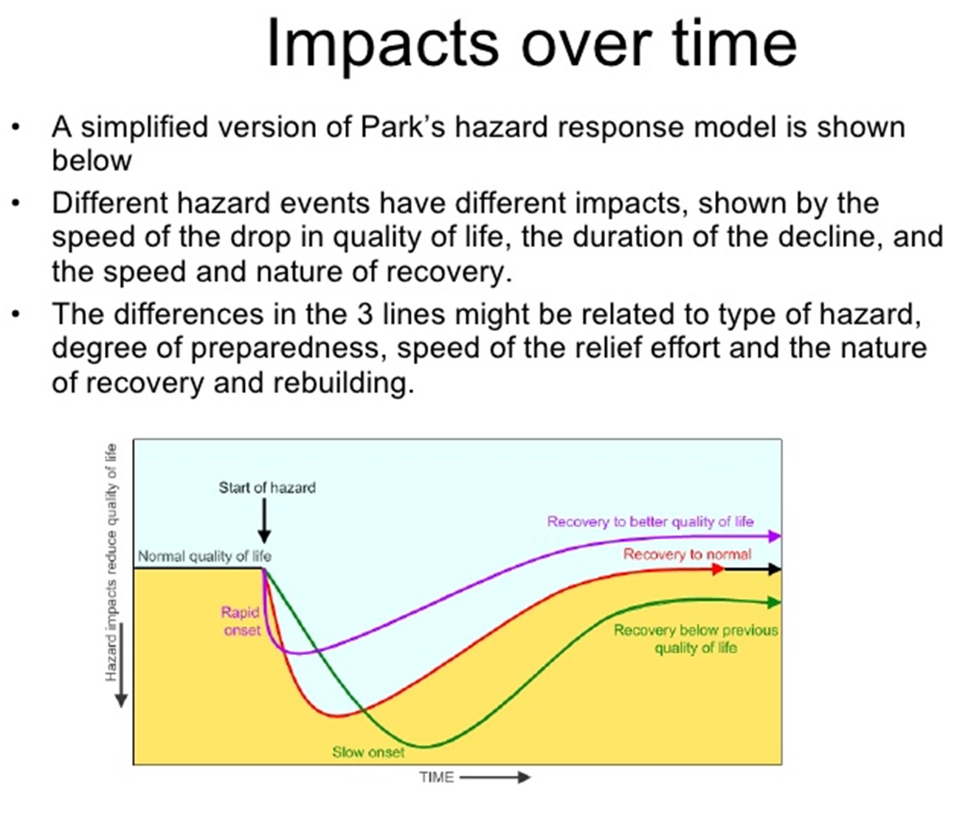
Model to follow from AJM

Slide 18
Park’s response model
1) On your copy of Park’s response model, draw two different curves for:
A powerful earthquake in a LEDC with high population density;
Flooding after prolonged rain in a MEDC.
Use two different colours.
2) Write a paragraph explaining the different shapes of the curves.

Slide 19
How is the Park model useful? It takes into account:
That hazards are inconsistent. Things such as the magnitude of the hazard, the development of places affected and the amount of aid received change over time.
All hazards have different impacts and responses (Haiti for example had immediate impact whereas Montserrat took place over several years).
In hazard events that affect multiple countries, each country has its own curve and comparisons can be made.

Slide 20
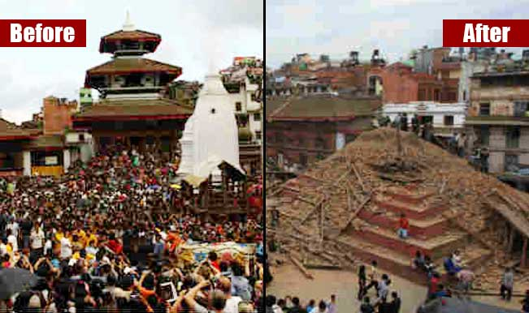
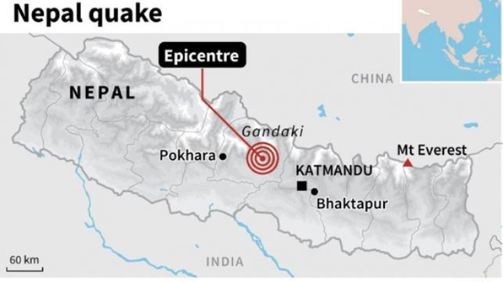
Read through the tweets from Steve Cranidge, a tourist who arrived in Nepal just before an earthquake.
Task: Create a living graph by placing these statements onto the Park Model.

Slide 21
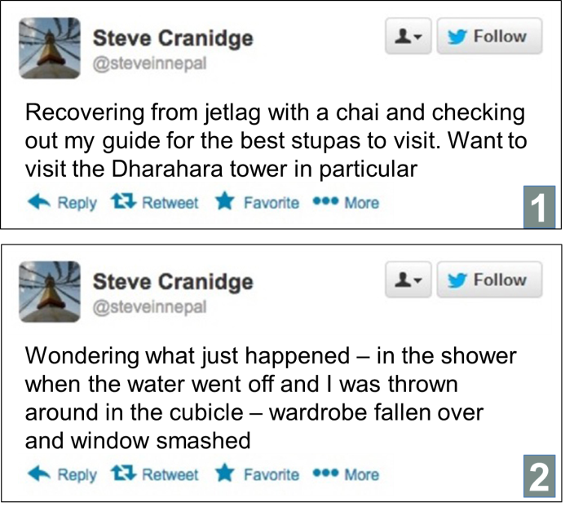
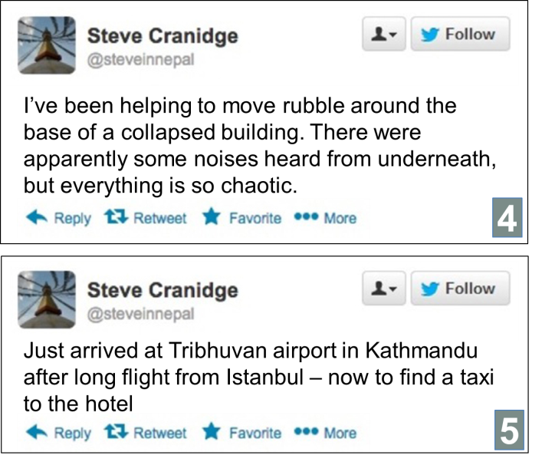
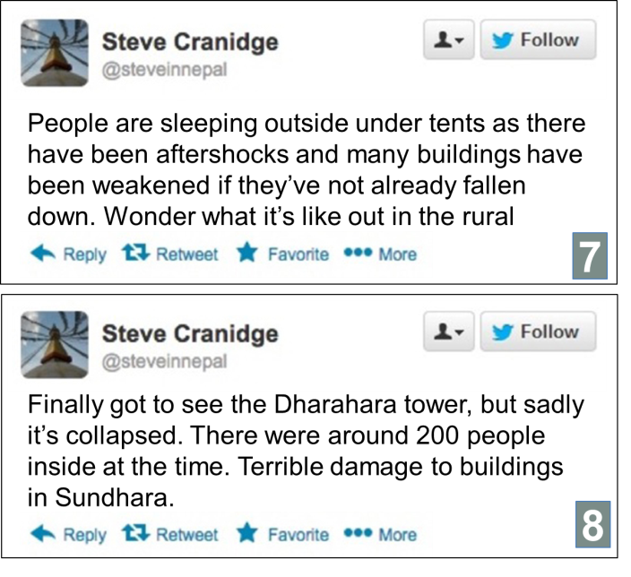
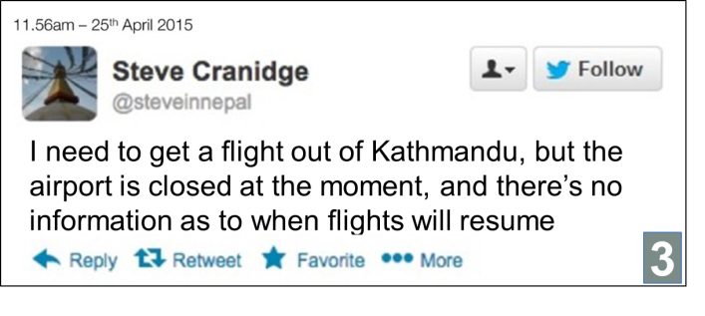
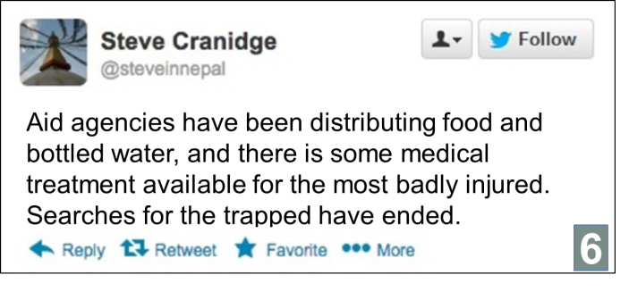
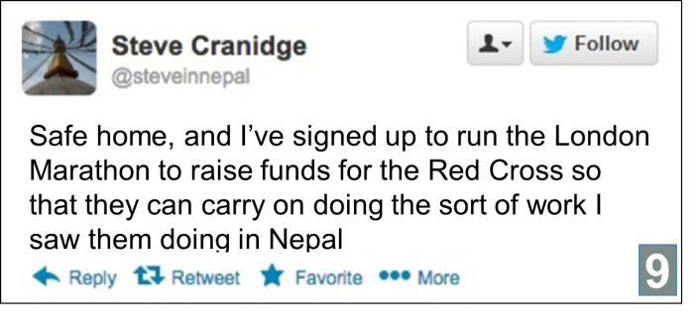
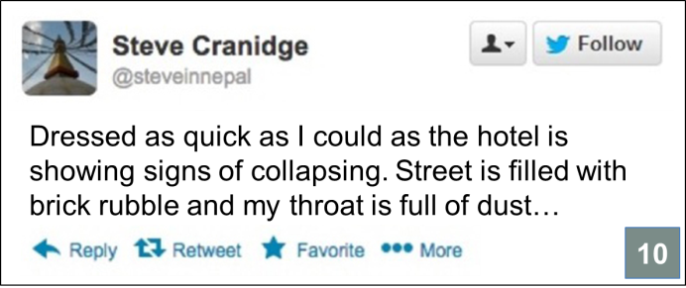
Stage 1 – modifying the cause and event
Stage 4 – Relief and rehabilitation. May include outside help (national or international)
Stage 2 – Hazardous event
Stage 5 – Nature of recovery related to the need to reduce vulnerability and restore normality
Stage 3 – search, rescue and
care
25th April 2015
11:56 (am)
Magnitude: 7.8
Notes:
Answers for Tweet sequencing order: 5, 1, 2, 10, 7, 3, 4, 6, 8, 9.

Slide 22
Explain how Parks model shows that hazards can have different impacts over time.
Summarise the ways people cope before, during and after a hazard.

Slide 23
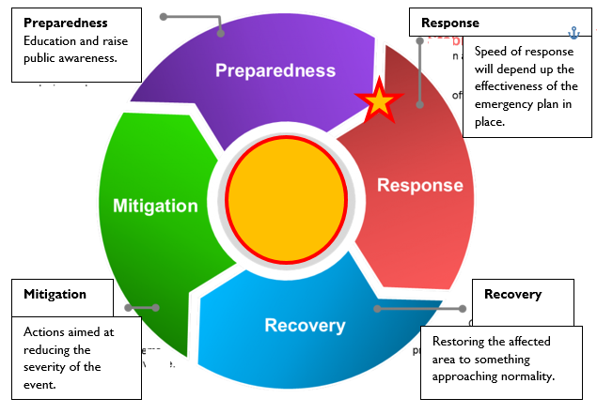
The Hazard Management cycle.
Both before and after a disaster strategies can be used to reduce the damage of the current and future hazards.
The Risk Management cycle outlines the strategies that can be taken at each stage.
What factors affect recovery?
What part of the cycle is most crucial in reducing impacts?
Add the following labels onto your copy of the Hazard Management Cycle:
Hazard risk assessments, Hazard maps produced, Warning, Evacuation, Saving people, Emergency aid, Assessing damage, On-going aid, Restoration of Infrastructure, Economic & Social recovery, Education and Public awareness, Building codes put in place, Defences built, Long term aid, Land use planning, evacuation plans put in place, temporary shelters put in place, Counselling for the bereaved.
Notes:
The response to a hazard, whether from the public or authority, will be dependent on the following:
• past experience of the hazard
• economic wealth
• technology and resources
• quality of research and knowledge
• attitude and perceptions of descision makers
• society and culture
• other priorities : jobs, health, national security.

Slide 24
TASK: Evaluate the usefulness of Parks Model and the Hazard Management Cycle in improving understanding and management of natural hazards (9)
Parks Model:
Allows comparison between events
Shape of curve shows length of disruption, speed of recovery, etc.
No data
Action taken prior to event is unknown.
Hazard Management Cycle:
Shows how preparedness strategies may impact ability to cope/recover.
Generic
Does not allow comparison.
Better if used together?
What else may help improve understanding and management?

Slide 25
TED talk: managing hazard response (10 mins) https://www.ted.com/talks/caitria_and_morgan_o_neill_how_to_step_up_in_the_face_of_disaster
Watch the clip and make notes on how communities can improve their preparedness and relief response.

Slide 26
Homework:
Read through and highlight the Tutor2u study notes Hazard types, perception, response & models.
This needs to be done in advance of your first lesson next week.

Slide 27
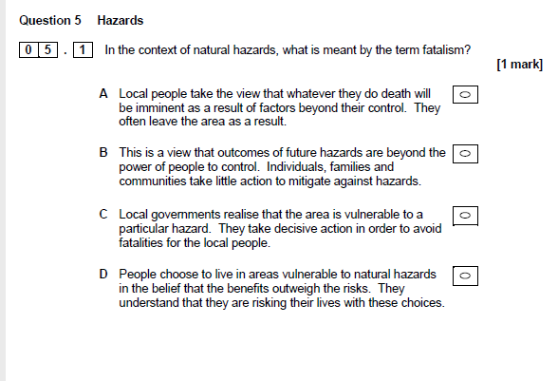

Slide 28
Multiple choice hazards questions
Tick the correct answer in each case. Each multiple choice question is worth one mark.
1. The following definition applies to which key term? (1 mark)
“a perceived natural/geophysical event that has the potential to threaten both life and property”
  Risk
  Natural hazard
  Disaster
  Vulnerability
2. Which of the following cannot be defined as a natural hazard? (1 mark)
  Hurricanes
  Landslides
  Wildfires
  Oil spills
3. Which stage of the Hazard Management Cycle would involve ‘restoration of infrastructure’?
  Preparedness
  Response
  Recovery
  Mitigation
4. Which response to hazards is described as the “view that hazard is natural and part of life in the area and so losses are accepted as inevitable” (1 mark)
  Fatalism
  Fear
  Adaptation
5. The timescale of the relief stage of the Park Model of Human Response is:
  Hours-days
  Days-weeks
  Weeks-years

