Slide 1
Unit 3: Topic A4
Managing Personal Finance – different types of insurance product

Slide 2
Key terms starter
Find out the meaning of the following:
Insurance
Insurance premiums
Which types of insurance do you think your family has?

Slide 3
Different types of insurance products
Car
Health
Home and contents
Types of insurance
Pet
Life assurance and insurance
Travel

Slide 4
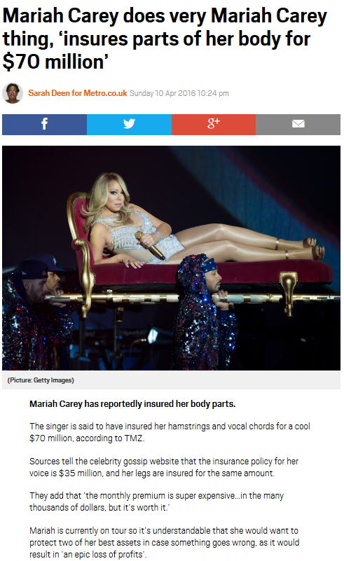
insurance
Insurance can be taken out against anything deemed to have a worth or where there is a risk of financial loss.
Watch what is insurance video
https://www.youtube.com/watch?v=v3jf45fTVKE

Slide 5
Advantages and disadvantages of different types of insurance
Description of type of insurance | Advantages | Disadvantages
Car: legal requirement to insure any car on the road. Covers theft and accidents. Degree of cover varies because…. | Meet legal requirements | Premiums can be high depending upon assessed level of risk
Home and Contents
Life assurance and insurance
Travel
Pet
Health

