Slide 1
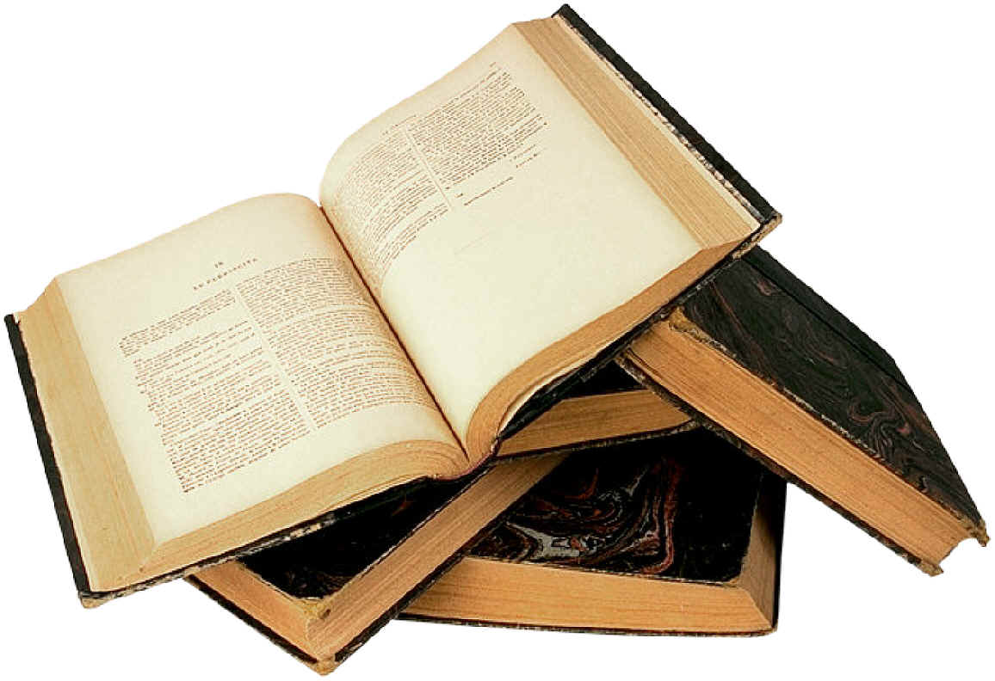
Week 4 The Exam and Genre
Assessment Objectives.
Notes:
Aims and objectives. Introduction: overview of the Aos; tackling the question of the way in which this text adheres to or subverts the comic or tragic genre, applying our findings to the text, and completing a piece of work responding to either pp 6-7 or p 17. 5 mins

Slide 2
Reduce each to one word….
AO1 Apply concepts and methods from integrated linguistic and literary study as appropriate, using associated terminology and coherent written expression. 9%
AO2 Analyse ways in which meanings are shaped in texts. 12%
AO3 Demonstrate understanding of the significance and influence of the contexts in which texts are produced and received. 8.5%
Notes:
Students to summarise each AO to one word. Note the weightings. 5 mins The language of poetry and plays (02) Closed text 64 marks Written paper: 2 hours 32% of total A level

Slide 3
Plays: dramatic and stylistic analysis. Which is which? Sort into A01, A02, and A03.
• Use linguistic and stylistic approaches and an understanding of dramatic techniques to develop an analysis of the text
• analyse aspects of the text foregrounded through the use of repetition, pattern-making, pattern breaking and deviation
• explore dramatic techniques such as on-stage and off-stage action, paralinguistic features (gesture/ manner of speech/facial expressions), soliloquy, asides and dramatic irony
• Apply relevant methods for text analysis, drawing on linguistic and literary fields.
• Explore contexts and connections between the scene and the play as a whole, as well as literary and generic contexts.
consider the significance of relevant dramatic or other contexts
• make accurate references to texts.
• identify and describe how meanings and effects are created and conveyed through language
• use English and terminology appropriately and coherently
Notes:
In pairs: to decide which of these fits into which AO – these are taken from the specification (Content and Learners should be able to). Compare to following slides. 10 mins

Slide 4
AO1
Use linguistic and stylistic approaches and an understanding of dramatic techniques to develop an analysis of the text
use English and terminology appropriately and coherently
explore dramatic techniques such as on-stage and off-stage action, paralinguistic features (gesture/ manner of speech/facial expressions), soliloquy, asides and dramatic irony
Apply relevant methods for text analysis, drawing on linguistic and literary fields.

Slide 5
A02
analyse aspects of the text foregrounded through the use of repetition, pattern-making, pattern breaking and deviation
make accurate references to texts.
• identify and describe how meanings and effects are created and conveyed through language

Slide 6
AO3
Explore contexts and connections between the scene and the play as a whole, as well as literary and generic contexts.
consider the significance of relevant dramatic or other contexts

Slide 7
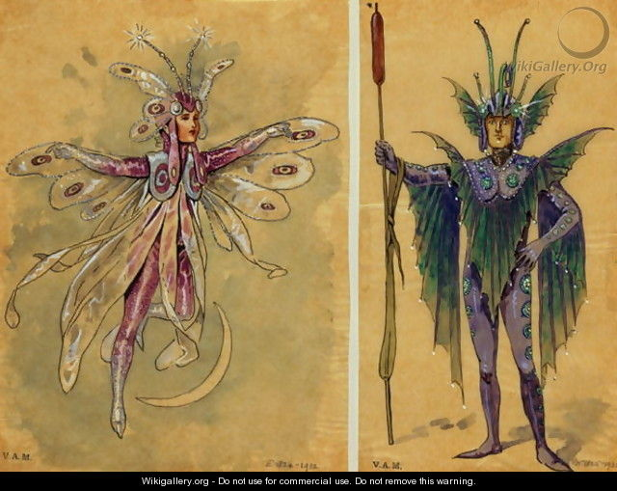
What do you know about Shakespearean comedy? What sort of things would you expect to see?

Slide 8
Some Ingredients of a Shakespearean comedy – find some parallels in Jerusalem
A celebration
An argument or misunderstanding
A new arrival
Legal order or decree from someone in authority
Character (villainous) is punished or expelled
A journey to another space
A muddle/disguise adopted/malicious trick exacted
Thwarted love
Muddle/misunderstanding sorted/disguise thrown off
Journey back
Reconciliation of characters
Festival, carnival, party, marriage
Notes:
Hand out Shakespearean comedy structure cards. They need to find their pair: a match for the ingredient from Jerusalem. 10 mins

Slide 9
Some ideas. What has happened to the order in Jerusalem?
A celebration
An argument or misunderstanding
A new arrival
Legal order or decree from someone in authority
Character (villainous) is punished or expelled
A journey to another space
A muddle/disguise adopted/malicious trick exacted
Thwarted love
Muddle/misunderstanding sorted/disguise thrown off
Journey back
Reconciliation of characters
Festival, carnival, party, marriage
The council officials arrive to evict Johnny (p 7)
Pea, Tanya, Davey all come to the wood because (in Johnny's words) "half of them are safer here than they are at home". (p 98)
Johnny's friends betray him by urinating on him while he is unconscious (p 82)
Lee and Davey return to Johnny to say sorry (p 85)
Johnny delivers a speech about how they will feast and celebrate in his "kingdom" (p 50)
Phaedra realises that she will no longer be the May Queen after the end of the day. (p 150)
Phaedra is dressed as a fairy (prologue and p 84)
Professor mistakes Ginger for a female university lecturer (p 7)
Johnny rejects Ginger at the end so that he can fight alone (p 106)
Lee explains to Pea that he doesn't want to have a relationship with her (p 72)
There is the village fair taking place off stage. (p 19)
Johnny is barred from the pubs (p 14)
Lee and Davey leave singing (p 91)

Slide 10
What do you notice?
A celebration
An argument or misunderstanding
A new arrival
Legal order or decree from someone in authority
Character (villainous) is punished or expelled
A journey to another space
A muddle/disguise adopted/malicious trick exacted
Thwarted love
Muddle/misunderstanding sorted/disguise thrown off
Journey back
Reconciliation of characters
Festival, song, dance, carnival, party, marriage
Party at the start ("Thumping music… People dancing wildly, with abandon." p 6)
The council officials arrive to evict Johnny (p 7)
Fawcett serves Notice F-17003 (p 7)
Professor mistakes Ginger for a female university lecturer (p 7)
Johnny is barred from the pubs (p 14)
There is the village fair taking place off stage. (p 19)
Johnny delivers a speech about how they will feast and celebrate in his "kingdom" (p 50)
Lee explains to Pea that he doesn't want to have a relationship with her (p 72)
Pea, Tanya, Davey all come to the wood because (in Johnny's words) "half of them are safer here than they are at home". (p 98)
Johnny's friends betray him by urinating on him while he is unconscious (p 82)
Phaedra is dressed as a fairy (prologue and p 84
Lee and Davey return to Johnny to say sorry, but Johnny doesn't acknowledge their apology (p 85)
Lee and Davey leave singing (p 91)
Johnny rejects Ginger at the end so that he can fight alone (p 106)
Phaedra realises that she will no longer be the May Queen after the end of the day. (p 150)

Slide 11
Order… what has happened in Jerusalem?
Reconciliation of characters
Festival, carnival, party, marriage
Journey back
Reconciliation of characters – denied at the end of the play
Festival, carnival, party, marriage – predominantly at the start and the middle of the play
Journey back – there is very little movement between the worlds, and no sense that Johnny will be welcomed back into the wider Flintock society.
Notes:
Discussion about what has happened in terms of the comedic structure. Where does the festival come in the play? Where does the reconciliation appear? What has Butterworth done? 5 mins Lead to the idea that perhaps it is a tragedy?

Slide 12
Aristotle (384-322 BC) provided a structure for the genre of tragedy
For each stage, work in a pair to find a quote to illustrate it. Include the page reference.
From the start, there are clues that all will not be well
The hero starts at a high position of happiness, prosperity and success
The hero, due to some tragic flaw in his nature, begins to fall and reaches a moment of extreme suffering (“pathos”)
This results in “anagnorisis”, where the hero begins to understand and realise his mistakes
There is a cleansing of the old order; the hero dies and another one prepares to take over
Through the hero’s suffering and death, the audience experiences “catharsis” – a kind of purification.
Notes:
In pairs to repeat with tragedy – plotting an event against each stage of the Greek tragedy. Does it fit more neatly? Could you repeat this with any structural overview? Discuss. 20 mins

Slide 13
Comedy or tragedy?
Decide in pairs whether this text sits more neatly in comedy or tragedy
Select the single event that proves that Jerusalem is adhering to either the comic sub-genre.
Select one event/quote to prove that it is adhering to the tragic sub-genre.
Notes:
What do we deduce about the employment of the Shakespearean comedic structure? What do we deduce about the relevance of the Greek tragedy stages? On a continuum: where does Jerusalem sit?
If time, run a debate. 20 mins. Read on to p 30. 20 mins

Slide 14
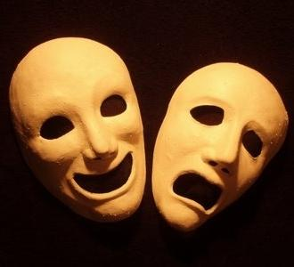
Comedy or tragedy?
Comedy is not the opposite of tragedy but the same, viewed from a different perspective.
Notes:
What do we deduce about the employment of the Shakespearean comedic structure? What do we deduce about the relevance of the Greek tragedy stages? On a continuum: where does Jerusalem sit?

Slide 15
Reading on…. p 18
Ginger paralinguistically takes control (points to….) Taboo language. The disconnection is obvious in that the Professor doesn't respond to the taboo language and maintains formality in his term of address ("Doctor Pringle" etc…)
Mixed register of Ginger's speech, parodying the Professor's formality ("delightful") and use of taboo language ("cock and balls")
Sergeant Major's – inclusion of whiskey. Repeated reference to military.
Archaic references of the Professor – "Woden" (an Anglo-Saxon warrior god, who used to ride his eight legged horse through the forests. It was believed that if you saw Woden's wild hunt then some disaster would befall you.) Direct reference to Titania, the fairy queen of Midsummer's Night Dream.
Unity of the two signified in the synchronised actions (Drain their cups. Slap them down.) Celebration of the ancient.
Johnny tells a story about the council officials to make sure that the Professor doesn't worry. He will offer another version later.
Notes:
Given 10 minutes to respond. Pulling together dramatic, stylistic, discourse, context….

Slide 16
p 19
Personification of the morn ("him") – suggesting Johnny's affinity with nature
Sense of the ancient celebration of May Day ("magic morn" "wild green time"), contrasting to the modern celebrations of the Flintock Fair ("Hot-dog vans" etc)
Johnny takes the more adult role here ("Don't worry yourself" "Take care, Professor") and answers his questions ("Are you sure… What about Mary? etc)
Use of second person pronoun ("your Mary") echoes the Professor's earlier use of "my Mary".

Slide 17
p 20
Incongruity of Lee appearing from the couch – theatricality of this – the audience is surprised by his appearance.
Repetition is a component of comedy – here the noun "gathering" is repeated again – see p 21 ("gathering. Gathering.") and p 11
Lexical repetition of "right. Then." (x 11) Comic repetition.
Sense of anarchy in Johnny's destruction of his television – he denies it three times until he sees the evidence. A repeated pattern, when characters don't believe a story until they see physical evidence.

Slide 18
p 21
Shift from the lexis of Rooster's wood, which is often idiomatic and taboo, and repetitive, to that of the outside world, with proper nouns and numerals: ("Heathrow Airport. 6 am)
This is a play featuring characters who are stuck – in grief, adolescence, apathy, and Lee is alone in his ability to leave the world
Parallel to the Professor, in the sense that Lee demonstrates knowledge of worlds and cultures beyond that of Flintock and Roosters Wood.

Slide 19
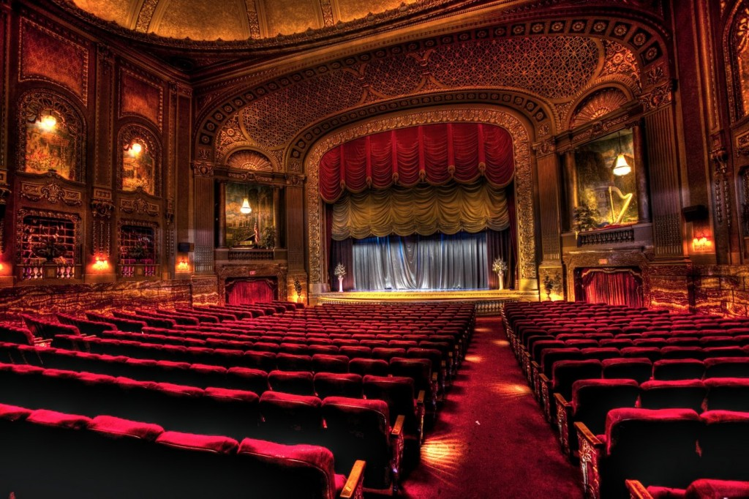
Read on For Next Week… and…
Find a review of Jerusalem. Read it, and summarise it.
Identify the most interesting point that the reviewer makes about the play.

