Slide 1
Week 3 – Never Let Me Go
Assessment Objectives and the Perfect Paragraph
Notes:
Introduction. Aims and objectives: to revise chapter 2, to examine the AOs of A level English Lit; to introduce the concept of science and society; to examine the method by which to write a paragraph; to apply this knowledge to extracts from the text. 5 mins

Slide 2
Assessment Objectives and weightings. Can you reduce them to one word each?
AO1 Articulate informed, personal and creative responses to literary texts, using associated concepts and terminology, and coherent, accurate written expression 5%
A01 Writing
AO2 Analyse ways in which meanings are shaped in literary texts 5%
A02 Analysis
AO3 Demonstrate understanding of the significance and influence of the contexts in which literary texts are written and received 5%
A03 Context
AO4 Explore connections across literary texts 5%
A04 Connections
Notes:
Play consequences on Chapter 2 around the class: one person starts off with what happens in the first part of the first page, then the next person takes over etc. 10 mins In response to this slide: in pairs to reduce each AO to one word. Compare words 10 mins

Slide 3
Perfect Paragraph: e.g. how does the writer attempt to make his story believable?
Topic sentence – link to question Ishiguro creates a parallel society within Never Let Me Go that is set in the 1990s in England
Specific point This forces the reader to read against the grain, as Kathy presumes that the reader shares her own experiences
Quote In her statement that “I don’t know how it was where you were”
Analysis we are addressed in the second pronoun “you”, but the past tense of “were” suggests that we have experienced a similar childhood. Logically, this would leave the reader nearing completion.
Context – wider angle The first person narrative voice enables Ishiguro to create the society of the novel through a limited viewpoint, that assumes that the world of carers and donations is normality.
Link back to question – and on to next paragraph The use of the first person narrator helps to increase the credibility of the novel, creating a link between the world of the novel and that of the reader.
Notes:
Introduction on how to create a perfect paragraph. 5 mins

Slide 4
Reading on through Chapter 1… a few things to note
p 6 "Driving around the country now" – adverb of time ("now") shifts the reader back to the present tense of narration. Also worth noting the repeated activity of driving ("I go on driving…" "I drive" "I was driving" (p 6) see Chapter 10 "I'll be driving…")
p 6 "misty" suggests confusion. Fog will become increasingly obvious at the close of the novel
p 6 "empty stretch" – desolate nature of the landscape through which Kathy drives increases the sense of her isolation and sadness
p 6 role of the pavilion – a space that is outside the institution of Hailsham, and beyond the surveillance of the guardians – evidence of this in the repeated reference to "hide out" and "hidden away"
p 6 also repeated reference to "closest" (p 7) and "best friends" foregrounds the importance of this to Kathy

Slide 5
p 7 and p 8
Analogical function of the setting to suggest Kathy's happiness – "bright sunshine"
Repeated references to windows, ("gathered around the windows" throughout the novel, as characters observe others, while remaining separate from them
p 8 sense of her fallibility ("Maybe I'm remembering it wrong…") unreliable narrator. Seen also on P 10 and 11 in her expression of uncertainty "I suppose"
p 8 Tommy's first tantrum

Slide 6
p 9 - 12
Repeated tantrum in Chapter 22, seen, too, in the lexis – (E.g. "Jumble of swear words" (p 9) and "jumbled swear words" (Ch 22) "nearest fence post" (p 9) "the fence post" (Ch 22) "flinging his limbs" (p 9) and "flinging his fists" (Ch 22) etc
First reference to the importance of possessions to the clones, here it is Tommy's T shirt ("the one he was so proud of…"). They hold onto things because they have so little, and they lose so much.
Often the characters "walk away" or "turn away" at the end of the chapters, but their separations are temporary – they have nowhere else to go.

Slide 7
Consequences - Chapter 2: one student starts the story from the start of the chapter, then the next student takes over from them.
p13 Realisation that the clones have a medical every week
p 14 Tommy tries to apologise to Kathy. She feels embarrassed
p 15 Exposition – we hear about past tantrums. Ruth is not sympathetic – "he's got to change his attitude" – the difference in their characters is already obvious
p 16 Explanation of exchanges, where their art work is exchanged for tokens, which the clones use to buy other students' artwork
p 17 Conversation with Ruth in Dover.
p 18 Conversation about poetry with Ruth
p 19 Revelation that Tommy can't draw (elephant incident)
p 20 Explanation that this is why the other clones started to reject him
p 21 Unexplained cessation of Tommy's tantrums
p 22 Kathy decides to ask him what has happened
p 23 Tommy reveals that it is related to something Miss Lucy said to him
p 24 He says that he will explain it to her later, down at the pond.

Slide 8
Never Let Me Go
Chapter 3 and 4, setting and genre
Notes:
One way in which the author creates a sense of credibility is through the choice of setting….

Slide 9
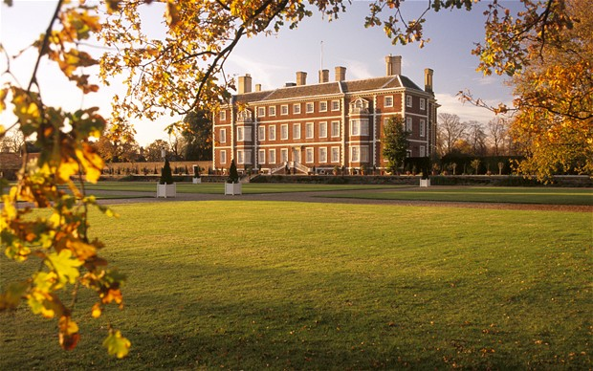
Notes:
word association with these images – to highlight the symbolic nature of the settings: to create contrast etc

Slide 10
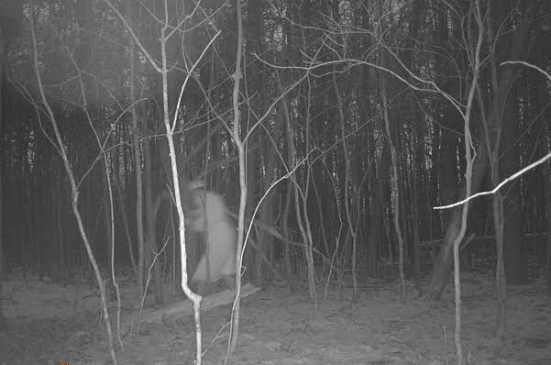

Slide 11
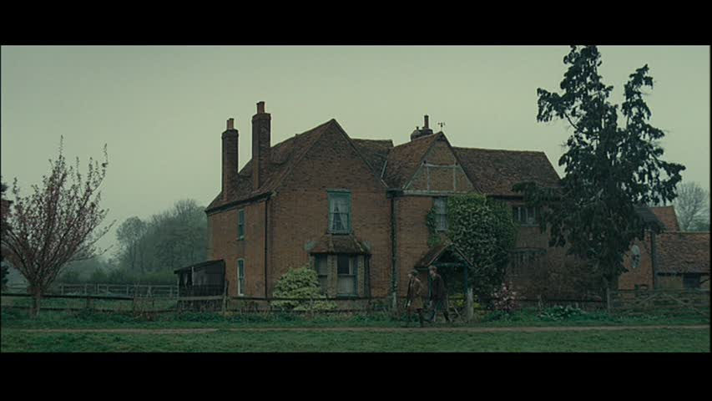

Slide 12
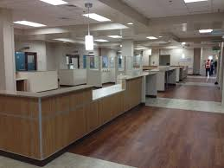

Slide 13
The Function of Setting – a few ideas:
To create the illusion of reality within the novel (referential function)
In other words: this is a fictional place where the fictional characters could actually exist.

Slide 14
To imitate the “real” world outside the novel (by using place names, names of cars etc) (verisimilitudinal function)
I O W: this novel is not disconnected from our world completely.

Slide 15
To build up atmosphere or to suggest a message (in the use of repetitions or contrasts, for example) (symbolic function)
I O W: these two settings contrast dramatically because of the type of people who live there/because different settings allow different actions to happen/the contrasts heighten our perception of each setting etc.

Slide 16
To suggest or reveal a character’s state of mind as a parallel becomes obvious between the setting and the character (analogical function)
I O W: this is the same setting, but the adjectives used/the focus is very different – it is the character whose perception has altered.

Slide 17
Settings – what function do each of these have?
The pond lay to the south of the house. To get there you went to the back entrance, and down the narrow twisting path, pushing past the overgrown bracken that, in the early autumn, would still be blocking your way. p25
The way the sound travelled across the water was hard to predict; if people wanted to eavesdrop, it was the easiest thing to walk down the outer path and crouch in the bushes on the other side of the pond. p25
It was well into October by then, but the sun was out that day… p25
We were in Room 7 on a sunny winter’s morning. p32
Hailsham stood in a smooth hollow with fields rising on all sides. That meant that from almost any of the classroom windows in the main house – and even from the pavilion – you had a good view of the long narrow road that came down across the fields and arrived at the main gate. p34
The afternoon Madame’s car was spotted coming across the fields, it was windy and sunny, with a few storm clouds starting to gather. p34
We were in the library, sitting around the big oak table. I remember there was a log burning in the fire-place… p40
Hailsham was full of hiding places, indoors and out: cupboards, nooks, bushes, hedges. p43
The little footpath that went all round the back of the main house was a real favourite of mine. It followed all the nooks, all the extensions; you had to squeeze past shrubs, you went under two ivy-covered arches and through a rusted gate. All the time you could peer in through the windows, one after the other. I suppose part of the reason I like the path so much was because I was never sure if it was out of bounds. p44
Because more and more these days, I’ll be driving past fields on a long afternoon, or maybe drinking my coffee in front of a huge window in motorway service station… p45
We’re in the open, under a warm sun, so it’s probably the sandpit in the Infants’ play area… p45
The woods were at the top of the hill that rose behind Hailsham House. All we could see really was a dark fringe of trees, but I certainly wasn’t the only one of my age to feel their presence day and night. p49
Even now, if I’m driving on a long grey road… p55
Notes:
Each student has a list of settings – identify the function…. 15 mins

Slide 18
How does the writer attempt to make the story credible? (e.g. voice, verisimilitudinal function of setting, referential function of setting, semantic field of numbers)
This was all a long time ago so I might have some of it wrong; but my memory of it is that my approaching Tommy that afternoon was part of a phase I was going through around that time – something to do with compulsively setting myself challenges – and I’d more or less forgotten all about it when Tommy stopped me a few days later.
I don’t know how it was where you were, but at Hailsham we had to have some form of medical almost every week – usually up in Room 18 at the very top of the house – with stern Nurse Trisha, or Crow Face, as we called her. That sunny morning a crowd of us was going up the central stair case to be examine by her, while another lot she’d just finished with was on its way down. So the stairwell was filled with echoing noise, and I was climbing the steps head down, just following the heels of the person in front, when a voice near me went: “Kath!”
Notes:
Students given an extract in their pairs. Feedback ideas to the class. 15 mins

Slide 19
Close Analysis
Inclusion of question of unreliability: undermining the certainty of the narrative voice
Use of hyphens to create the sense of the spoken voice: attempting to engage the reader
Assumption of shared experience of Kathy and the reader: shared society.
Broken, elliptical sentences – creating sense of immediacy, of the thought process
Science is part of the normality of this society – in the form of a medical and examination
“finished with” suggests a casualness
“following the heels”: sense of acceptance of fate
This was all a long time ago so I might have some of it wrong; but my memory of it is that my approaching Tommy that afternoon was part of a phase I was going through around that time – something to do with compulsively setting myself challenges – and I’d more or less forgotten all about it when Tommy stopped me a few days later.
I don’t know how it was where you were, but at Hailsham we had to have some form of medical almost every week – usually up in Room 18 at the very top of the house – with stern Nurse Trisha, or Crow Face, as we called her. That sunny morning a crowd of us was going up the central stair case to be examine by her, while another lot she’d just finished with was on its way down. So the stairwell was filled with echoing noise, and I was climbing the steps head down, just following the heels of the person in front, when a voice near me went: “Kath!”
Notes:
Complete a perfect paragraph, with reference to these notes if they prefer. 15 mins

Slide 20
Your Task: using the extract that you have been given….
Write a piece of analysis using the Perfect Paragraph structure, answering the question “How does the writer attempt to make the story credible”?
Topic sentence
Specific point
Quote
Analysis
Wider context
Link back to question and onto next paragraph.
You have 10 minutes to complete this task.

Slide 21
How does the writer attempt to make the story credible?
I saw a few of the incidents myself. But mostly I heard about them, and when I did, I quizzed people until I’d got a more or less full account. There were more temper tantrums, like the time Tommy was supposed to have heaved over two desks in Room 14, spilling all the contents on the floor, while the rest of the class, having escaped onto the landing, barricaded the door to stop him coming out. p 14

Slide 22
How does the writer attempt to make the story credible?
Looking back now, I can see why the Exchanges became so important to us. For a start, they were our only means, aside from the Sales – the Sales were something else, which I’ll come to later – of building up a collection of personal possessions. … Ruth and I often found ourselves remembering these things a few years ago, when I was caring for her down at the recovery centre in Dover. p 16

Slide 23
How does the writer attempt to make the story credible?
I’m not sure when the big temper tantrums started. My own memory of it is that Tommy was always known for his temper, even in the Infants, but he claimed to me they only began after the teasing got bad. Anyway, it was those temper tantrums that really got people going, escalating everything, and around the time I’m talking about – the summer of our Senior 2, when we were thirteen – that was when the persecution reached its peak. pp 20-21

Slide 24
How does the writer attempt to make the story credible?
I was mystified, and decided to probe him a bit the next time we could talk in private. The chance came along before too long, when I was lining up for lunch and spotted him a few places ahead in the queue.
I suppose this might sound odd, but at Hailsham, the lunch queue was one of the better places to have a private talk. p 22

Slide 25
Read on, in preparation for a quiz and work on Chapters Three, Four and Five for next week.
Please bring in your annotated texts to class.
You should look in particular at
the function of setting,
the narrative voice,
the narrative choices,
at patterns of lexis, syntax and imagery.

