Slide 1
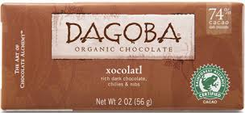
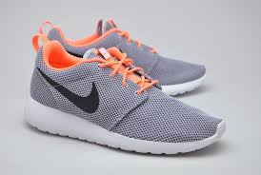
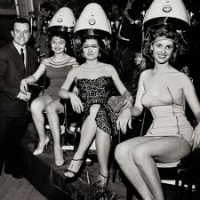
Identify the Market
Global / Local
Mass / Niche
Trade / Consumer
Product/Service
/Seasonal

Slide 2
Market Segmentation

Slide 3
What would this person spend their money on?
Male
Mid 30’s
Family (Partner, 2 kids under 8 years old)
Professional
Vegetarian
Enjoys Music, Sport (taking part and watching)
Notes:
Write your ideas on a post-it note and stick it on the whiteboard.

Slide 4
Learning Objectives
Explain what is meant by market segmentation (and the reasons for it)
Explain how markets are segmented
Evaluate the importance and impact of segmentation to a business and its customers

Slide 5
What is it?
It is a way of breaking down the market into segments (sub-groups) that have common features or individuals who make purchasing decisions on common factors.

Slide 6
What makes targeting a segment worthwhile?
They must be recognisable
(i.e. different enough from other segments to make producing for that segment worthwhile e.g. housing)
Must have critical mass (be big enough to be worthwhile i.e. produce enough sales value to make the production worthwhile e.g. two seater sports cars)
Targetable – have their own identity that can be promoted to

Slide 7
NOTE! You have to give specifics in your exam answers not just the category!!

Slide 8
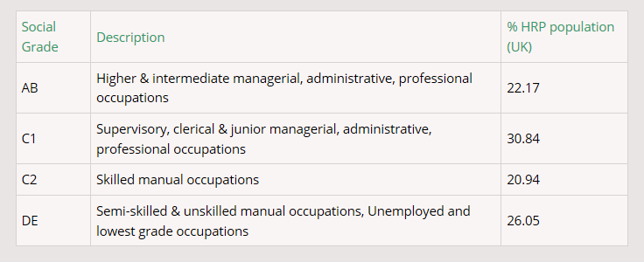
Socio-economic groups
Notes:
It applies to every Household Reference Persons (HRP) aged 16 to 64

Slide 9
Why segment?
Businesses can use a segment oriented marketing approach
Targeted marketing to stress the product features that are most relevant for the segment (e.g. price vs quality vs brand identity) Targeting will occur even if the product being sold to different segments is identical./
Customers change their preferences over time – sustainable customer relationships in all phases of the customer life cycle can come from segmenting markets and allow the business to serve different segments along a customer’s life cycle (e.g. can manufacturers offer first cars for students, fun car for young professionals, a family car for young families and SUV for growing families)

Slide 10
Market Segmentation

Slide 11
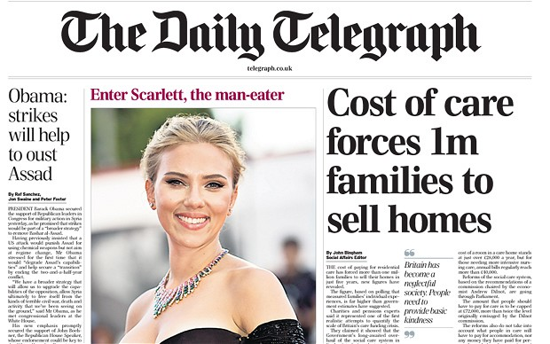
Socio-economic groups activity
In pairs, can you link the newspapers to socio economic groups? Why would a newspaper want to do this?

Slide 12
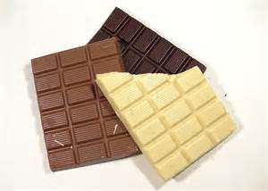
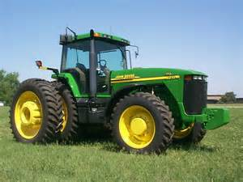
Choose 2 products to segment
Notes:
Work with person sat next to.
Compare with other class mates.

Slide 13
Benefits of segmentation
To increase market share
To assist new product development
To extend products into new markets
To identify new ways of marketing a product

Slide 14
Drawbacks of segmentation
Difficulty in identifying the most important segments for a product
Reaching the chosen segment with marketing
Recognising changes in the segments interested in the product
Meeting the needs of customers not included in the chosen segment

Slide 15
Activities
Work your way through the market segmentation workbook on Godalming Online (just write your answers to the questions into your notes)
Use the exam board notes (at the top of the Markets section) together with the Wolinski Market Segmentation Notes and my lesson slides (all on GOL)
Internet for question 6.
Please read questions carefully if you are being asked to explain, make sure you do actually explain your answer.
It is all good exam practice!

Slide 16
Exam Question Example
How to approach this type of question ....
Choose two segmentation examples, explain the benefits to Ford and then the benefits to the customers

Slide 17
How are the marks allocated?

