Slide 1
Jerusalem
Comedic Conventions

Slide 2
Your task – you have 10 minutes to prepare to present on the topic of…
The Green World
The Lord of Misrule
The Carnivalesque
Three theories of comedy
You should explain what it is. At home, you can research it. In class, you have a handout to inspire you…
You should explain what relevance it has to Jerusalem.
You should find specific examples from the text to illustrate it.
You will talk to the rest of the class, with a PowerPoint slide as a backdrop to your talk

Slide 3
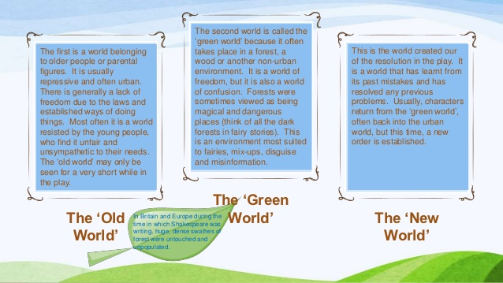
“The Green World”
There is a movement from the tyranny of the everyday social world to a magical, natural realm in which festive play renews society, inhibitions are lifted and new identities are found. The ritual of death and revival is the fundamental drama of the “Green World”.

Slide 4
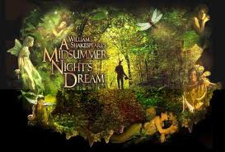
The Green World

Slide 7
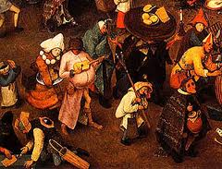
The Carnivalesque
Mikhail Bakhtin's four categories of the carnivalistic sense of the world:
1. Familiar and free interaction between people: carnival often brought the unlikely of people together and encouraged the interaction and free expression of themselves in unity.
2. Eccentric behaviour: unacceptable behaviour is welcomed and accepted in carnival, and one's natural behaviour can be revealed without the consequences.
3.Carnivalistic misalliances: familiar and free format of carnival allows everything that may normally be separated to reunite- Heaven and Hell, the young and the old, etc.
4. Sacrilegious: Bakhtin believed that carnival allowed for sacrilegious events to occur without the need for punishment. Bakhtin believed that these kinds of categories are creative theatrical expressions of manifested life experiences in the form of sensual ritualistic performances.
This is a term used in the English translations of works written by the Russian critic - Mikhail Bakhtin - which refers to a literary mode that subverts the established genre or style through humour and chaos.
Through the carnival and carnivalesque literature, a "world upside-down" is created, ideas and truths are endlessly tested and contested, and all demand equal dialogic status. The “jolly relativity” of all things is proclaimed by alternative voices within the carnivalised literary text that de-privileged the authoritative voice of the hegemony through their mingling of “high culture” with the profane (ie no one voice has superiority over another – they are all equally valid.)

Slide 8
The Carnivalesque

Slide 9
The Carnivalesque

Slide 10
The Carnivalesque….
brings unlikely people together, encouraging interaction
welcomes usually unacceptable behavior
The freedom allows everything that may normally be separated to reunite
Allows normally unacceptable events to occur without the need for punishment.

Slide 11
The Lord of Misrule

Slide 12
The Lord of Misrule
Misrule – often featuring someone in charge who possibly shouldn’t be; hierarchies are upset. This figure orchestrated the entertainment. …was given permission to rule … to take charge of the society for a limited period. His period in charge was one of misrule, of subversive freedom and topsy-turvyness.
Asserts his power over others through his stories – wooing Dawn, for example, with words.
Mocking the council, parodying their words and official language
Power over them in terms of providing them with drugs – Wesley prepared to humiliate himself for three grams of “whizz”
Parodies the language of the establishment in his speeches to his “minions of my kingdom”, holding a “beggar’s banquet”. Refers to himself as their “merciless ruler” and passes “a new law”.
His kingdom is under threat from the establishment. He used to be the Flintock Fair, but in Act 2 he makes the decision to not even attend. Idea that his kingdom has shrunk to the mobile home in the wood. The carnivalesque used to exist outside the forest, but the fair has been commercialised and Johnny is no longer relevant or tolerated outside the green world in which he lives (banned from all the pubs)
Power over a world that has few rules – except those decreed by Johnny himself – usually involving him banishing characters from his kingdom – “if you are, get out of my wood” “if you’re saying I’m that sad, get off my land” (pp 74-76)
Elements of the carnivalesque: brings unlikely people together, encouraging interaction, welcomes usually unacceptable behavior. The freedom allows everything that may normally be separated to reunite. Allows normally unacceptable events to occur without the need for punishment.

Slide 13
The Lord of Misrule

Slide 14
Lord of Misrule …
This figure orchestrated the entertainment
…was given permission to rule
… to take charge of the society for a limited period
his period in charge was one of misrule, of subversive freedom and topsy-turvyness.

Slide 15
Theories of Comedy
Incongruity | mismatch of style and subject, contrasts etc
Superiority theory: | we laugh because we believe ourselves to be superior to the characters
Relief theory | we laugh because we are uncomfortable

Slide 16
Relief theory

Slide 17
Superiority theory

Slide 18
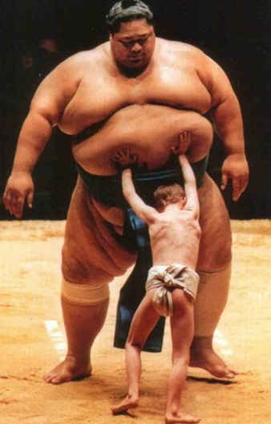
Incongruity Theory

Slide 19
What’s so funny?
Whiz. Wangers. Sick beats. Tasty birds. Rum n’ Ribena. Benilyn ‘n’ brandy…. Birds are going bats for it. Banging it back. Then, right. Then. Right. Then. (He cracks up.) Then. Right. Then. (Laughs) Then. Right. Rooster. Right. (Cracks up. He says it. He’s laughing so hard, you can’t understand it.) (p 20)
Whiz. Wangers. Alliteration – language of comedy Sick beats. Parody of a sociolect Tasty birds. Rum n’ Ribena. Benilyn ‘n’ brandy…. Incongruity – drinks from two worlds: adult and child. Birds are going bats for it. Banging it back. Alliteration Then, right. Then. Right. Then. (He cracks up.) Then. Right. Then. (Laughs) Then. Right. Rooster. Right. Repetition – language of comedy. (Cracks up. He says it. He’s laughing so hard, you can’t understand it.) Superiority theory – we recognise the character's lack of control.

Slide 20
What’s so funny?
GINGER: So what’s your Red Indian spirit name then, Lee?
JOHNNY: “Burns his Smurfs”
GINGER: “Flies to Australia and Comes Straight Back.” (p 23)
GINGER: So what’s your Red Indian spirit name then, Lee?
JOHNNY: “Burns his Smurfs” Parody of sociolect
GINGER: “Flies to Australia and Comes Straight Back.” Parody

Slide 21
What’s so funny?
TANYA: They should put him in the town square. Next to King Arthur.
PEA: His arm round King Arthur and a fucking great spliff on the go.
LEE: “Johnny Byron. Wiltshire’s Biggest Bullshitter.” p 33
TANYA: They should put him in the town square. Next to King Arthur. Incongruity of juxtaposition of these two figures – one ancient, one modern – establishment and anti-establishment
PEA: His arm round King Arthur and a fucking great spliff on the go. Incongruity of monarch and drugs
LEE: “Johnny Byron. Wiltshire’s Biggest Bullshitter.” Parody of official language of the "blue plaque"

Slide 22
Comedic Language Features
Hyperbole (exaggeration)
Litotes (understatement)
Incongruous juxtapositions (things put together that don’t naturally go together)
Paronomasia (puns or word play)
Parody of other styles
Allusion to other texts
Repetition
Euphemism

Slide 23
Analyse the following extract, examining how Butterworth uses comedic language…
I went along. I weren’t busy, so I snuck in the back in disguise. You get a cup of tea. Flapjack. Then they all sit down on foldy chairs and go beserk. All these normal-looking people screaming like banshees. Snakes on their neck. Weeping with rage. Tearing their hair out. Everyone gets very red in the face. This one mum, Kelly Wetherley, she’s up there, red in the face, microphone, saying, ‘Johnny Byron is a filthy menace, Johnny Byron is a disgrace to Flintock,’ and I swear to Christ that I was shagging her only last June. I painted her house. Every time her husband went away she suddenly wanted her skirting boards seeing to. Stairs. Bedroom ceiling. In fact I’d say I know her pretty well, and I’m here to tell you, she goes a lot redder in the face than what she did at that meeting. That bedroom must’ve got sixteen coats. I counted five or six others sprinkled around that hall. I can’t help it if they can’t forget me. You watch. Four hundred yards down there, through them trees, across the brook, are seventy-eight brand-new houses. Them houses is lovely, clean and spanking now. But come two, three summers, couple hard winters, those windows’ll peel. Doors. Ceilings. Skirting boards. Sooner or later those houses, trust me, those houses’ll need painting. P 34
What you can look for: Hyperbole (exaggeration). Litotes (understatement). Incongruous juxtapositions (things put together that don’t naturally go together). Paronomasia (puns or word play). Parody of other styles. Allusion to other texts. Repetition. Euphemism

Slide 24
Comedic Language Features
Incongruous juxtaposition: “foldy chairs” and “go beserk” – (the practical juxtaposed with an extreme emotion that suggests a lack of control)
Allusion to Greek myth etc. “snakes on their neck” – incongruity of all encompassing Greek myth with the villagers in the hall
Hyperbole: “weeping with rage. Tearing their hair out.” followed by litotes “Everyone gets very red in the face”
Incongruous juxtaposition: “I swear to Christ I was shagging her…” (the sacred and the profane)
Repetition: “I painted her house”, “skirting boards seeing to” “sixteen coats” “those houses’ll need painting” “red in the face”, “red in the face” “lot redder in the face” – delayed resolution
Euphemisms: “seeing to” “sixteen coats” contrasts with the overtly taboo language that Johnny usually uses.
Parody of Kelly Wetherley in the use of the direct speech: “Johnny Byron is a filthy menace. Johnny Byron is a disgrace to Flintock.”

Slide 25
Comedic language….
Language turned on its head.
Used subversively to disorientate us: we laugh at Johnny’s adultery, we laugh at the villagers’ anger.
“Giddy language” according to Keirnan Ryan: “the dialogue is free to dance, however dark and painful the realities that lie beneath it.”

Slide 26
Your Task:
You are responsible for one page (allocated to you)
You should identify the central quote on your page, explaining why you have chosen it. You should analyse it from a
Stylistic perspective
Dramatic perspective
In terms of your contextual knowledge about comedic conventions and language
Its relevance to the play as a whole. (thematic focus)
p 23, p 24, p25, p 26, p 27, p 28, p 29, p 30, p 31, p 32, p 33, p 34

Slide 27
pp 34 - 35
Echo of the comedic convention of putting on a disguise: Enter Wesley, dressed as a morris dancer.
"It's a long story … I got roped in" – a characteristic feature of Wesley's speech is his use of cliché. Repeated on p 35.
p 35 Use of first person plural by Wesley – suggesting a community beyond Rooster's Wood.
p 35 Wesley claims to be a part of a different group ("The Flintock Men") – this is questioned by his friends. Their scorn is borne out by the fact that this is a newly established group, formed by the brewery.
p 35 Mixed register in Wesley's speech of informality ("It's bollocks, really.") and a learned discourse ("it connotes fertility and the hunt.") He adopts the brewery's discourse later in "Point-of-sale material"). Wesley is controlled by the pub ("it's out of my hands"), and this is reflected in the way that he unquestioningly adopts the brewer's discourse.

Slide 28
p 36 - 37
Sense of community and unity, as the others sense that Wesley needs to speak in private ("Right, I'm off" etc)
Repetition of DJ conversation of p 17 – lexical and syntactical parallelism ("No he's not…. He's not.)
Stichomythic exchange indicates closeness of characters ("Get lost?//"crash?// "Have a fight" etc)
Paronomasia of "over" and "under"
Repeated reference to the young as "rats" "vermin", now "cheeky moo" – impression of numbers of them- a herd or plague – something unwelcome.

Slide 29
p38 - 39
p 38 Military reference ("Spitfire flyby")
p 38 Dialect evident throughout ("Laters.")
p 38 Subject specific lexis ("gram" "chalk" "whizz" "bluey") – a shared knowledge, indicating the closeness of the group
p 39 Incongruity of using a tortoise as payment – perhaps appropriate for this anarchic world
p 39 Johnny's mix of register "sunk this economy" (formal) prefaced with non-standard use of adverb "what". (informal)

