Slide 1
Market Structure: Marketing and Competitiveness

Slide 2
Learning Objectives
Understand that different markets have differing degrees of competition
Explain the features of perfect competition, monopolistic competition, oligopoly and monopoly and their impact on business behaviour
Understand the reasons why consumers sometimes need protection from exploitation from businesses

Slide 4
Marketing and competitiveness are affected by the business environment
Type of industry
Market conditions
Number of competitors

Slide 5
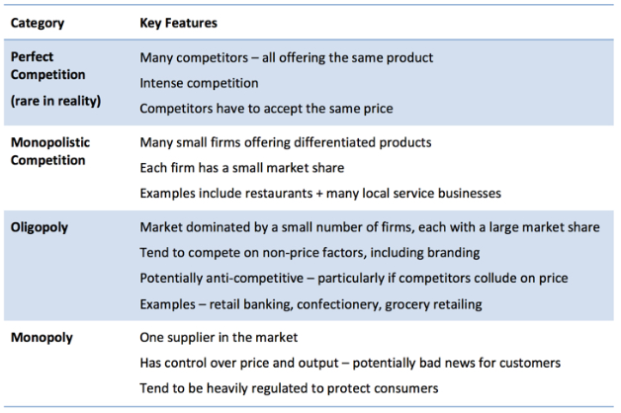

Slide 6
Activities
Read the exam board notes on market structures as well as the scanned text book pages
(all on GOL in Business Opportunities/Markets/Market Structures – all of my resources are at the bottom of the list)
Complete the Market Structures tasks (document on GOL) which includes:
Define the key terms task:
Describe and explain the different types of market structures task
Market structures quiz
Extension:
Complete the case study “Market conditions in the UK milk industry”

Slide 7
Key Term | Definition
Barriers to entry | Factors which make it difficult or impossible for businesses to enter a market and compete with existing producers
Cartel | A group of businesses (or countries) which join together to agree on pricing and output in a market in an attempt to gain higher profits at the expense of customers
Collusion | Where several businesses (or countries ) make agreements amongst themselves which benefit them at the expense of rival businesses or customers
Competition | Rivalry between businesses offering products in the same market. Competition may take forms such as price competition, distinctive product offering, advertising and distribution
Market Structures | The characteristics of a market, such as the size, barriers to entry, the number of businesses in the market or whether they produce identical products which determine the behaviour of businesses within the market
Product differentiation | The the process of distinguishing a product or service from others, to make it more attractive to a particular target market)
Price maker / taker | Able to determine the prices they charge Large firm sets a market price that small firms (price taker) tend to follow

Slide 8
Key Term | Definition
Price war | A price war occurs when rival companies match each other’s price cuts in order to increase sales volume and keep customer leading to reduced profit margins
Product differentiation | The the process of distinguishing a product or service from others, to make it more attractive to a particular target market)
Monopolistic competition | When a large number of firms are competing in a market, each having enough product differentiation to achieve a degree of monopoly power and therefore some control over the price they charge

Slide 9
Perfect competition
Definition: a market structure where there is a large number of small businesses producing identical products, where barriers to entry are low and where businesses are price takers.
Characteristics
All the sellers produce homogeneous (identical) products.
Sellers are ‘price takers’ — they accept the ruling market price.
The buyers all have perfect knowledge.
There is freedom of entry into and exit from the market for firms.

Slide 10
Perfect competition
To a large extent perfect competition is a theoretical model, rather than one that exists in the real world.
Because all products are identical and firms are price takers, there can be no distinction in products and prices between different firms competing in a perfect market.
Consequently, there is also no point in promoting a product that cannot be distinguished from competition.

Slide 11
Monopolistic competition
Definition: A large number of small businesses producing differentiated, branded products, where barriers to entry are low and businesses are price setters
When a large number of firms are competing in a market, each having enough product differentiation to achieve a degree of monopoly power and therefore some control over the price it charges.
Monopolistic competition can result from the development of a brand name or local reputation.

Slide 12
Monopolistic competition
Examples are hairdressers, cafés and gyms.
A hair salon might have an excellent reputation and loyal clientele, which enable it to charge higher prices that other hair salons in the vicinity
It is easy for a new firm to enter this type of market because the set-up costs tend to be relatively low and the nature of the market is such that there is a constant flow of businesses.
Notes:
E.g. a local bar may have developed a reputation as ‘the place to be’ for 18 to 25 year olds, even though its prices are much higher than the pub next door

Slide 13
Monopoly
Definition: A market structure where there is a single business in the market and there are barriers to entry.
Characteristics
A single producer within a market (one business has 100% of the marketplace).
The legal definition is a firm with a market share of 25% or more.
The potential danger of monopolies is that they will exploit the consumer.
They will erect barriers
The government investigates them and can require them to change their behaviour and subject them to massive fines.
Notes:
30 years ago – Monopolies were common (same gas, electricity, telephone suppliers)

Slide 14
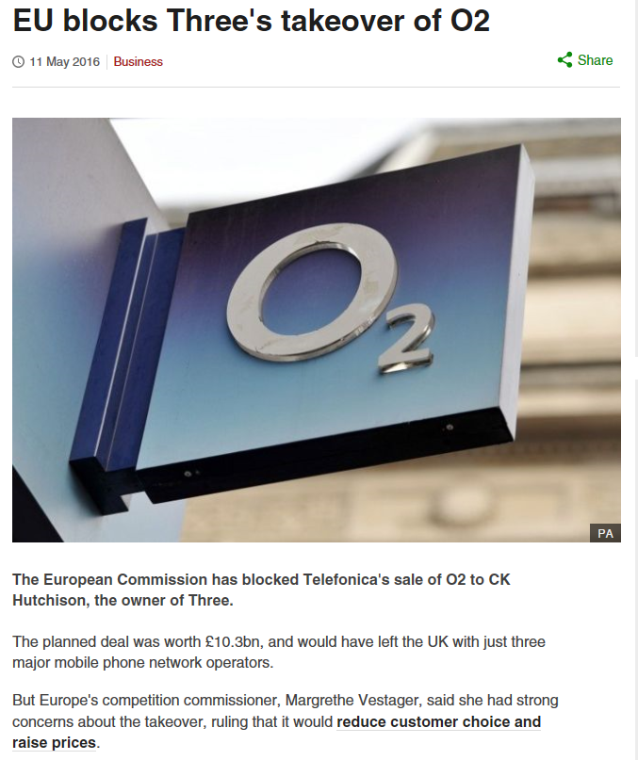
Monopoly
Firms with more than 25% of the market continue to exist because it is extremely difficult for a new firm to enter the market of a monopolist owing to high barriers to entry
http://www.bbc.co.uk/news/business-36266924
Notes:
Tesco managed to get away with it (30%) as they argued that they are not just grocery
Barriers: patents, advertising (to build brand loyalty)

Slide 15
Monopoly
Advantages | Disadvantages
May reduce prices making goods affordable (due to economies of scale) | May exploit the consumer
Profits earned can be invested into improving production techniques or developing new product | Can charge high prices and offer poor service (as no competition)
 | May waste scarce resources due to being inefficient

Slide 16
Monopoly
Barriers to entry include:
the high capital costs required to set up a new business in large markets
patents that allow existing firms to ‘monopolise’ the market legally
the loyalty of customers to existing firms
the need for new firms to achieve large scale production quickly in order to be competitive

Slide 17
Oligopoly
Definition: a market structure where a few large businesses dominate the market producing differentiated, branded products, where barriers to entry are typically high and where businesses are prices setters.
Characteristics
Many businesses by only a few dominate the market
Differentiated products with a strong brand identify
Brand loyalty is encouraged
Prices can be stable however price wars can occur
Some barriers do exist
Price war = a period of fierce competition in which traders cut prices in an attempt to increase their share of the market.
Notes:
Many of our large industries are oligopolistic in nature (e.g grocery market / Clothing retail – three or four major chains dominate their market place)

Slide 18
Oligopoly
Non-price competition. If one oligopolist reduces price, the others follow suit and so no firm gains. Therefore, rivalry is usually in the form of ‘non-price’ competition (e.g. special offers and advertising).
Cartels. This is a group of firms that come together to agree price and output levels within an industry. Cartels are illegal in the UK, but oligopolists may be tempted to form them to keep prices high.
Examples of oligopolistic industries: grocery, clothing retail, airlines.

Slide 19
How does monopoly affect the marketing mix?
Product. With only one organisation in the market, there is little need for new product development.
Price. Monopolies are price leaders/setters and can take advantage of the lack of competition in the market in order to set very high prices.
Promotion. There are high barriers to entry in monopoly, so it is unlikely that new competition can emerge. Therefore, promotion will mainly be informative. i.e. geared towards ensuring that customers are aware of the product and its benefits, rather than persuasive.
Place. This is a relatively important element of the marketing mix because customers will be less likely to purchase products or services that are not conveniently located.

Slide 20
How does oligopoly affect the marketing mix?
Product. The product is crucial to success because a unique selling point can be achieved.
Price. Although price wars are a feature of oligopoly markets, price does not tend to be the main element of the marketing mix because price wars lead to all oligopolists losing profit.
Promotion. Promotion is important in oligopoly because it is one of the major ways in which product differentiation and unique selling points can be achieved.
Place. Place is also important in oligopolistic markets, as consumers will prefer easy access to the product.

Slide 21
How does monopolistic competition affect the marketing mix?
Product. Product is vital in monopolistic competition, as it is the critical way in which a business can make its marketing mix different from the competition. However, the vast number of competitors in this market makes it difficult to achieve a completely distinctive product.
Price. Firms accept that prices tend to be very similar and use other mechanisms to compete.
Promotion. The need to be price competitive is likely to limit promotional budgets in monopolistic competition. Therefore, it is less significant than in markets such as oligopoly, although more important than promotion would be in a monopoly market.
Place. Monopolistic competition features many small firms. Place can be very important, as consumers want convenience.

Slide 22
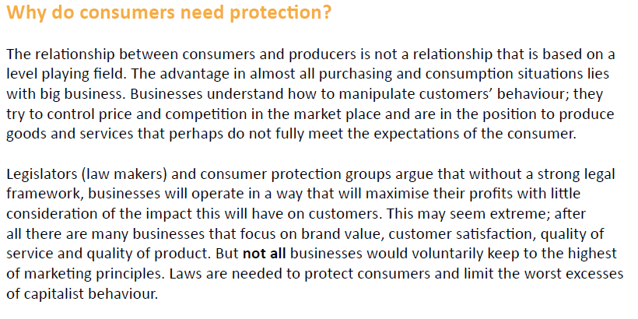
Consumer Protection

Slide 23
Activities
Log on to Godalming Online/Markets/Market Structures
Read the Consumer Protection notes and summarise on to one side of A4 – your summary sheet should include
Explanation of why consumers need protection
Brief description of the main consumer protection laws
Brief description of the role of the Ombudsman and CMA
An example of ethical issues related to consumer protection
30 minutes

