Slide 1
Markets: Demand and Supply

Slide 2
Think – Pair – Share What factors would cause the demand for the following products to increase/decrease?
Getting started:
Read pages 1- 3 of the demand and supply notes (highlight key information)
Then…..
Notes:
Beans = Income (the price and demand for other goods)
Uggs = Changes in taste and fashion (as well as the price and demand for other goods)
Zimmer frame = Changes in population e.g. ageing

Slide 3
Learning Objectives
Explain what is meant by demand, supply and equilibrium
Understand the importance of demand and supply in the market
Explain the factors that lead to a change in demand and supply
Explain how a change in demand and supply can impact on price and quantity

Slide 4
Key Terms
Demand:
The amount of a product that consumers are willing and able to purchase at any given price.
Supply:
The amount of a product which suppliers will offer to the market at a given price
Equilibrium:
The point where the demand curve and the supply curve intersect. At this point, the quantity that consumers are willing to purchase matches the quantity that suppliers are willing to supply at a given price

Slide 5
Markets and the External Environment
The markets in which a business sells its products or services are part of the external environment in which a business operates.

Slide 6
External Factors
A business does not operate in isolation, it is affected by external factors.
These will include:
Competition
Economic factors and the state of the economy
Government objectives and government policy
Legislation
Population
Social factors
Political factors
Environmental issues
Technology

Slide 7
Demand
Demand: the amount of a product that consumers are willing and able to purchase at any given price.
Demand is concerned with what consumers are actually able to buy (what they can afford to and would buy) rather than what they would like to buy.
Within any market, price is determined by the interaction of demand and supply.

Slide 8
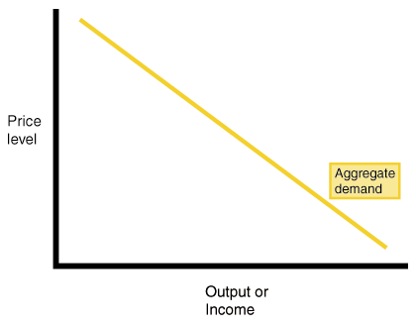
The Demand Curve
We can represent demand by drawing a demand curve.
Demand curve is downward sloping because demand and price have a negative relationship. When price increases, demand falls
The demand curve slopes downwards from left to right. A change in price will lead to a change in quantity demanded.
As price falls, demand rises (curve moves to the right).
As price rises, demand falls (curve moves to the left).
The higher the price the lower the quantity demanded.
The lower the price the higher the quantity demanded.
Quantity demanded
https://www.youtube.com/watch?v=kUPm2tMCbGE
Notes:
Curve slopes downward left to right because the quantity demanded is likely to be higher at lower prices and lower at higher prices
Aggregate demand = the total demand for goods and services within a particular market

Slide 9
What causes changes in demand?
P.I.R.A.T.E
Population (changes)
Income
Related goods and services (price and demand for these)
Advertising
Taste and fashions/preferences
Expected price changes
Notes:
Price and demand for other goods: demand for one product often depends on the price of and demand for another (e.g. the demand for one brand of tea bags can be influenced by the price of other brands)

Slide 10
Changes in demand
Income: Demand for a product will only increase if incomes of those consumers buying the product increase
Rise in income/demand at any given price: curve shifts to the right
Fall in income/demand at any given price: curve shifts to the left

Slide 11
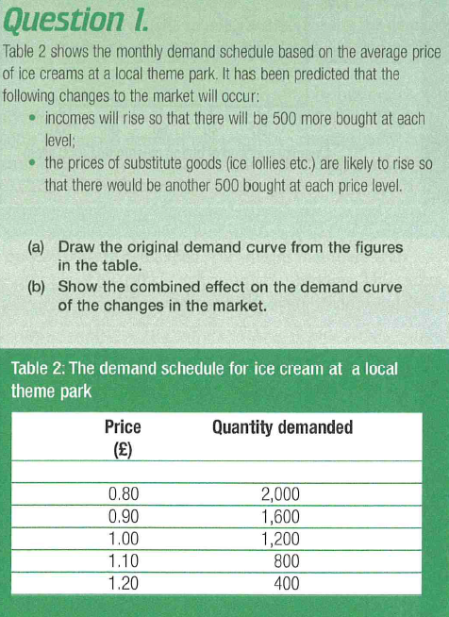
Task
Open up the “Introduction to Demand and Supply L1 Tasks” document from Godalming Online and answer question 1 (into your notes)
Notes:
10 minutes

Slide 12
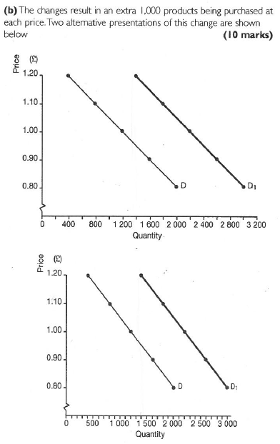
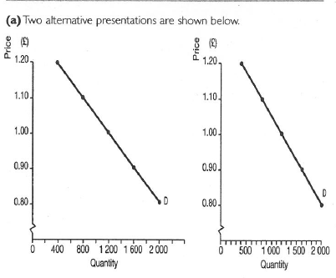
Answers to Question 1

Slide 13
Supply
Supply is the amount of a product which suppliers will offer to the market at a given price.
The higher the price of a particular good or service, the more will be offered to the market

Slide 14
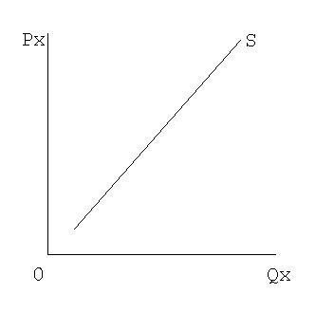
Supply Curve
The supply curve slopes upwards from left to right there is a positive relationship between supply and price. When price increases, supply increases.
As price rises producers offer more goods to the market. A fall in price will lead to the quantity supplied falling.
Again, a change in price will cause a movement up or down the supply curve but the curve will not change position.
https://www.youtube.com/watch?v=nKvrbOq1OfI

Slide 15
What causes changes in supply?
C.R.E.W.S
Cost of inputs
Related goods and services
Expected price changes
Weather
Subsidies and taxes
Less products being supplied = shift to left
More products being supplied = shift to right

Slide 16
Market Mechanism
The market mechanism works by the interaction of supply and demand (they are affected by each other)
Within a market price is determined by the interaction of supply and demand. That is how much consumers are willing to buy combined with how many goods suppliers are willing and able to supply. This will set the market price.

Slide 17
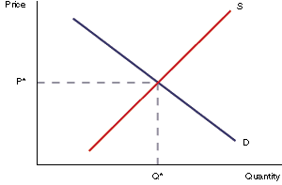
Market Equilibrium
The price in any market for any good is determined by the interaction of supply and demand.
The equilibrium point is where Supply = Demand. At this point all goods produced are sold.
https://www.youtube.com/watch?v=7eZcPs9z9OA

Slide 18
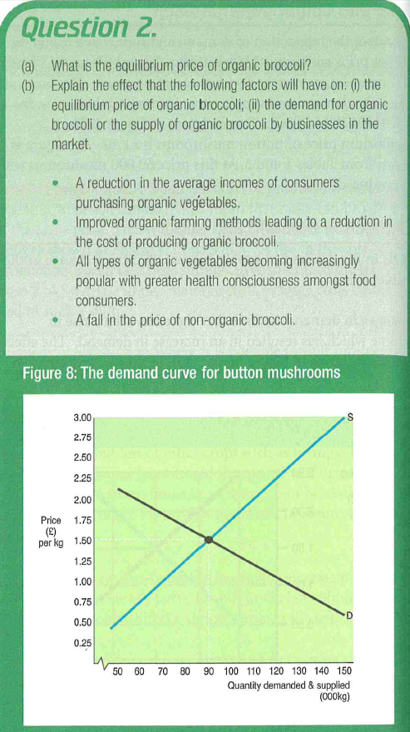
Task
Answer Question 2 from the “Introduction to Demand and Supply L1 Tasks” document from Godalming Online
Notes:
20 minutes

Slide 19
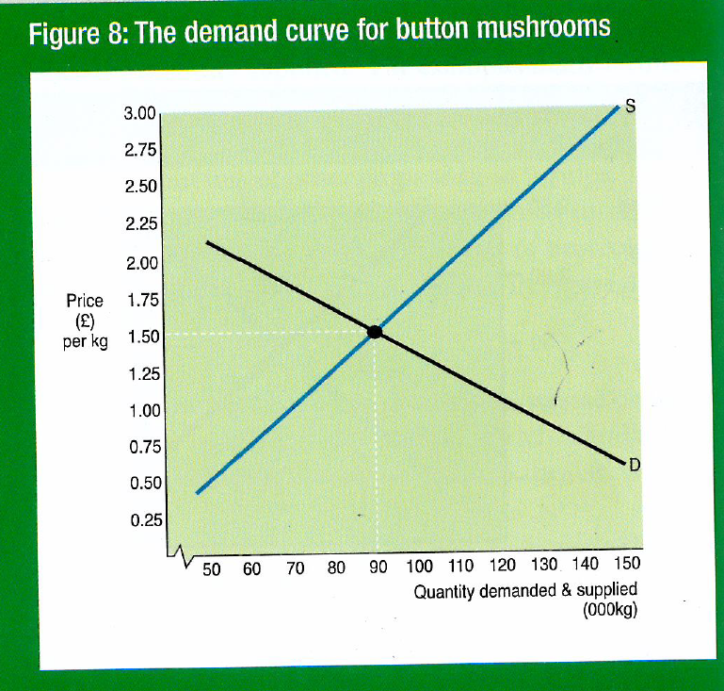

Slide 20
Excess demand and excess supply
Excess demand: occurs when the demand for a product is greater than supply.
Excess supply: occurs when the supply of a product is greater than the demand

Slide 21
Task
Carefully read the Welsh Rugby Union past paper question
Is the question concerned with customers (demand) or businesses (supply)?
Shift the demand or supply curve
Remember: LESS = LEFT so RISE = RIGHT

