Slide 1
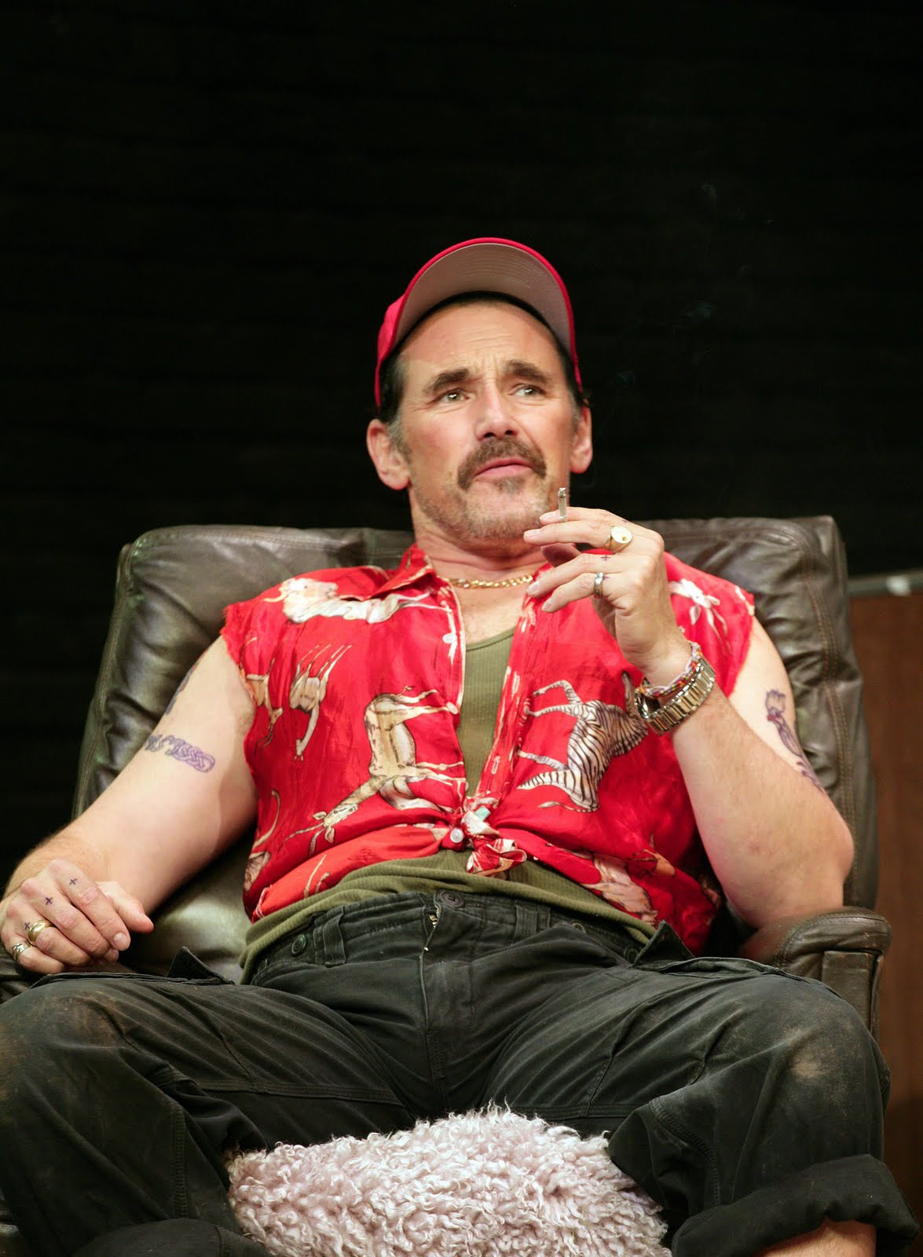
Week 6
Essay structure and Character Creation

Slide 2
A1 pp 34 - 35
Echo of the comedic convention of putting on a disguise: Enter Wesley, dressed as a morris dancer.
"It's a long story … I got roped in" – a characteristic feature of Wesley's speech is his use of cliché. Repeated on p 35.
p 35 Use of first person plural by Wesley – suggesting a community beyond Rooster's Wood.
p 35 Wesley claims to be a part of a different group ("The Flintock Men") – this is questioned by his friends. Their scorn is borne out by the fact that this is a newly established group, formed by the brewery.
p 35 Mixed register in Wesley's speech of informality ("It's bollocks, really.") and a learned discourse ("it connotes fertility and the hunt.") He adopts the brewery's discourse later in "Point-of-sale material"). Wesley is controlled by the pub ("it's out of my hands"), and this is reflected in the way that he unquestioningly adopts the brewer's discourse.

Slide 3
p 36 - 37
Sense of community and unity, as the others sense that Wesley needs to speak in private ("Right, I'm off" etc)
Repetition of DJ conversation of p 17 – lexical and syntactical parallelism ("No he's not…. He's not.)
Stichomythic exchange indicates closeness of characters ("Get lost?//"crash?// "Have a fight" etc)
Paronomasia of "over" and "under"
Repeated reference to the young as "rats" "vermin", now "cheeky moo" – impression of numbers of them- a herd or plague – something unwelcome.

Slide 4
p38 - 39
p 38 Military reference ("Spitfire flyby")
p 38 Dialect evident throughout ("Laters.")
p 38 Subject specific lexis ("gram" "chalk" "whizz" "bluey") – a shared knowledge, indicating the closeness of the group
p 39 Incongruity of using a tortoise as payment – perhaps appropriate for this anarchic world
p 39 Johnny's mix of register "sunk this economy" (formal) prefaced with non-standard use of adverb "what". (informal)

Slide 5
Some terms
Foil –
the character that is the opposite of them and reveals certain characteristics about them
Protagonist –
generates the action, often engaging the reader’s interest/empathy
Antagonist –
opposes the protagonist
Dynamic –
changes and develops through the play
Static -
remains the same throughout
Notes:
Check understanding of the terms foil, and protagonist, and antagonist. Compare to PowerPoint. 5 mins

Slide 6
Functions of Names: Johnny Rooster Byron. What can you say about the choice of this name? Its connotations, associations, derivations….
To signal a moral dimension of the character
To signal a physical or emotional characteristic
To signal a cultural or racial dimension
To signal a moral dimension of the character: Byron was an English poet, renowned for his eccentric lifestyle, and his sexual activity – "mad, bad and dangerous to know"
To signal a physical or emotional characteristic: a rooster is a bird that is loud, flamboyant. Two roosters will fight to the death, rather than share a flock.
To signal a cultural or racial dimension: Johnny has been thought of as a typical English name from the 18th century onwards. The nickname (from "John") creates a sense of informality.
Notes:
Discuss the connotations of Johnny Byron’s name: associations with the literary figure, the single monarch, the extrovert etc 10 mins

Slide 7
For the lesson after half term break. Please could you give a presentation on:
Olivia and Teri - Ginger
Maddy and Lewis - Lee
Henry and Buster – Fawcett and Parsons
Bonnie and Millie S – Pea and Tanya
Emily and Esme – The Professor
Stella and Amelia (R) - Wesley
Carol and Millie - Johnny
Dresden and Lucy (T) - Johnny
Lucy (B) and Esme – The Professor
Lee and Lexie - Johnny
Tenzin and Sofia - Ginger
Edward and Lydia - Lee
Grace and Lottie and Martha – Pea and Tanya
Amelia (Watters) and India – Fawcett and Parsons.

Slide 8
Research for Your Presentations
Notes:
After half term: research an allocated character 10 mins

Slide 9
Your Research – produce a PowerPoint slide tackling the following:
The function of their name/s
The imagery/language in stage directions that is used to describe them
Their foil (the character that is the opposite of them and reveals certain characteristics about them)
Where they appear in the play and why
defining physical attributes or props associated with their character
Language traits of their character (idiolect/dialect)
the role of the character ( protagonist, antagonist etc)
Their development in the play (e.g. dynamic, static)?

Slide 10
B1 Decide what function your character plays. You can select up to three – and provide examples.
To play a major, central role, or a minor one.
To act as a foil or contrast to another character, to bring out their qualities.
To be representative of a “type” (e.g. jealous husband, orphaned child)
To further the plot (playing a key role in events)
To create a dramatic experience (to create light relief, for example, or to comment on the action)
To develop a key theme of the play (e.g. conflict, power, identity, loyalty etc)
To help create a mood or a tone, associated with a particular type of language (e.g. the magical, the commercial, the official, the comical)
Something else particular to an individual play or character.
Notes:
Each pair has a different character: Johnny, Ginger, Lee, Tanya, Pea, Professor, Dawn, Marky, Wesley, Phaedra, Ms Fawcett, Mr Parsons, Davey, Troy Whitworth. They should decide what function their character plays. They can select up to three – and provide examples. 20 mins

Slide 11
A Top Level Essay on the Representation of Power on pp 16-17. As we read, note what each paragraph is about.
This extract appears early on in Act 1, and in this respect, it has an expository function. It has the role of introducing the character of the Professor; of illustrating the respect that Johnny has for him, as well as reiterating the theme of conflict and power that runs throughout the play.
The opening of the play exposed the battle for power between the official and the anarchic, between society and the individual, between Johnny and the council, as foregrounded by the number of World War II props evident in the first scene. However, this extract is exploring a different battle for power; a battle, I will argue, between instrumental and influential power. It is a battle between those who have nominal status (the Professor), those who would like to gain power (Ginger), and those who have both status and power (Johnny).
It has already become clear that although Johnny’s power is being threatened by the council and the law of the country, he recognises himself as having had power “invested” in him by an unnamed force. It is precisely this power that enables him to “instruct” Kennet and Avon Council, but the power that becomes evident in the extract from pp16-17 is less declarative: illustrated, perhaps, through his control of the conversation and his refusal to adhere to the rules of conversational discourse.
At the start of the extract it appears that it is Ginger who has the instrumental power: he holds the floor, instructing the Professor to wait: “Just a tick, mate”, and allocating the turn taking: “Sorry. You were saying”, but it soon becomes clear that it is Johnny who really has control. Despite the fact that the imperative “say it” is repeated nine times, for example, Johnny refuses to follow the order. Indeed, at one point, he not only refuses to respond, but he also replies in taboo language, clearly unaffected by the face-threatening act that he levels at Ginger.
The focus in this extract, then, is on the power balance within the conversation, rather than on the action of the scene. Consequently, there are very few stage directions, and in a sense, this foregrounds the final direction on page 17: “beat”. In this single world that is ambiguously either noun or verb, the reader, actor and director are left creating a meaning. This is a form of lexical deviation, in so far as “beat” replaces the more conventional “pause”, and it is difficult to dismiss the associations we have in this play with the “beating” of the drum in the Prologue and again at the end of the play. In foregrounding this stage direction, Butterworth is perhaps re-enforcing the power that is “invested” in Johnny Byron. This is a power, arguably, that draws on the “fields of ghosts who walk these green plains still.”

Slide 12
Top Level Essay continued…
By this point in the play, Johnny has already warned Ginger about the need to respect the Professor, asking him to “play nicely”. However, at the start of the extract, Ginger apparently deliberately undermines the Professor’s status, by this choice of term of address: “mate”. He repeats this term of address three times in this extract, enforcing the sense that he is unwilling to recognise the Professor’s nominal status. This is foregrounded further by Butterworth, as Ginger awards himself a doctorate, in order to gain social status in the academic world of the Professor, and the graphological deviation of the use of italics (“Doctor Maureen Pringle”) highlights his insistence, not just once, but twice in this extract.
Clearly, Butterworth is also using this device for comedic effects, drawing on the accepted comedic convention of mistaken identity and disguise. Here, however, the comedy has darker overtones. The uncertainty of the Professor’s hold on reality is foregrounded in his repeated use of interrogatives (“A DJ eh?” “How does that work?” “…isn’t it?” “…funding cuts there?) and both Ginger and Johnny assert their superior levels of power as they indulge the Professor’s confusion, reiterating the proper noun “Maureen” no fewer than four times. In the world beyond Rooster’s Wood, the Professor should have a status that affords him power and control. In this green world of the carnivaleseque, however, there is a levelling of status in this respect. It is a place where plasterer and professor are both incidental and also socially equal.
Therefore, it is clear that the balance of power shifts in this extract. The Professor has the power of status, that has become irrelevant to all of the characters with the exception of Johnny; Ginger has a transient power that enables him initially to control the conversation, but it is arguably Johnny who holds the enduring power.
It may appear, in the stichomythic exchange between Johnny and Ginger that they are equally matched, with the fast pace of the delivery suggesting a sense of conflict between the two. However, a stylistic analysis reveals something else. Johnny’s lexical repetition of the future tense (“I’ll tell you what…” “I’ll roll a spliff, we’ll spruce up…” “I’ll never say it.”), suggests an inflexibility and a certainty about what will happen. In contrast, Ginger attempts to set up a condition for the future (“Only if…”, and his repeated imperatives (x6) are met with the lexical clusters of refusal (“Never”. “Never” “No.” “No.”) In terms of discourse, too, it is evident that Johnny’s responses that were initially elliptical, simple sentences, are dwindling down to emphatic, single word answers.
Although, therefore, Johnny and Ginger may share a sociolect (“Ruckus”, “spliff” etc.) Ginger does not have the same power as Johnny. Ginger may have instrumental power over the delusional Professor, able to adapt his register and to parody the Professor’s language for comedic effect (“I don’t see how we’re going to meet our quotas.”), but his attempts to overpower Johnny are ineffectual. In terms of lexical repetition, “DJ” appears seven times in this extract, said five times by Ginger, and twice by the Professor. Johnny does not say the word once.
In a play that is all about the conflict between worlds and ideologies, the figure of Johnny Byron is axiomatic. This is a character whose wold is being threatened, and whose kingdom is shrinking, and yet his power, this play suggests, is instrumental. In this drama, that has been variously described as being about contemporary life, and as being a state of England play, an intransigent, stubborn individual stands up against the faceless power of the law. The power that enables him to do this is obviously rooted more deeply than in his unwillingness to respond to agency pairs, or in his use of imperatives. His power, this play seems to argue, lies in the recognition of the power of language to seduce and to heal, and perhaps in his connection to the ancient, to the mythic, to the “beat” that echoes through the green plains of England.

Slide 13
What do you notice about the structure of the essay. E.g what function does the first paragraph have?
Context: placing the extract in the play, explaining its function
Context: demonstrating knowledge of the whole play, what goes before and after the extract; explaining the structure of the essay
Context: focus on the extract with reference to the rest of the play
Discourse analysis: turn taking, imperatives, taboo language
Dramatic features: stage directions (use of “beat”)
Notes:
Compare to original 10 mins

Slide 14
Skeleton structure continued
Stylistic analysis: repetition, deviation
Context: reference to comedic conventions
Stylistic analysis: analysis of lexis and syntax
Discourse analysis: sociolect – and stylistic: lexical repetition
Context: overview- critical reception, demonstrating knowledge of whole text (re-visiting quote, for example)
Notes:
Before this slide, hand out the essay in the correct order – with comments added. What observations can they make about the structure of this essay? What will they apply to their own work?

Slide 15
Possible structure for your essay… One Hour – 32 Marks Examine some of the ways in which …. is presented in the extract from …. You should consider the use of dramatic and stylistic techniques in the extract, its significance within the play and any other relevant dramatic or other contexts
Open: with setting the scene in context: where does it appear in the play? What function does it have? What is it doing in terms of structure? Explain your conceptualised response to the theme/focus named in the question, and its relevance to the play as a whole.
First Section: give an analysis that is focused on dramatic features- the use of a prop to symbolise a theme, for example; the detailed analysis of stage directions and what they reveal about theme/character etc: each time giving specific examples, and analysing their use with reference to the theme/focus named in the exam question. Link your analysis to the wider context – another point in the play (the characteristic use of this feature by Butterworth) – an observation about the original production – a link to a reviewer’s comment, or one made by Butterworth/Rylance etc. Return to the question and hook into the next paragraph.
Section Section: add to your argument with a stylistic analysis, looking at syntactical parallelism, lexical repetitions/oppositions/clusters. Each time give a specific example, and analyse it. Consider the syntactical use in the extract: the choice of sentence types and moods and how they might shape the meaning of the play, in terms of the theme/focus named in the exam question. Link your analysis to the wider context – another point in the play (the characteristic use of this feature by Butterworth) – an observation about the original production – a link to a reviewer’s comment, or one made by Butterworth/Rylance etc. Return to the question and hook into the next paragraph.
Third Section: focus on discourse – on the features of power in terms of the language; on the supportive or combatative communication; on how the discourse features shape the character, or the theme. Link your analysis to the wider context – another point in the play (the characteristic use of this feature by Butterworth) – an observation about the original production – a link to a reviewer’s comment, or one made by Butterworth/Rylance etc. Return to the question and hook into the next paragraph.
Conclusion: give a conceptualised analysis of the focus of the question: an overview of way in which the lexical/syntactical use; the dramatic features shapes our understanding of this extract and of the play as a whole.

Slide 16
Finishing Act 1
Notes:
After half term: character, and then critical reception and production. Set assignment. If time: half the class to decide on appropriate adjectives for the start of Act 1, and half the class to decide on adjectives for the start of Act 2 – what has changed?

Slide 17
p 40- 41
"two careful owners" – parody of language used by car adverts
note the way exits and entrances are used. Here Lee and Davey leave, so that Johnny and Wesley can have a private conversation
Johnny parodies the language of radio shows "What's your point, caller?" (x2)
Dialect obvious in the non-standard deviation of the personal pronoun "him's"

Slide 18
p 42 - 43
Contrast of the two characters, brought up together, but making different choices that send Wesley into the corporate world of the brewery, and Johnny to the anarchic world of Rooster's Wood. Here Johnny outlines the parallels: "What's different about it?" The difference (in his mind) is financial: the pub charges the under-aged drinkers.
Nostalgia of the memories of the two "losing [their] pips" – reflected in Butterworth's choice of name "Heather Bloom", with its connotations of nature and fecundity.

Slide 19
p 44- 45
Johnny equated with an animal in "gonna flush Byron out of his hole" – hunting lexis.
Third version of a story about the "piece of paper" as told by Johnny, ("love letters") reflecting how skilful and adept he is at creating fiction
Sense of Johnny as the green man in the statement "I have eyes everywhere" – this is repeated throughout the play with the stage direction "watching" ("Johnny watches him leave " p 19, " Johnny watches her" p71, "Johnny watches them walk away" p 91, "Johnny watches him leave" p 100.)
"I'm heavy stone me.." link to the standing stones on p72 – elemental, holy and ancient
Off stage celebration and unity contrasts with Johnny who is "alone"

Slide 20
p 46
Lexical repetition of time, reminding Johnny and the audience of time passing and running out for Johnny
"I ain't going" – Johnny's kingdom is shrinking, and he needs to stay to protect it. Contributory factor is that Johnny has no place in the wider society of Flintock (where he banned from the pubs and the council has "made dare-devilling illegal" (p 32).
Second fire of the play (first one is Lee burning his possessions, and preparing for a new life). Here, it is an act of defiance, foregrounded by the sound of the air-raid siren as a warning of attack.
Stark contrast with the formality of the lexis of the wife of the Mayor off stage.

Slide 21
“The Werewolf”

Slide 22
Tonal shift
Discuss the difference between the use of “Jerusalem” at the start of Act One and “Werewolf” by Barry Dansfield at the start of Act Two.
“Jerusalem”:
Christian references
Pastoral idyll, but with the threat of industrialisation
“Werewolf” –
The mythic and supernatural
The threat is no longer that of man, but of the supernatural – a shift of power? Or focus?

