Slide 1
Demand and Supply

Slide 2
Getting started – apply your learning from yesterday
Log on to Godalming online – go to Business Opportunities, Markets and then Demand and Supply.
Open the Welsh Rugby past paper question and complete question a and b
(draw your diagram into your notes)
Answer b in full (i.e. EXPLAIN)

Slide 3
Think – Pair - Share
What factors could cause the supply of a product or service to increase / decrease?
Come up with at least two.

Slide 4
Learning Objectives
Construct and interpret demand and supply diagrams
Understand the factors that cause the demand and supply curves to shift and the effect this has on equilibrium price and quantity
Analyse and evaluate the factors that affect demand and sup0ply and equilibrium

Slide 5
Factors that cause the demand and supply curves to shift
Demand | Supply
Population (changes) | Cost of inputs
Income | Related goods and services
Related goods and services (price and demand for these) | Expected price changes
Advertising | Weather
Taste and fashions/preferences | Subsidies and taxes
Expected price changes

Slide 6
Movement along the curve vs shift
Remember....
a change in price will leads to a change in the quantity demanded/supplied and movement along the curve.
A shift in the curve occurs when more or less is demanded/supplied at each and every price

Slide 7
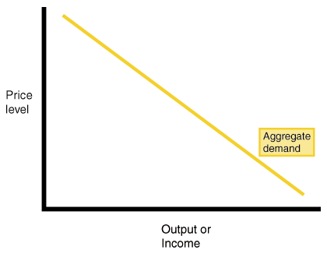
The Demand Curve
We can represent demand by drawing a demand curve.
Demand curve is downward sloping because demand and price have a negative relationship. When price increases, demand falls
The demand curve slopes downwards from left to right. A change in price will lead to a change in quantity demanded.
As price falls, demand rises.
As price rises, demand falls.
The higher the price the lower the quantity demanded.
The lower the price the higher the quantity demanded.
Price changes only lead to an extension (rise) or contraction (fall) in the quantity demanded (the demand curve itself does not move)
Quantity demanded
Notes:
Curve slopes downward left to right because the quantity demanded is likely to be higher at lower prices and lower at higher prices

Slide 8
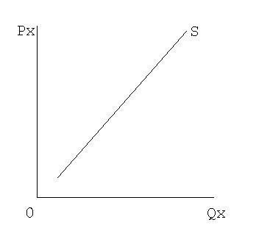
Supply Curve
The supply curve slopes upwards from left to right there is a positive relationship between supply and price. When price increases, supply increases.
As price rises producers offer more goods to the market. A fall in price will lead to the quantity supplied falling.
Again, a change in price will cause a movement up or down the supply curve but the curve will not change position.

Slide 9
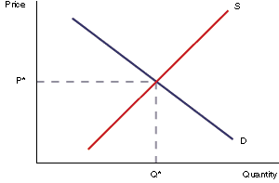
Market Equilibrium
The price in any market for any good is determined by the interaction of supply and demand.
The equilibrium point is where Supply = Demand. At this point all goods produced are sold.

Slide 10
Excess demand and excess supply
At a price of £0.50 per kilo, 100,000 kilos of mushrooms are demanded but only 20,000 kilos are supplied. This means there is excess demand of 80,000 kilos which means there will be a shortage of mushrooms.
When there is excess supply there is a surplus.

Slide 11
Labour market: Skills surpluses and shortages
Skills surplus: this means that demand for the skills is less than supply.
This is likely to lead to: falling wages, unemployment
Skills shortage: means that demand for particular skills is greater than supply.
This is likely to lead to higher wages, retraining of existing staff, greater effort to retain staff
Read more about labour market and demand and supply in your notes
Notes:
The state of the labour market depends on supply and demand

Slide 12
Activities
Work your way through the demand and supply booklet (read the info pages at the start of the booklet first).
You will need to draw each diagram into your notes.
Take your time and ensure you draw changes accurately with correct labelling.
Extension: Use the internet to investigate how the recent recession and disposable income levels affected the demand/supply of certain goods and services such as holidays, alcohol and the motor industry.
Create an A4 revision sheet with examples of how demand/supply was affected

Slide 13
Homework due next lesson
Use the demand and supply notes to define the following key terms
Price elasticity (PED)
Price elastic
Price inelastic
Income elasticity (YED)
Income elastic
Income inelastic
Luxury goods
Normal goods
Inferior goods

