Slide 1
Starting unit 6
Topic 1: Management, Leadership & Culture
Topic 2: Human Resources
Topic 3: Motivation
Topic 4: Total Quality Management (TQM)
Topic 5: Managing Change
Set up folders (paper based and on user area)
MAIN FOLDER:
UNIT 6 Management & Leadership (AAW)
Then 5 sub folders
Notes:
www.businesscasestudies.co.uk (A series of real-life business cases studies on a variety of management-related issues.)
http://www2.cipd.co.uk/toolclicks/management/training-tools/setting-objectives/default.aspx
There are a number of different versions of the acronym with different terms associated with some of the letters as indicated in the table below. They should be based on organisational strategy and be aligned with corporate vision, mission and values.
They can be set at the level of the whole organisation or at divisional, department, team or individual levels.
SMART objectives came into place back in 1955 and are now firmly established within most successful companies and sit comfortably alongside most end of year appraisals.
An objective is a statement which describes what an individual, team or organisation is hoping to achieve.

Slide 2
Topic 1: Management, Leadership and Culture
Syllabus sections A1, A2, B1, B2, A3
These sections overlap however the key issues are to be able to understand the difference between management and leadership, the skills required, a range of management and leadership styles and how these determine the culture of the organisation
Lessons online at normal lesson times
Week 1 11th -15th May 2020 Tasks 1-3
Week 2 18th -22nd May 2020 Task 4

Slide 3

Management & Leadership
Unit 6 Week 1 Lesson 1
Learning Aims A2, B2

Slide 4
LeadershiP & Management
Leadership is about aligning people to a vision, which means buy-in and communication, motivation and inspiration. Leaders have people who follow them.
Management is needed to keep an organisation functioning. This involves planning, budgeting, staffing, clarifying jobs, measuring performance, and problem-solving when results do not go to plan. Managers have people who work for them.
Notes:
https://www.theguardian.com/careers/difference-between-leadership-management

Slide 5
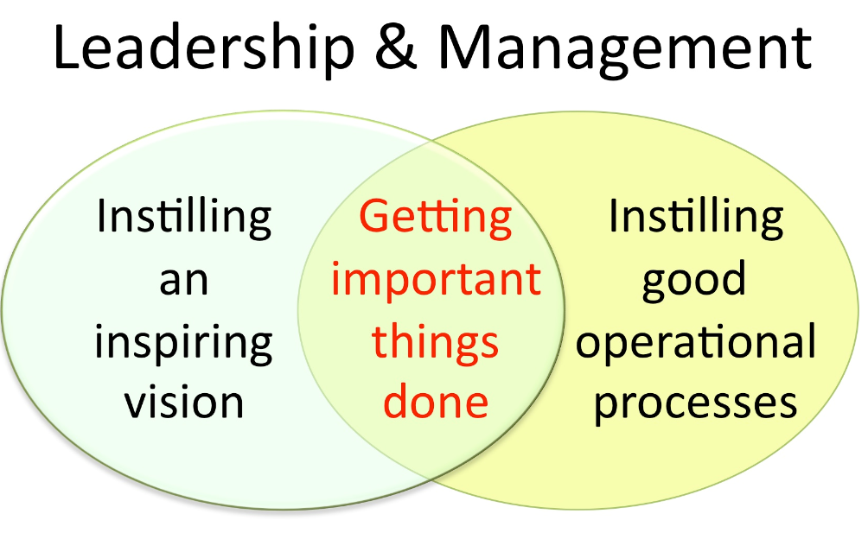

Slide 6
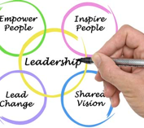
Leadership skills
Envisioning – leading change
Inspiring – creating followers
Persuading and communicating
Influencing stakeholders
Determining the best route to achieve success
Notes:
www.businesscasestudies.co.uk (A series of real-life business cases studies on a variety of management-related issues.)
Leadership: The eight essential skills
1. Give a clear sense of direction
2. Bring the customer into the boardroom
3. Communicate clearly - inside and out
4. Be flexible but not floppy
5. Take risks but don’t bet the company
6. Build the team around you
7. Listen with humility, act with courage
8. Earn your reward through building trust

Slide 7
Management skills
setting objectives (SMART)
decision making
communicating
motivating
team building
valuing and supporting others
consulting
problem solving
using emotional intelligence
managing conflict
building positive interpersonal relationships

Slide 8
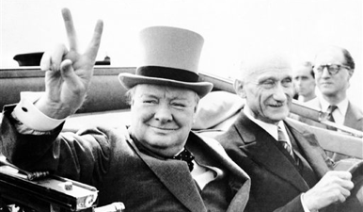
LeadershiP or Management?
Churchill is a great example of a leader, but he is not a manager.
He is not beloved because he made the bureaucracy function

Slide 9
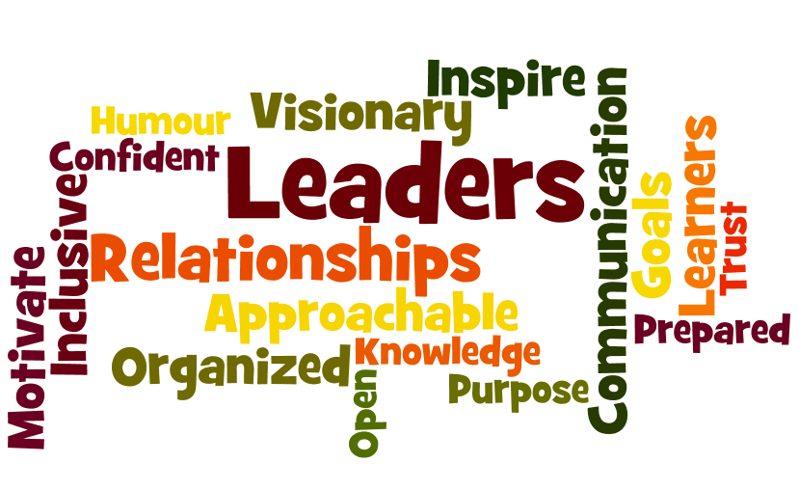
conclusion
What are the qualities you need to be a successful chief executive?
Being a visionary?
Having a strong personality?
Possessing business acumen?
A group of CEOs rated strategic thinking as the single most critical skill for a chief executive, followed by customer focus and the ability to communicate clearly.

Slide 10
types of management & leadership
Management by Objectives
Functional Management
Transformational and Transactional
Notes:
http://www.bized.co.uk (Leadership and management)
www.mindtools.com

Slide 11
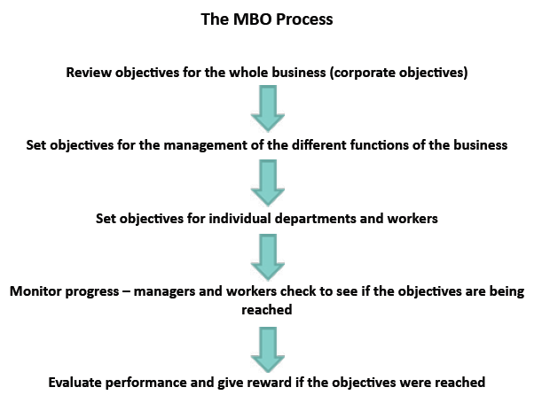
management by objectives (Drucker)
Notes:
Peter Drucker (1955)
http://www.bized.co.uk (Leadership and management)

Slide 12
Advantages of Management by objectives
Management control
Departments and managers are coordinated, everyone is working towards a common goal. Clear target setting.
Improved financial control
It can motivate the workforce
When managers at all levels are involved in setting and agreeing objectives they will have a commitment to ensuring the goals are achieved.
Involving all employees in the process gives employees empowerment, increases job satisfaction and commitment
Opportunities to improve communication both up and down the hierarchy.
Notes:
Peter Drucker (1955)
http://www.bized.co.uk (Leadership and management)

Slide 13
Dis-Advantages of Management by objectives
Time spent on setting objectives rather than managing the organisation
Goals might change and objectives may no longer be appropriate
Objectives not met can be demotivating
Everyone has to feel part of the target setting
Managers can get stuck on short term targets and lose track of the overall long term goals
Notes:
Peter Drucker (1955)
http://www.bized.co.uk (Leadership and management)

Slide 14
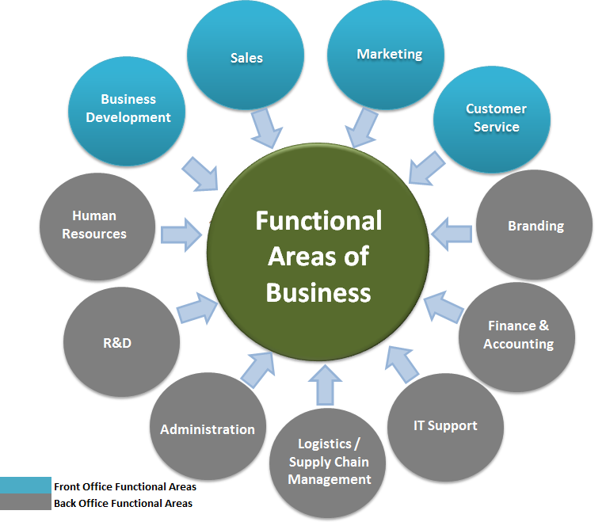
Functional management
The most common type of organisational management.
The organization is grouped by functional areas (departments)
Management and communication generally occurs within a single department
Notes:
Functional management is the most common type of organizational management. The organization is grouped by areas of speciality within different functional areas (e.g., finance, marketing, and engineering). Some refer to a functional area as a "silo". Besides the heads of a firm's product and/or geographic units the company's top management team typically consists of several functional heads such as the chief financial officer, the chief operating officer, and the chief strategy officer.^{[1]}
Communication generally occurs within a single department. If information or project work is needed from another department, a request is transmitted up to the department head, who communicates the request to the other department head. Otherwise, communication stays within the department. Team members complete project work in addition to normal department work.
The main advantage of this type of organization is that each employee has only one manager, thus simplifying the chain of command.

Slide 15
Transformational and Transactional
Transactional leaders focus on the role of supervision, organisation, and group performance. They are concerned about the status quo and day-to-day progress toward goals.
Transformational leaders work to enhance the motivation and engagement of followers by directing their behaviour toward a shared vision
Notes:
http://www.bized.co.uk (Leadership and management)
https://www.mindtools.com/pages/article/transformational-leadership.htm
Transformational?
Harriet Green – Thomas Cook
George Davies – Next, Asda
Nelson Mandela
Alex Ferguson
Ronaldo
Beckham
Steve Jobs
Transactional?
Theresa May
John Scully (ousted Steve Jobs from Apple)

Slide 16
Transactional leaders
Transactional leaders use an exchange model, where performance is monitored and either rewarded or punished, according to the quality or quantity of work produced.
In other words, the transactional leader exchanges tangible rewards for the work and loyalty of their followers.
Discussion: Does this relate to your part time job? How?
Notes:
If people are good only because they fear punishment, and hope for reward, then we are a sorry lot indeed. (Albert Einstein)
Transactional Leadership isn’t. about changing the future It’s about getting the job done. For the most part, it is a directive leadership style.
Directive behaviour is telling people what to do, how to do it, where to do it, and when to do it.
Also, directive behaviour as we learn from Hersey and Blanchard — is characterised by the close supervision of performance

Slide 17
Transformational leaders
They see themselves as change agents
They are courageous
They believe in people and role models
They are driven by a strong set of values
They are lifelong learners
They cope with complexity, ambiguity and uncertainty
They are visionaries
Transformational leaders are important because they make choices that most other leaders would not
Notes:
https://www.leadershipthoughts.com/transformational-leadership-guide-models-theories/
https://www.mindtools.com/pages/article/transformational-leadership.htm
Seven Characteristics of the Transformational Leader
In a nutshell, the transforming leader is excited by the challenges of leading high performing teams. The transformational leader is a role model.
Transformational leaders are important because they make choices that most other leaders would not. – Joseph Nye
And, they publicly display the following leadership characteristics:
They clearly see themselves as change agents.
They are courageous.
They believe in people.
They are driven by a strong set of values.
They are lifelong learners.
The can cope with complexity, ambiguity and uncertainty.
They are visionaries.
https://www.mindtools.com/pages/article/transformational-leadership.htm
Transformational leadership is a style of leadership where a leader works with subordinates to identify needed change, creating a vision to guide the change through inspiration, and executing the change in tandem with committed members of a group.
Transformational leadership serves to enhance the motivation, morale, and job performance of followers through a variety of mechanisms; these include connecting the follower's sense of identity and self to a project and to the collective identity of the organization; being a role model for followers in order to inspire them and to raise their interest in the project; challenging followers to take greater ownership for their work, and understanding the strengths and weaknesses of followers, allowing the leader to align followers with tasks that enhance their performance.
https://www.leadershipthoughts.com/transformational-leadership-guide-models-theories/
Seven Characteristics of the Transformational Leader
In a nutshell, the transforming leader is excited by the challenges of leading high performing teams. The transformational leader is a role model.
Transformational leaders are important because they make choices that most other leaders would not. – Joseph Nye
And, they publicly display the following leadership characteristics:
They clearly see themselves as change agents.
They are courageous.
They believe in people.
They are driven by a strong set of values.
They are lifelong learners.
The can cope with complexity, ambiguity and uncertainty.
They are visionaries.

Slide 18

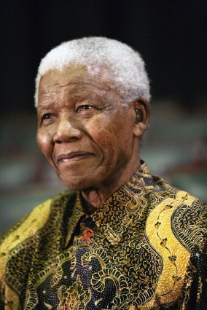
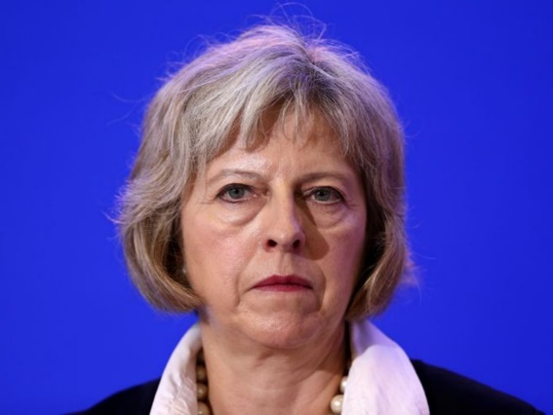
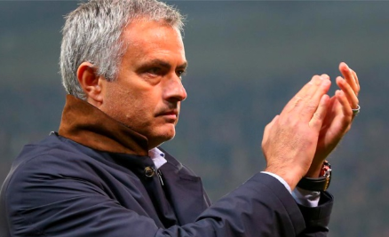
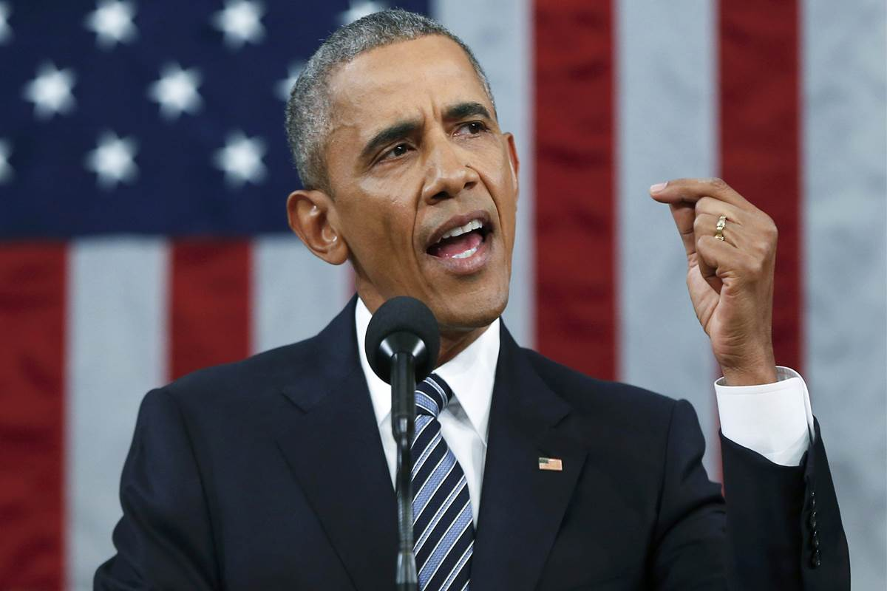
Transformational or transactional?
Steve Jobs Nelson Mandela Theresa May Jose Morinho Barack Obama
Notes:
When managing Manchester United in the 1990’s, Fergsuon sold establised Man United stars Paul Ince, Lee Sharpe, Mark Hughes and other players and began the evolution of a new generation dubbed “the class of 92” http://www.liveandlearnconsultancy.co.uk/top-5-leadership-tips-from-sir-alex-ferguson/
Abramovitch, huge cash injection into Chelsea and appoints Morinho who chooses the players and determines the strategy – Chelsea rise to the top
http://www.liveandlearnconsultancy.co.uk/top-5-leadership-tips-from-jose-mourinho/

Slide 19
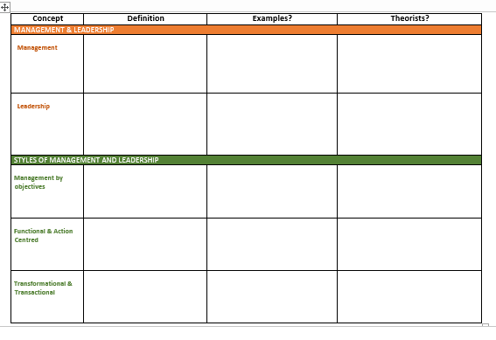
Task at the end of Lesson 1
Read through this PowerPoint again
Complete the table (on Godalming Online) to summarise your learning for this lesson

Slide 20
Leadership & Management theories & styles
Unit 6 Week 1 Lesson 2
Learning Aims A1, B1

Slide 21

leadership theories
Fiedler’s Situational Contingency Theory
The Concept of Leadership Continuum for Management Behaviour
Hersey & Blanchard
McGregor X and Y Manager Theory
Notes:
http://www.bized.co.uk (Leadership and management)
www.mindtools.com

Slide 22
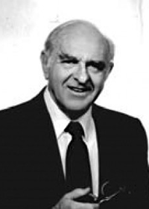
Fiedler: Situational Contingency
The Fiedler Contingency Model was created in the mid-1960s by Fred Fiedler, a scientist who studied the personality and characteristics of leaders.
Fiedler believed that leadership style is fixed, and it can be measured using a scale he developed called Least-Preferred Co-Worker (LPC) Scale
The model states that there is no one best style of leadership. Instead, a leader's effectiveness is based on a combination of the situation and the style of the leader.
He devised a method for identifying what type of leader you are and what type of leader is best for a range of situations
Notes:
http://www.bized.co.uk (Leadership and management)
www.mindtools.com
(Fiedler’s contingency model)
The fundamental underpinning of the Situational Leadership Model is that there is no single "best" style of leadership. Effective leadership is task-relevant, and the most successful leaders are those who adapt their leadership style to the Performance Readiness (ability and willingness) of the individual or group they are attempting to lead or influence. Effective leadership varies, not only with the person or group that is being influenced, but it also depends on the task, job or function that needs to be accomplished.^{[3]}
The Situational Leadership Model rests on two fundamental concepts; leadership style and the individual or group's Performance Readiness level
The Fiedler Contingency Model was created in the mid-1960s by Fred Fiedler, a scientist who studied the personality and characteristics of leaders.
The model states that there is no one best style of leadership. Instead, a leader's effectiveness is based on the situation. This is the result of two factors – "leadership style" and "situational favorableness" (later called "situational control").
The model says that task-oriented leaders usually view their LPCs more negatively, resulting in a lower score. Fiedler called these low LPC-leaders. He said that low LPCs are very effective at completing tasks. They're quick to organize a group to get tasks and projects done. Relationship-building is a low priority.
However, relationship-oriented leaders usually view their LPCs more positively, giving them a higher score. These are high-LPC leaders. High LPCs focus more on personal connections, and they're good at avoiding and managing conflict. They're better able to make complex decisions.

Slide 23
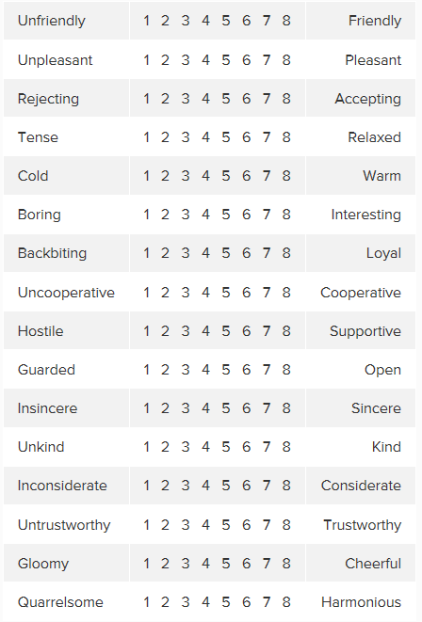
Least-Preferred Co-Worker Scale
Think about the person who you've least enjoyed working with
Rate how you feel about this person for each factor, and add up your scores.
If your total score is high, you're likely to be a relationship-orientated leader.
If your total score is low, you're more likely to be task-orientated leader
Notes:
http://www.bized.co.uk (Leadership and management)
www.mindtools.com
(Fiedler’s contingency model)
www.businessballs.com (Action centred leadership)
www.johnadair.co.uk (Articles and media on Adair’s work)

Slide 24
Two more leadership models to consider…
Hersey & Blanchard
Tannenbaum-Schmidt
Notes:
http://www.bized.co.uk (Leadership and management)
www.mindtools.com

Slide 25
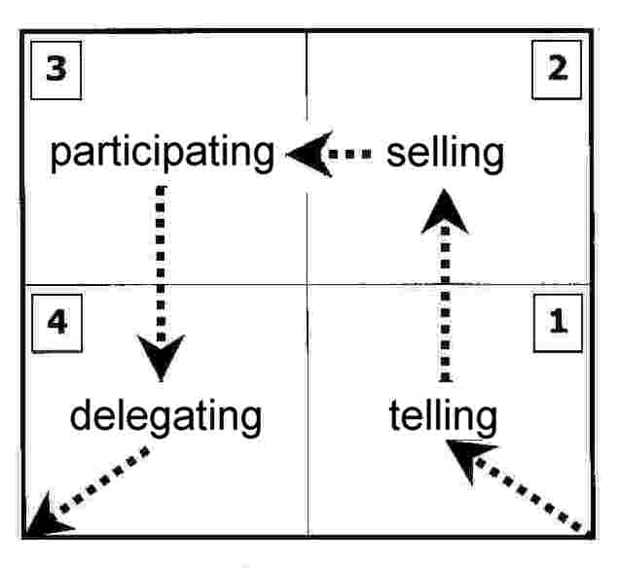
Hersey & Blanchard leadership model
Leadership is Directive or Supportive
Directive behaviour includes telling people what to do, how to do it, where to do it, when to do it, and so on.
DIRECTIVE behaviour is characterised by the close supervision of performance. (micromanagement)
Notes:
Hersey & Blanchard
Paul Hersey and Ken Blanchard created their popular leadership model from the observation and premise that leadership is made up of two kinds of behaviour:
directive, and
supportive.
They say directive behaviour includes telling people what to do, how to do it, where to do it, when to do it, and so on. What’s more, such behaviour is characterised by the close supervision of performance. Some may say this is micromanagement.
In contrast, supportive behaviour involves listening, providing positive support and encouraging people to get things done by themselves. Supportive behaviour is characterised by the leader involving people in problem solving and decision making.

Slide 26
Hersey & Blanchard leadership model
In contrast, Supportive behaviour involves listening, providing positive support and encouraging people to get things done by themselves.
SUPPORTIVE behaviour is characterised by the leader involving people in problem solving and decision making
Notes:
Hersey & Blanchard
Paul Hersey and Ken Blanchard created their popular leadership model from the observation and premise that leadership is made up of two kinds of behaviour:
directive, and
supportive.
They say directive behaviour includes telling people what to do, how to do it, where to do it, when to do it, and so on. What’s more, such behaviour is characterised by the close supervision of performance. Some may say this is micromanagement.
In contrast, supportive behaviour involves listening, providing positive support and encouraging people to get things done by themselves. Supportive behaviour is characterised by the leader involving people in problem solving and decision making.

Slide 27
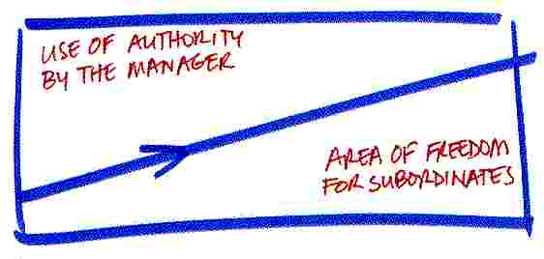
Tannenbaum-Schmidt leadership continuum for management behaviour
Notes:
The Tannenbaum-Schmidt Continuum shows where a manager's approach lies on a continuum, running from the manager exerting rigid authority at one extreme, through to the team having full freedom to act at the other.
Hersey & Blanchard and Tannenbaum-Schmidt Continuum expressing similar concepts

Slide 28
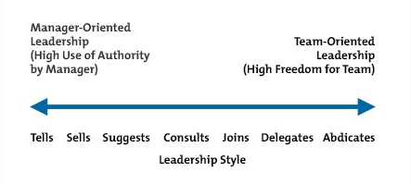
Tannenbaum-Schmidt leadership continuum for management behaviour
Notes:
The Tannenbaum-Schmidt Continuum shows where a manager's approach lies on a continuum, running from the manager exerting rigid authority at one extreme, through to the team having full freedom to act at the other.
One popular approach to leadership, the "contingency" approach, argues that your choice should be based on the situation, and not on your personal preferences (here, "contingency" means that your approach is dependent on, or contingent upon, the situation).
In 1958, contingency theorists Robert Tannenbaum and Warren Schmidt identified a continuum of seven distinct leadership styles, which they published in the Harvard Business Review. By understanding this continuum, you can see some of the options available to you, and these help you think about which leadership style is most appropriate in a given situation.

Slide 29
So are there types of managers & leaders?
McGregor X and Y Manager Theory
Lewin’s Leadership Styles
Notes:
http://www.bized.co.uk (Leadership and management)
www.mindtools.com

Slide 30
Lewin's Three Core Leadership Styles
Autocratic (authoritarian) leadership
Democratic (participative) leadership
Laissez-faire (delegative) leadership
Consider how these relate to the Hersey & Blanchard and Tannenbaum-Schmidt models
Notes:
Lewin's Leadership Styles Framework
Three Core Leadership Styles
In 1939, psychologist Kurt Lewin led a study that identified three core styles of leadership, and outlined the effect that each style had on team members. His research also showed that leaders get different results when they lead their teams in different ways.
Although Lewin conducted this study many decades ago, his findings have influenced many of today's leadership theories and approaches , including transformational leadership (which, we believe, is often the most effective leadership style to use in business).
The three core leadership styles he identified were:
Authoritarian (autocratic) leadership.
Participative (democratic) leadership.
Delegative (laissez-faire) leadership.
It's important to understand the advantages and disadvantages of each style, so that you can recognize your own natural leadership style, and adapt your approach to fit your situation.
When you understand each style, you will also know what behaviours to avoid if you want to get the best from your people

Slide 31
Mcgregor x & y theory
Theory Y managers think workers:
have many different needs which motivate them
can enjoy work, are motivated by own achievement
want independence and responsibility
can organise themselves to do well
Therefore management should create a situation where workers can show creativity and apply their job knowledge
Theory X managers think workers are:
motivated by money
lazy and dislike work
must be pushed to perform
are selfish and ignore the needs of organisations
avoid responsibility, lack ambition
Therefore they need to be controlled and directed by management

Slide 32
Task at the end of Lesson 2
Read the info sheet on Godalming Online
Complete the Fiedler LPC sheet (also on the info sheet)
Complete the other discussion questions at the end of the info sheet

Slide 33
Business culture
Unit 6 Week 1 Lesson 3
Learning Aim A3

Slide 34
Business culture
the way we do things around here
often defined through the Mission, Vision or Values statements
an evolving set of collective beliefs, values and attitudes
Notes:
Culture illustrates the accepted norms and values and traditional behaviour of a group.
One definition of culture by Deal and Kennedy is “the way a we do things around here”. However, culture also evolves over time.
The culture of each country has its own beliefs, values and activities.
In other words culture can be defined as an evolving set of collective beliefs, values and attitudes.
Culture is a key component in business and has an impact on the strategic direction of business.
Culture influences management, decisions and all business functions from accounting to production.
National culture is only one aspect
Business culture is its own unique dimension that includes getting off on the right foot, meetings, negotiation, formalities, social media use, internships and work placements

Slide 35
Business culture
Mission statements define the organization's purpose and primary objectives, both to members of the organisation and to people outside it.
Mission statements tend to be short, clear and powerful
Vision statements focus on its goals and aspirations.
These statements are designed to be uplifting and inspiring.
They're also timeless: even if the organization changes its strategy, the vision will often stay the same.
Value statements tell customers and other stakeholders what the business values the most when achieving the mission and vision.
Excellence? Integrity? Teamwork? Originality? Equality? Honesty? Freedom? Service?
Notes:
www.businessballs.com
Starbucks Coffee’s website states that the company’s mission statement is “To inspire and nurture the human spirit – one person, one cup and one neighborhood at a time. ”
Microsoft’s mission statement is to provide individuals and businesses with technologies and products to increase efficiency, capability, speed and innovation both in the workplace and in the home.
Facebook Mission "Give people the power to build community and bring the world closer together."
Nike’s mission statement is "To bring inspiration and innovation to every athlete in the world."
Mission statements define the organization's purpose and primary objectives. These statements are set in the present tense, and they explain why you exist as a business, both to members of the organization and to people outside it. Mission statements tend to be short, clear and powerful.
Vision statements also define your organization's purpose, but they focus on its goals and aspirations. These statements are designed to be uplifting and inspiring. They're also timeless: even if the organization changes its strategy, the vision will often stay the same.
Next, identify what you, your customers and other stakeholders value the most about how your organization will achieve this mission Some examples of values include excellence, integrity, teamwork, originality, equality, honesty, freedom, service, and strength

Slide 36
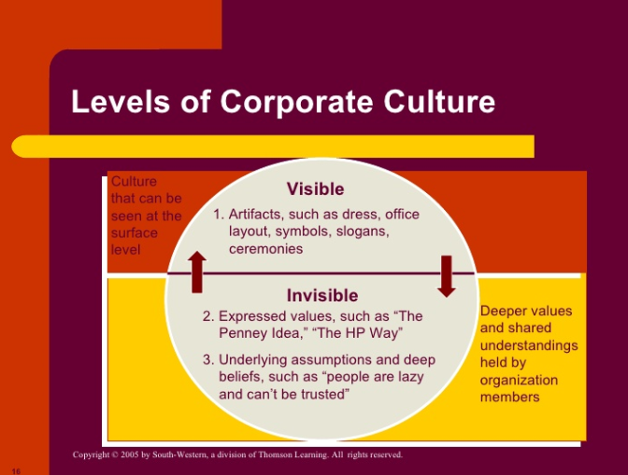
CULTURE
There might be an image that an organisation wants to promote (professionalism, trustworthiness etc)
This may not be the same as what is really going on behind the scenes (eg BA strikes and staffing issues)

Slide 37
What does Business culture affect?
Business Vision, mission and values/ethos
Management practices
Management styles
Policies and procedures
Structure of the workforce
How people work
Notes:
Policies and procedures are designed to influence and determine all major decisions and actions, and all activities take place within the boundaries set by them.
Procedures are the specific methods employed to express policies in action in day-to-day operations of the organization

Slide 38
Policies and procedures
Policies and procedures are designed to influence and determine all major decisions and actions, and all activities take place within the boundaries set by them.
Procedures are the specific methods employed to express policies in action in day-to-day operations of the organization

Slide 39
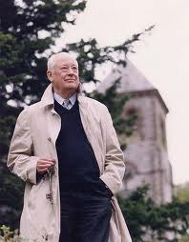
Charles Handy
4 main types of organisational culture
POWER CULTURE: power held by just a few people. Typically found in relatively young SME where a single owner founded the firm and is still very much in control
ROLE CULTURE: staff have clearly defined job titles and authority is associated with a role (marketing director) rather than with individuals. Role cultures are bureaucratic (Civil Service)
TASK CULTURE: team working is common, power lies with expertise rather than job titles
PERSON CULTURE: individuals have expertise but do not necessarily work together closely eg accountants doctors lawyers
Notes:
Charles Handy Understanding Organisations (1981)

Slide 40
Task at the end of WEEK 1 Lesson 3
Read the Snapchat Case study on Godalming Online
Using the PowerPoint Case Study Task, complete Activity 1 (the written report) up to 1 side of A4

Slide 41
Task FOR WEEK 2
After Mondays lesson (18/5/20 – 22/5/20)
Read SnapChat case study again on Godalming Online
Monday 18/5/20 Log on to teams to have a recap on the work so far
Using the PowerPoint Case Study Task, complete Activity 2 (the presentation) up to 6 ppt slides

