Slide 1
Introduction to Motivation
Weeks 3 & 4
Monday June 1st – Thursday June 4th
Monday 8th June – Thursday 11th
Unit 6 Topic 2
Learning Aim D1

Slide 2
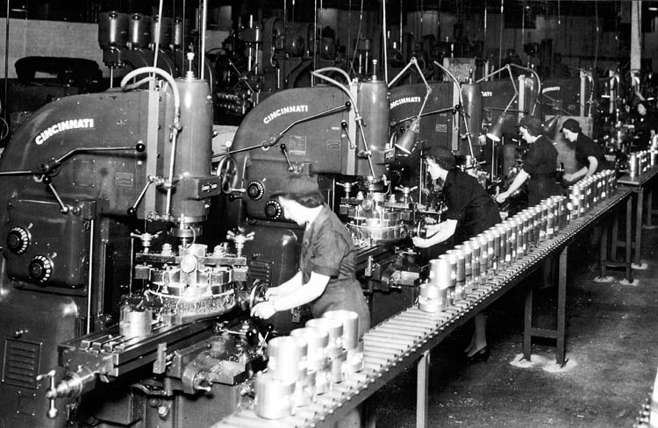
Notes:
Quick intro to how manufacturing has changed, mass production, start of work study and motivation research etc esp car manufacturing

Slide 3
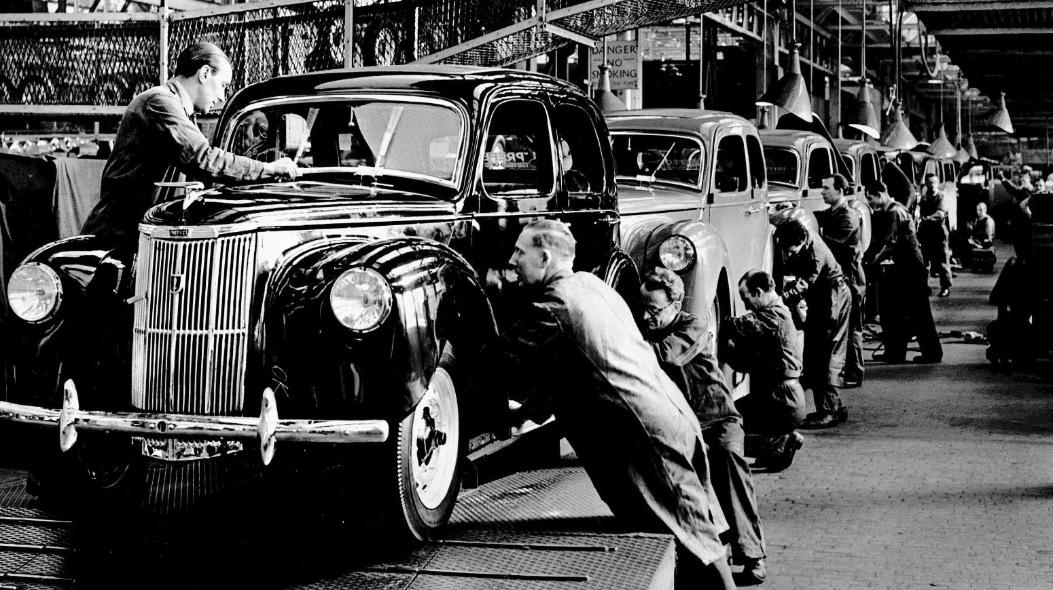

Slide 4
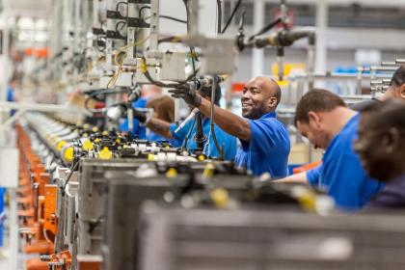

Slide 5
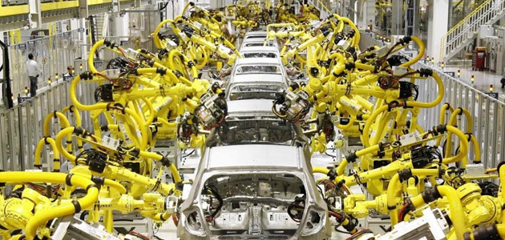

Slide 6
Motivation
What might make you want to do these jobs?
What would make your day better?
What might make you work harder?

Slide 11
Different MOTIVATORS?
Monetary factors: some staff work harder if offered higher pay
Non monetary factors: other staff respond to incentives that have nothing to do with pay, eg improved working conditions or the chance to win promotion.
Notes:
Motivation is about the ways a business can encourage staff to give their best. Motivated staff care about the success of the business and work better. A motivated workforce results in:
A manager needs to be able to motivate their staff
Increased output caused by extra effort from workers.
Improved quality as staff take a greater pride in their work.
A higher level of staff retention. Workers are keen to stay with the firm and also reluctant to take unnecessary days off work.
Managers can influence employee motivation in a variety of ways:
Monetary factors: some staff work harder if offered higher pay.
Non monetary factors: other staff respond to incentives that have nothing to do with pay, eg improved working conditions or the chance to win promotion.

Slide 12
Motivation Theories
Lesson 1 Week 3
Monday June 1st – Thursday June 4th
Unit 6 Topic 2
Learning Aim D1

Slide 13
In 1995 FFC was placed 95th in the league, 1 place from relegation to the Conference. The home fans were extremely unhappy, and the manager got sacked. The fans made threatening cheers at each home game.
A new manager was appointed – Micky Adams, who had a few free transfers but the side was mainly the same.
One year later they sat on the top of the same league, what happened?
The players pay had not risen, the key difference was in the players motivation.
Notes:
http://managementstudyguide.com/what_is_motivation.htm
http://businesscasestudies.co.uk/business-theory/people/motivation.html
Motivation is a theoretical construct used to explain behaviour. It gives the reason for people's actions, desires, and needs. Motivation can also be defined as one's direction to behaviour, or what causes a person to want to repeat a behaviour and vice versa. A motive is what prompts the person to act in a certain way, or at least develop an inclination for specific behaviour.

Slide 14
Motivation The will to work
The study of factors that influence the behaviour of people in the workplace.
Motivation is a theoretical construct used to explain behaviour. It gives the reason for people's actions, desires, and needs.
Motivation can also be defined as one's direction to behaviour, or what causes a person to want to repeat a behaviour and vice versa.
A motive is what prompts the person to act in a certain way, or at least develop an inclination for specific behaviour.
Notes:
http://managementstudyguide.com/what_is_motivation.htm

Slide 15
F W Taylor
F.W. Taylor (1856 – 1915) was an American engineer who invented work-study and founded the scientific approach to management
Scientific Management – Business decision making based on data that is researched and tested quantitatively in order to improve efficiency of an organisation.
He considered money to be the main factor that motivated workers, so he emphasised the benefits of Piece Work.
Higher efficiency would generate higher profits and thus higher wages to workers.
Taylor saw Humans as Machines

Slide 16
Taylor recommended
Extreme division of labour
Breaking a job into small repetitive tasks, each of which can be done at a speed with little training.
Payment by piecework
Payment by results, e.g. per item produced.
Tight management control
To ensure that workers concentrate on their jobs and follow the correct processes
This method had a big influence on Mass production but introduced at Ford Motor Company it led to poor industrial relations and saw a growth in trade unions.

Slide 17
Mayo
Elton Mayo (1880 – 1949) was a follower of F.W. Taylor, but his experiments led him to conclude that Scientific Management could not explain the importance of peoples behaviour in the workplace.
Many of his findings, including the Hawthorne Effect, came from research he did at the Western Electric School factory in Hawthorn, USA and provided the foundations for the Human Relations School of Management.
His early research involved trying to measure the impact on productivity of improving the lighting conditions in the Western Electric Factory.
Notes:
Mayo suggested the following:
Recognition, belonging, and security are more important that money in motivating employees.
Employees should be seen as members of a group.
Managers need to pay attention to individuals social needs.
Increased results are due to greater communication and improved relations with informal groups.

Slide 18
Mayo (Hawthorne effect)
Notes:
Mayo suggested the following:
Recognition, belonging, and security are more important that money in motivating employees.
Employees should be seen as members of a group.
Managers need to pay attention to individuals social needs.
Increased results are due to greater communication and improved relations with informal groups.

Slide 19
Task at the end of Lesson 1 WEEK 3
Do your own research and read through the slides on Taylor and Mayo again in this PowerPoint
Complete a summary sheet for Taylor and Mayo (template on Godalming Online)
Read through the next couple of slides on Maslow and Herzberg ready for next lesson

Slide 20
Motivation Theories
Lesson 2 Week 3
Tuesday June 2nd
Unit 6 Topic 2
Learning Aim D1

Slide 21
Maslow’s Hierarchy of Needs
Self-actualisation
Esteem
Social
Safety
Physiological / basic needs
Abraham Maslow (1908 – 70) was an American psychologist whose work on human needs has had a major influence on management thinking.
His Hierarchy of Needs suggests that people have similar types of needs from low level basic to the need for achievement.
Notes:
Physiological needs earning an income and having reasonable working conditions.
Safety needs a secure job, a safe working environment, clear lines of accountability and responsibility.
Social needs a sense of belonging, being a part of a team, facilities like staff rooms, canteens etc.
Esteem needs self-respect and respect from others, positive feedback, recognition and status for achievement and opportunities for promotion
Self-Actualisation fulfilling one’s potential through actions and achievements, Maslow did not believe this need could be filled fully and thought people would always strive to develop further and achieve more.

Slide 22
Maslow’s Hierarchy of Needs
Physiological needs earning an income and having reasonable working conditions.
Safety needs a secure job, a safe working environment, clear lines of accountability and responsibility.
Social needs a sense of belonging, being a part of a team, facilities like staff rooms, canteens etc.
Esteem needs self-respect and respect from others, positive feedback, recognition and status for achievement and opportunities for promotion
Self-Actualisation fulfilling one’s potential through actions and achievements, Maslow did not believe this need could be filled fully and thought people would always strive to develop further and achieve more.

Slide 23
Maslow’s Hierarchy of Needs
Maslow thought employees needed to work up the hierarchy of needs and if employees didn’t have access to gain those needs then it would lead to de-motivation.
This theory is appealing but some key issues are raised:
Do all humans have the same set of needs?
Do different people have different degrees of needs?
Can anyone’s need ever be said to be fully satisfied?

Slide 24
Herzberg
Frederick Herzberg (1923-2000) was an American psychologist whose research led him to develop the Two-Factor theory of job satisfaction and dissatisfaction.
He suggested some factors had the potential to give job satisfaction (Motivators) and some factors can reduce job satisfaction (Hygiene or Maintenance Factors).

Slide 25
Herzberg
Motivators | Hygiene / maintenance factors
Sense of Achievement | Working Conditions
Recognition for effort & achievement | Supervision
Nature of the work itself | Pay
Responsibility | Interpersonal relations
Promotion & improvement opportunities | Company policy and Admin, inc paperwork, rules, red tape

Slide 26
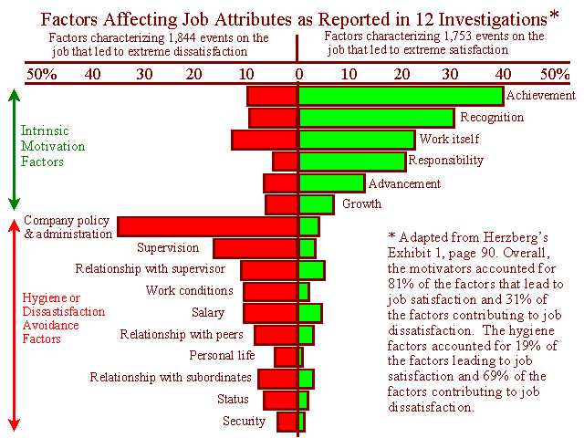
Notes:
All of the Motivators concern the job itself rather than issues such as pay, and all are likely to motivate workers and improve productivity.
All of the Hygiene factors ‘surround’ the job: they do not concern the job itself, ensuring that they are acceptable to the workforce prevents dissatisfaction rather than causing motivation.
One of the main principles is Job Enrichment
This is the attempt to motivate workers by giving them opportunity to use their abilities and allowing them greater independence and authority over the control of their work.

Slide 27
Herzberg & Maslow
There are close links between the two theories
Motivators
Achievement
Recognition
Work itself
Responsibility
Advancement
Personal Growth
Self-actualisation
Esteem
Social
Safety
Physiological / basic needs
Hygiene factors
Supervision
Working Conditions
Relationship with peers
Pay
Security
Company Policy

Slide 28
why is Motivation important?
Increased output caused by extra effort from workers
Improved quality as staff take a greater pride in their work
A higher level of staff retention. Workers are keen to stay with the firm and also reluctant to take unnecessary days off work
Notes:
Motivation is about the ways a business can encourage staff to give their best. Motivated staff care about the success of the business and work better. A motivated workforce results in:
A manager needs to be able to motivate their staff
Increased output caused by extra effort from workers.
Improved quality as staff take a greater pride in their work.
A higher level of staff retention. Workers are keen to stay with the firm and also reluctant to take unnecessary days off work.
Managers can influence employee motivation in a variety of ways:
Monetary factors: some staff work harder if offered higher pay.
Non monetary factors: other staff respond to incentives that have nothing to do with pay, eg improved working conditions or the chance to win promotion.

Slide 29
Task at the end of Lesson 2 WEEK 3
Read through the slides on Maslow and Herzberg again in this PowerPoint
Complete 2 summary sheets, 1 each for Maslow and Herzberg (template on GoL)

Slide 30
Financial & non financial incentives
Lesson 3 Week 3
Thursday June 4th
Topic 2 Lesson 3
Learning Aim D1

Slide 31
What motivates us to work harder?
Money ?
The job itself?
Both?

Slide 32
FINANCIAL/NON FINANCIAL MOTIVATORS?
Monetary factors: some people are motivated by pay
Non monetary factors: other people respond to incentives that have nothing to do with pay such as working conditions, praise, responsibility
Notes:
Next lesson
Motivation is about the ways a business can encourage staff to give their best. Motivated staff care about the success of the business and work better. A motivated workforce results in:
A manager needs to be able to motivate their staff
Increased output caused by extra effort from workers.
Improved quality as staff take a greater pride in their work.
A higher level of staff retention. Workers are keen to stay with the firm and also reluctant to take unnecessary days off work.
Managers can influence employee motivation in a variety of ways:
Monetary factors: some staff work harder if offered higher pay.
Non monetary factors: other staff respond to incentives that have nothing to do with pay, eg improved working conditions or the chance to win promotion.

Slide 33
Financial motivators Key methods
Profit sharing
Performance related pay
Piece work
Commission
Share options
Company discount

Slide 34
Piece work (or piece rates) Payment based on the number of items each worker produces
Advantages
Increase in productivity
Incentive to work harder
Disadvantages
Quantity at the expense of quality
Output may be heavily influenced by workers needs rather than customers demands. Research shows productivity will increase in July and Dec
May increase resistance to change

Slide 35
Performance related pay (PRP) A bonus or salary increase usually awarded for above average employee performance.
Advantages
Direct link between pay and effort
May lead to reduction in costs – lower levels of supervision
Possible improvements in motivation and reduction in labour turnover and absenteeism
Linking of individual targets to corporate objectives
Disadvantages
Conflict between those receiving different bonuses
PRP is often only a small proportion of salary – so will it really motivate?
Often difficult to measure performance
Individuality of pay makes collective bargaining difficult

Slide 36
Profit share (or profit-related bonuses) A financial incentive in which a proportion of a firm’s profit is divided among its employees in the form of a bonus paid in addition to an employee’s salary
Advantages
May reduce resistance to change
Provide incentive to keep costs down and productivity high
Managers and staff all working for a collective aim
Disadvantages
Unless significant – may not be considered important
Not linked to individual performance so may encourage some to let others do the work
If employees become dependent on it can cause financial uncertainty and unease
Large payouts from profit may affect shareholder dividends and profit retained for investment

Slide 37
Main Non financial incentives
Job enrichment – giving employees greater responsibility and offering them challenges that allow them to utilise their skills fully.
Job empowerment – giving employees the means by which they can exercise power over their working lives.
Job enlargement – increasing the scope of a job, either by job enrichment or by job rotation.
Team working – a system where production is organised into large units of work and a group of employees work together in order to meet shared objectives.

Slide 38
Additional non financial methods
Goal setting
Appraisal
Flexible timings
Employee participation
Quality Circles
Fringe benefits
Job rotation

Slide 39
Are different methods are appropriate for different types of work?
How does this relate to company culture and leadership styles?
Which theories seem most relevant and why?

Slide 40
Task at the end of WEEK 3 Lesson 3
Read through this PowerPoint again and any relevant resources on Godalming Online
Produce a mind map of cultures, leadership styles and motivational theories. Show how these are interrelated.

Slide 41
Motivation practice tasks
Week 4
Monday 8th June – Thursday 11th
Unit 6 Topic 2
Learning Aim D1

Slide 42
Week 4 Lesson 1 case study 1
Class discussion of ‘The New Laser Scanning System’ Case Study on Godalming Online
What is going wrong with their approach and what you recommend they should do?
Notes:
Next lesson
Motivation is about the ways a business can encourage staff to give their best. Motivated staff care about the success of the business and work better. A motivated workforce results in:
A manager needs to be able to motivate their staff
Increased output caused by extra effort from workers.
Improved quality as staff take a greater pride in their work.
A higher level of staff retention. Workers are keen to stay with the firm and also reluctant to take unnecessary days off work.
Managers can influence employee motivation in a variety of ways:
Monetary factors: some staff work harder if offered higher pay.
Non monetary factors: other staff respond to incentives that have nothing to do with pay, eg improved working conditions or the chance to win promotion.

Slide 43
Task at the end of Lesson 1 (WEEK 4)
Read the case study ‘The New Laser Scanning System’ on Godalming Online
On a side of A4, write a brief report analysing the problems and how the management could remotivate the workforce

Slide 44
Week 4 Lessons 2&3 motivation and leadership
Week 4 Lesson 2
Class discussion of Ryanair Case Study on Godalming Online
Notes:
Next lesson
Motivation is about the ways a business can encourage staff to give their best. Motivated staff care about the success of the business and work better. A motivated workforce results in:
A manager needs to be able to motivate their staff
Increased output caused by extra effort from workers.
Improved quality as staff take a greater pride in their work.
A higher level of staff retention. Workers are keen to stay with the firm and also reluctant to take unnecessary days off work.
Managers can influence employee motivation in a variety of ways:
Monetary factors: some staff work harder if offered higher pay.
Non monetary factors: other staff respond to incentives that have nothing to do with pay, eg improved working conditions or the chance to win promotion.

Slide 45
Ryanair case study activity 1
You are working for an outside agency which has been called in to analyse the Management and Leadership situation at Ryanair.
Having investigated pilots complaints regarding their pay and conditions, summarise the problems in 3 paragraphs explaining
What the issue with the pilots is about
What the outcome has been to date
What you would recommend Ryanair should do in the future
Notes:
The report should be written paragraphs, concise and with relevant and up to date facts/data used to support points made.
The first half of the report should be an analysis of the situation (not a retelling of the story), the second half should be your recommendations.
Business theory and terms should be used throughout.

Slide 46
Task at the end of Lesson 2 (WEEK 4)
Read the Ryanair case study on Godalming Online, considering the leadership and motivation concepts we have learned
Complete Activity 1 of the Ryanair Case Study Questions and upload to Godalming Online

Slide 47
Ryanair case study activity 2
The Board have read your notes and now want some ideas on how to motivate the pilots in the future. Produce up to 6 paragraphs to explain:
What motivation is and what motivational issues you have discovered at Ryanair
Why the current motivational approach is not working
What motivational theory you recommend should be considered to improve relations in the future.
As before, the analysis of the situation should be concise, using facts, theory and data where relevant.
Notes:
The report should be written paragraphs, concise and with relevant and up to date facts/data used to support points made.
The first half of the report should be an analysis of the situation (not a retelling of the story), the second half should be your recommendations.
Business theory and terms should be used throughout.

Slide 48
Task at the end of Lesson 3 (WEEK 4)
Read the Ryanair case study again on Godalming Online, considering the motivation concepts we have learned
Complete Activity 2 of the Ryanair Case Study Questions and upload to Godalming Online

