Slide 1
HR planning workforce performance
Week 7 Lesson 1
Thursday June 29th
Unit 6 Lesson 3
Learning Aim C2

Slide 2
Workforce performance
Most organisations will monitor efficiency
To improve control of the business
To make comparisons with competitors
To monitor and review wages, levels of staff.
Costs are only one indicator of efficiency
Notes:
www.personneltoday.com (Planning your workforce in uncertain times, Jo Faragher, 22 January 2013)
www.cipd.co.uk/hr-resources/factsheets (Chartered Institute of Personnel Development – Factsheet on Strategic Human Resource Management)
www.cipd.co.uk/hr-resources/factsheets (Chartered Institute of Personnel Development –factsheet on recruitment)
www.gov.uk (Service manual – key performance indicators)
www.businesscasestudies.co.uk (A series of real-life business cases studies covering a variety of management-related issues.)

Slide 3
Workforce performance measuring productivity
Labour turnover
Productivity.
Skill shortages
Workplace stress
Absenteeism
Motivation
Engagement with business culture
Employee satisfaction
Notes:
www.personneltoday.com (Planning your workforce in uncertain times, Jo Faragher, 22 January 2013)
www.cipd.co.uk/hr-resources/factsheets (Chartered Institute of Personnel Development – Factsheet on Strategic Human Resource Management)
www.cipd.co.uk/hr-resources/factsheets (Chartered Institute of Personnel Development –factsheet on recruitment)
www.gov.uk (Service manual – key performance indicators)
www.businesscasestudies.co.uk (A series of real-life business cases studies covering a variety of management-related issues.)
Labour turnover (expressed in words and numbers).
Productivity.
Skill shortages.
Workplace stress.
Absenteeism (expressed in words and numbers)
Motivation.
Engagement with business culture.
Employee satisfaction

Slide 4
Labour turnover
Labour turnover is the number of employees that leave a company and have to be replaced.
A certain level of turnover can be beneficial. It brings new people into the organization with new ideas and a fresh perspective.
Some turnover is unavoidable (retirement, moving home, promotion), but too much can ruin a company.
Notes:
https://www.tutor2u.net/business/reference/labour-turnover
https://www.thebalance.com/employee-turnover-2275788
When employees leave a company and have to be replaced, that's called turnover. A certain amount of turnover is unavoidable, but too much can ruin a company.
Some employees will always retire, move away, go back to school, or leave the workforce. This level of turnover is not only unavoidable, it can be beneficial. It brings new people into the organization with new ideas and a fresh perspective.
You calculate the turnover rate by dividing the number of employees who left by the total number of employees at the beginning of the period
www.personneltoday.com (Planning your workforce in uncertain times, Jo Faragher, 22 January 2013)
www.cipd.co.uk/hr-resources/factsheets (Chartered Institute of Personnel Development – Factsheet on Strategic Human Resource Management)
www.cipd.co.uk/hr-resources/factsheets (Chartered Institute of Personnel Development –factsheet on recruitment)
www.gov.uk (Service manual – key performance indicators)
www.businesscasestudies.co.uk (A series of real-life business cases studies covering a variety of management-related issues.)

Slide 5
Labour productivity
Labour productivity measure the amount (volume) of output that is obtained from each employee
    Output (per period of time)
    Average Number of employees (per period)
If 20 employees pick 40,000 lettuces a day therefore productivity is 2,000 lettuces per worker per day
Notes:
www.personneltoday.com (Planning your workforce in uncertain times, Jo Faragher, 22 January 2013)
www.cipd.co.uk/hr-resources/factsheets (Chartered Institute of Personnel Development – Factsheet on Strategic Human Resource Management)
www.cipd.co.uk/hr-resources/factsheets (Chartered Institute of Personnel Development –factsheet on recruitment)
www.gov.uk (Service manual – key performance indicators)
www.businesscasestudies.co.uk (A series of real-life business cases studies covering a variety of management-related issues.)

Slide 6

Skills shortages
Is there a shortage of jobs or a shortage of people to do them?
A record number of people in the UK are in employment, and immigration from the EU is also at a record level.
Business surveys suggest employers value international migrants because local candidates lack skills.
Shortage of skilled workers drags down UK jobs market, driving up pay inflation
http://www.bbc.co.uk/news/business-34297368
Engineers, nurses and construction workers are in short supply
Notes:
http://www.bbc.co.uk/news/business-34297368
A record number of people in the UK are in employment, and immigration from the EU is also at a record level.
Business surveys suggest employers value international migrants because local candidates lack skills.
Whether young people have the skills, attitudes and aptitudes valued by employers, and the impact this has on migration levels and productivity are among the most challenging questions facing policymakers in the UK.
http://www.get-uk-jobs.com/uk-skills-shortage.html

Slide 7
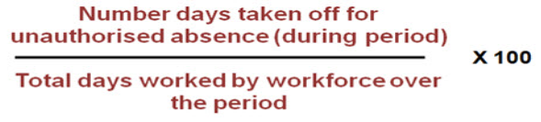
absenteeism
Unauthorised absence from work - Employees don’t turn up for work and don’t have a legitimate reason
Notes:
https://w
Absenteeism is an employee's intentional or habitual absence from work. While employers expect workers to miss a certain number of workdays each year, excessive absences can equate to decreased productivity and can have a major effect on company finances, morale and other factors
Absenteeism costs companies billions of pounds each year in lost productivity, wages, poor quality of goods/services and excess management time. In addition, the employees who do show up to work are often burdened with extra duties and responsibilities to fill in for absent employees, which can lead to feelings of frustration and a decline in morale
ww.tutor2u.net/business/blog/qa-what-is-absenteeism-and-what-can-businesses-do-about-it
The important point to remember about absenteeism is that is represents a significant business cost. Sickness absence alone costs UK businesses around £600 for each worker per year (source: BusinessLink).
The key for management is to understand the reasons for absent employees (genuine or not). E.g.
Genuine sickness, bereavement, bullying, stress
- Some employees simply “playing the system”
- Predictable / traditional absenteeism –e.g. Monday / Friday, when there is a major sporting event during the day or at the end of a shift pattern
What can a business do to reduce absenteeism? Here is a list of some possible actions:
- Understand the causes
- Set targets and monitor trends
- Have a clear sickness & absence policy
- Provide rewards for good attendance
- Consider the wider issues of employee motivation

Slide 8
Workplace stress
long hours and shift work
lack of control or insecurity
lack of job satisfaction, boredom or isolation
fear of violence, bullying or harassment
bad relations with other work colleagues
low pay
problems with the working environment (such as noise, temperature, overcrowding and poor facilities)

Slide 9
Employee satisfaction
Employee satisfaction is a key indicator for defining staff rewards and benefits
Over 70% of UK businesses have taken steps to monitor it.
Clearly links to motivation
Notes:
http://hrmguide.co.uk/general/job-satisfaction.htm
http://www.express.co.uk/life-style/life/821892/UK-workers-job-satisfaction-rank-low-employee
https://www.kent.ac.uk/careers/Choosing/career-satisfaction.htm
Will Hutton is a British political economist, writer, weekly newspaper columnist and former editor-in-chief for The Observer. He is currently Principal of Hertford College, Oxford, and Chair of the Big Innovation Centre, an initiative from the Work Foundation, having been chief executive of the Work Foundation from 2000 to 2008.

Slide 10
Measuring Employee satisfaction?
Leadership: How employees feel about the head of the company and its senior managers
Wellbeing: How staff feel about the stress, pressure and the balance between their work and home duties
Giving something back: How much companies are thought by their staff to put back into society generally and the local community
Personal growth: To what extent staff feel they are stretched and challenged by their job
My manager: How staff feel towards their immediate boss and day-to-day managers
My company: Feelings about the company people work not the people they work with
My team: How staff feel about their immediate colleagues
Fair deal: How happy the workforce is with their pay and benefits
Notes:
http://appointments.thesundaytimes.co.uk/article/best100companies/
Welcome to The Sunday Times 100 Best Companies to Work For. This is the 17th annual survey of our original list, and its appearance each year is a high-profile event in the nation’s business calendar.
The data-gathering and analysis used across all sectors are extensive. The views of 270,429 employees have determined the rankings in all our lists. So it’s the staff themselves, the people whose hard work builds the success of these organisations -- whether they’re lawyers, mechanics or shop assistants -- who are giving opinions about their employers and their working environments.
And once a company is on one of our lists, they have to work hard to stay there. In all, 857 organisations registered to take part in this year’s survey and there are 82 new entries on our final line-up of 330, displacing many from previous years who failed to make the grade this time.
Our lists honour:
■ The 100 Best Companies to Work For in the mid-size category (250-3,000 employees).
■ The 30 Best Big Companies to Work For (3,000-plus).
■ The 100 Best Small Companies to Work For, which covers SMEs (50-250 staff).
■ The 100 Best Not-for-Profit Organisations to Work For recognises public-sector bodies, charities and housing associations of all sizes.

Slide 11
Impact of a motivated workforce?
Better productivity
Lower levels of absenteeism
Lower levels of staff turnover
Good reputation
Improved product quality or customer service
Notes:
This can lead to lower training and recruitment costs
This can lead to lower unit costs of production and so enable a firm to sell its product at a lower price
Motivated employees may influence the development of a business
Employees are content with their working lives
Contented workers reflect well on an employer so making it easier to recruit more good workers

Slide 12
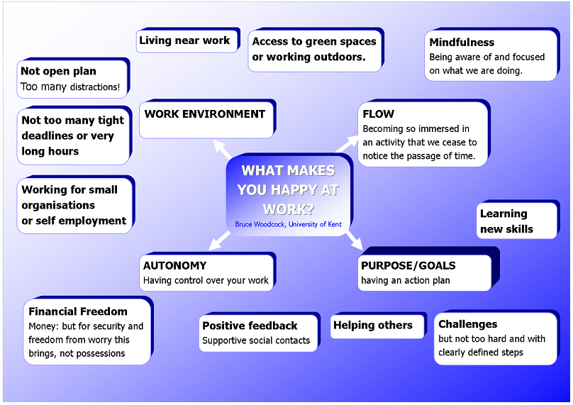
Notes:
http://hrmguide.co.uk/general/job-satisfaction.htm
http://www.express.co.uk/life-style/life/821892/UK-workers-job-satisfaction-rank-low-employee
https://www.kent.ac.uk/careers/Choosing/career-satisfaction.htm
Will Hutton is a British political economist, writer, weekly newspaper columnist and former editor-in-chief for The Observer. He is currently Principal of Hertford College, Oxford, and Chair of the Big Innovation Centre, an initiative from the Work Foundation, having been chief executive of the Work Foundation from 2000 to 2008.

Slide 13
Task for Lesson 1&2 WEEK 7
(ready to talk through on Thursday 2nd July)
Read the Sushi2U Case Study on Godalming Online
Complete Task 1 Practice Assessment 1 Write a report outlining the key HR issues and proposing a solution to each one
Notes:
Task 1:
Write a report (typed, size 12 text) which outlines the key human resource issues at SUSHI2U. Use the performance data you have been given and any other information from the case study you think may be relevant. After highlighting the key issues, provide recommendations for improvement and outline how your suggested improvements will be implemented

