Slide 1
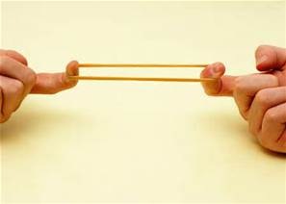
Price and Income Elasticity of Demand

Slide 2
For the products below, do you think a rise in price will lead to a large or small change in demand? Why?
Notes:
Habit = inelastic

Slide 3
Learning Objectives
Understand the concept of price and income elasticity of demand.
Explain the nature of inferior, normal and luxury goods.

Slide 4
What is ELASTICITY?
Price Elasticity of Demand (PED): measures the degree of responsiveness/sensitivity demand has to a change in a product/service’s price
How sensitive is the demand for a good or service to a change in price?
Understanding price elasticity of demand....
Helps business managers predict the impact of changes in price on likely levels of demand.
Helps with decision making
Helps with the marketing of goods

Slide 5
Price Elasticity of Demand (PED)
Price elastic/Price sensitive: a change in price will cause a more than proportional change in the quantity demanded.
Price goes up – demand falls dramatically
Price goes down – demand increases dramatically
Likely in markets where there is lots of substitutes/competition
Price inelastic/Price insensitive: a change in price causes a less than proportional change in the quantity demanded.
Price goes up – demand falls just a little
Price goes down – demand increases just a little
Likely in markets where there are few substitutes
Goods are necessities or addictive
Notes:
Price elastic: when goods are largely undifferentiated (like perfect competition markets) the impact of the change of demand levels is quite predictable. Why should people buy a higher priced good when a virtually identical good is immediately available at a lower price.

Slide 6
Elastic or Inelastic?
Elastic Products:
Any change in price results in a BIG impact on demand.
To increase revenues, price should be reduced, as demand will soar.
IF PED = >1 then it is price elastic
Inelastic Products:
Any change in price result in a SMALL impact on demand.
To increase revenues, price should be increased, as demand will not be particularly affected, meaning people will still buy the product.
If PED = <1 then it is price inelastic
Effect of sales revenue of a change in price
 | Elastic Demand | Inelastic demand
Price increase | Revenue down | Revenue up
Price decrease | Revenue up | Revenue down
Notes:
If PED/YED = >1 then it is price elastic
If PED/YED = <1 then it is price inelastic

Slide 8
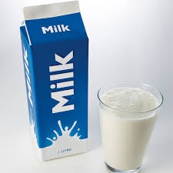
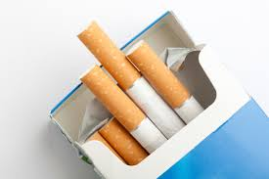
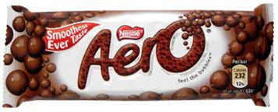
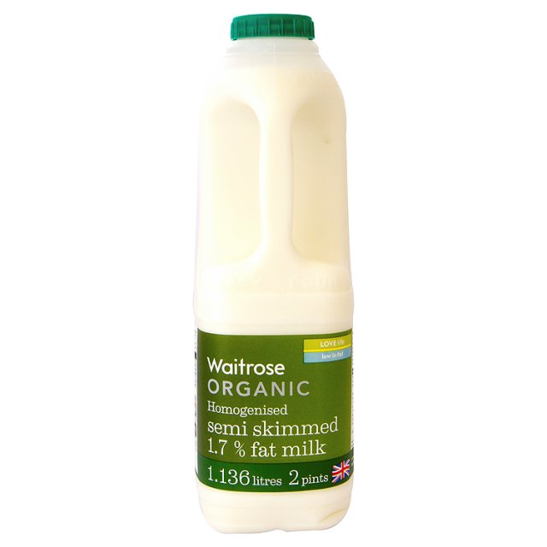
Elastic or inelastic?
Peak travel rail card
Notes:
INELASTIC = cigarettes, peak train travel, milk, Chanel and petrol
ELASTIC – organic milk, cinema, cheap flights, aero

Slide 9
How to make products more price inelastic
Businesses would like to make their goods or services as inelastic as possible to have more control over their prices and ultimately increase revenue
Businesses can make their product more price inelastic by:
Customer loyalty
Reduce / restrict competition in the market
Increase brand value

Slide 10
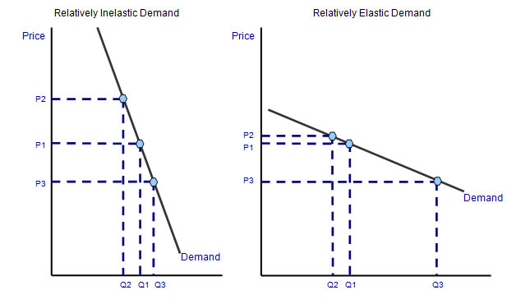
Price Elasticity on a Graph

Slide 11
Activity
Complete the PED worksheet (first page of the PED and YED Activities on Godalming Online)
10 minutes
If you finish before we are ready to go through the answers, please read about YED in the lesson slides

Slide 12
Income Elasticity of Demand
As with price elasticity, some goods will be income elastic (e.g. sensitive to income changes), other will be income inelastic
Income Elasticity of Demand (YED): measures the degree of responsiveness/sensitivity demand has to a change in income
Income elastic:
Overseas holidays
Sports cars
Washing machines
Dishwashers
Houses
Income inelastic:
Potatoes
Milk
Newspapers
Pencils
Notes:
Inferior: bread, bus travel, sugar

Slide 13
Income Elasticity of Demand
Income Elasticity of Demand (YED): measures the degree of responsiveness/sensitivity demand has to a change in income
Income elastic: A change in income will cause more than a proportional change in demand.
Income inelastic: A change in income will cause less than a proportional change in demand
Negative income elasticity: A rise in incomes causes a fall for demand
For example:
5% increase in income will see a 10% increase in demand for pizzas
Incomes fall by 4% but demand for toothpaste falls by just 2%
Incomes increase by 6% and this cause a 5% fall in demand for supermarket's own brand lemonade

Slide 14
Income Elasticity of Demand
INFERIOR GOODS: Those that you will lose interest in buying if your income increases
NORMAL GOODS: Those that demand remains relatively unchanged if your income increases
SUPERIOR/LUXURY GOODS: Those that demand increases if your income increases.
COME UP WITH AN EXAMPLE FOR EACH TYPE OF GOOD
Notes:
Inferior: bread, bus travel, own label products
Normal: cars, furniture, washing machines (everyday items)
Luxury: gym memberships

Slide 16
Income Elasticity of Demand
Why do marketers try to understand a product’s Income Elasticity of Demand?
What are the advantages and disadvantages of selling each type of product?
elasticity –first 5 mins (Pedro only) http://estream.godalming.ac.uk/View.aspx?ID=4975~4z~aXw9tWQC

Slide 17
Activities
1. Complete the YED worksheets.
2. Complete the PED and YED knowledge and understanding questions
3. Extension:
Research tasks:
1 and 2 answer into your notes
3 carry out internet research to help you answer into your notes

Slide 18
Homework – Due Tuesday 3rd November
Complete all of the price and income elasticity exercises in the workbook given out in lesson.
Read and summarise onto one side of A4 the the “Market Research” notes from the Market research section on GOL. Include:
Objectives
Definition of primary research
Definition of secondary research
Methods of primary research
Methods of secondary research
The difference between quantitative and qualitative market research
(UPLOAD TO GOL)
You should also complete some 50/50 over the half term break – upload evidence to GOL (in new 50/50 section)

